Slide 1
Applied corpus linguistics and legal interpretation: A rapidly developing field of interdisciplinary scholarship
AAAL 2023, Portland, Oregon
Clark D. Cunningham | School of Law www.clarkcunningham.org
Ute Römer | Department of Applied Linguistics and ESL https://uteroemer.weebly.com/
This presentation can be downloaded at www.clarkcunningham.org/L2-PPT.html

Slide 2
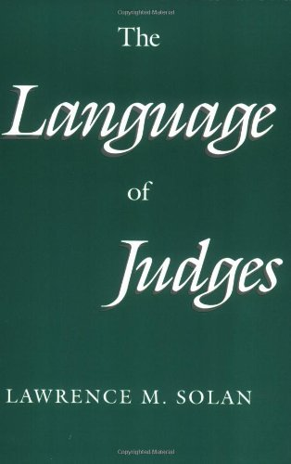
Law & Linguistics: Early Success Stories
Univ of Chicago Press 1993
2

Slide 3
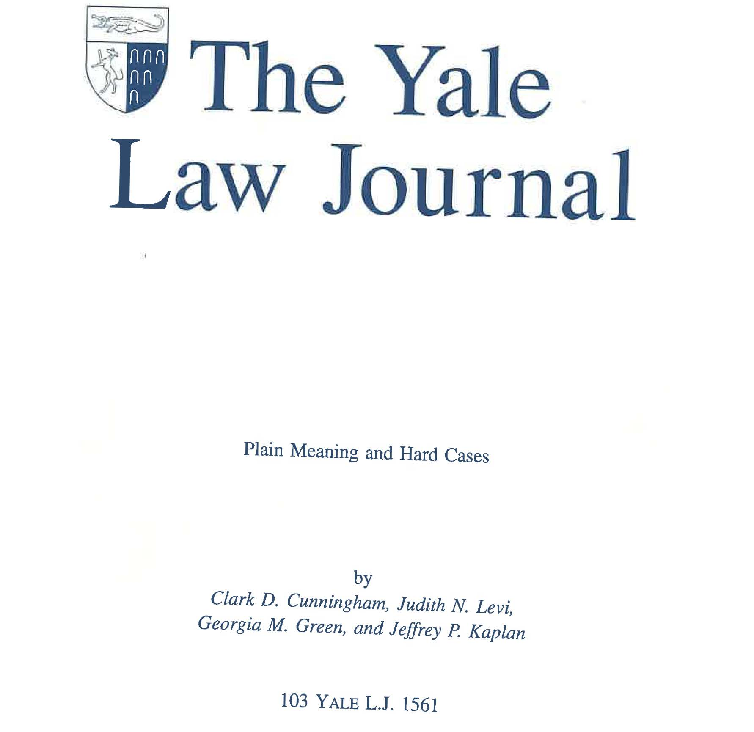
Law & Linguistics: Early Success Stories
3

Slide 4
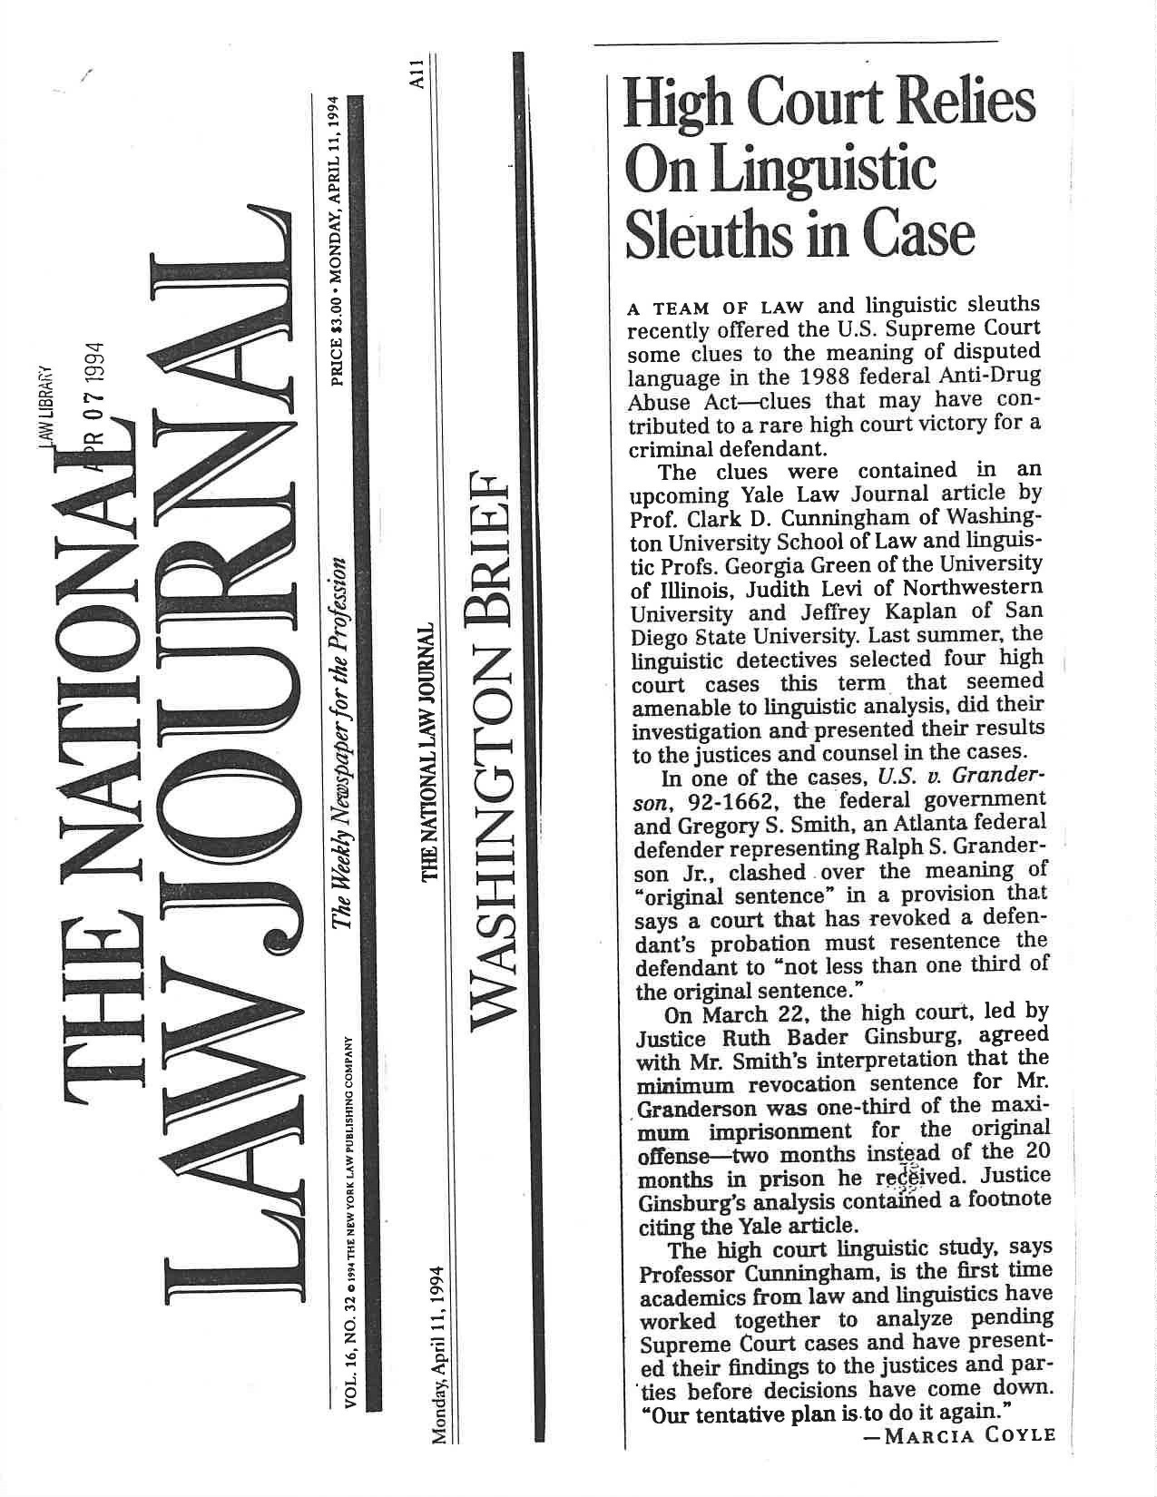
Law & Linguistics: Early Success Stories
4

Slide 5
Justice Ruth Bader Ginsburg
Communicating and Commenting on the Court's Work, 83 Georgetown Law Journal 2119, 2127 (1995)
“…articles accessible and useful to judges remain in vogue.
Last Term, for example, a Yale Law Journal article sensibly discussing "Plain Meaning and Hard Cases" received credit lines in three Supreme Court opinions (two of them mine).
Director, Office of Workers' Compensation Programs v. Greenwich Collieries, 114 S.Ct. 2251, 2255 (1994)(O'Connor, J.)
Staples v. United States, 114 S.Ct. 1793, 1806 (1994)(Ginsburg, J., concurring in judgment)
United States v. Granderson, 114 S.Ct. 1259, 1267 n.10 (1994)(Ginsburg, J.).”
5

Slide 6
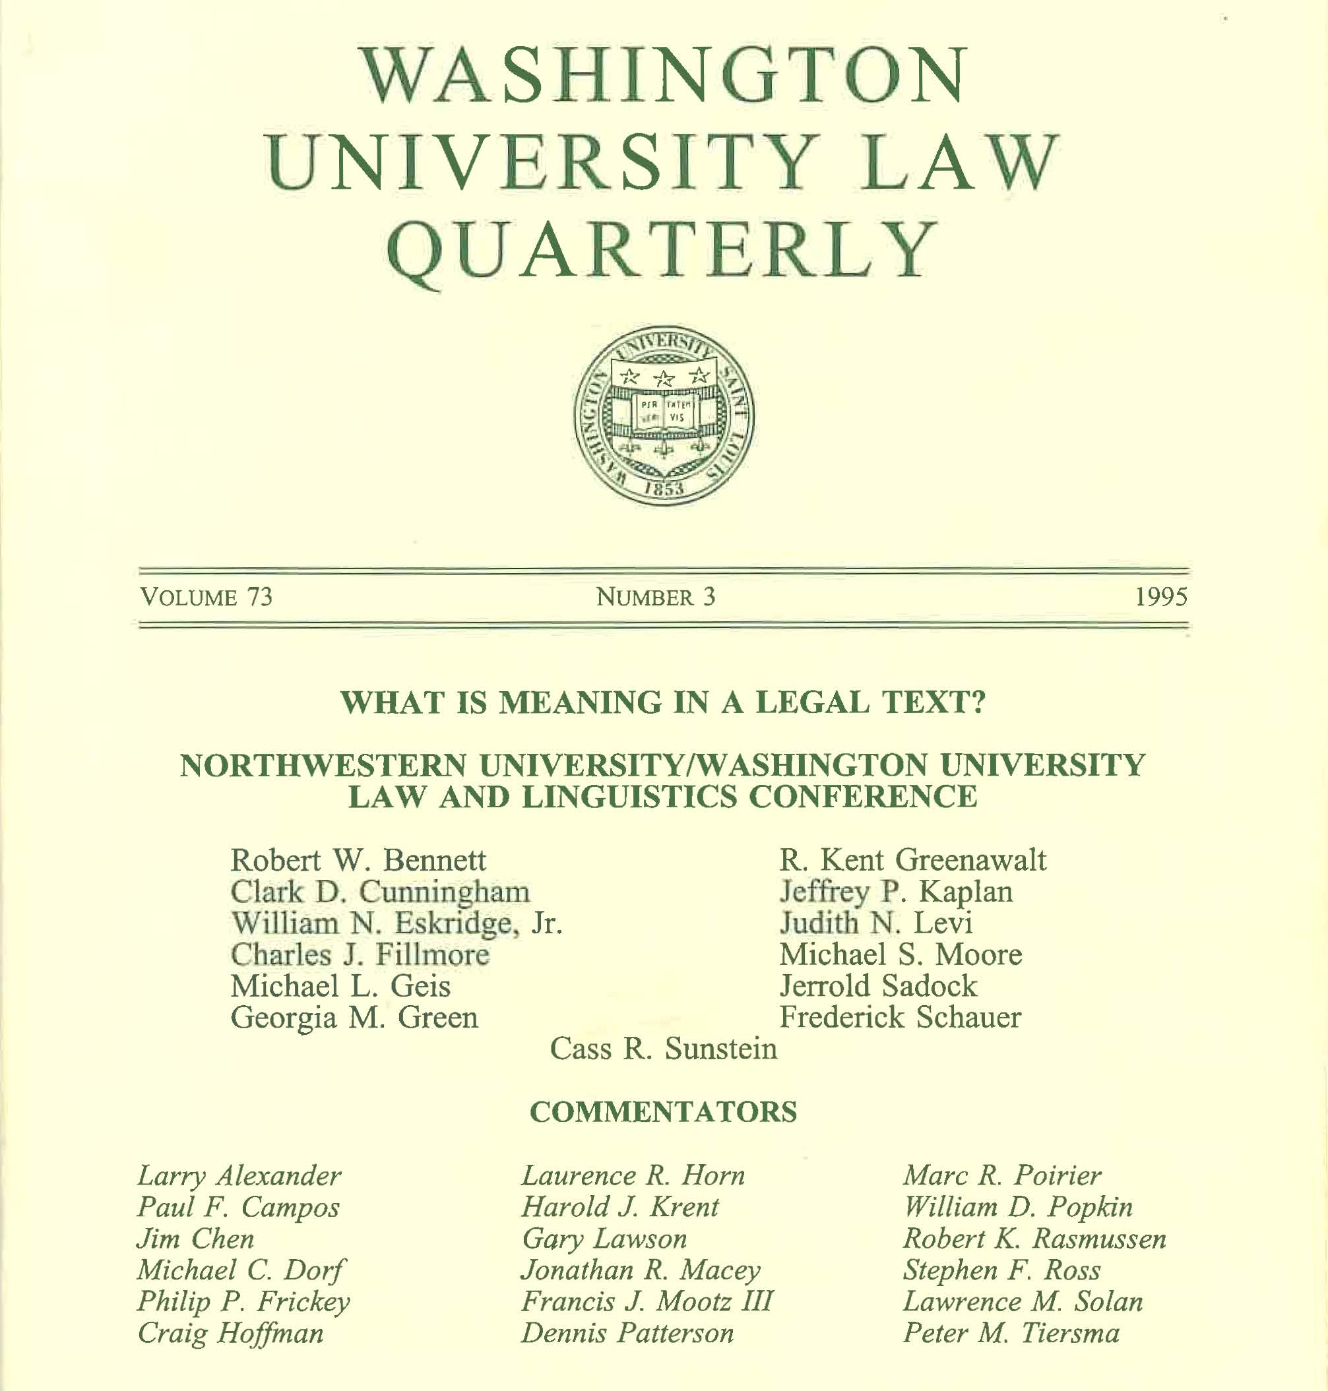
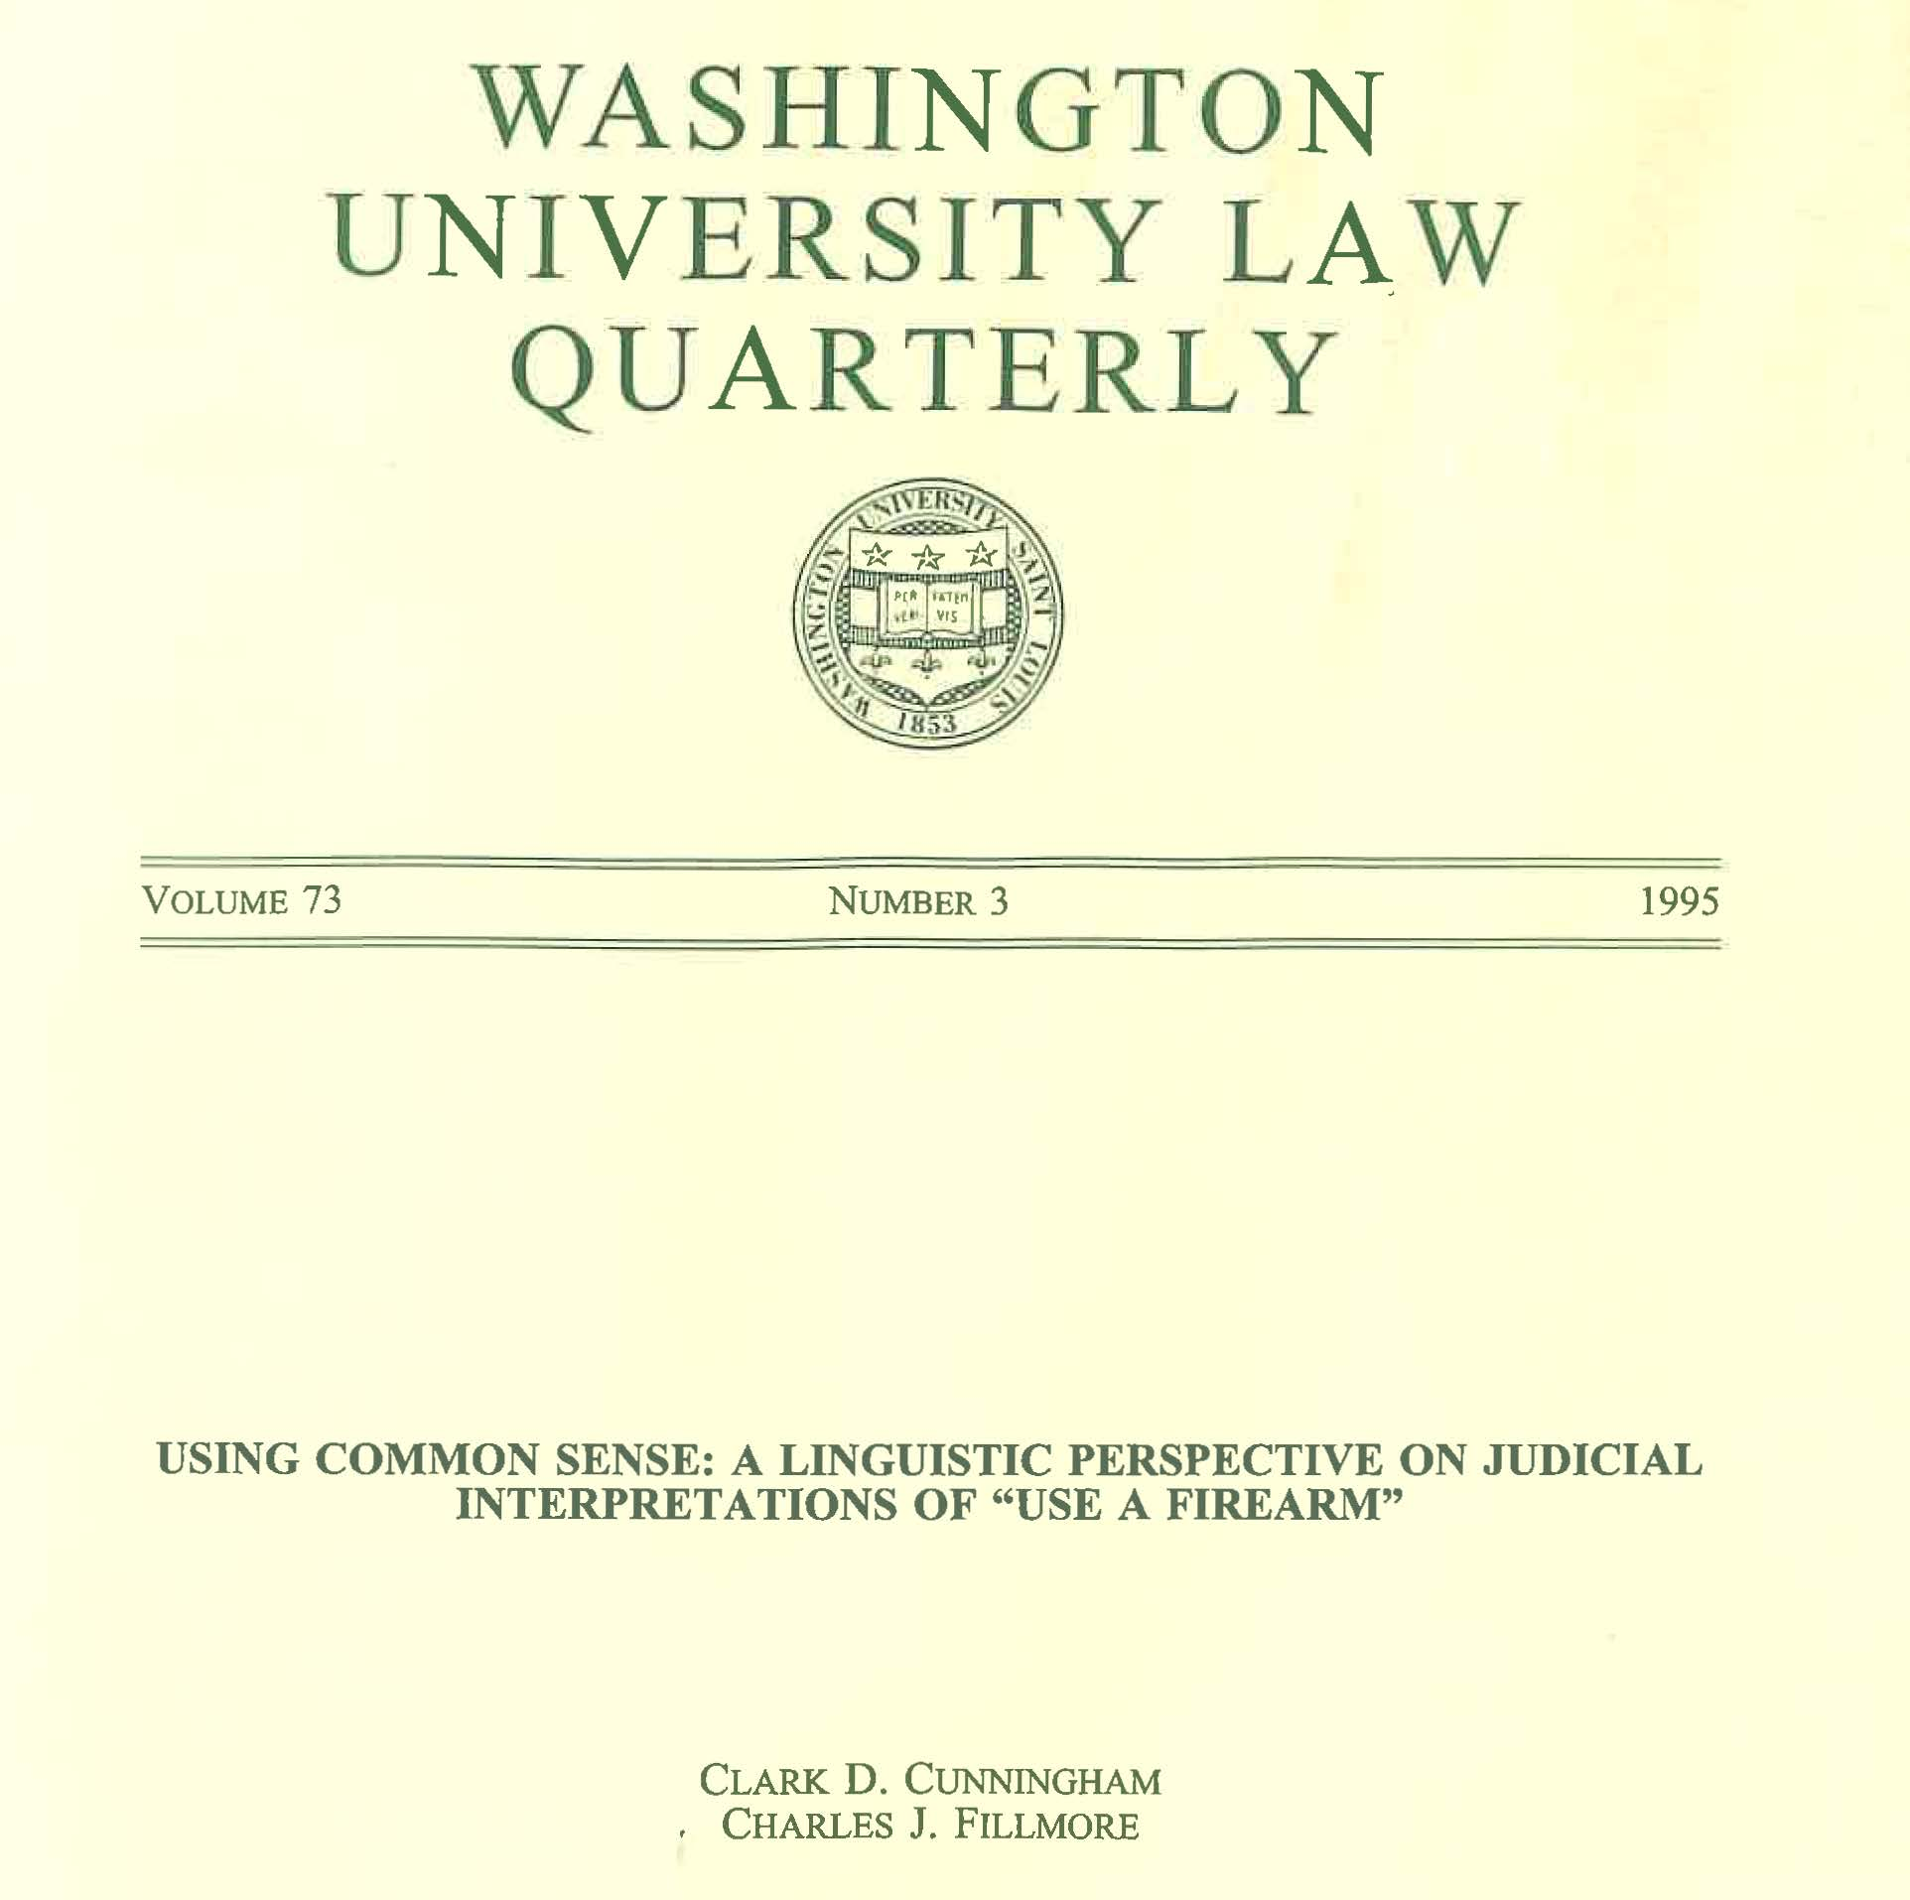
Law & Linguistics: Early Success Stories
6

Slide 7
Bailey v US 516 U.S. 137, 116 S. Ct. 501 (1995)
Brief for Bailey:
The error of the government’s reading is confirmed by the linguistic analysis of Section 924(c) in a forthcoming article (which has been lodged with the Clerk).
See Clark Cunningham & Charles Fillmore, Using Common Sense: A Linguistic Perspective on Judicial Interpretations of “Use a Firearm,” 73 WASH. U.L.Q. 1159 (1995).
Cunningham and Fillmore analyze the ordinary meaning of the phrase “uses * * * a firearm” by examining instances where that phrase (or its equivalent) occurs in newspaper articles and in Title 18 of the United States Code.
They conclude that the government’s interpretation is “contrary to linguistic ‘common sense.’
7

Slide 8
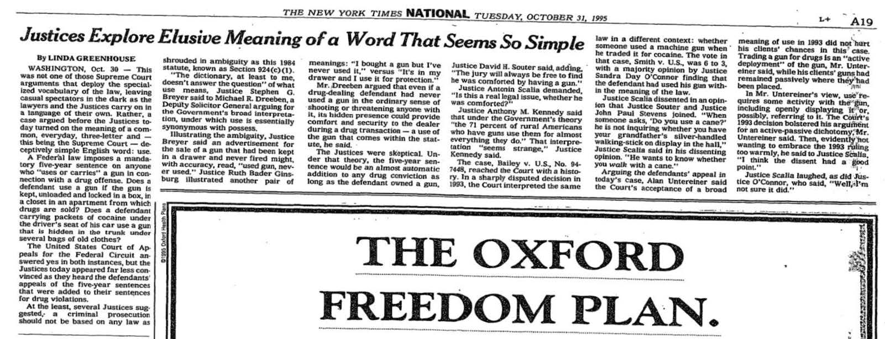
Bailey v US 516 U.S. 137, 116 S. Ct. 501 (1995)
8

Slide 9
For more details on collaboration in mid-1990s
Clark D. Cunningham & Jesse Egbert (2020). Analyzing Legal Discourse in the United States. In Routledge Handbook of Corpus Approaches to Discourse Analysis 462-480 (Eric Friginal & Jack A. Hardy eds.)
Working paper version published on the Social Science Research Network at: https://papers.ssrn.com/sol3/papers.cfm?abstract_id=3554023
Also available at http://clarkcunningham.org/L2-Articles.html
9

Slide 10
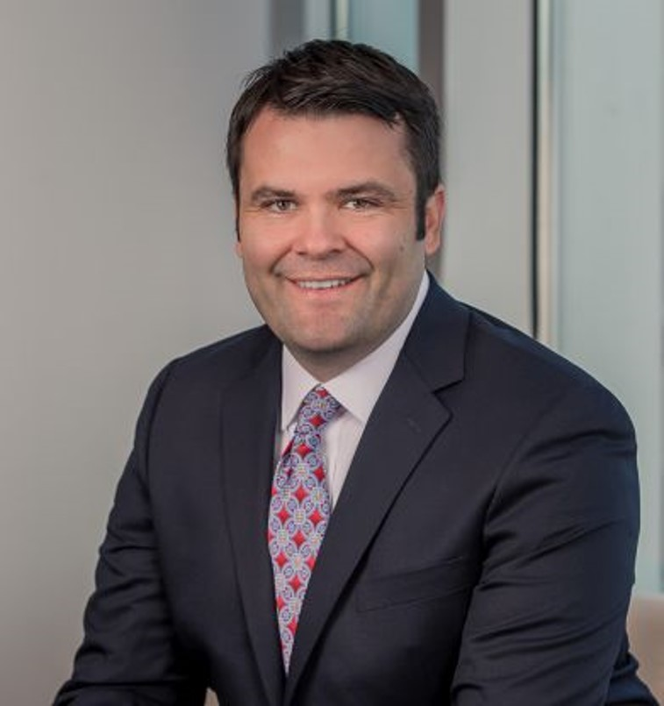
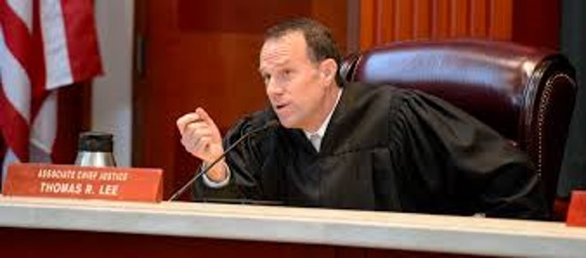
Corpus linguistics in a court decision
Stephen C. Mouritsen
2007, M.A., Brigham Young University, Linguistics (Mark Davies)
2010, J.D., Brigham Young University
The Dictionary Is Not a Fortress: Definitional Fallacies and a Corpus-Based Approach to Plain Meaning, 2010 BYU Law Review 1915
Thomas Rex Lee
1997 – 2010 Law professor, Brigham Young University
2010 Appointed to Utah Supreme Court, hires Mouritsen as law clerk In the Matter of the Adoption of Baby E.Z., 266 P.3d 702, 715-32 (Utah 2011) (Justice Thomas Rex Lee, concurring)
10

Slide 11
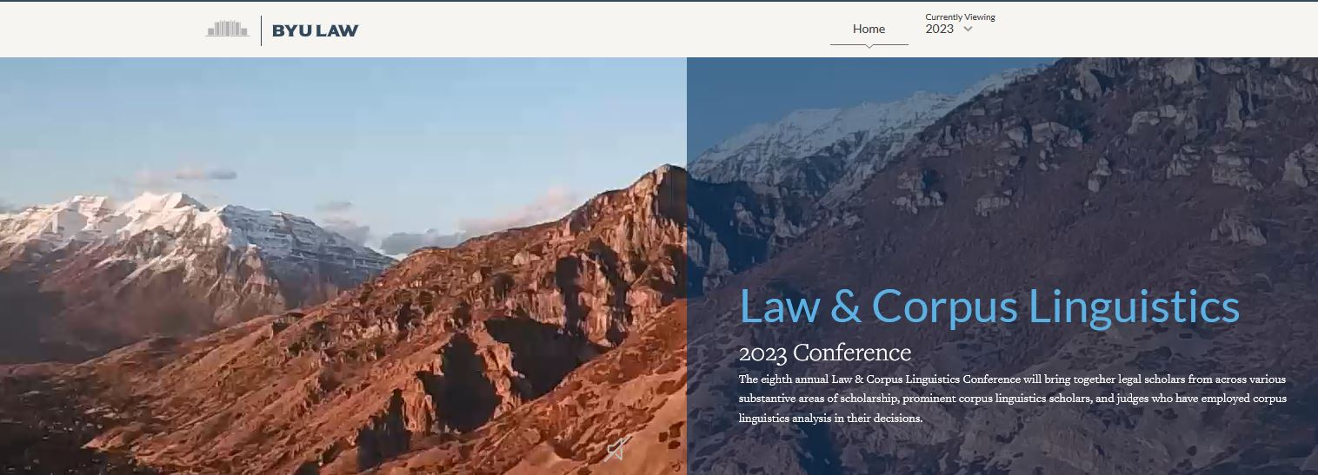
2016 – BYU Law hosts first LCL Conference
8th iteration this October https://corpusconference.byu.edu/2023-home/
11

Slide 12
2016 – BYU Law launches COFEA
Corpus of Founding Era America English https://lcl.byu.edu/projects/cofea/ https://lawcorpus.byu.edu/cofea/concordances/
12

Slide 13
Law & Corpus Linguistics takes off
Over 40 articles including journals at Harvard, Yale, Stanford, U Chicago, U Mich, U Penn
http://clarkcunningham.org/L2-Articles.html
Over 18 court decisions mentioning CL
http://clarkcunningham.org/L2-Cases.html
Law-Linguistics collaboration in friend of court briefs
http://clarkcunningham.org/L2-Briefs.html
13

Slide 14
Law review articles using or discussing corpus-based linguistic analysis www.clarkcunningham.org/L2-Articles.html
Stephanie H. Barclay, Brady Early & Annika Boone, Original Meaning and the Establishment Clause, 61 Ariz. L. Rev. 505 (2019), also available at https://papers.ssrn.com/sol3/papers.cfm?abstract_id=3295239 Barton Beebe & Jeanne C. Fromer, Are We Running Out of Trademarks? An Empirical Study of Trademark Depletion and Congestion, 131 Harv. L.Rev. 945 (2018) Jacob Crump, Corpus Linguistics in the Chevron Two-Step, 2018 BYU L.Rev. 399 (2018) Clark D. Cunningham & Jesse Egbert, Using Empirical Data to Investigate the Original Meaning of “Emolument” in the Constitution, 36 Georgia State Law Review 465 (2020). Clark D. Cunningham & Jesse Egbert, Analyzing Legal Discourse in the United States, in Routledge Handbook of Corpus Approaches to Discourse Analysis 462-80 (Eric Friginal & Jack A. Hardy eds. 2020) William N. Eskridge Jr., Brian G. Slocum, & Stefan Th. Gries, The Meaning of Sex: Dynamic Words, Novel Applications, and Original Public Meaning, 119 Mich. L. Rev. 1503 (2021), available at: https://repository.law.umich.edu/mlr/vol119/iss7/3 Edward Finegan, Comments on James C. Phillips & Jesse Egbert, Advancing Law & Corpus Linguistics , 2017 BYU L.Rev. 1297 (2017) Tammy Gales & Lawrence Solan, Revisiting a classic problem in statutory interpretation: Is a minister a laborer?, 36 Georgia State Law Review 491 (2020) Neal Goldfarb, A Lawyer's Introduction to Meaning in the Framework of Corpus Linguistics, 2017 BYU L.Rev. 1359 (2018) Stefan Th. Gries & Brian Slocum, Ordinary Meaning and Corpus Linguistics, 2017 BYU L.Rev. 1417 (2017) James A. Heilpern, Temporary Officers, (Nov. 8, 2018) Geo. Mason L.Rev. (forthcoming) (https://papers.ssrn.com/sol3/papers.cfm?abstract_id=3281292) James A. Heilpern, Acting Officers, 27 Geo. Mason L. Rev. 263 (2019) Carissa Bryne Hessick, Corpus Linguistics and the Criminal Law, 2017 BYU L.Rev. 1503 (2017) Thomas R. Lee & Stephen C. Mouritsen, Judging Ordinary Meaning, 127 Yale L.J. 788 (2018) Thomas R. Lee & James C. Phillips, Data-Driven Originalism, 167 U. Pa. L.Rev. 261 (2019) Thomas R. Lee & Stephen C. Mouritsen, Testing Ordinary Meaning, 88 Univ of Chicago L. Rev. 275 (2021)

Slide 15
Law review articles using or discussing corpus-based linguistic analysis www.clarkcunningham.org/L2-Articles.html
Jake Linford, Datamining the Meaning(s) of Progress, 2017 BYU L. Rev. 1531 (2018) Jennifer L. Mascott, Who are "Officers of the United States"?, 70 Stan. L.Rev. 443 (2018) Jennifer L. Mascott, The Dictionary as Specialized Corpus, 2017 BYU L. Rev. 1557 (2018) Eleanor Miller & Heather Obelgoner, Effective But Limited: A Corpus Linguistic Analysis of the Original Public Meaning of Executive Power, 36 Georgia State L. Rev 607 (2020) Stephanie Nicole Miller & Mary Kay Bacallao, Justice Alito's Question: "Can it be said that the right to abortion is deeply rooted in the history and traditions of the American people?" Corpus linguistic evidence suggests the answer is “No.”, Harvard Journal of Law & Public Policy - Per Curiam (May 18, 2022) Stephen C. Mouritsen, The Dictionary is Not a Fortress: Definitional Fallacies and a Corpus-Based Approach to Plain Meaning, 2010 BYU L.Rev. 1915 (2010) Stephen C. Mouritsen, Hard Cases and Hard Data: Assessing Corpus Linguistics as an Empirical Path to Plain Meaning, 13 Col. Sci. & Tech. L.Rev. 156 (2012) Stephen C. Mouritsen, Corpus Linguistics in Legal Interpretation: An Evolving Interpretive Framework, 6 Int'l J. Lang. & Law 67 (2017) Stephen C. Mouritsen, Contract Interpretation with Corpus Linguistics, 94 Wash. L. Rev. 1337 (2019) Daniel Ortner, The Merciful Corpus: The Rule of Lenity, Ambiguity and Corpus Linguistics, 25 B.U. Pub. Int. L.J. 101 (2016) James C. Phillips, Daniel M. Ortner & Thomas R. Lee, Corpus Linguistics & Original Public Meaning: A New Tool to Make Originalism More Empirical, 126 Yale L.J.F. 20 (2016) James Cleith Phillips & Sara White, The Meaning of the Three Emolument Clauses in the U.S. Constitution: A Corpus-Linguistic Analysis of American English from 1760-1799, 59 S.Tex.L.Rev. 181 (2017) James C. Phillips & Jesse Egbert, Advancing Law and Corpus Linguistics: Importing Principles and Practices from Survey and Content-Analysis Methodologies to Improve Corpus Design and Analysis, 2017 BYU L.Rev. 1589 (2017) James C. Phillips, Benjamin Lee & Jacob Crump, Corpus Linguistics and “Officers of the United States”, 42 Harv. J. L. & Pub. Pol’y 871 (2019)

Slide 16
Law review articles using or discussing corpus-based linguistic analysis www.clarkcunningham.org/L2-Articles.html
John D. Ramer, Corpus Linguistics: Misfire or More Ammo for the Ordinary-Meaning Canon?, 116 Mich. L.Rev.303 (2017) Haoshan Ren, Margaret Wood, Clark D. Cunningham, Noor Abbady, Ute Römer, Heather Kuhn & Jesse Egbert,“Questions Involving National Peace and Harmony” or “Injured Plaintiff Litigation”? The Original Meaning of “Cases” in Article III of the Constitution, 36 Georgia State Law Review 491 (2020). Brian Slocum & Stefan Th. Gries, Judging Corpus Linguistics, 94 S. Cal. L. Rev. Postscript 13 (2020) Lawrence M. Solan, Can Corpus Linguistics Help Make Originalism Scientific?, 126 Yale L.J.F. 57 (2016) Lawrence M. Solan, Patterns in Language and Law, 6 Int'l J. Lang. & Law 46 (2017) Lawrence M. Solan and Tammy Gales, Corpus Linguistics as a Tool in Legal Interpretation, 2017 BYU L. Rev. 1311 (2018). Lawrence B. Solum, Triangulating Public Meaning: Corpus Linguistics, Immersion, and the Constitutional Record, 2017 BYU L.Rev. 1621 (2018) (http://ssrn.com/abstract=3019494) Abigail Stout, Diana Coetzee & Ute Römer, “We the Citizens?”: A Corpus Linguistic Inquiry into the Use of “People” and “Citizens” in the Founding Era, 36 Georgia State Law Review 665 (2020) Lee J. Strang, How Big Data Can Increase Originalism's Methodological Rigor: Using Corpus Linguistics to Reveal Original Language Conventions, 50 U.C. Davis L. Rev. 1181 (2017) Lee J. Strang, The Original Meaning of Religion in the First Amendment: A Test Case of Originalism's Utilization of Corpus Linguistics, 2017 BYU L.Rev. 1683 (2017) Kevin P. Tobia, Testing Ordinary Meaning, 134 Harv. L. Rev 726 (2020), see also Appendix detailing experiments, data and analysis

Slide 17
Court decisions mentioning CL www.clarkcunningham.org/L2-Cases
In the Matter of the Adoption of Baby E.Z., 266 P.3d 702, 715-32 (Utah 2011) (Justice Thomas Rex Lee, concurring) State v. Rasabout, 356 P.3d 1258, 1271-90 (Utah 2015) (Associate Chief Justice Thomas Rex Lee, concurring) People v. Harris, 885 N.W.2d 832 (Mich. 2016) (Opinion for the court by Justice Brian K. Zahra) (Justice Stephen J. Markman, concurring) (both opinions use data from the Corpus of Contemporary American English, but come to opposite conclusions as to whether statute prohibiting admission of "information" provided by a law enforcement officer under threat of employment sanction applied to providing false information) Fire Ins. Exch. v. Oltmanns, 416 P.3d 1148, 1163 n.9 (Utah 2018) (Justice Christine M. Durham, concurring) Carpenter v. United States, 138 S.Ct. 2206, 2235, 2238-39 (2018) (Justice Clarence Thomas, J. dissenting) Wilson v Safelite Group, Inc.,930 F.3d 429 (6th Cir. 2019) -- Concurring opinion by Judge Amul R. Thapur, 930 F.3d at 438-45 ("corpus linguistics is a powerful tool for discerning how the public would have understood a statute's text at the time it was enacted") -- Concurring opinion by Judge Jane B. Stranch, 930 F.3d at 445-48 ("the use of corpus linguistics is a difficult and complex exercise ... I would leave this task to qualified experts, not to untrained judges and lawyers. See, e.g., Brief for Professor Clark D. Cunningham, et al. as Amicus Curiae on Behalf of Neither Party, In Re: Donald J. Trump, President of the United States of America, No. 18-2486 (4th Cir. Jan. 29, 2019) (discussing use of corpus linguistics by professor of applied linguistics to help determine the meaning of "emoluments" during the founding era).” ) Caesars Entertainment Corp. v. Int'l Union of Operating Engineers, 932 F.3d 91, 95 (3rd Cir. 2019) (using data from Corpus of Historical American English regarding use of "previously") (Opinion for the court by Judge Thomas Hardiman) State of Idaho v. Lantis, 447 P.3d 875, 880-81 (Idaho 2019) (Opinion for the court by Justice G. Richard Bevan) (using data from Corpus of Historical American English regarding use of "disturbing the peace" in 1887)

Slide 18
Court decisions mentioning CL www.clarkcunningham.org/L2-Cases
State v Misch, 256 A.3d 519 (Vt. 2021) (meaning of "bear arms" in Vermont constitution) (citing D. Baron, Corpus Evidence Illuminates the Meaning of Bear Arms, 46 Hastings Const. L.Q. 509, 510 (2019), J. Jones, Comment: The “Weaponization” of Corpus Linguistics: Testing Heller’s Linguistic Claims, 34 BYU J. Pub. L. 135, 161 (2020), J. Blackman & J. Phillips,Corpus Linguistics and the Second Amendment, H.L. Rev. Blog (Aug. 7, 2018), https:// blog.harvardlawreview.org/corpus-linguistics-and-the-second-amendment/ )
Facebook v Duguid, 141 S.Ct. 1163, 1174 (2021) (Alito, J. concurring) (suggesting that corpus linguistics could be used to test the strength and validity of interpretive canons). Jones v Bonta, 34 F.4th 704 (9th Cir. 2022), vacated and remanded, 47 F.4th 1124 (2022) -- Order for supplemental briefing to be filed in 21 days on whether corpus linguistics helps inform the determination of the original public meaning of 2nd amendment (March 26, 2021) 34 F.4th at 714 n.6 ("Corpus linguistics “is a powerful tool for discerning how the public would have understood a statute's text at the time it was enacted,” and “[c]ourts should consider adding this tool to their belts.” [Citing Wilson v. Safelite Grp., Inc., 930 F.3d 429, 439-40 (6th Cir. 2019) (Thapar, J., concurring in part and concurring in the judgment)] We asked the parties to file supplemental briefing addressing in part the applicability of corpus linguistics to this case. We thank the parties for their hard work. Because neither of them asks us to apply corpus linguistics here, we decline to consider it further.")

Slide 19
Court decisions mentioning CL www.clarkcunningham.org/L2-Cases
New York State Rifle & Pistol Association v Bruen, 142 S.Ct. 2111, 2178 (2022) (Breyer, J. dissenting) ("The majority in [District of Columbia v Heller] rejected Justice Stevens’ argument that the Second Amendment's use of the words “bear Arms” drew on an idiomatic meaning that, at the time of the founding, commonly referred to military service. 554 U.S. at 586, 128 S.Ct. 2783. Linguistics experts now tell us that the majority was wrong to do so. See, e.g., Brief for Corpus Linguistics Professors and Experts as Amici Curiae (Brief for Linguistics Professors); Brief for Neal Goldfarb as Amicus Curiae; Brief for Americans Against Gun Violence as Amicus Curiae 13–15. Since Heller was decided, experts have searched over 120,000 founding-era texts from between 1760 and 1799, as well as 40,000 texts from sources dating as far back as 1475, for historical uses of the phrase “bear arms,” and they concluded that the phrase was overwhelmingly used to refer to “ ‘war, soldiering, or other forms of armed action by a group rather than an individual.’ ” Brief for Linguistics Professors 11, 14; see also D. Baron, Corpus Evidence Illuminates the Meaning of Bear Arms, 46 Hastings Const. L. Q. 509, 510 (2019) (“Non-military uses of bear arms in reference to hunting or personal self-defense are not just rare, they are almost nonexistent”); id., at 510–511 (reporting 900 instances in which “bear arms” was used to refer to military or collective use of firearms and only 7 instances that were either ambiguous or without a military connotation).)
Health Freedom Defense Fund v Biden, 599 F.Supp.3d 1144, 1180 (M.D. Fla. 2022) (court used Corpus of Historical English (COHA) to explore uses of "sanitation" between 1930 and 1944).
United States v Seefried, __ F.Supp.3d __, 2022 WL 16528415 (D.D.C. 2022) (concluding that certification of electoral votes on January 6, 2021, did not involve "administration of justice" for purposes of sentencing a January 6 protester, using among other sources searches of the Corpus of Caselaw Access Project (COCAP) and the Corpus of Historical American English (COHA)).

Slide 20
Briefs using CL http://www.clarkcunningham.org/L2-Briefs
Lucia v SEC, 138 S.Ct. 2044 (2018) Amicus Brief of Corpus Linguistics Scholars in Lucia v. SEC (U.S. 2018) (Laurence Anthony, Waseda University (Japan), Ronald Butters, Duke (emeritus); Malcom Coulthard, Aston University (emeritus); Mark Davies, BYU; Jesse Egbert, Northern Arizona University; William Eggington, BYU; Edward Finnegan, USC (emeritus); Tammy Gales, Hofstra; Tim Grant, Aston University; Stefan Th. Gries, UC Santa Barbara; Jack Grieve, University of Birmingham (UK); Tony McEnry, Lancaster University (UK); Jeffrey Parker, BYU; Rui Sousa-Silva, University of Porto (Portugal); Sara White, BYU. Filed by James Heilpern, BYU. Rimini Street v Oracle, 139 S.Ct. 873 (2019) Amicus Brief of Corpus Linguistics Scholars in Rimini Street v. Oracle (Laurence Anthony, Waseda University (Japan), William Eggington, BYU; Tammy Gales, Hofstra; Tim Grant, Aston University; Stefan Th. Gries, UC Santa Barbara; Benjamin Lee, BYU; Tony McEnry, Lancaster University (UK); Jeffrey Parker, BYU; Rui Sousa-Silva, University of Porto (Portugal); Lawrence Solan, Brooklyn Law School; Sara White, BYU). Filed by James Heilpern, BYU

Slide 21
Briefs using CL http://www.clarkcunningham.org/L2-Briefs
Wright v. Spaulding, 939 F.3d 695 (6th Cir. 2019)
--Letter from the court to lawyers for the parties requesting supplemental briefs on original meaning of the Article III Cases or Controversies requirement (May 28, 2019) (asking "How does the corpus help inform that determination? See https://lcl.byu.edu/projects/cofea/."). -- Amicus brief filed by Law & Linguistics Research Team (July 25, 2019) --Supplemental amicus brief filed by Law & Linguistics Research Team (August 22, 2019) (Prof. Clark D. Cunningham, GSU; Prof. Ute Roemer, GSU; Professor Jesse E. Egbert, NAU; Haoshan Ren, PhD student, GSU; Noor Abbady, MA Applied Linguistics, GSU; Margaret Wood, PhD student, NAU; Heather Kuhn, J.D. GSU.) --See 939 F.3d at 700 n.1 ("We asked the parties to file supplemental briefs on the original meaning of Article III’s case-or-controversy requirement, specifically whether the corpus of Founding-era American English helped illuminate that meaning. A team of corpus linguistics researchers submitted two amicus briefs as well. We are grateful to both the parties and the amici for their hard work.”) --See also The Original Meaning of “Cases” in Article III of the Constitution, 36 Georgia State Law Review 491 (2020), available at https://readingroom.law.gsu.edu/gsulr/vol36/iss5/8/.

Slide 22
Briefs using CL http://www.clarkcunningham.org/L2-Briefs
Blumenthal v. Trump, 949 F.3d 13 (D.C. Cir. 2020) Brief of Amici Curiae Professor Clark D. Cunningham and Professor Jesse Egbert in Support of Neither Party, Blumenthal v. Trump, also published on the Social Science Research Network at https://papers.ssrn.com/abstract=3475650 In re Trump, 958 F.3d 274 (4th Cir.2020) (en banc), dismissed as moot sub nom Trump v District of Columbia, 141 S.Ct. 1262 (Mem) (Jan. 25, 2021). Brief for Professor Clark D. Cunningham & Professor Jesse Egbert as Amici Curiae Supporting Neither Party, 2019 WestLaw 366218, also published on the Social Science Research Network at, https://papers.ssrn.com/sol3/papers.cfm?abstract_id=3334017. --See 958 F.3d at 286 ("The President's insistence that “emoluments” indisputably include only “profit arising from office or employ” (that is, payment for services rendered in performance of a formal job), while possible, is certainly not indisputable. .... See, e.g., Brief of Amici Curiae Professor Clark D. Cunningham and Professor Jesse Egbert on Behalf of Neither Party").” --See also Using Empirical Data to Investigate the Original Meaning of “Emolument” in the Constitution, 36 Georgia State Law Review 465 (2020).

Slide 23
Briefs using CL http://www.clarkcunningham.org/L2-Briefs
Bostock v Clayton County, Georgia, 140 S.Ct. 1731 (2020) Brief for Amici Curiae Corpus-Linguistics Scholars Professors Brian Slocum, Stefan Th. Gries, and Lawrence Solan in Support of Employees, (Brian Slocum, University of the Pacific McGeorge School of Law; Stefan Th. Gries University of Cal. Santa Barbara; Lawrence Solan, Brooklyn Law School) See also William N. Eskridge Jr., Brian G. Slocum, & Stefan Th. Gries, The Meaning of Sex: Dynamic Words, Novel Applications, and Original Public Meaning, 119 Mich. L. Rev. 1503 (2021), available at: https://repository.law.umich.edu/mlr/vol119/iss7/3
Young v Hawaii, 992 F.3d 765 (9th Cir. 2021) Brief of Corpus Linguistics Professors and Experts as Amici Curiae Supporting Appellees, Young v. Hawaii (filed June 20, 2020) (Dennis Baron, University of Illinois; Alison LaCroix, University of Chicago, Stefan Th. Gries University of Cal. Santa Barbara; Jason Merchant, University of Chicago), http://home.uchicago.edu/~merchant/pubs/2020-06-04_CorpusLinguisticsAmicusBrief.pdf

Slide 24
Briefs using CL http://www.clarkcunningham.org/L2-Briefs
Nelson v State, 312 Ga. 375, 863 S.E.2d 61 (2021) --Order Granting Appeal (Jan. 7, 2021) ("The Court is particularly concerned with the following: When is a search warrant for the contents of an electronic device 'executed' under the Fourth Amendment to the United States Constitution?") --Amicus Brief of Law-Linguistics Research Team in Support of Neither Party (filed April 19, 2021) (Prof. Clark D. Cunningham, GSU; Amanda R. Black & Maria Kostromitina, PhD students, NAU; Megan Wells & Bradford Poston, law students, GSU) --Order for Oral Argument (Apr. 29, 2021) ("following appellant's opening argument, the Court will then immediately hear from neutral amicus counsel who shall have 10 minutes to argue") --Oral Argument (Aug. 26, 2021), https://www.gasupreme.us/oral-arguments-august-26-2021/ --- Partial Transcript of Oral Argument --Slides for amicus oral argument
See 863 S.E.2d at 64 n.4 ("We thank the amicus curiae for its brief and oral argument regarding the application of corpus linguistics to some of the questions presented.”)
See also What Does it Mean to "Search a Cell Phone?", presentation, 7th Annual Law & Corpus Linguistic Conference, Feb. 4, 2022 ppt pdf

Slide 25
Briefs using CL http://www.clarkcunningham.org/L2-Briefs
Jones v Bonta, 34 F.4th 704 (9th Cir. 2022), vacated and remanded, 47 F.4th 1124 (2022) -- Order for supplemental briefing to be filed in 21 days on whether corpus linguistics helps inform the determination of the original public meaning of 2nd amendment (March 26, 2021) -- Plaintiff-Appellants' Supplemental Brief (April 23, 2021) ("The methodology of corpus linguistics suffers from several fatal conceptual difficulties that make it an unreliable guide to the original public meaning of the Second Amendment.") -- Appellees' Supplemental Brief (April 23, 2021) ("Corpus linguistics is a new and emerging tool that presents opportunities and challenges in the search for original public meaning. Corpus linguistics may be of limited value, particularly at this stage of the case.") --Appellees' Response to Appellants' Supplemental Brief (May 3, 2021) ("Corpus linguistics is unlikely to assist in resolving this interlocutory appeal and should be approached with caution [but] may prove to be a useful addition to the jurist's toolbox in future cases.") --Plaintiff-Appellants' Responsive Supplemental Brief (May 3, 2021) ("Corpus linguistics' flaws make it an unreliable guide to the Second Amendment's original meaning.") -- Motion of Neal Goldfarb for Leave to File a Reply Brief as Amicus Curiae Supporting Neither Party (May 3, 2021) ("much of the information about corpus linguistics in the parties' supplemental briefs is false or misleading")(motion dened, May 4, 2021) 34 F.4th at 714 n.6 ("Corpus linguistics “is a powerful tool for discerning how the public would have understood a statute's text at the time it was enacted,” and “[c]ourts should consider adding this tool to their belts.” [Citing Wilson v. Safelite Grp., Inc., 930 F.3d 429, 439-40 (6th Cir. 2019) (Thapar, J., concurring in part and concurring in the judgment)] We asked the parties to file supplemental briefing addressing in part the applicability of corpus linguistics to this case. We thank the parties for their hard work. Because neither of them asks us to apply corpus linguistics here, we decline to consider it further.")

Slide 26
Briefs using CL http://www.clarkcunningham.org/L2-Briefs
New York State Rifle & Pistol Association v Bruen, 142 S.Ct. 2111 (2022) -- Brief for Corpus Linguistics Professors and Experts as Amici Curiae (Dennis Baron, Univ. of Illinois; Alison LaCroix, Univ. of Chicago; Stefan Th. Gries Univ. of Cal. Santa Barbara; Jason Merchant, Univ. of Chicago) -- Brief for Neal Goldfarb as Amicus Curiae 142 S.Ct. at 2178 (Breyer, J. dissenting) ("The majority in [District of Columbia v Heller] rejected Justice Stevens’ argument that the Second Amendment's use of the words “bear Arms” drew on an idiomatic meaning that, at the time of the founding, commonly referred to military service. 554 U.S. at 586, 128 S.Ct. 2783. Linguistics experts now tell us that the majority was wrong to do so. See, e.g., Brief for Corpus Linguistics Professors and Experts as Amici Curiae (Brief for Linguistics Professors); Brief for Neal Goldfarb as Amicus Curiae; Brief for Americans Against Gun Violence as Amicus Curiae 13–15. Since Heller was decided, experts have searched over 120,000 founding-era texts from between 1760 and 1799, as well as 40,000 texts from sources dating as far back as 1475, for historical uses of the phrase “bear arms,” and they concluded that the phrase was overwhelmingly used to refer to “ ‘war, soldiering, or other forms of armed action by a group rather than an individual.’ ” Brief for Linguistics Professors 11, 14; see also D. Baron, Corpus Evidence Illuminates the Meaning of Bear Arms, 46 Hastings Const. L. Q. 509, 510 (2019) (“Non-military uses of bear arms in reference to hunting or personal self-defense are not just rare, they are almost nonexistent”); id., at 510–511 (reporting 900 instances in which “bear arms” was used to refer to military or collective use of firearms and only 7 instances that were either ambiguous or without a military connotation).)

Slide 27
Briefs using CL http://www.clarkcunningham.org/L2-Briefs
State of Utah v. Planned Parenthood Association (Utah Supreme Court) Amicus Brief of Pro-Life Utah (Dec. 9, 2022) (filed by Thomas R. Lee, Lee Nielsen) Amicus Brief of Neal Goldfarb (Feb. 3, 2023) (abstract)

Slide 28
3 Case Studies – U.S. Constitution
1. “Cases” in Article III
“The judicial power shall extend to all cases, in law and equity, arising under this Constitution, the laws of the United States, and treaties made, or which shall be made, under their authority”
2. “Such inferior officers” in the Appointments Provision
Congress may by Law vest the Appointment of such inferior Officers, as they think proper, in the President alone, in the Courts of Law, or in the Heads of Departments.”
3. “Misdemeanors” in the Impeachment Clause
“The President, Vice President and all civil Officers of the United States, shall be removed from Office on Impeachment for, and Conviction of, Treason, Bribery, or other high Crimes and Misdemeanors.”
14

Slide 29
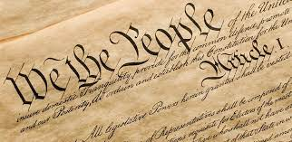
U.S. Constitution
Drafted by a small group: The Constitutional Convention meeting in Philadelphia in 1787
But its authority comes from the ratification process
Thousands involved in ratification conventions held in each of the 13 states from 1787-1790
“The Constitution was written to be understood by the voters; its words and phrases were used in their normal and ordinary as distinguished from technical meaning” US Supreme Court, United States v. Sprague, 282 U.S. 716, 731 (1931)
15

Slide 30
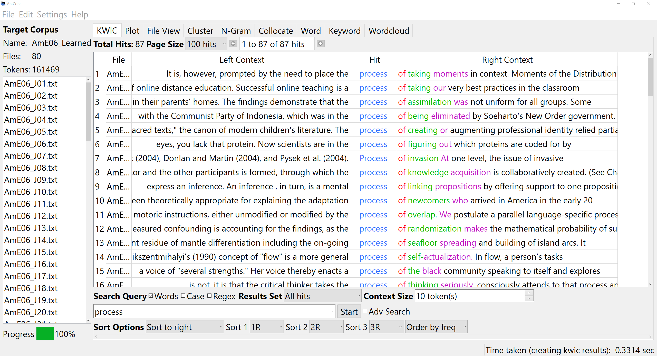
3 Case Studies – Common features
Law professor/linguistics professor collaboration
Use of AntConc to explore phraseological patterns, shifting focus from just individual words to phrases or constructions
Our linguistic analysis resulted in reframing the legal interpretation question
Also: grad students in both law and linguistics served as co-collaborators in 2 of 3 case studies
16

Slide 31
Meaning of “cases”
Collaborators: Haoshan Ren, Margaret Wood, Clark Cunningham, Noor Abbady, Ute Römer, Heather Kuhn & Jesse Egbert
Originated as course project at GSU law school
Filed as friend of the court brief and cited, Wright v Spaulding, US Court of Appeals, 6th Circuit (2019)
Published in Georgia State Univ. L. Rev 36, 5 (2020)
17

Slide 32
18

Slide 33
Meaning of “cases” study
Corpora:
COFEA (Corpus of Founding Era American English, https://lawcorpus.byu.edu/, 126,000 texts, 137 mio. words)
Madison Corpus (Founders Online subset, 11 mio. words)
Analytic steps:
Concordance analysis (“such other”, identification of “a … such other b” pattern)
Construction analysis (meaningful patterns around “case” and “cases”, e.g., case(s) wh-clause, all cases arising, all cases of)
Conceptualizing “case” as a shell noun (Schmid, 2000)
19
Notes:
“cases arising under laws passed by the general Legislature, and to such other questions as involve the National peace and harmony”
Shell nouns: form a “shell” around such (often complex) “chunks of information,” which are “contained” within that “shell” providing the “shell content.”

Slide 34
Meaning of “cases” study: Results
“cases arising under laws” understood by Constitution drafters as subcategory of “questions as involve the National peace and harmony”
“cases” as used in final draft of Constitution functioned as a shell noun
Did not have inherent meaning but
Indicated differing complex ideas “shelled” by “cases”
20

Slide 35
Meaning of “such inferior officers”
Collaborators: Haoshan Ren, Abigail Coker, Ute Römer & Clark Cunningham
Originated as course project at GSU law school
Results presented at 15th American Association for Corpus Linguistics Conference (AACL 2022)
Article in preparation
21

Slide 36
Meaning of “such inferior officers” study
Corpora:
COFEA (Corpus of Founding Era American English, https://lawcorpus.byu.edu/, 126,000 texts, 137 mio. words)
Madison Corpus (Founders Online subset, 11 mio. words)
Analytic steps:
Concordance searches (“such inferior N”, “such ADJ N”)
Determination of endophoric reference (anaphoric vs. cataphoric uses of “such”)
Construction analysis (“such ADJ N as…”), functional classification of the as-phrase (in relation to the preceding noun phrase)
22
Notes:
“such” here used cataphorically, referring forward to an item mentioned later in the text; functions: as-phrase as a descriptive qualifier, exemplification, discretionary qualifier

Slide 37
Meaning of “such…”: Results
“such inferior officers” in Constitutional provision used cataphorically, not anaphorically
In “Congress may by Law vest the Appointment of such inferior Officers, as they think proper”, “such ADJ N as…” functions as a discretionary qualifier
23

Slide 38
Meaning of “misdemeanors”
Collaborators: Clark Cunningham & Ute Römer
Results presented at BYU Law & CL Conference 2021, ICAME 2022, GSU Law School Lecture 2023
Article currently under review
24

Slide 39
Meaning of “misdemeanors” study
Corpora:
Founders Online Corpus (180,000 texts downloaded from https://founders.archives.gov/, 67 mio. words)
COFEA (Corpus of Founding Era American English, https://lawcorpus.byu.edu/, 126,000 texts, 137 mio. words)
COCA, COHA, COEME for reference purposes
Analytic steps:
Concordance, collocates, and cluster searches, distribution analysis
Construction analysis (form-meaning pairings with “misdem*”)
Close reading of historical source texts (from all corpora)
25
Notes:
Our interest in this originated in the first impeachment trial of former president Trump (January 2020); wider contextual analysis through close reading of source texts

Slide 40
Meaning of “misdemeanors”: Results
“other” and “high” modify both “crimes” and “misdemeanors” (Impeachment clause interpreted as “other high crimes” and “other high misdemeanors”)
“high misdemeanor(s)” has largely disappeared from AmE usage, but “high misdemeanors” occurs repeatedly in founding era texts
“high misdemeanor(s)” is used as a non-compositional compound (not “severe ms.” but referring to misconduct that affects governance)
“high misdemeanors” are not necessarily crimes
26
Notes:
On 3: Unlike “high praise” or “high cost” (expressing compositional meaning)

Slide 41
Potential relevance of these studies
“cases” analysis could be used to question current Supreme Court hostility to public interest lawsuits, even if authorized by Congress
“such inferior officers” analysis might limit courts’ ability to promote the growing conservative “war on the administrative state”
“misdemeanor” analysis could be used to refute arguments that impeachment is limited to criminal conduct
27

Slide 42
Thank you!
AAAL 2023, Portland, Oregon
Clark D. Cunningham | School of Law
www.clarkcunningham.org
Ute Römer | Department of Applied Linguistics and ESL https://uteroemer.weebly.com/
This presentation can be downloaded at www.clarkcunningham.org/L2-PPT.html

