Slide 1
“We the Citizens?”:
A Corpus Linguistic Inquiry into the Use of “People” and “Citizens” in the Founding Era
Abby Stout, Diana Coetzee & Ute Römer

Slide 2
Agenda
Spring Seminar Research
Current Research Question
Corpus Linguistic Analysis
- Methodology
- Observations & Examples
Implications

Slide 3
Tenth Amendment
“The powers not delegated to the United States by the Constitution, nor prohibited by it to the States, are reserved to the States respectively, or to the people.”

Slide 4
Tenth Amendment
“The powers not delegated to the United States by the Constitution, nor prohibited by it to the States, are reserved to the States respectively, or to the people.”

Slide 5
Seminar Research Question
Are “the people” a third sovereign in the Tenth Amendment such that the “to the people” phrase is an invocation of popular sovereignty?

Slide 6
Popular Sovereignty
The principle that the authority of a state and its government are created and sustained by the consent of the people, who are the source of all political power, through their elected representatives.

Slide 7
Seminar Corpus Methodology & Results
556 concordance lines for “people” in COFEA
People strongly collocated with power* (4 to L and 4 to the R)
Delegated occurred in the top 15 pre-modifiers of power in these concordance lines

Slide 8
Tenth Amendment
“The powers not delegated to the United States by the Constitution, nor prohibited by it to the States, are reserved to the States respectively, or to the people.”

Slide 9
Observations
People always delegated power.
Power was never delegated to the people.
Whenever people and power appeared near each other, the ultimate government-related power resided in the people.

Slide 10
Which specific powers?
People’s elective power.
Related to elective power, many of the COFEA texts seem to suggest that the people’s elective powers are a way to indirectly assert their own sovereign powers and hold their legislators politically accountable.
This political accountability appears to be largely aimed at protecting the people’s individual rights, including protecting themselves against an infringement on their individual liberty.

Slide 11
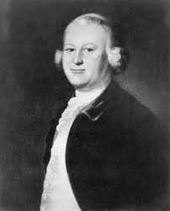
“The People” and Popular Sovereignty: An Example
“[T]here can be but one supreme power which is the legislative , to which all the rest are and must be sub-ordinate ; yet the legislative being only a fiduciary power , to act for certain ends , there remains still , " in the people , a supreme power to remove , or alter , the legislative when they find the legislative act contrary to the trust reposed in them. " - James Otis, political activist and Massachusetts legislator (1764)

Slide 12
Citizens?
The Constitution is written in terms of people and citizens.
If people were truly considered the source of elective political power, where did that leave citizens during the Founding Era?
21st century American rhetoric chiefly refers to citizens rather than people as those who effectuate voting.
Voting rights are one of the most characteristic rights associated with citizenship.
Yet the Bill of Rights, the protector of individual rights, used the word people and not citizens.

Slide 13
Research Question
During the Founding Era, how were the words people and citizens used differently, especially in terms of constructs that convey agency?

Slide 14
Corpora
Corpus of Founding Era American English
Over 136,800,000 words
1760 - 1799
Public Papers of James Madison from Founders Online
10,729,712 words
extends into the 1800s

Slide 15
Methodology
Frequencies of occurrence
Collocations (with a focus on verb collocates of search words and phrases)
Fixed Recurring Phrases (n-grams) – extracted via AntConc, using the James Madison Corpus

Slide 16
Frequencies
People: 886.4 per million words (118,325 instances) in COFEA
Citizens: 199.2 per million words (26,585 instances) in COFEA
People was significantly more frequently used than citizens during the Founding Era.

Slide 17
Collocates
Top 10 collocates of “citizens” and ”people” in COFEA (5L, 5R)
Citizens
People
Collocate | Frequency | Per Mio | Range | Collocate | Frequency | Per Mio | Range
the | 26,699 | 200.0 | 4,396 | the | 133,675 | 1,001.4 | 12,951
of | 24,160 | 180.1 | 4,591 | of | 76,759 | 575.0 | 10,999
and | 9,795 | 73.4 | 2,594 | and | 42,089 | 315.3 | 7,166
to | 9,523 | 71.3 | 2,809 | to | 41,607 | 311.7 | 8,301
our | 4,098 | 30.7 | 1,506 | a | 22,892 | 171.5 | 5,344
states | 3,733 | 27.9 | 1,132 | in | 22,633 | 169.5 | 5,916
their | 2,973 | 22.3 | 1,242 | that | 17,824 | 133.5 | 5,143
fellow | 2,953 | 22.1 | 1,403 | by | 11,549 | 86.5 | 3,742
by | 2,792 | 20.9 | 1,105 | are | 10,772 | 80.7 | 3,976
or | 2,783 | 20.9 | 809 | their | 10,267 | 76.9 | 3,358

Slide 18
Discussion
Overlap: the, of, and, to, by, and their.
Given the importance of phrases in meaning creation, we decided to look beyond single words that co-occur.
This led us to examine longer, fixed sequences of words that contained the search terms (3- to 5-grams).

Slide 19
Per Mio | Frequency | Range | Cluster | Per Mio | Frequency | Range | Cluster
144.9 | 1555 | 1034 | of the people | 64.7 | 694 | 575 | citizens of the
87.6 | 940 | 717 | the people of | 50.0 | 537 | 446 | the citizens of
39.4 | 423 | 348 | to the people | 36.4 | 391 | 338 | citizens of the united
35.4 | 380 | 300 | people of the | 36.3 | 389 | 336 | citizens of the United states
29.6 | 318 | 260 | the people of the | 30.4 | 326 | 287 | of our citizens
24.4 | 262 | 189 | by the people | 24.1 | 259 | 224 | the citizens of the
24.1 | 259 | 220 | of the people of | 21.9 | 236 | 218 | of the citizens
19.2 | 206 | 187 | that the people | 15.1 | 162 | 133 | our fellow citizens
18.3 | 196 | 185 | the people in | 14.53 | 156 | 135 | my fellow citizens
16.1 | 173 | 154 | people of this | 13.4 | 144 | 133 | of the citizens of
14.5 | 156 | 142 | the people of this | 12.9 | 138 | 128 | the citizens of the united
12.9 | 139 | 127 | to the people of | 12.7 | 136 | 117 | citizens of the u

Slide 20
Per Mio | Frequency | Range | Cluster | Per Mio | Frequency | Range | Cluster
12.4 | 133 | 124 | the people are | 11.5 | 123 | 109 | citizens of this
11.9 | 128 | 123 | the people to | 10.9 | 118 | 107 | to the citizens
11.6 | 125 | 109 | the American people | 9.2 | 99 | 87 | of our fellow citizens
11.1 | 119 | 99 | the people at | 8.1 | 86 | 79 | to the citizens of
10.9 | 117 | 99 | people of the United | 7.4 | 79 | 71 | of American citizens
10.6 | 114 | 97 | people of the united states | 7.1 | 76 | 67 | to our citizens
10.3 | 111 | 99 | the people, and | 7.0 | 75 | 71 | the citizens of this
9.4 | 101 | 84 | people at large | 6.9 | 74 | 67 | our own citizens
9.4 | 101 | 89 | the people of the united | 6.8 | 73 | 66 | U.S. citizens
9.1 | 98 | 81 | the people at large | 6.7 | 72 | 66 | of my fellow citizens
8.7 | 93 | 91 | of the people in | 6.5 | 70 | 63 | to citizens of
8.4 | 90 | 82 | among the people | 6.2 | 66 | 66 | his fellow citizens

Slide 21
Per Mio | Frequency | Range | Cluster | Per Mio | Frequency | Range | Cluster
8.3 | 89 | 77 | of the people of the | 6.2 | 66 | 59 | of its citizens
8.2 | 88 | 73 | people of America | 5.9 | 64 | 60 | of the citizens of the
7.6 | 82 | 76 | and the people | 5.6 | 60 | 57 | of citizens of
7.5 | 81 | 78 | people in the | 5.5 | 59 | 51 | the citizens of the U
7.4 | 80 | 66 | the people of america | 5.5. | 59 | 54 | to the citizens of the
7.3 | 78 | 72 | body of the people | 5.4 | 58 | 52 | class of citizens
7.3 | 78 | 74 | that the people of | 5.3 | 57 | 56 | your fellow citizens
7.0 | 75 | 64 | on the people | 5.2 | 56 | 54 | their fellow citizens
6.8 | 73 | 69 | the people have | 4.9 | 53 | 51 | by the citizens
6.5 | 70 | 63 | of our people | 4.8 | 51 | 48 | fellow citizens of
6.2 | 66 | 54 | representatives of the people | 4.5 | 48 | 43 | to the citizens of the

Slide 22
by the people and by the citizens in COFEA
By the people: 2,882 (21.6 per million words)
By the citizens: 417 (3.1 per million words)
We decided to take a closer look at the phrases by the people/citizens as these identify people and citizens as objects of the preposition by, and therefore the agents of an action.
We also focused on verbs that specify what is “done” by the people or by the citizens.

Slide 23
Top 25 Verb Collocates (6L)
by the people
by the citizens
Collocate | Frequency | Per mio | Range | Collocate | Frequency | Per mio | Range
be | 621 | 4.7 | 396 | be | 110 | 0.82 | 75
chosen | 470 | 3.5 | 285 | chosen | 29 | 0.22 | 19
was | 263 | 2.0 | 182 | is | 29 | 0.22 | 29
elected | 224 | 1.7 | 162 | was | 26 | 0.19 | 26
is | 205 | 1.5 | 159 | are | 22 | 0.16 | 20
are | 190 | 1.4 | 141 | been | 15 | 0.11 | 15
been | 183 | 1.4 | 145 | held | 15 | 0.11 | 13
were | 162 | 1.2 | 127 | enjoyed | 14 | 0.10 | 13
made | 83 | 0.60 | 71 | sustained | 14 | 0.10 | 12
appointed | 82 | 0.60 | 69 | made | 12 | 0.09 | 11
being | 80 | 0.59 | 69 | paid | 11 | 0.08 | 9
had | 73 | 0.55 | 64 | owned | 10 | 0.08 | 9
paid | 51 | 0.38 | 40 | exercised | 9 | 0.07 | 9
given | 43 | 0.32 | 37 | appointed | 8 | 0.06 | 6
has | 36 | 0.27 | 35 | being | 8 | 0.06 | 8
held | 33 | 0.25 | 30 | carried | 8 | 0.06 | 8
received | 29 | 0.22 | 22 | elected | 8 | 0.06 | 7
supported | 29 | 0.22 | 28 | were | 8 | 0.06 | 8
enacted | 28 | 0.21 | 20 | given | 6 | 0.04 | 6
approved | 27 | 0.20 | 22 | recovered | 6 | 0.04 | 6
established | 26 | 0.19 | 25 | has | 5 | 0.03 | 5
taken | 25 | 0.18 | 24 | led | 5 | 0.03 | 5
considered | 24 | 0.17 | 23 | received | 4 | 0.02 | 4
delegated | 24 | 0.17 | 22 | regarded | 4 | 0.02 | 4

Slide 24
Constructions
Passive constructions: to be + past participle + by the people/citizens
e.g. were chosen by the people
A passive construction is often used when the action should be highlighted, instead of the doer or agent.

Slide 25
Discussion
Overlap (verb form collocates of both nouns): chosen, made, elected, held, appointed, paid, given, received
by the people only: supported, enacted, approved, established, taken, considered, delegated
by the citizens only: enjoyed, sustained, owned, exercised, carried, recovered, led, regarded

Slide 26
Verb Case Studies
Analysis of concordance lines and legal contexts of three high-frequency verb collocates: elected, chosen, made
elected by the people | elected by the citizens
153 instances | 5 instances
chosen by the people | chosen by the citizens
266 instances | 11 instances
made by the people | made by the citizens
39 instances | 7 instances

Slide 27
Examples: elected by the citizens
 | Context Left | Elected by the citizens | Context Right
(1) | These officers , it is true , are | elected by the citizens | , but they niuft by law be ele ~ ed , as well as the deputies to the biennial parliament or juntit general
(2) | The deputies | elected by the citizens | of Mecklenburg Lunenburg , Brunswick and Greensville to report to the President of the United States their Opinions of the Treaty
(3) | The Senators are to be chosen by eight electors , four whereof to be | elected by the citizens | of the Eastern , and four by the citizens of the Western precinct , which electors shall have the same qualifications as…
(4) | … for he , though born in a foreign country , had been | elected by the citizens | of this country to transact their Legislative business for many years…
(5) | We the Deputies of the District of Brunswick | elected by the citizens | thereof for this express purpose , do respectfully report the Opinions of our Constituents as follow…

Slide 28
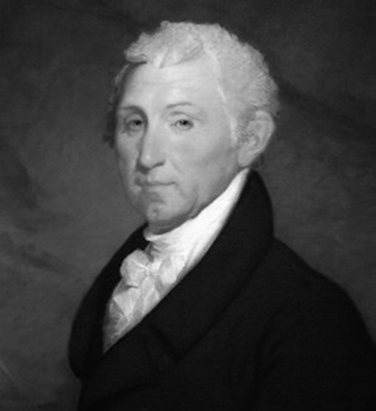
Examples: elected by the people
“But although the legislative branch shall be elected by the people , and amenable to them alone for their conduct , yet as the state sovereignties though qualified , will still remain , and of course the state spirit , in contradiction to a foederal one , from necessity be more or less in ∣ fluential in its councils , we should turn our attention to the other branches of the govern ∣ ment , as our firm resource.” - James Monroe

Slide 29
Examples: chosen by the people
[T]hat in cases of an abuse of the delegated powers the members of the general government , being chosen by the people , a change by the people would be the constitutional remedy ; but , where powers are assumed which have not been delegated , a nullification of the act is the rightful remedy[.]
The President and members of Congress are all chosen by the people . The Government is theirs , and in their hands , as clay is in the hands of the potter ,

Slide 30
Examples: made by the citizens
Left Context: “Item” being made by the citizens | Made by the Citizens | Right Context
A noble stand | was made by the citizens | of Dublin
[T]he captures of our vessels | was made by the citizens | of France
[N]o small tumult | [was] made by the citizens | of the order of the twelve
The contracts” | were made by the citizens | of their own free will, and if the French government never . .
That the [election] of [electors], for the purpose of choosing the president and vice-president of the United States | will] be made by the citizens | of this ( late, qualified to vote for members of the houses of delegates
That . . . [election] of representatives . . . in the [Congress] of the United States | [shall be] made by the citizens | of this Rate qualified to vote for [members] of the house of delegates
[I]f the same declarations and assurances are made by you, which it is required |  | should be made by the citizens to be assembled at Redstone

Slide 31
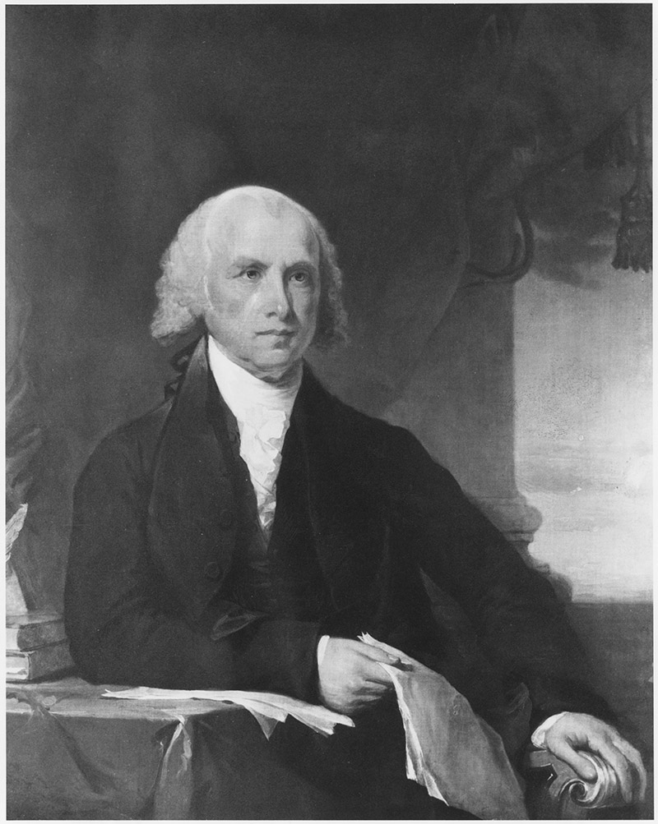
Example: made by the people
“. . . was of the opinion that the appointment of the Members to the first branch of the national Legislature ought to be made by the people for two reasons , -- one was that it would inspire confidence , and the other that it would induce the Government to sympathize with the people .” - James Madison

Slide 32
Conclusions
The actions of the citizens—especially actions such as electing, choosing, and making—were of a lesser scope and frequency than the actions of the people associated with the same verb constructs.
Our earlier research established that in the Founding Era, the people are a ground up source of power. This research further supports that proposition.
Sheds light on why “We the People”—rather than “We the Citizens”—“do ordain and establish this Constitution for the United States of America.”

Slide 33
Extra slides
Mutual Information collocate scores for people/citizens & by the people/citizens
To the people

Slide 34
MI-sorted collocates
5L, 5R
citizens
people
Collocate | Per Mio | Frequency | Range | MI | Collocate | Per Mio | Frequency | Range | MI
fellow | 22.1 | 2,953 | 1,403 | 7.24 | minds | 8.8 | 1,168 | 752 | 3.37
class | 3.1 | 412 | 237 | 5.14 | among | 25.1 | 3,353 | 1,570 | 2.88
foreigners | 1.9 | 248 | 136 | 5.12 | representatives | 9.1 | 1,212 | 520 | 2.63
subjects | 7.0 | 933 | 287 | 4.49 | free | 12.5 | 1,668 | 909 | 2.59
respectable | 1.9 | 255 | 190 | 4.29 | rights | 8.3 | 1,105 | 576 | 2.36
citizen | 2.1 | 285 | 88 | 4.04 | large | 9.9 | 1,327 | 780 | 2.19
virtuous | 1.3 | 174 | 143 | 3.82 | young | 7.3 | 977 | 379 | 1.98
united | 20.4 | 2,724 | 845 | 3.69 | body | 10.1 | 1,343 | 768 | 1.89
privileges | 1.6 | 212 | 139 | 3.64 | America | 11.7 | 1,559 | 903 | 1.77
states | 28.0 | 3,733 | 1,132 | 3.59 | themselves | 13.1 | 1,744 | 1,009 | 1.77

Slide 35
Collocate | Frequency | Documents | Mutual Info
disparage | 14 | 14 | 10.55
elected | 224 | 162 | 8.40
chosen | 470 | 285 | 8.13
eleded | 7 | 6 | 7.48
disliked | 6 | 6 | 7.22
delegated | 24 | 22 | 7.14
detested | 9 | 9 | 6.91
acquiesced | 8 | 8 | 6.67
reposed | 19 | 16 | 6.62
enatled | 9 | 3 | 6.34
adored | 5 | 5 | 6.21
surrendered | 11 | 8 | 6.17
retained | 24 | 21 | 5.98
hated | 8 | 8 | 5.77
selected | 8 | 8 | 5.73
framed | 9 | 9 | 5.63
ratified | 14 | 13 | 5.49
entrusted | 10 | 10 | 5.26
enjoyed | 21 | 19 | 5.20
exercised | 22 | 22 | 5.11
approved | 27 | 22 | 4.79
supported | 29 | 28 | 4.73
esteemed | 12 | 12 | 4.56
submitted | 18 | 16 | 4.55
respected | 8 | 8 | 4.54
by the people – MI-sorted

Slide 36
by the citizens – MI-sorted
Collocate | Frequency | Documents | Mutual Info
owned | 10 | 9 | 7.95
sustained | 14 | 12 | 7.77
enjoyed | 14 | 13 | 7.40
chosen | 29 | 19 | 6.90
exercised | 9 | 9 | 6.61
elected | 8 | 7 | 6.38
held | 15 | 13 | 5.09
recovered | 6 | 6 | 4.97
led | 5 | 5 | 4.41
carried | 8 | 8 | 4.26
paid | 11 | 9 | 3.63
appointed | 8 | 6 | 3.29
given | 6 | 6 | 2.24
be | 110 | 75 | 1.92
made | 12 | 11 | 1.80
been | 15 | 15 | 1.30
being | 8 | 8 | 1.25
are | 22 | 20 | 1.06
was | 26 | 26 | 0.95
were | 8 | 8 | 0.46
is | 29 | 29 | 0.45
has | 5 | 5 | 0.03
by the citizens – MI-sorted
z

Slide 37
Results: Made by the Citizens
Left Context: “Item” being made by the citizens | Made by the Citizens | Right Context
A noble stand | was made by the citizens | of Dublin
[T]he captures of our vessels | was made by the citizens | of France
[N]o small tumult | [was] made by the citizens | of the order of the twelve
The contracts” | were made by the citizens | of their own free will, and if the French government never . .
That the [election] of [electors], for the purpose of choosing the president and vice-president of the United States | will] be made by the citizens | of this ( late, qualified to vote for members of the houses of delegates
That . . . [election] of representatives . . . in the [Congress] of the United States | [shall be] made by the citizens | of this Rate qualified to vote for [members] of the house of delegates
[I]f the same declarations and assurances are made by you, which it is required | should be made by the citizens | to be assembled at Redstone

Slide 38
Results: Elected by the Citizens
 | Context Left | Elected by the citizens | Context Right
(1) | These officers , it is true , are | elected by the citizens | , but they niuft by law be ele ~ ed , as well as the deputies to the biennial parliament or juntit general
(2) | The deputies | Elected by the citizens | of Mecklenburg Lunenburg , Brunswick and Greensville to report to the President of the United States their Opinions of the Treaty
(3) | The Senators are to be chosen by eight electors , four whereof to be | elected by the citizens | of the Eastern , and four by the citizens of the Western precinct , which electors shall have the same qualifications as…
(4) | … for he , though born in a foreign country , had been | elected by the citizens | of this country to transact their Legislative business for many years…
(5) | We the Deputies of the District of Brunswick | elected by the citizens | thereof for this express purpose , do respectfully report the Opinions of our Constituents as follow…

Slide 39
Spring Seminar Data
people collocated with power* 1,118 times – scrubbed to result in 556 concordance lines to manually examine
People was preceded by the 482 times in the 556 lines – this high frequency indicates a unified agency of the people acting as a collective agent.

Slide 41
Eight Most Frequent Pre-Modifiers of People (notwithstanding “the”): By Category
Determiners | Adjective | Conjunction | Preposition
A | Any | And | From
That | Free |  | Of
 | Roman

Slide 42
Notes:
Mostly identifying the people with their country

Slide 44
Power
When collocated (4R, 4L) with people, power is possessed: 13 instances of people’s power, 99 instances of power of the people

Slide 46
Fifteen Most Frequent Pre-Modifiers of Power: By Category
Measurable Amounts | Governmental in Nature | Value-Based | Action
All | Civil | Arbitrary | Delegated
Full | Elective | Special
Same | Executive | Supreme
Unlimited | Governmental
Whole | Legislative
 | Sovereign

Slide 47
41 instances of the root delegat* in the 556 concordances lines discussing people and power

