Slide 1
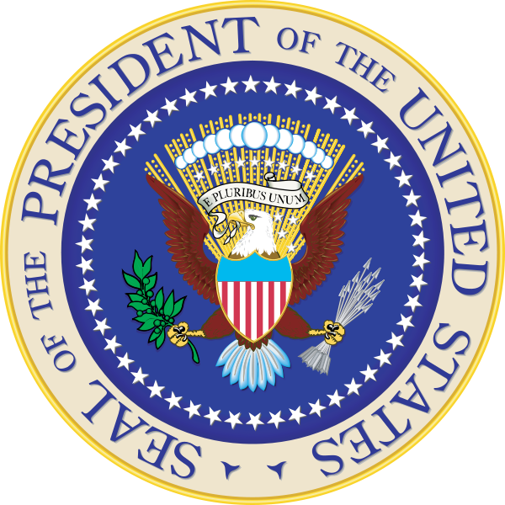
Effective but limited:
A Corpus Linguistic Analysis of the
Original Public Meaning of Executive Power
Eleanor Miller & Heather Obelgoner

Slide 2
“Men may intend what they will . . .”
Article II:
The executive power
shall be vested in a President
of the United States of America.
Article I:
All legislative powers herein granted
shall be vested in a Congress
of the United States
Article III:
The judicial power of the United States,
shall be vested in one Supreme Court,
and in such inferior courts as the Congress may
from time to time ordain and establish

Slide 3
What is the Original Meaning of Executive Power?
Historical &
Philosophical
Context
Linguistic
Analysis
Original
Public
Meaning
The Power to Execute the Laws

Slide 4
Corpus Linguistics
Linguistic Drift
A linguistic theory which posits that the meanings of words shift subtly over time, altering the way that a word or phrase is perceived by one generation as compared to another.

Slide 5
Linguistic Drift – COFEA Results
Supreme
Whole
All
Chief
Federal
Legislative

Slide 6
Linguistic Drift – COCA Results
Chief
Senior
Top
Marketing
Advertising
Business

Slide 7
Linguistic Methodology
Sense Coding
  The process of determining whether a word or phrase has more than one sense and then assigning different numbers to each distinct sense.

Slide 8
Linguistic Methodology
Grounded Theory
Determining and coding senses as they emerge during the data review itself, instead of relying on predetermined sense categories

Slide 9
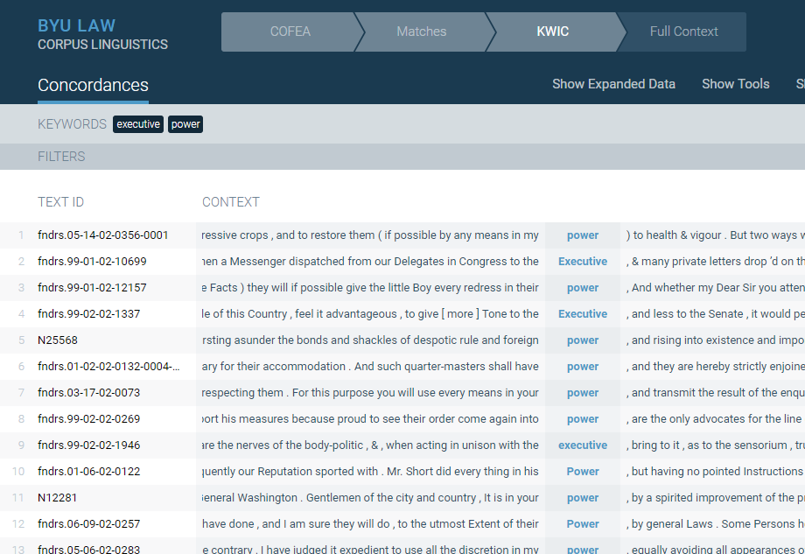
Concordance Data

Slide 10
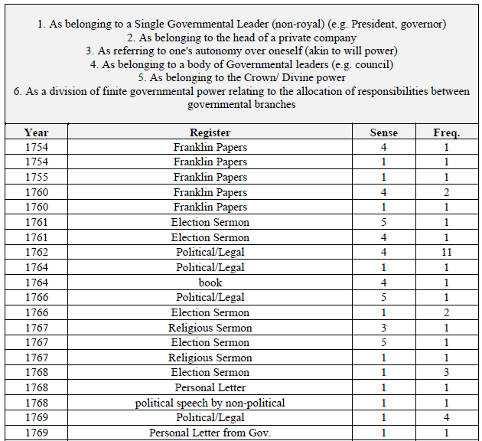
Sense Frequency Coding

Slide 11
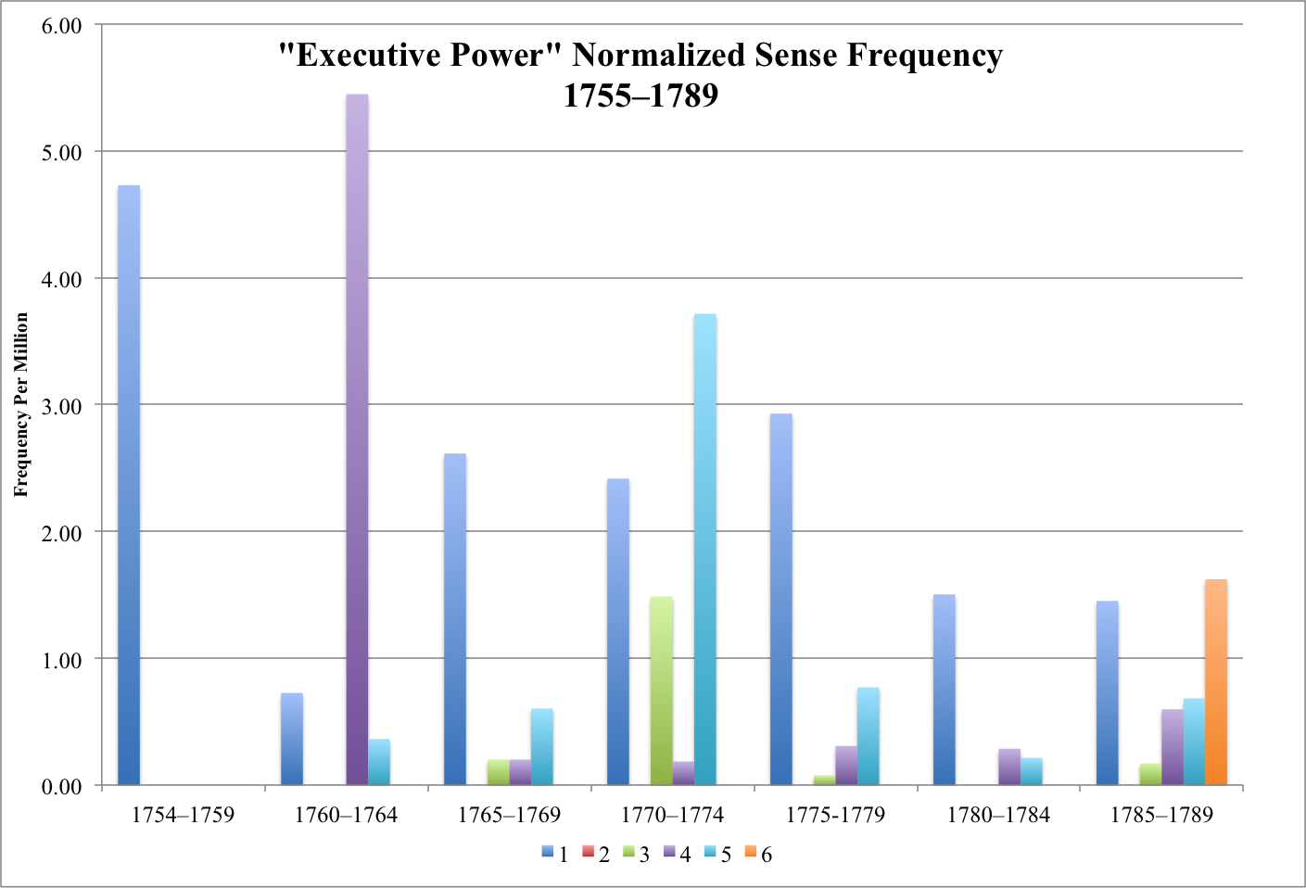
Normalized Frequency Data

