Slide 1
“Questions Involving National Peace and Harmony” or “Injured Plaintiff Litigation”? The Original Meaning of “Cases” in Article III of the Constitution
Heather Kuhn, Margaret Wood, Ute Römer, Haoshan Ren, Noor Abbady, Clark Cunningham, Jesse Egbert

Slide 2
Agenda
Introduction and Paper Origins
“Such other” Research Design & Results
Phrases and Patterns in Linguistic Analysis
Shell Nouns Research Design & Results
Future Law-Linguistic Collaboration
Open Discussion

Slide 3
Introduction and Paper Origins

Slide 4
Original Research Questions: Judicial Power Seminar Spring 2019
What is the original public meaning of “case”?
Is there any corpus evidence that injury was part of the definition of ‘case’?

Slide 5
Why is original meaning of ‘case’ relevant?
Tax Payer Cases
Massachusetts v. Mellon (1923)
Flast v. Cohen (1968)
Environmental Cases
Sierra Club v. Morton (1972)
Lujan v. Defenders of Wildlife (1992)
Data Breach Cases
Spokeo, Inc. v. Robins (2016)
Zappos, Inc. v. Stevens (2019)
(SCOTUS denied certiorari in both)
Notes:
In my paper, I looked at the trend of how ‘case’ and ‘harm’ were treated in relation to one another in each of these categories of cases through the 1900’s into the present.
Tax payer case: Individual tax payers were saying they were harmed by the use or misuse of federal funds and wanted to bring a case before the court.
Environmental cases: plaintiffs are looking to establish harm through development of land or the descrease in wildlife- cases where the harm is becoming less tangible and less individualized.
Data Breach cases: statutory violations alone when there is no tangible harm as of yet.
Ultimately, it gets us talking about whether the founders when they were having conversations about Art III and who could get a resolution for their matter really needed to have a tangible injury and if that should be the minimum standard as the courts has argued.
_______________________________
The first cases of standing started with citizens challenging the actions of Congress in passing a federal Act that allegedly misappropriated funds. Massachusetts v. Mellon, 262 U.S. 447 (1923).
In 1968, another tax payer took on the issue of standing when taking issue with how federal funds were spent. Flast v. Cohen, 392 U.S. 83 (1968)
Environmental cases: In Sierra Club v Morton (1972), the Court declared that an environmental organization would have standing to challenge development in the Mineral King Valley of California, on land owned by the National Forest Service and National Park Service, if it could show that its members were likely to suffer an aesthetic injury were the development to go forward.
In the important case of Lujan v Defenders of Wildlife(1992), the law relating to environmental standing sharply departed from the relaxed approach taken in the two earlier cases. The case involved a national environmental organization's challenge to a Dep't of Interior rule declaring that federal agencies had no duty to consult with DOI about the impact their projects in foreign countries might have on endangered populations of animals. The Court found the organization lacked standing even though the complaint asserted that members planned to visit certain foreign countries where they hoped to see endangered species threatened by projects receiving federal assistance ("too speculative" an injury, according to the Court), or visit zoos where these animals might be less likely in the future to be found ("beyond all reason," said the Court). The Court also rejected standing based on a citizen suit provision in the Endangered Species Act. Finally, four members of the Court agreed that even if the plaintiffs could have met the injury-in-fact test, standing would still not exist because the alleged injury might not be preventable by relief granted if the court ruled in the defendant's favor.
Zappos.com, Inc. v. Stevens, the issue that was pending before the U.S. Supreme Court was whether individuals whose information is stored in a database have standing due to a data breach alone occurring even without concrete harm. Ree v. Zappos.com, Inc. (In re Zappos.com, Inc.), 888 F.3d 1020 (9th Cir. 2018). Cert. denied, Zappos.com, Inc. v. Stevens, 2019 U.S. LEXIS 2106 (U.S., Mar. 25, 2019)
Spokeo, Inv. V. Robins: Petitioner Spokeo, Inc., an alleged consumer reporting agency, operates a “people search engine,” which searches a wide spectrum of databases to gather and provide personal information about individuals to a variety of users, including employers wanting to evaluate prospective employees. After respondent Thomas Robins discovered that his Spokeo-generated profile contained inaccurate information, he filed a federal class action complaint against Spokeo, alleging that the company willfully failed to comply with the FCRA’s requirements

Slide 6
Traceable to Defendant
Concrete and Particularized Harm
Relief Redress Harm
Standing
Standing Doctrine is back in legal scholarship
Data breach cases are pushing the limits on what is considered a harm or injury
Access to Justice issue

Slide 7
“Such other” Research Design & Results

Slide 8
Motivation
“the jurisdiction of the national Judiciary shall extend to cases arising under laws passed by the general Legislature, and to such other questions as involve the National peace and harmony”
What does this excerpt suggest about the meaning of “case” as we see it used in relation to “questions”?

Slide 9
Methodology
Preliminary analysis
100 lines randomly sampled from the Corpus of Founding Era English (COFEA)
Search term “such other */n”
Findings: a appears to always fall under the general, overarching category of b
Primary analysis
Three 100-line samples collected from COFEA
Three samples qualitatively analyzed, line-by-line
Questionable lines flagged for further analysis by legal scholars
Modified search term: “such other”

Slide 10
Findings
“Resolved also, that on the Passage of such Bills as now lie before the Governor, the Naturalization Bill, and such other Bills as may be presented to him.”
“…before any ship or vessel shall have performed the quarantine, and such other cautionary measures.”
“…and for the education of youth in the English, Latin and Greek Languages; in Writing, Arithmetic, Musick, and the Art of Speaking, Practical Geometry, Logic and Geography, and such other of the Liberal Arts.”
“…Capt. Myles Standish, Capt. John Mason, Capt. John Leverett, Lieut. Robert Seely (or such other as shall have chiefe command.)”
“for encouraging our own manufactures is to ensure a preference and encourage a demand for them by overcharging the prices of foreign by heavy duties. Such other means of encouragement…. ”
1) a...such other + noun
2) a…such other
+ pre-modifier + noun
3) a…such other
+ of the + noun
4) a…such other + as
5) a. Such other...b

Slide 11
Implications
“the jurisdiction of the national Judiciary shall extend to cases arising under laws passed by the general Legislature, and to such other questions as involve the National peace and harmony”
cases (a) was likely considered a type, or example of questions (b)
“other questions as involve the National peace and harmony” (b) was likely considered a more general category of jurisdiction than “cases arising under laws passed by the general Legislature” (a).

Slide 12
Phrases and Patterns in Linguistic Analysis

Slide 13
“The word is not enough” (Römer, 2008, p. 121)
Language has a “phraseological tendency”; words do not appear in isolation but “go together and make meanings by their combinations.” (Sinclair, 2004, p. 29; Sinclair, 1991)
“We have come a long way from the presumption that, mostly, the word is the unit of meaning. […] the normal primary carrier of meaning is the phrase and not the word” (Sinclair, 2008, p. 409)
“Many words are frequent because they are used in frequent phrases.” (Stubbs, 2009, p. 119) Why is “thing” the most frequent noun in English?
Notes:
The headline here is a quote from a paper in which I tried to automatically extract items of (evaluative) meaning from a corpus of academic book reviews (freq wordlists, keyword lists turned out not to be useful but n-gram/cluster extraction was);
“The phrase, the whole phrase and nothing but the phrase” (Sinclair, 2008, p. 407) “[the phrase] is the place where structures are engineered to allow meanings to take shape” (Sinclair, 2008, p. 408) … so, if we are interested in meaning, we need to look beyond the word and at the phrase;
Stubbs article: http://docenti.unimc.it/gilliansusan.philip/teaching/2017/17162/files/lettura-in-programma/stubbs-2009

Slide 14
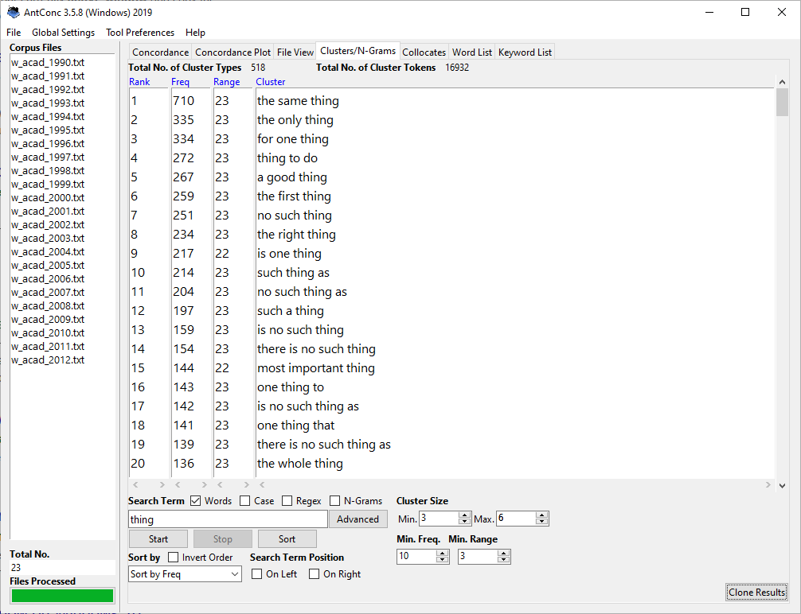
Top-20 “thing” clusters (spans 3-6) in COCA_acad (9,092 instances of “thing” in this corpus)
Notes:
… because it occurs in frequent phrases that have important communicative functions

Slide 15
Different patterns, different meanings!
Linguistic usage patterns and meanings are “mutually dependent” (Hunston & Francis, 2000, p. 3)
An example (Hunston and Francis, 1998, p. 51):
recover + from + noun or noun phrase = get better (e.g. she recovered from the flu)
recover + noun or noun phrase = get back (e.g. he recovered the corrupted files)
Notes:
Perhaps also share “cup of tea” example (Hunston, personal communication)

Slide 16
Shell Nouns Research Design & Results

Slide 17
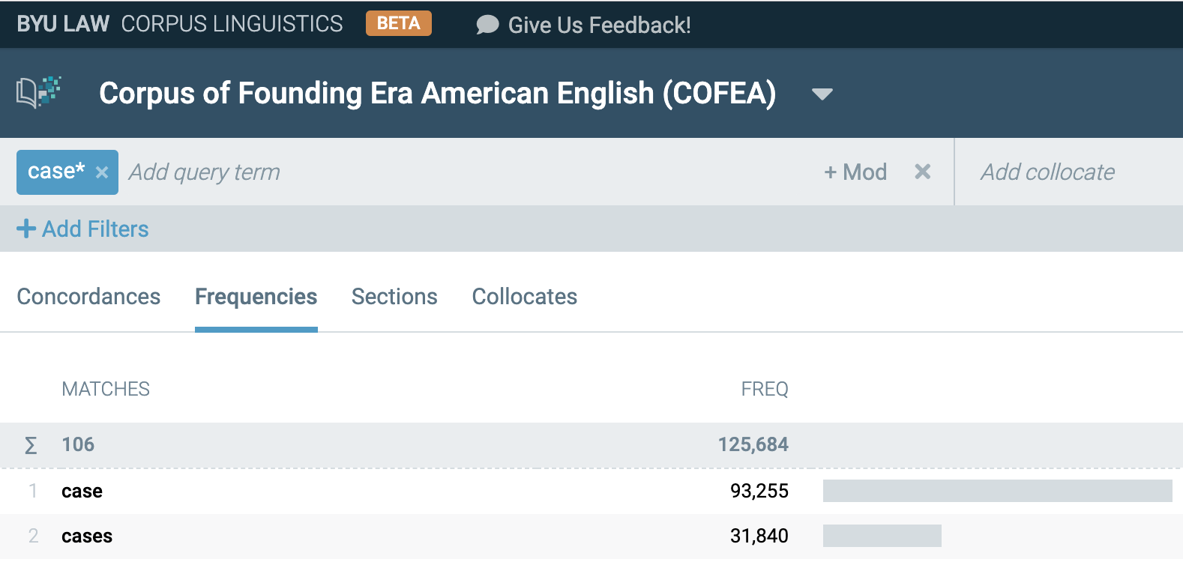
Notes:
From unmanageable big data to systematic and patterned use:
- Where to start? – grounded theory guided by phraseology perspective
- form-meaning pairing enable us to systematically group meaningful results and analyze patterns, instead of each individual occurrence

Slide 18
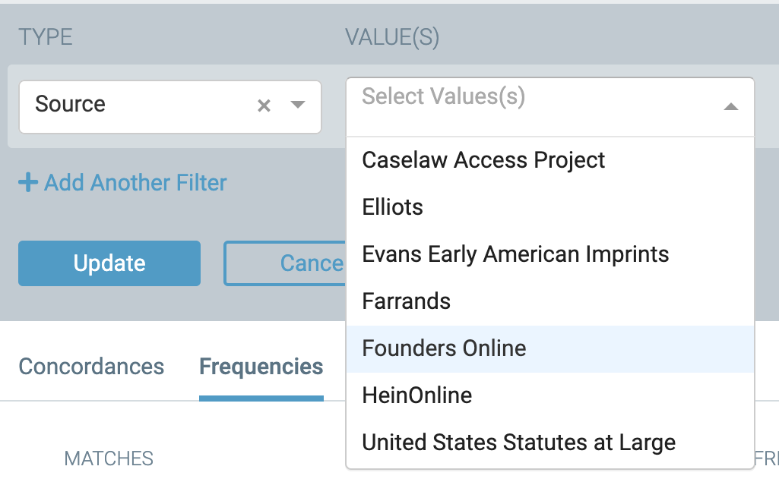
The offline sub-corpus:
All documented writings by James Madison between 1751 to 1836
27416 files
10,729,712 words (tokens)
90700 types
Notes:
Corpus linguists will care about the shape of the corpus – this slide explains FondrsOnline but not the whole COFEA, which I assume appears earlier in the presentation.

Slide 19
Grounded Theory
AntConc
Shell Noun
Schmid (2000)
Founders Online – Madison offline
Article III patterns
COFEA
Founders Online – Madison offline
3 target patterns
Highly patterned
Case & cases are frequently used as shell noun
all cases affecting
all cases arising
all cases of
Notes:
Sequence of research procedure

Slide 20
Shell noun Schmid (2000)
… telehealth can enable regular access to an SLP at another school or center. Even in cases where
there is an Speech-Language Pathology (SLP) service at a school,
telehealth can enable access to support from an SLP who specializes in stuttering treatment.
Carey, B., O'Brian, S., Lowe, R., & Onslow, M. (2014). Webcam delivery of the Camperdown Program for adolescents who stutter: A Phase II trial. Language, Speech, and Hearing Services in Schools, 45(4), 314-324.
Notes:
Shell noun slide → has ordered animations
Complex information
Shelled by a noun that does not have inherent meaning, but indicates the shelled complex idea → shell content
The phrase is commonly used in this function – shell noun usage
Some may say the target phrase can be replaced by “when”, which proves the idea that “case” here does not bring meaningful content
Clarify that not all “in cases where” are shell usage, but it could be.

Slide 21
Grounded Theory
AntConc
Shell Noun
Schmid (2000)
Founders Online – Madison offline
Article III patterns
COFEA
Founders Online – Madison offline
3 target patterns
Highly patterned
Case & cases are frequently used as shell nouns
all cases affecting
all cases arising
all cases of
Notes:
Sequence of research procedure

Slide 22
Frequent patters of case and cases top 5 examples
case Patterns | Token Frequency | Document frequency
the case of | 1313 | 995
in the case | 985 | 811
in case of + NP | 716 | 631
in case + Clause | 709 | 671
of the case | 541 | 483
cases Patterns | Token frequency | Document frequency
in all cases | 263 | 230
in such cases | 211 | 199
in cases of | 140 | 121
the cases of | 101 | 99
in cases where | 82 | 76
79+% of all occurrences of “cases”
(7,066/8,900)
appeared in one of 23 frequent patterns
36% of all occurrences of “cases”
(1,088/3,024)
appeared in one of 10 frequent patterns
Notes:
Example of detailed results – hidden, may use for discussion
^{[1]} Token Frequency: Number of occurrences of a phrase to appear in the entire corpus.
^{[2]} Document Frequency: Number of documents in which the pattern appears.
^{[1]} NP refers to Noun Phrase, which can include a sequence of determiner, adjective, and the noun possibly followed by modifying prepositional phrases.
^{[2]} A Clause is similar in form of a sentence but is a subunit of attached to a sentence. It contains a complete idea typically expressed by a subject and a verb. The clause is underlined in the following example. “I shall direct him in case he can not succeed within the terms prescribed”

Slide 23
“In many cases where American Seamen have been discharged at this place, in consequence of their vessel being sold, or of deviation from the original voyage; the concern’d have offer’d to put them into immediate pay, on the same terms they came hither, in our vessels returning direct to the U.S.A…
Notes:
Example of 18th shell noun usage in Madison
Source https://founders.archives.gov/?q=%22the%20last%20paragraph%20of%20my%20letter%20of%20the%2024th%20July%20last%22&s=1111311111&sa=&r=1&sr=

Slide 24
The judicial power shall extend to all cases, in law and equity, arising under this Constitution, the laws of the United States, and treaties made, or which shall be made, under their authority;
-- to all cases affecting ambassadors, other public ministers and consuls;
-- to all cases of admiralty and maritime jurisdiction;
-- to controversies to which the United States shall be a party;
-- to controversies between two or more states;
-- between a state and citizens of another state;
-- between citizens of different states;
-- between citizens of the same state claiming lands under grants of different states, and between a state, or the citizens thereof, and foreign states, citizens or subjects.
Notes:
Article three “cases” patterns – may be helpful to show target patterns

Slide 25
Future Law-Linguistic Collaborations

Slide 26
“Corpus-based research has the potential to re-orient our entire approach to the study of language” – McEnery and Hardie (2012)
Notes:
What prompted this topic is an observation in this new interdisciplinary research between law and linguistics and that is a tendency to limit the scope of a very wide field
This can yield to limited findings, sometimes impact the accuracy of our results. Given the high stakes of this kind of research, and the impact meaningful, collaborative partnership is
Book: Corpus Linguistics: Method, theory, and practice

Slide 27
What do collocational frequencies reveal?
Lexical word combinations
Statistical/ quantitative results
MI (Mutual Information)
Semantic association
Notes:
Online concordance tools are user-friendly, provide descriptive quantitative results.
They give limited access to actual texts
Familiarize ourselves with settings and filters, sometimes can skew the results.
Online tools in its default settings restricts results.
One word co-occurring with my search word does not give the full semantic profile of that word

Slide 28
What they do not reveal
Grammatical words
Structure
Phraseology: constructions, n-grams, lexico-grammatical patterns
Access to context far from core search item.
Notes:
Collocational searches that are based on online corpus tools do not, in their default settings, provide function words, which can be very important in interpreting the findings.
No data, or means to get data, about structures that are attracted to our query item
And thus, does not enable phraseological analysis

Slide 29
Preserving research methods is our goal
“there should be no motivated selection of examples to favour those examples that fit the hypothesis, and no screening out of inconvenient examples.” - McEnery and Hardie (2012)
Notes:
If you approach a corpus with a specific theory in mind, it can be easy to unintentionally focus on and pull out only the examples from the corpus that support the theory (this is technically called a confirmation bias)

Slide 30
To ensure methodological rigor, accurate results, a specialized linguistic researcher must be a partner; both in research and in assessment processes.
Using CL for legal interpretation is yet another application for linguistics.
It is an obligation for linguists to claim their field of study.
True collaboration - an obligation, not just an opportunity

Slide 31
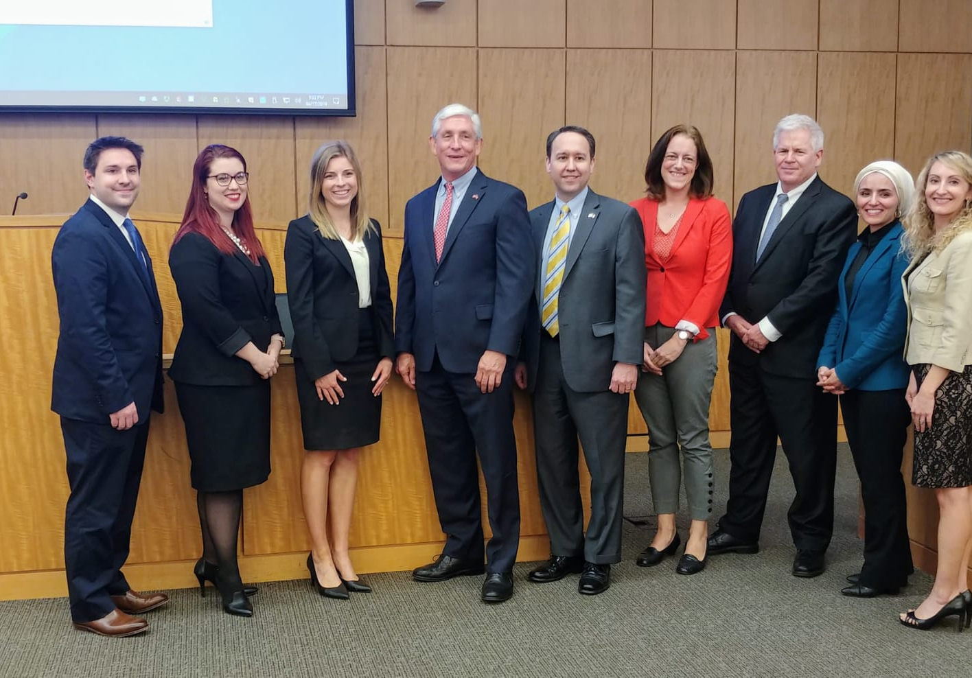
Interdisciplinary research: linguists and lawyers both as researchers and as judges. GSU COL, April/May 2019

Slide 32
Comments on “Questions Involving National Peace and Harmony” or “Injured Plaintiff Litigation?
Georgia State University Workshop on Law & Linguistics
Susan Navarro Smelcer
October 18, 2019

Slide 33
Roadmap
Some thoughts on validity (or, legal writing is not English)
Yes, “case” is a shell word, but tell me more about “arising under”
“Case” + “arising under” = stable meaning?

Slide 34
Legal writing is not English . . .
. . . and this could have implications for using COFEA to draw conclusions about the meaning of the word “case”
Letters and books written by ordinary people . . . | 18th judges’ opinions . . .
Display a wide range of language and experiences | Resemble reading a very bad Jane Austen book but without any of emotional drama or angst
Express positive and negative emotions | Use otherwise innocuous words in weird ways
Are generally comprehensible to an average reader | Employ strange or difficult terms for otherwise straightforward concepts

Slide 35
Yes, “case” is a shell word, but tell me more about “arising under”
Instance
Occurrence
(One of a list)
“All cases of”
“In the case of”
“In case of”
“The case of”
CASE!
?
“Arising under”

Slide 36
“Case” + “arising under” = stable meaning
“Arising under” as a specialized legal term that gives “case” a stable adversarial meaning within notions of traditional judicial power or activities (maybe?)
Based on the description in the paper and related data, “arising under” ONLY occurs in connection with legal analysis, even when not directly related to interpretation of Article III:
1 U.S. 229: "He then contended, that from general principles, from positive authorities, arising under the bankrupt laws of different countries, from the reason of the thing, and from the mischievous consequences of a contrary position, the discharge of the Defendant in one state, ought to be sufficient to discharge him in every state . . ."
4 U.S. 47: The act of assembly, when it provides a further remedy for the indorsee, implies and recognises the law to be so. At common law, a promissory note could not be declared on; all the declarations on record upon promissory notes, state the liability as arising under the statute of Anne; and the distinction in this particular has been repeatedly recognised by our Courts. . . . The act of assembly, indeed, cannot refer to notes delivered and put in circulation out of Pennsylvania; and surely, the objection arising under our local law, ought not to proceed from the plaintiff in the attachment . . .

Slide 37
What just happened?
18th century legal writing detached from ordinary language
Case may be a shell term but one that is modified by “arising under” only in legal texts
“case” + “arising under” = stable term denoting narrow understanding of a case?

Slide 38
In re Trump, 928 F.3d 360 (4th Cir. 2019)
Emoluments lawsuit brought by State of Maryland and District of Columbia against President Trump in his official capacity
Plaintiffs failed to show “concrete and particularized injury” that was different than the alleged harm suffered by all citizens if the President is corrupted by receipt of foreign payments
“the District and Maryland’s interest in constitutional governance is no more than a generalized grievance, insufficient to amount to a case or controversy within the meaning of Article III”
Responding to the argument that if the District of Columbia and Maryland “could not obtain judicial review of [the President’s] action, then as a practical matter no one can,”
the Fourth Circuit cited the answer provided in a 1974 Supreme Court decision:
“The assumption that if [plaintiffs] have no standing to sue, no one would have standing, is not a reason to find standing”

Slide 39
Open discussion & Questions

