Slide 1
Using Empirical Data to Investigate the Original Meaning of Emolument in the Constitution
Available at: www.clarkcunningham.org/MeaningOfEmolument.html
Clark D. Cunningham
W. Lee Burge Chair in Law & Ethics
Georgia State University College of Law
cdcunningham@gsu.edu www.clarkcunningham.org
Jesse Egbert
Assistant Professor, Applied Linguistics
Northern Arizona University
jesse.egbert@nau.edu http://oak.ucc.nau.edu/jae89/

Slide 2
Guiding principles for linguists involved in legal interpretation

Slide 3
Guiding principles for linguists involved in legal interpretation
Linguists are not judges
  They should not interfere in the judicial process
Linguists are not political activitists
  They should not use their expertise as an excuse to participate in partisan political debates
Linguists are not hired guns
  They should not perform linguistic analysis with the goal of supporting a biased position, especially for money
Linguists are not (usually) lexicographers
  They should avoid conclusive statements about word definitions
Linguists are not prescriptivists
  They should focus on describing language rather than prescribing or proscribing language choices

Slide 4
Guiding principles for linguists involved in legal interpretation
Linguists are (usually) scientists
  They should apply the scientific method to address important linguistic questions
Linguists are language experts
  They should account for all relevant linguistic parameters and apply state of the art methods
Linguists have specialized training
  They should apply use their specialized skills but should not purport to be an expert in areas of linguistics outside of their expertise
Linguists are language professionals
  They should educate the legal profession about the benefits of specialized legal training
Linguists can be interdisciplinary scholars
  They should work hand-in-hand with legal scholars

Slide 5
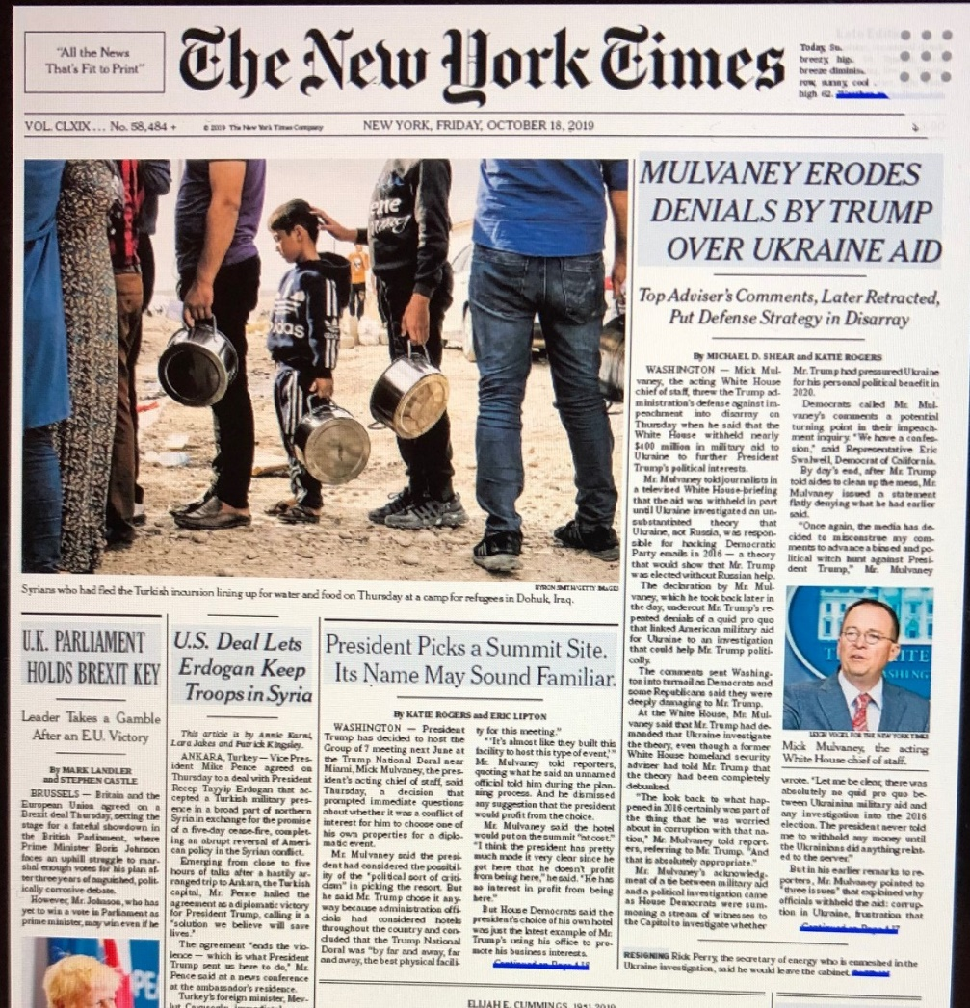
This morning’s newspaper

Slide 6
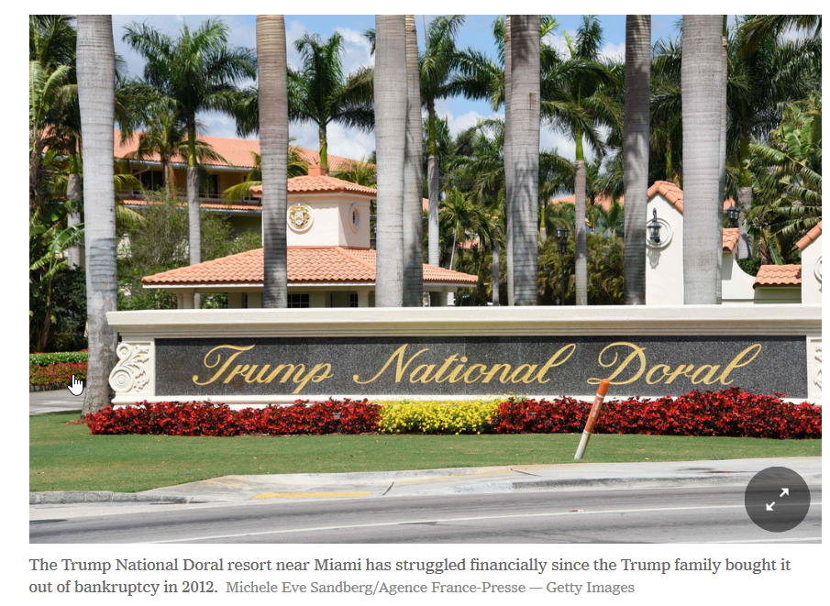
Trump Will Host Next G7 Summit at His Doral Resort

Slide 7
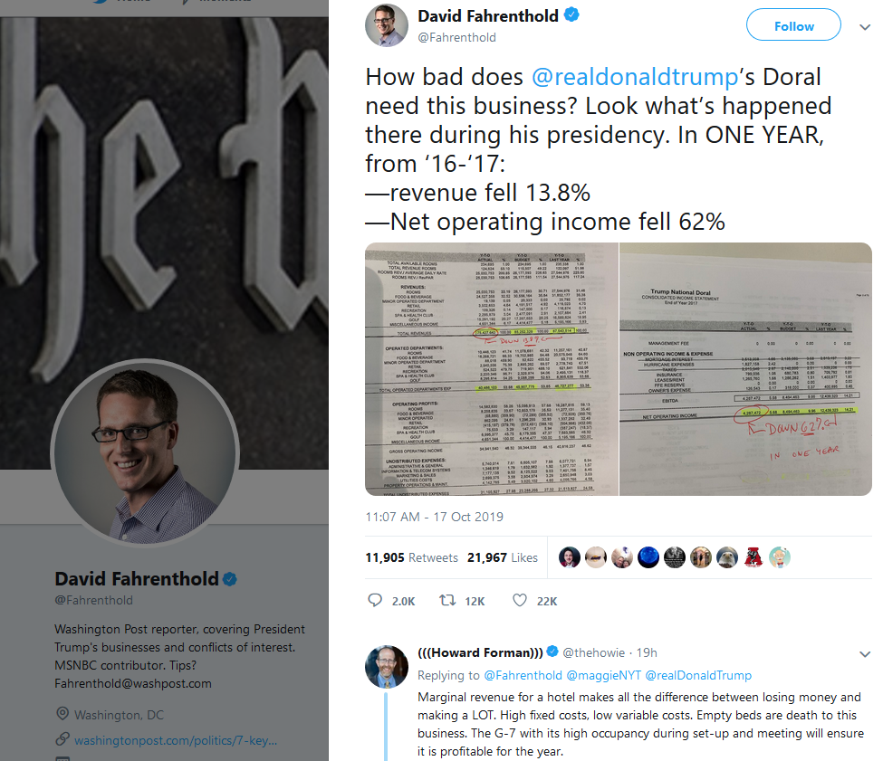

Slide 8
Representative Jerrold Nadler of New York, the chairman of the House Judiciary Committee
which is charged with drawing up articles of impeachment against the president
“He is exploiting his office and making official U.S. government decisions for his personal financial gain”
“The emoluments clauses of the Constitution exist to prevent exactly this kind of corruption.”

Slide 9
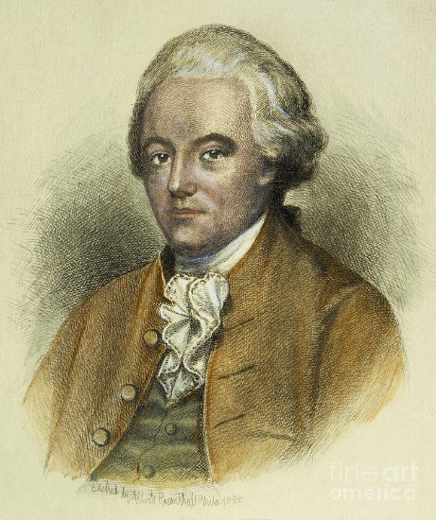
Constitutional Convention
August 23, 1787
Charles Pinckney
Delegate from South Carolina
Moved to add to Article I:
“no Person holding any Office of Profit or Trust under them [the United States], shall, without the Consent of the Congress, accept of any present, Emolument, Office, or Title, of any kind whatever, from any King, Prince, or foreign State.”

Slide 10
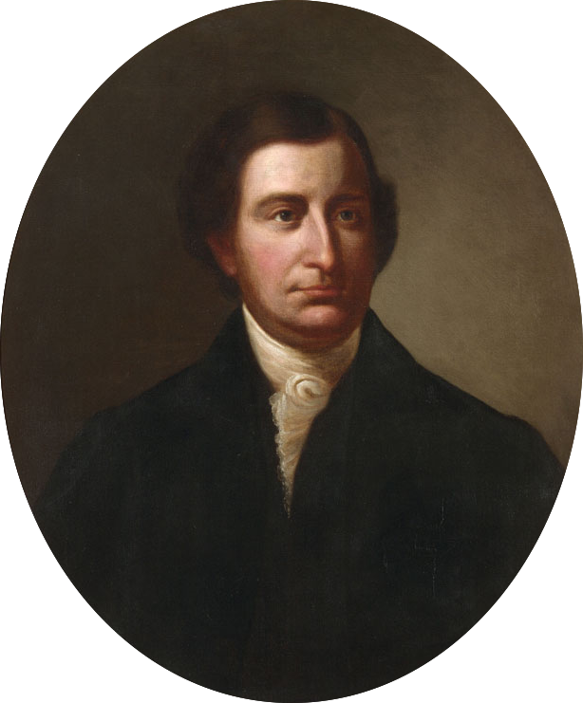
Virginia Ratifying Convention
June 15, 1788
Governor Edmund Randolph
Explains the Foreign Emolument Clause
“[It] restrains any person in office from accepting of any present or emolument, title or office, from any foreign prince or state.
This restriction is provided to prevent corruption.
[This] provision [is] against the danger … of the President receiving emoluments from foreign powers.
If discovered, he may be impeached.
I consider, therefore, that he is restrained from receiving any present or emolument whatever. It is impossible to guard better against corruption.”

Slide 11
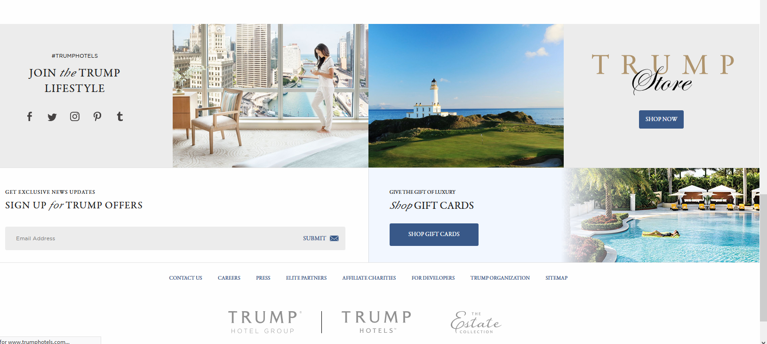

Slide 12
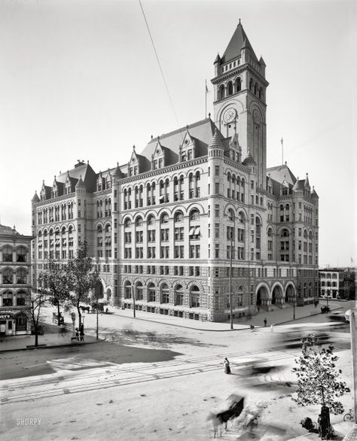
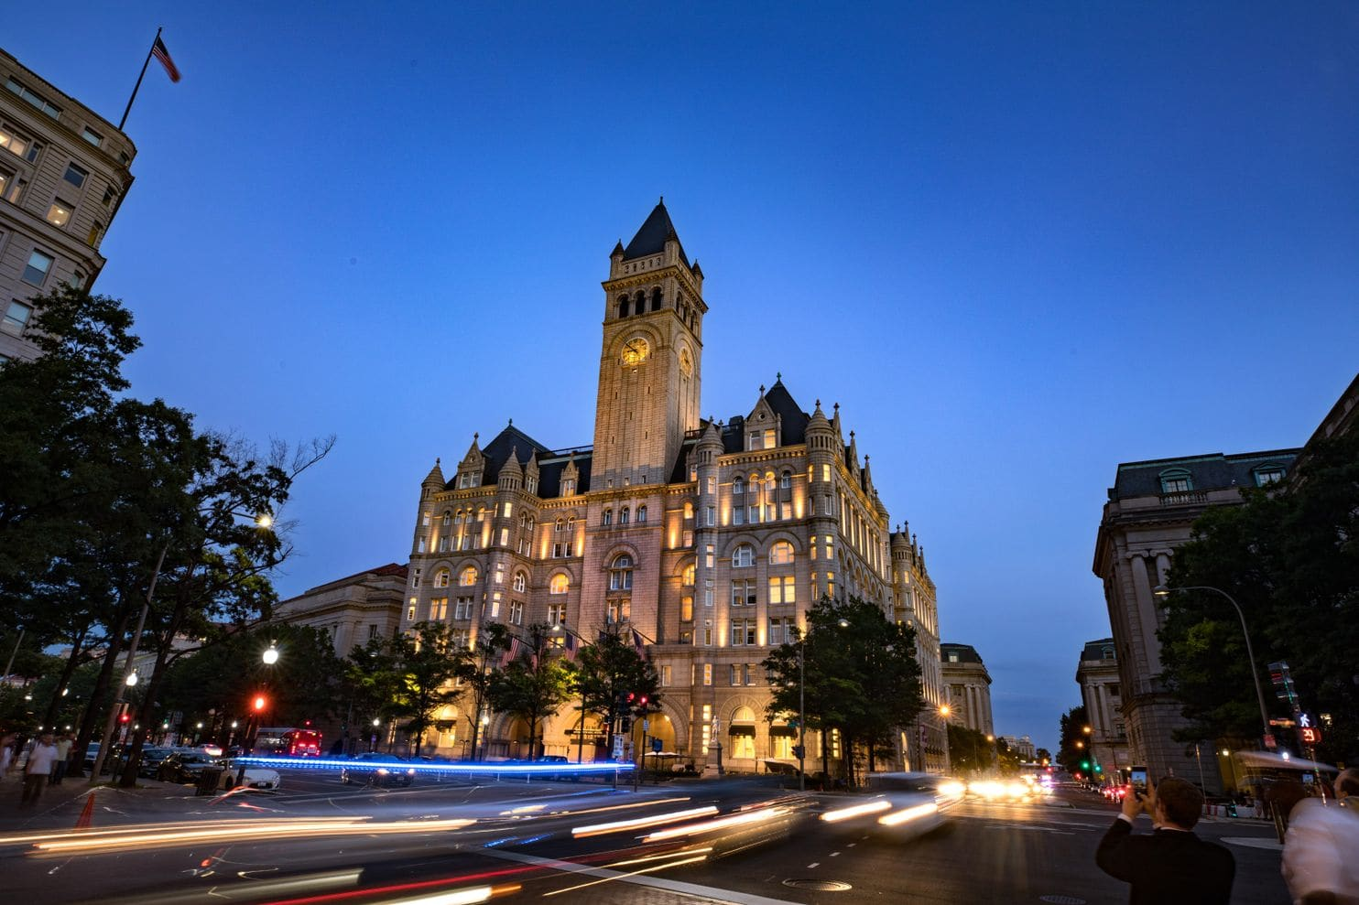
1899: Old Post Office built
2013: 60 year lease to Trump Organization
10/26/16: Reopened as Trump International Hotel

Slide 13
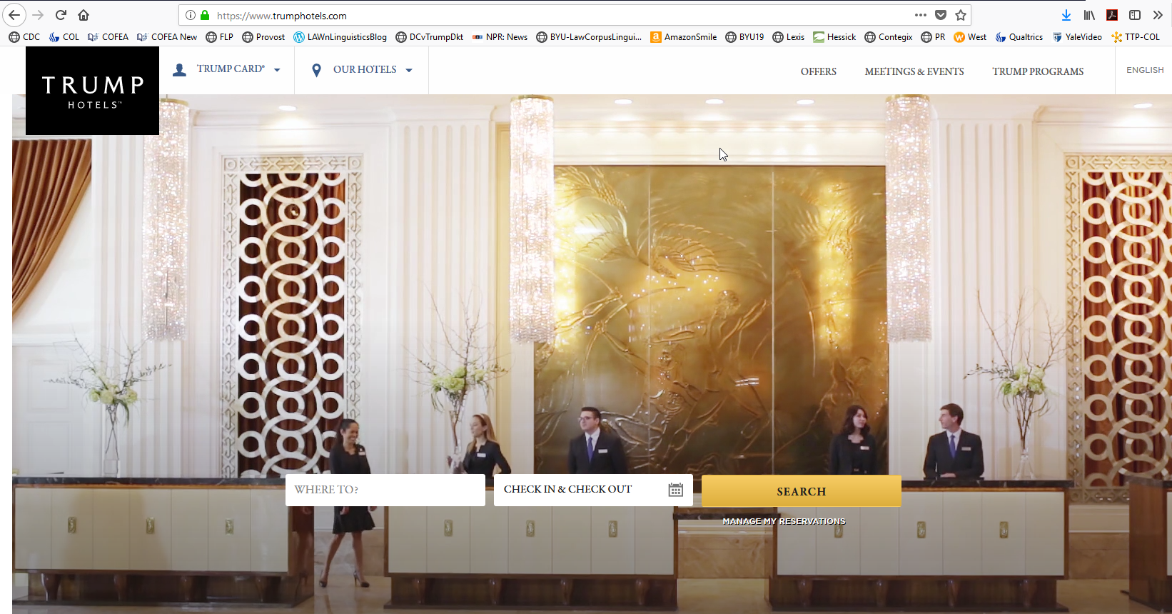

Slide 14
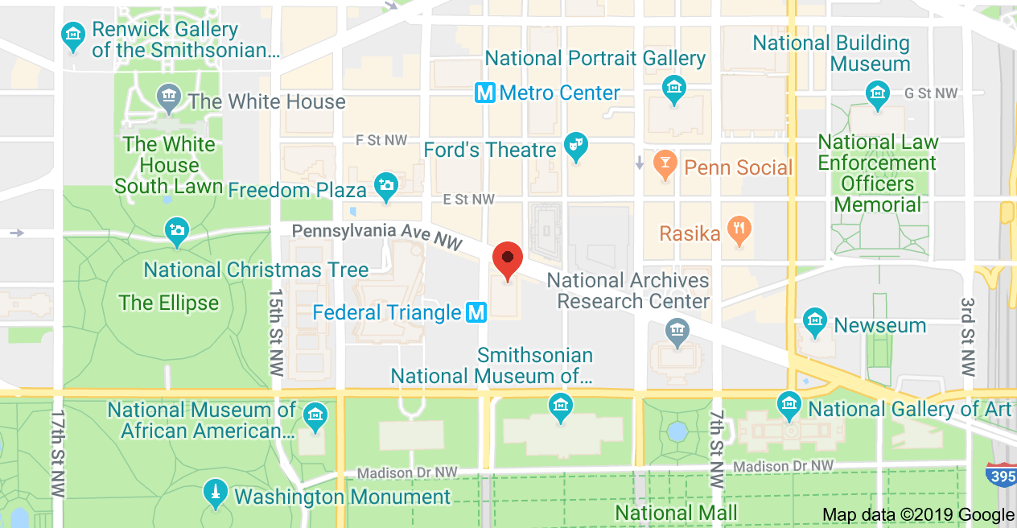

Slide 15
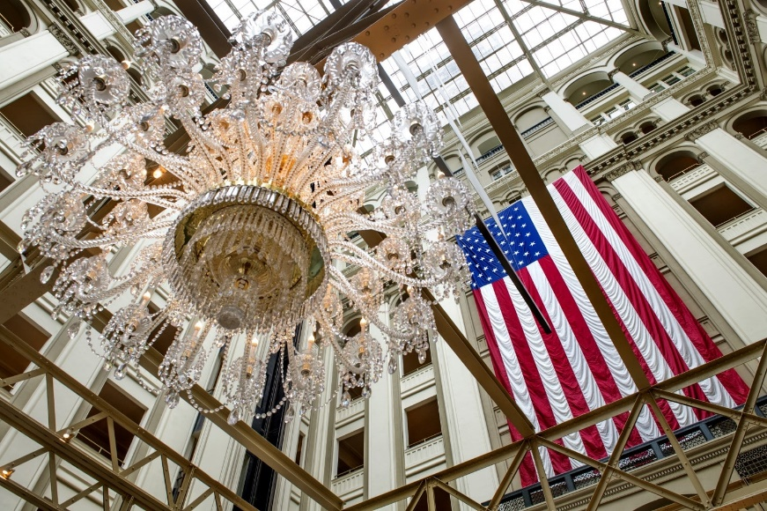
How the Trump hotel changed Washington’s culture of influence
Washington Post Aug 7, 2017
Veterans groups were brought in to lobby Congress against a law allowing victims of 911 to sue Saudi Arabia
$270,000 in hotel charges
  $190,000 for rooms
  $78,000 for catering
  $1,600 for parking
The bill was paid by the Kingdom of Saudi Arabia

Slide 16

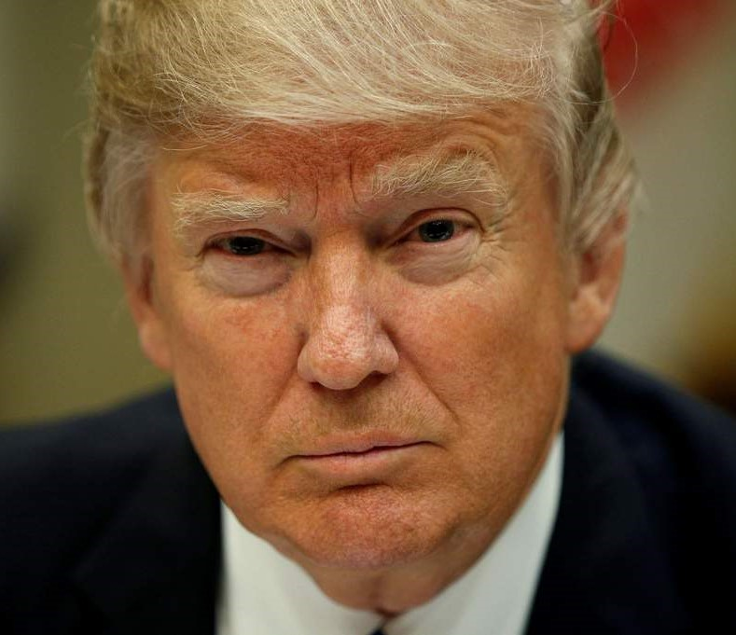
District of Columbia and State of Maryland v. Trump
Filed June 12, 2017 in U.S. District Court, Maryland

Slide 17
President’s Motion to Dismiss
when the Constitution was ratified “emolument” had two distinct meanings:
a “narrow” sense limited to “profit arising from an office or employ”
a “broad” sense meaning “benefit, advantage or profit”
emolument in the Constitution only referred to the narrow meaning

Slide 18
Emolument Cases – Current Status
DC & Maryland v Trump (Maryland)
  July 25, 2018: Trial court denies President’s Motion to Dismiss
    “emolument” covers profits from the Trump Hotel
    Relies heavily on friend of court brief filed by legal historians listing definition of “emolument” in all late 18th century dictionaries
  December 20, 2018: U.S. Court of Appeals for the 4th Circuit grant’s President’s emergency motion to halt trial court proceedings
    Sets expedited briefing schedule
  January 29, 2019: Clark Cunningham & Jesse Egbert file friend of court brief in support of neither party

Slide 19
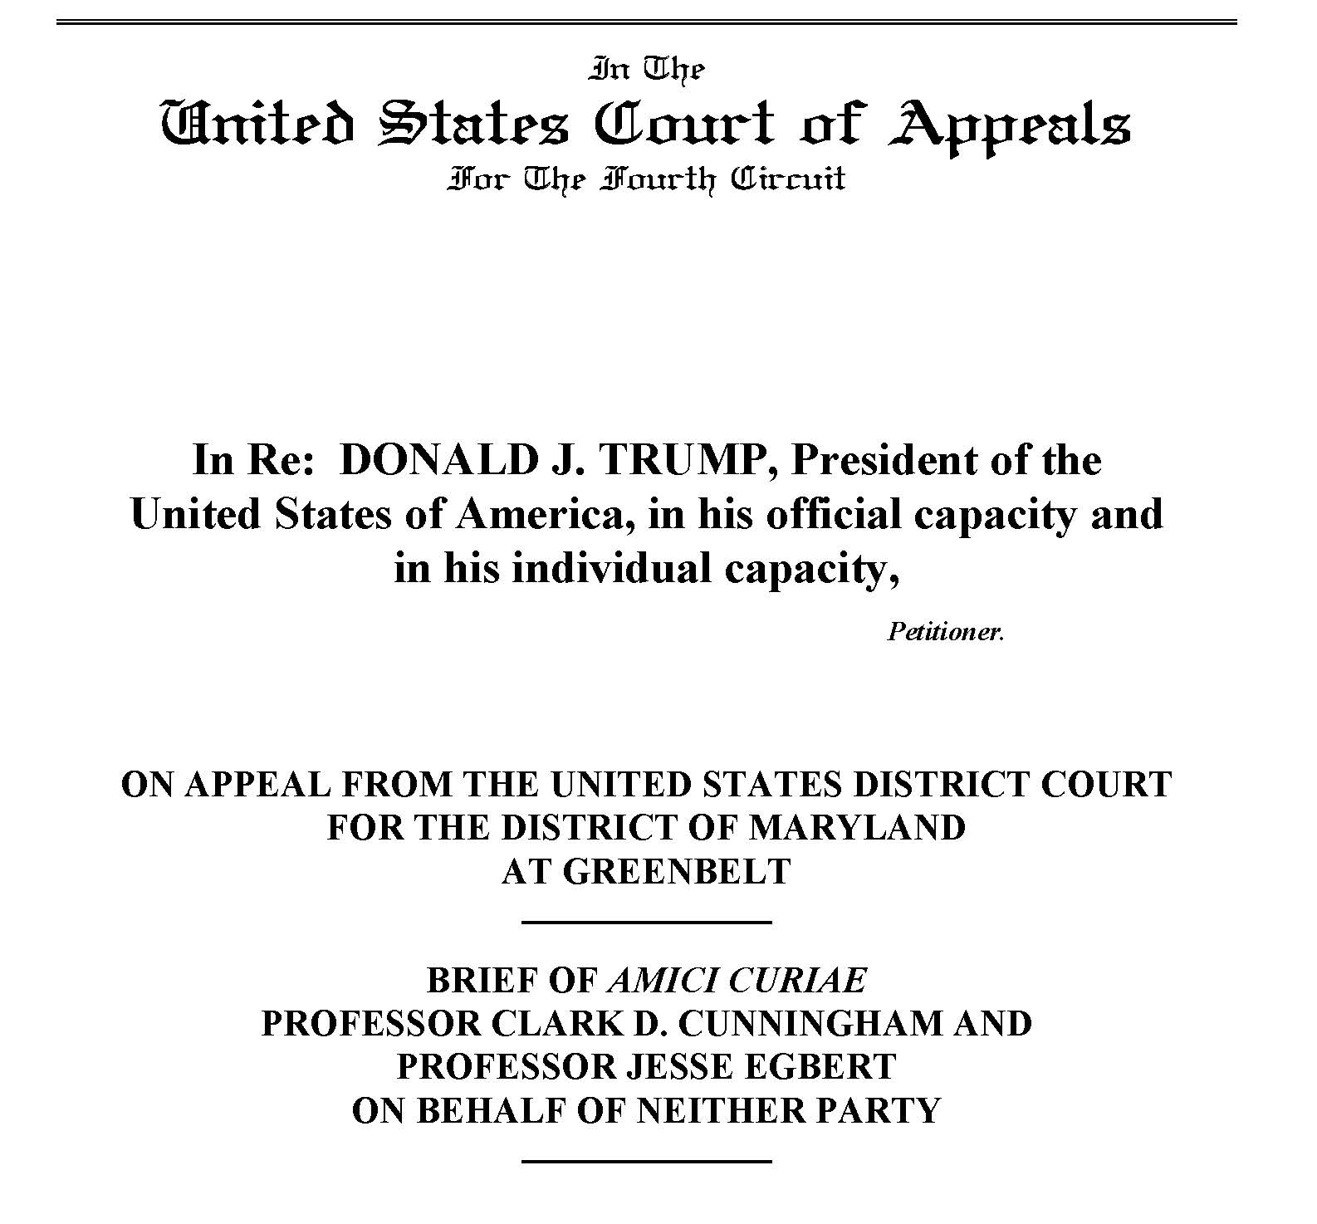
Brief can be downloaded at: www.clarkcunningham.org/Law-Linguistics.html

Slide 20
Emolument Cases – Current Status
DC & Maryland v Trump (Maryland)
Amicus brief cited and discussed in subsequent briefs filed by both President and Maryland/DC
July 11, 2019 Three-judge panel of the 4th Circuit Court of Appeals orders dismissal based on lack of standing
  Does not address meaning of emolument
September 5, 2019 Maryland and DC file petition to have dismissal order reviewed by all 15 judges of the 4th circuit (“en banc review”)
Case may end up at U.S. Supreme Court

Slide 21
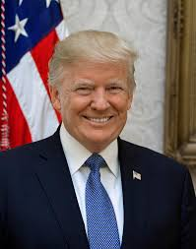
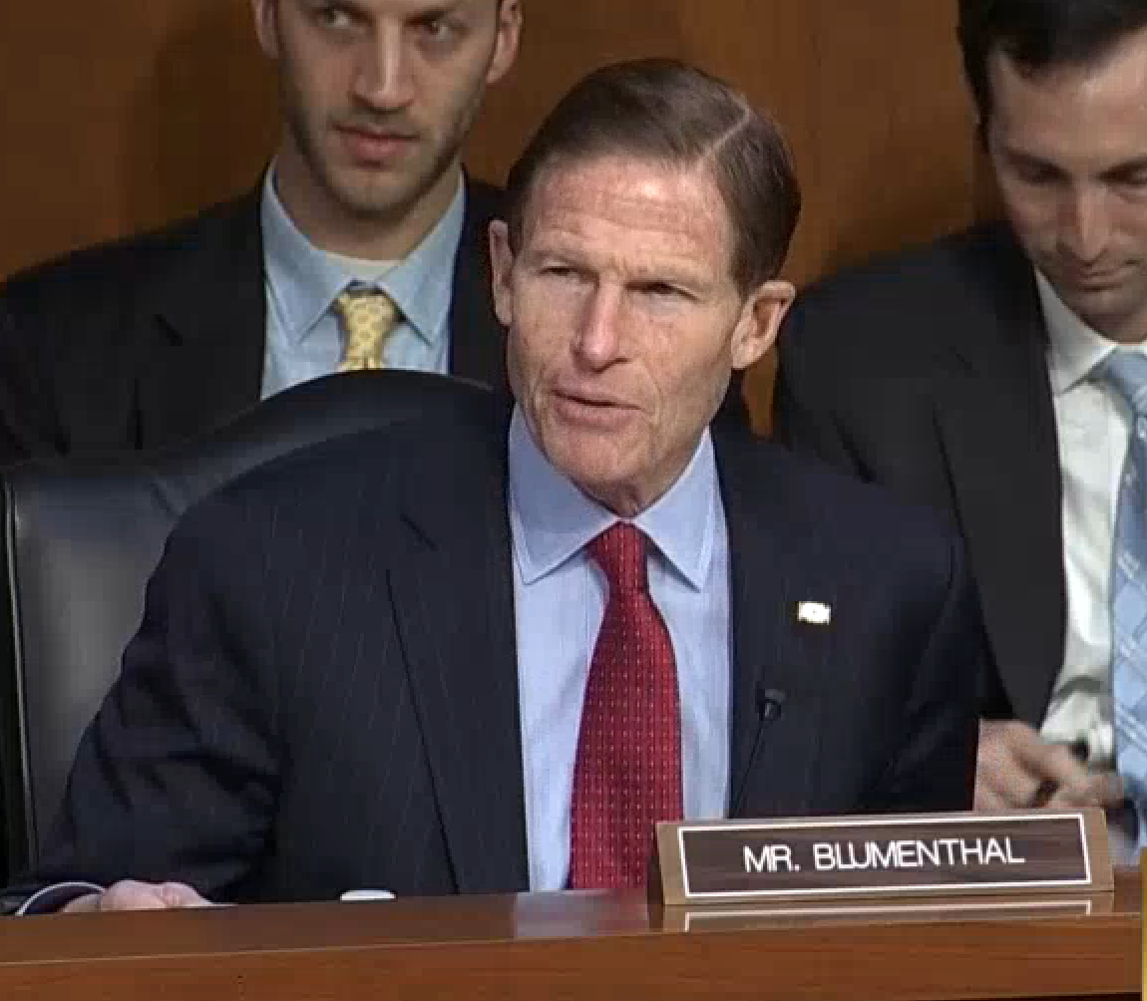
Senator Richard Blumenthal et al v. Trump
Filed June 14, 2017 in U.S. District Court, D.C.
30 members of Senate
171 members of House of Representatives

Slide 22
Senator Richard Blumenthal, Democrat of Connecticut, said
Democrats in Congress who have one of the pending lawsuits against Mr. Trump
will now revise it to include the president’s plan to have the Group of 7 meeting at the Doral

Slide 23
Emolument Cases – Current Status
Blumenthal v Trump (District of Columbia)
  Sep 28, 2018: Trial court denies President’s motion to dismiss
    Cites and largely follows reasoning of Maryland trial court including reliance on 18th century dictionaries
  President’s asks trial court to permit immediate appeal
    Cunningham-Egbert 4th amicus brief and working paper cited by both President and Congressional plaintiffs in briefs on this issue
  Trial court refuses President’s request for immediate appeal
  July 19, 2019: Court of Appeals for the D.C. Circuit orders trial court to halt proceedings and allow appeal
  October 2019: briefs filed in the D.C. Court of appeals
    Issues will include meaning of “emolument”
    10/8/19 Cunningham & Egbert file amicus brief

Slide 24
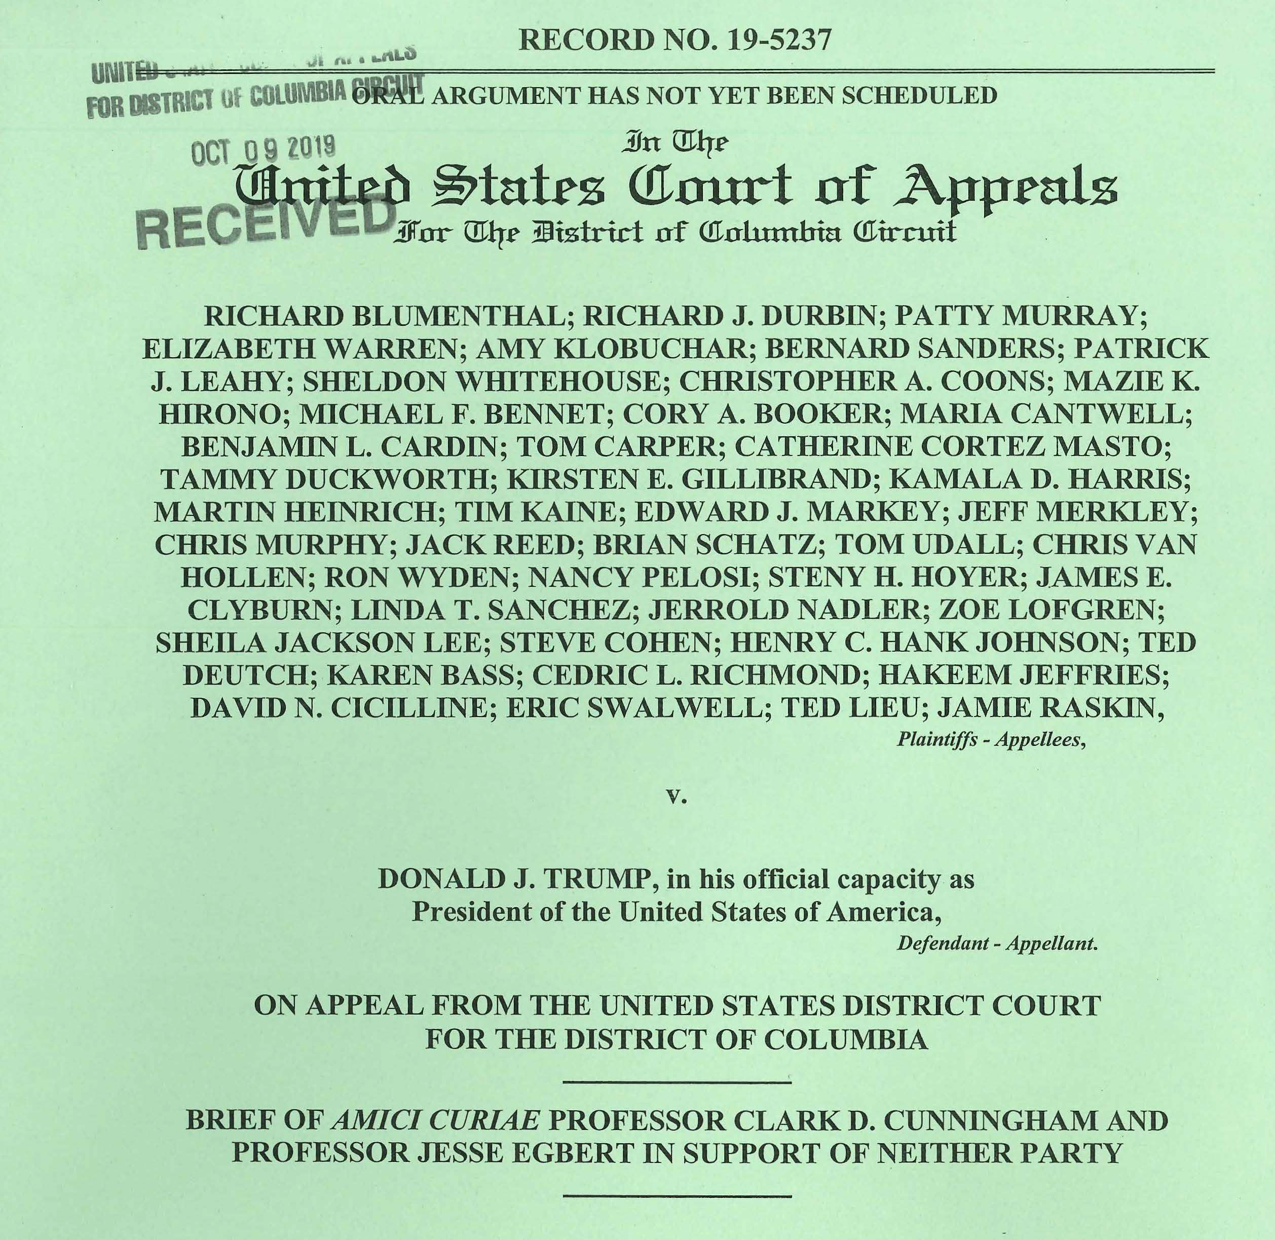

Slide 25
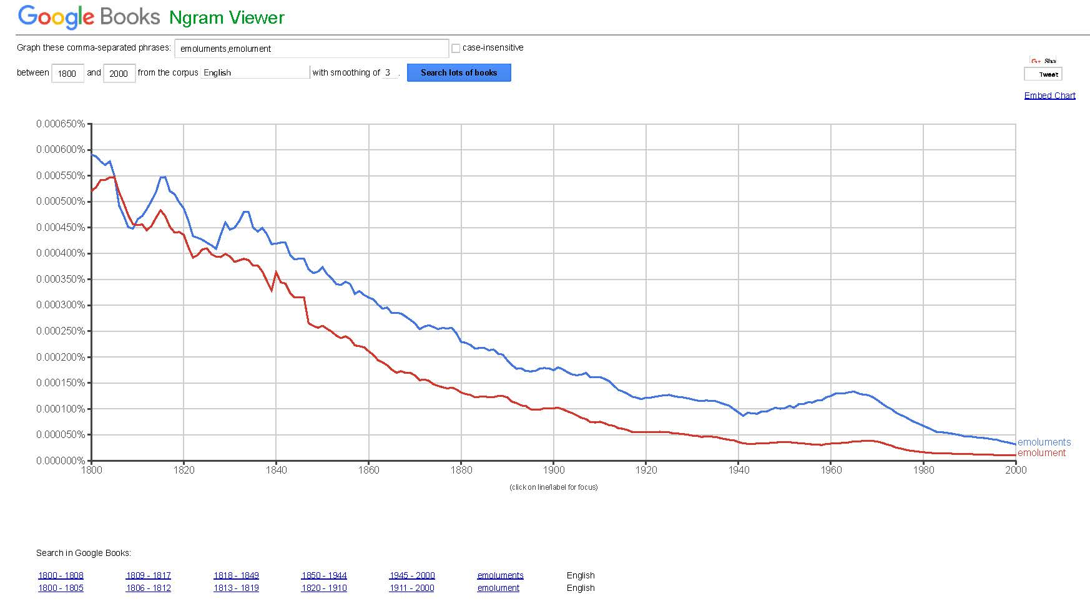

Slide 26
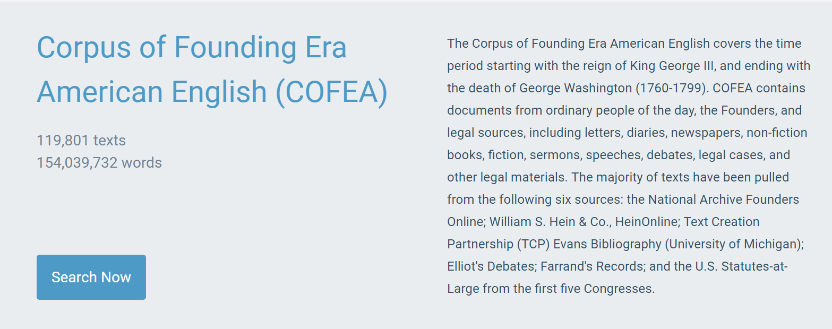
Corpus analysis of emolument

Slide 27
If emolument only refers to profit from office or employment…
H₁: Nouns preceding other emolument(s) in coordinated noun phrases (i.e. lists of nouns) will only refer to the narrow meaning
  Cats, dogs, and other animals
  *Cats, birds, and other dogs
Method: identify all nouns preceding other emolument(s) in coordinated NPs
Results: Emolument often appeared (35 percent of the time) at the end of a “coordinated noun phrase," preceded by ‘other’. Any previous nouns in the list are also emoluments.
  We can say “dogs, cats, and other animals”, but not “cats, birds, and other dogs”
  bounties, fees, contracts, clothing, privileges, places

Slide 28
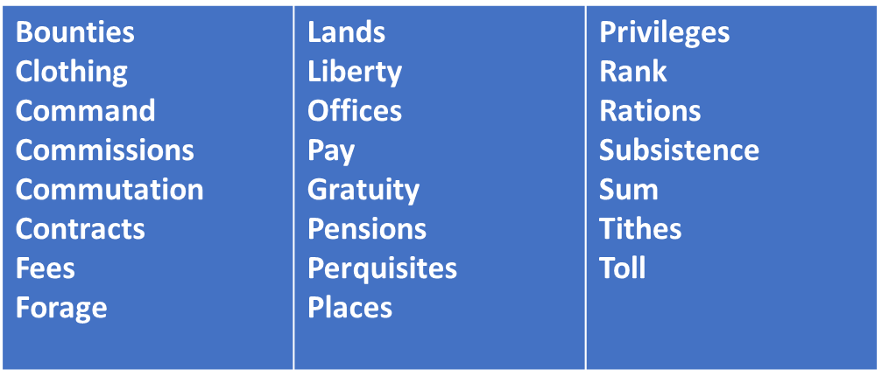
Nouns preceding other emolument(s) in coordinated Noun Phrases

Slide 29
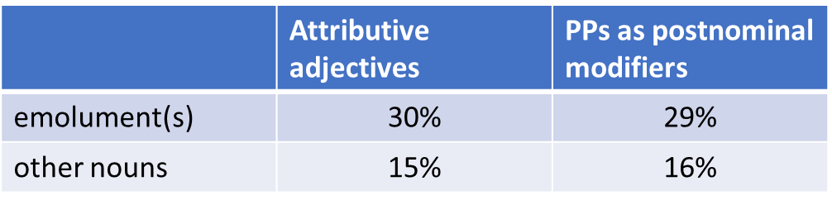
If emolument only refers to profit from office or employment…
H₂: Emolument(s) will require modification less frequently than the average noun (because the meaning is narrow and self-evident without modification)
Method: percent of emolument(s) pre-modified by adjectives or post-modified by prepositional phrases
Results:

Slide 30
If emolument only refers to profit from office or employment…
H₃: Emolument(s) will not be modified by adjectives related to official or government capacities (because these words would be redundant)
  *metal fork
Method: semantically classify attributive adjectives
Result: Emolument frequently pre-modified by adjectives related to official or government capacities
  official
  federal
  public

Slide 31
Alexander Hamilton, 1793
I shall regret your final determination to resign at the same time, that I should be wanting in candour were I to hold out to you the probability of any material increase of your present official emoluments.

Slide 32
If emolument only refers to profit from office or employment…
H₄: Emolument(s) will not be modified when communicating that something had been received or accepted “arising from an official’s services.”
Method: search for all cases of emolument within six words on either side of the words receive and accept
  Manually eliminate cases where emolument* was not the direct object
Result: Most were pre-modified or post-modified by a linguistic structure that served to further specify the meaning of emolument
  93% of the cases of receive emolument
  77% of the cases of accept emolument
  Many cases specifically referred to receiving or accepting an emolument for “services rendered pursuant to an office”
    and yet added words to emolument to so indicate

Slide 33
George Washington, 1798
I have finally determined to accept the Commission of Commander in Chief of the Armies of the United States … I must decline … that I can receive any emoluments annexed to the appointment

Slide 34
Conclusions
Emolument was a common word in the founding era
There is no evidence that there were two distinct senses of emolument
Emolument had a broad, inclusive meaning
The evidence suggests that revenue from hotel would have been considered an emolument

