Slide 1
“UNDER COLOR OF”
By: Maddy Caito

Slide 2
Section 1983 and Monroe
“Every person who, under color of any statute, ordinance, regulation, custom, or usage, …” deprives someone’s rights.
misuse of power, possessed by virtue of state law and made possible only because the wrongdoer is clothed with the authority of state law, is action taken ‘under color of’ state law.

Slide 3
Why does it matter?
Section 1983 is one of the most important laws enforcing civil rights in the United States
According to the Bureau of Justice Statistics: “one in every ten civil lawsuits is a Section 1983 lawsuit”

Slide 4
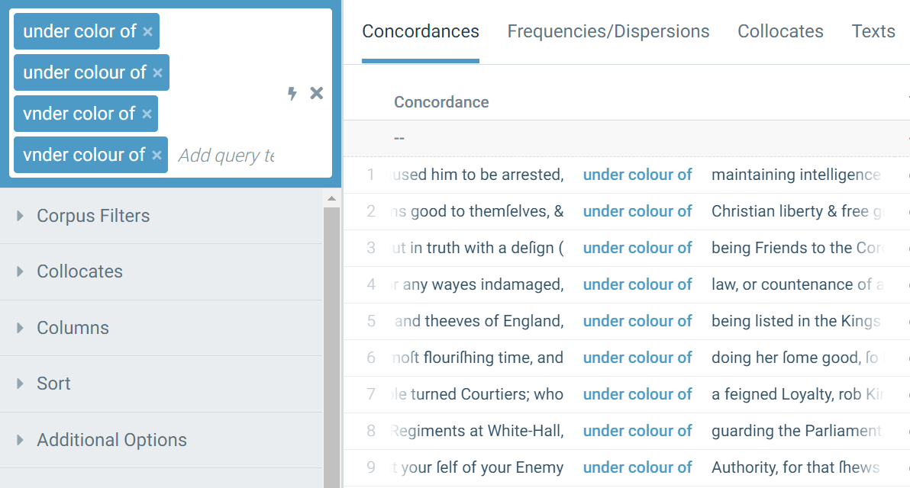
COEME and COFEA

Slide 5
What does the phrase mean?
The action is done under color of X,
but not really
The consequence of the action is unjust, unlawful, or “evil”
&

Slide 6
Verbs that Collocate with “Under Color of” “under color of */v”
Defending | …Princes strike at liberty, is the overturning the constitution under colour of defending it , and the punishing as rebels those who should attempt really to defend it.
Taking | [They] made him a Prisoner , under Colour of taking him into Protection ;
Going | To this end [the king]dispatched the Duke of Espernon (under colour of going to see his Mother, who being old, lived in Gascogne ) to confer with the King of Navarre…
Doing | and will themselves be [God’s] Agents even to kill men under colour of doing him good service .
Giving | …under colour of giving me more aire and liberty of breath , and seeking a cure for my present disease , they gave me a generall cure for all my diseases at once.
“appearing to do one thing, while actually doing another”

Slide 8
An action is taken under color of X, but not really
Intentional Deception
Undetermined
Intentional Abuse Of Power

Slide 10
Intentional Abuse Of Power
[ 91 ]
Our charters were “taken away under color of law; upon trial in courts of justice.”
“under color of law and the cloak of a general warrant”
“discover a disposition in their rulers, to subvert the principles of natural justice, and injure them of their just rights under color of law.”

Slide 11
Intentional Deception
[ 75 ]
“a man knowen to be a protestant, was murthered in his owne house, by a company of bluddie ruffians that came under colour of friendship to visit him.”
“how the Greeks made an Horse of brasse, wherein they put a thousand armed Knights; and under color of peace, brought it into Troy, by the which it was utterly destroyed forever.”
“attempted innovations in government under color of law,”

Slide 12
Undetermined
[ 34 ]
“with such as the humble House shall join be a Committee to treat with the Persons who under color
of a title from this Government have entered into possession of the Lands mentioned in this Petition ….”

Slide 13
The consequence is is unjust, unlawful, or “evil:”
[ 136 ]
“It is restricted by no rule to particular evils, and until the contrary is proved, it has a right to vacate any act committed under colour of law, directly contrary to that law; and more especially when this act tends to oppression, and to deprive the inhabitants of the free exercise of their elective franchise.”

Slide 14
Conclusion
The action is under color of some power when really it is not according to that power.
It is really an intentional deception
It is really an abuse of power
The consequence of the action is unjust, unlawful, or otherwise evil.

Slide 15
Further Research is Needed

Slide 16
Narrow
Only action taken pursuant to law
Examples: Zagran, Scalia
Broad
Action taken in violation of, or pursuant, to law
Examples: Monroe v. Pape, Winters

Slide 17
The Phrase does have a idiomatic meaning.
Notes:
For a phrase to be idiomatic, the phrase itself must have a meaning unique from the individual words alone

Slide 18
Initial searches:
“Under Color Of”
Raw Frequency
COEME
3,516
COFEA
342
Notes:
Initially, to get an idea for the phrase and it’s usage I did a raw frequency search in each corpus
This shows that the phrase appears with some frequency.

Slide 19
indiviual words
color | 6080 | colour | 95,215 | Total:
under | 651,183
color of | 876 | colour | 19,358 | Toal:
under *of | 22,438 | pretence (pretense) | 6109 (67) | Total: | pretenses: 81
 |  | cover | 291
 |  | colour (color) | 2257 | Total: 342
 |  | convoy | 78
 |  | pretext | 662
 |  | command | 306
 |  | authority | 0
 |  | sanction | 0
 |  | grants | 0
 |  | comand | 306
 |  | countenance | 0
* color of | 876 | the | 441 | * colour of (19358) | the - 1977
 |  | under | 38 | 2257
 |  | vnder | 31 | 1221
 |  | or | 17 | 461
 |  | a | 17 | 660
 |  | by | 14 | 792
 |  | and | 13 | 750
 |  | any | 6 | 704
 |  | no | 5 | 455
 |  | or |  | 461
 |  | some |  | 223

Slide 20
Under color of ≠ hue
(the color of the sky)
“Color of” 20,234
“Under Color of” 3,516
Notes:
I then compared the target phrase the frequency and use of it’s individual parts
Color of appears much more frequently than under color of
And when color of is used, it means the hue of a thing, not that something is “colored by law”

Slide 21
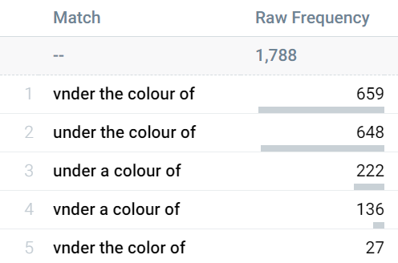
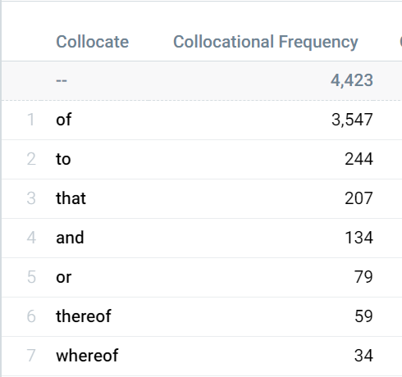
“under * color of”
“under color ”
Notes:
I then searched the phrase to see if there are any words that appear within the phrase, which would mean that it is not these three words that have a special meaning
I found that whenever a word appears within the target phrase it is an article or an adjective and does not change the meaning

