Slide 1
A CORPUS LINGUISTICS ANALYSIS OF THE “RIGHT TO/OF PRIVACY”
Stephanie Miller

Slide 2
Agenda
Introduction of the Phrase
Why This Inquiry is Important – Case Law
Prevalence of the Phrase (surprise ahead!)
Public Meaning Analysis of “privacy”
The Future Use of a “Right to Privacy”

Slide 3
Introduction: A Right to/of Privacy
Roe v. Wade
So, where did the phrase come from? The word privacy is not in the Constitution nor any amendments.
My research showed origins of the phrase as far back as 1849. Prince Albert and Queen Victoria sought an injunction for their property rights

Slide 4
Why should we care?
Cases that relied on this elusive right:
How our children are educated (Meyer v. Nebraska 1923)
Contraception (Griswold v. Connecticut 1965)
Inter-racial marriage (Loving v. Virginia 1967)
Abortion (Roe v Wade 1973)
Same-sex marriage (Obergefell v. Hodges 2015)

Slide 5
Linguistics: Prevalence of the phrase
~COFEA (1760-1799) reveals no instances of “right to/of privacy”
~COHA (1820-1910s)
Decade Term | 1840 | 1850 | 1860 | 1880 | 1890 | 1900 | 1910 | 1920 | 1940 | 1950 | 1960 | 1970 | 1980 | 1990 | 2000 | 2010 | Total
Frequency “of” | 0 | 0 | 0 | 1 | 22 | 3 | 0 | 1 | 2 | 8 | 4 | 21 | 3 | 4 | 2 | 1 | 72
Frequency “to” | 1 | 1 | 1 | 0 | 1 | 1 | 1 | 0 | 1 | 1 | 2 | 14 | 11 | 32 | 17 | 16 | 100
Total | 1 | 1 | 1 | 1 | 23 | 4 | 1 | 1 | 3 | 9 | 6 | 35 | 14 | 36 | 19 | 17 | 172

Slide 6
The Corpus of Supreme Court Opinions of the United States (COSCO-US), which houses all opinions since the founding of the court in 1789 to 2016.
Decade Term | 1920 | 1930 | 1940 | 1950 | 1960 | 1970 | 1980 | 1990 | 2000 | 2010 | Total
Frequency “of” | 3 | 1 | 19 | 23 | 67 | 108 | 28 | 23 | 10 | 7 | 289
Frequency “to” | 0 | 0 | 4 | 6 | 32 | 42 | 46 | 10 | 10 | 2 | 152
Total | 3 | 1 | 23 | 29 | 99 | 150 | 74 | 33 | 20 | 9 | 441
Here, the phrase was used 441 times in 90 years by a miniscule subset of society - Supreme Court Justices

Slide 7
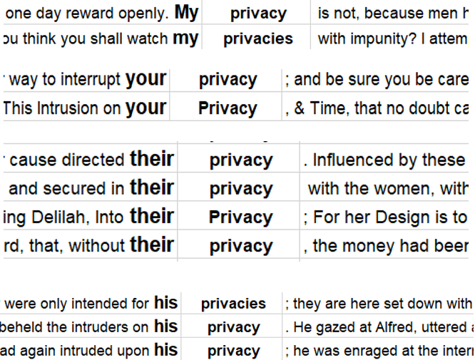
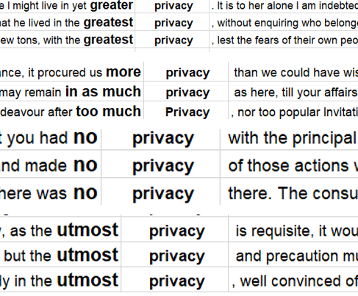
Lines with “privacy” and the lemma “privacies” located in the Corpus of Founding Era American English (COFEA), which contains over 136 million words written from 1760-1799.
Subtitle
possessive personal pronouns
“privacy” does not appear to be binary, range.

Slide 8
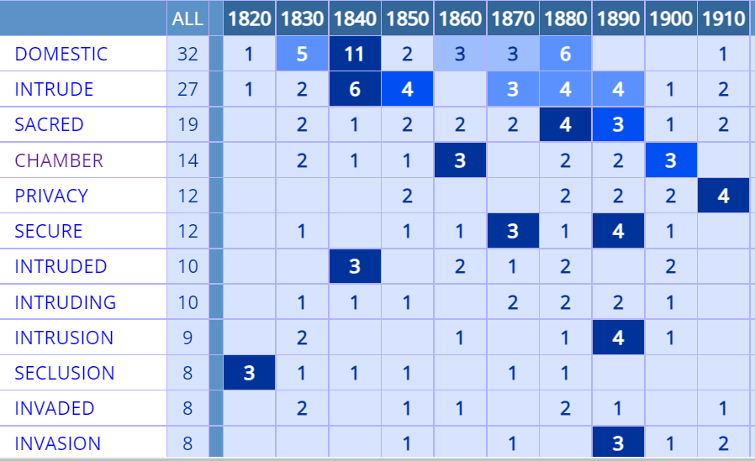
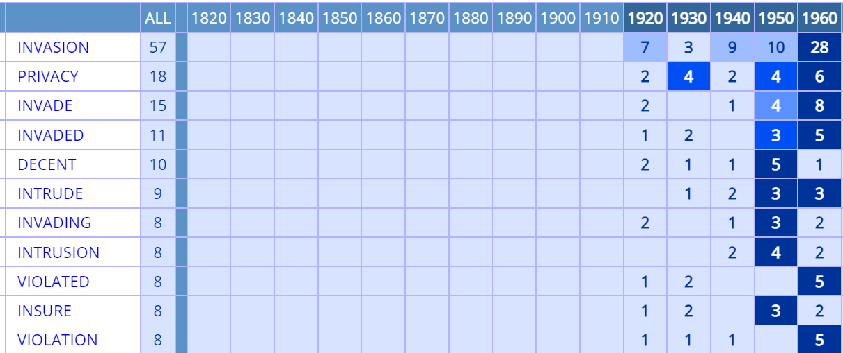
The Frequency of “Privacy” from the 1820s to 2010s
6,011 results are much more data than the phrases “right to/of privacy” came up with.
Below are the collocates, or words that are frequently found in conjunction with, “privacy” among ordinary citizens

Slide 9
The Meaning and Use of “Privacy” from the 1820s to 2010s
The Corpus of Historical American English (COHA),
“Privacy” in COHA based on percentage of available words for each decade from the 1820s to the 2010s

Slide 10
Qualitative analysis of the collocate from 1820 to 1890 reveals . . . .

Slide 11
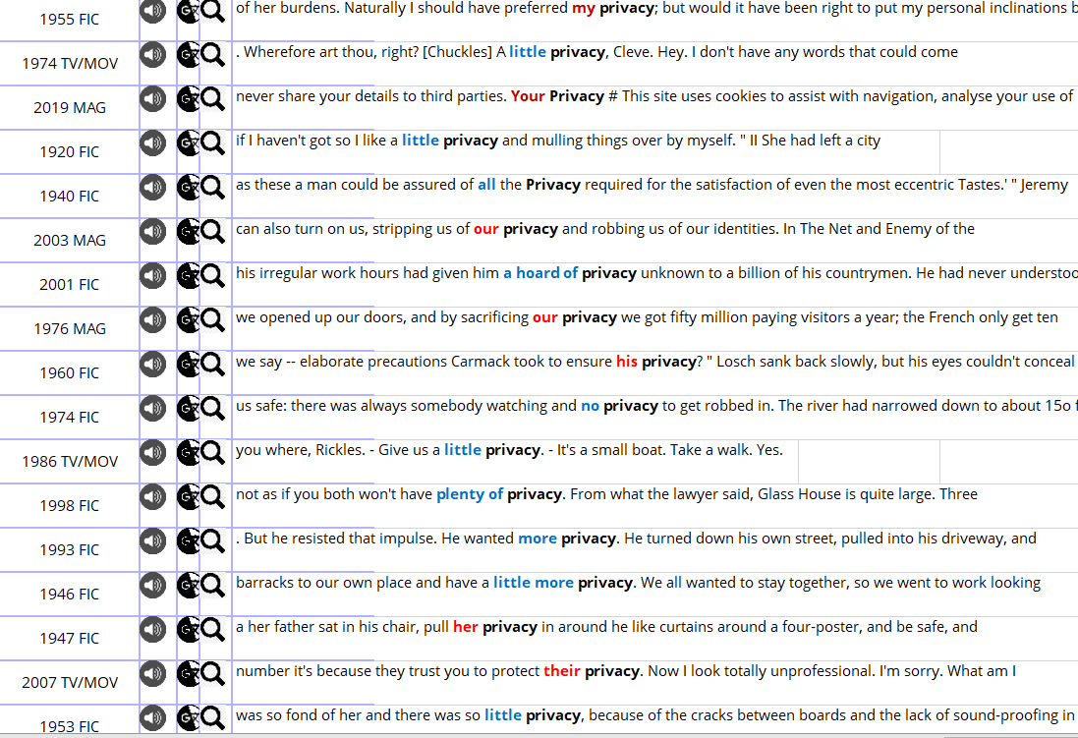
TABLE 11: Concordance lines for “privacy” in COHA (red is possessive) (blue is amount)

Slide 12
100 randomized lines of data from 1820 to 1849 downloaded from COHA
Privacy
Circumstantial
Spatial
Temporal
Personal
???
General
Occasional

Slide 13
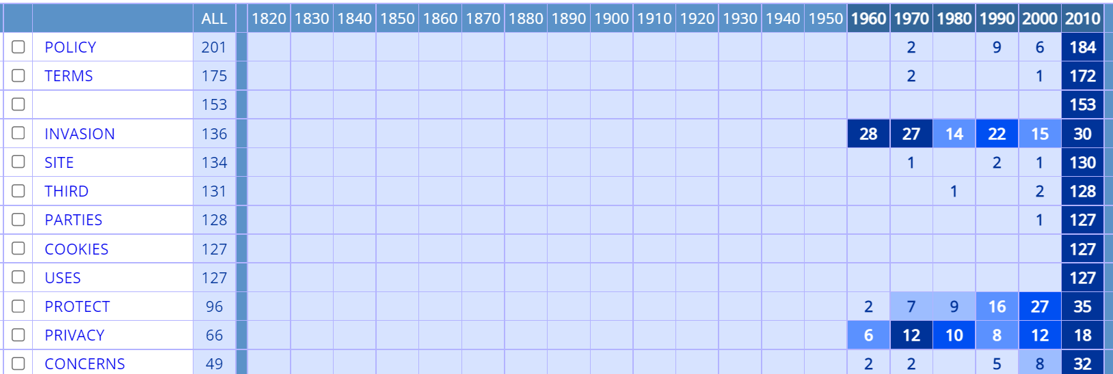
The Future of “Privacy” Rights and Concerns

Slide 14
Could the “Right to/of Privacy” Be Tamed in the Near Future?
This academic endeavor is even more relevant than it was 47 years ago when Roe v. Wade was decided. For, many cases pending before the Supreme Court could potentially altar the right.
Constitutional scholar, Eric Segall, pleads for an end to the current power of The Supreme Court and its “life-tenured, unelected judges having the power to veto laws passed by voters and legislators.”
Brian Slocum says it well, “language is exciting; history is fascinating. Those disciplines have much to offer legal interpretation by judges, and we implore jurists to engage with their critics

Slide 15
Thank You For Coming!
If Roe is overturned, or the “right of privacy” is deemed to not cover abortions, what happens to all the issues decided as a result of this penumbral right?
What if the term and Roe withstand stand these 2 upcoming challenges?
While the Supreme Court receives many criticisms on all political sides claiming Justices’ personal beliefs inappropriately influence legal decisions, they are put in a position where criticism is impossible to avoid.
You now have the right to ask questions . . .

