Slide 1
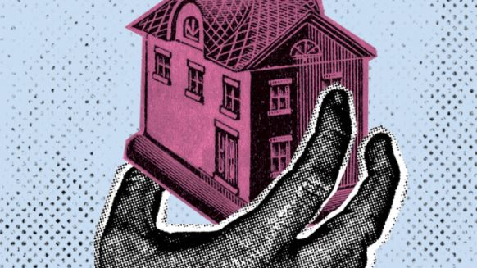
A Corpus Linguistics Quest for The Ordinary Meaning of “Public Use” in the Fifth Amendment

Slide 2
8 East Street, New London, Connecticut

Slide 3
1997: Susette Kelo purchases property
1998: Pfizer announces research facility in financially struggling New London but needs land for facility
2000: New London condemns property
8 East Street, New London, Connecticut

Slide 4
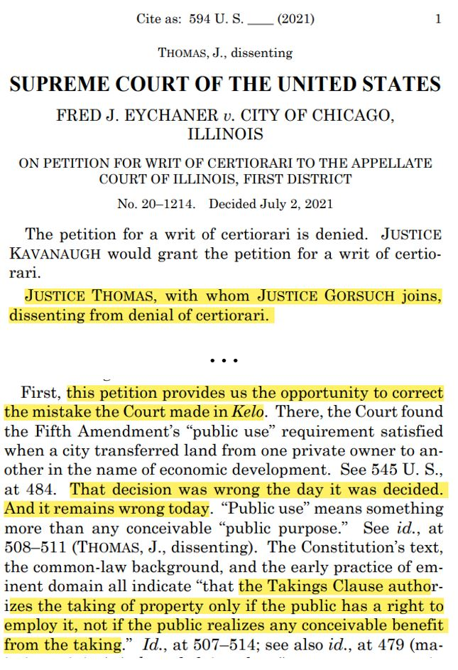
Kelo v. City of New London, 545 U.S. 469 (2005)
5th Amendment: “…nor shall private property be taken for public use, without just compensation.”
Held (5-4): Economic development = public use
Justice Thomas, dissenting: “the Takings Clause authorizes the taking of property only if the public has a right to employ it, not if the public realizes any conceivable benefit from the taking.”

Slide 5
Public Use
Research Question: What was the original meaning of “public use” in the Fifth Amendment?
Majority:
Public use = Broad
Thomas Dissent:
Public use = Narrow
Court splits over meaning of “public use”
Virtually no focus on actual texts produced in Founding Era…

Slide 6
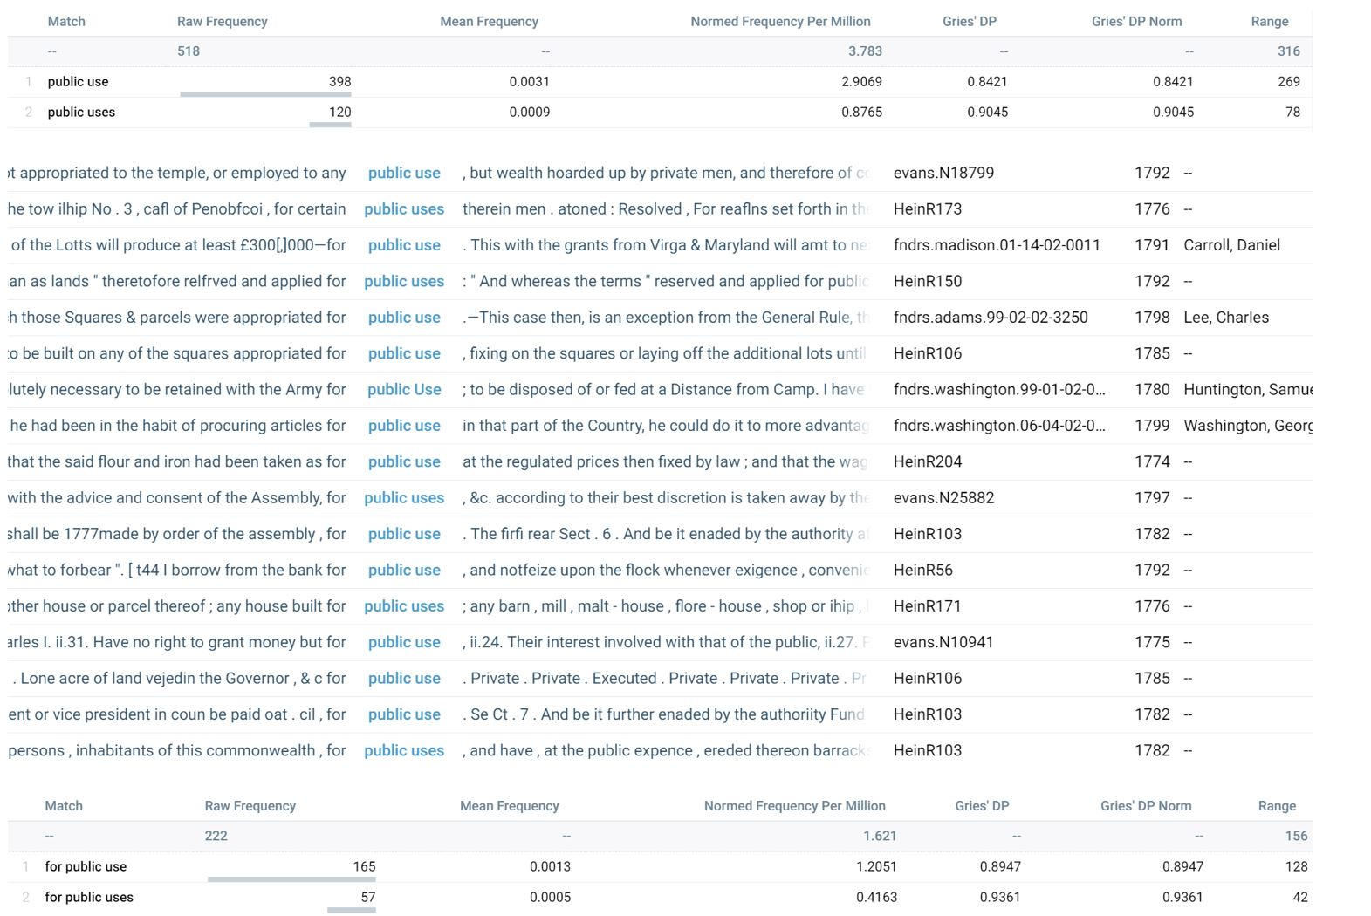
Public Use
518 instances of “public use(s)”
Sorted two places to left, noticed “for” frequently precedes phrase
222 instances of “for public use(s)”

Slide 7
…to (briefly) illustrate this cognitive observation
Context is key to understanding the meaning of “use” in “for public use”
Use
Use
Vs.
-----

Slide 8
Results
Manual Analysis:
Analyzed 187 lines
Coded categories of nouns:
real or personal property
processed and unprocessed
Categorized 161 lines
Real Property
Personal Property
Buildings (10)
Paper(s) (7)
Signposts (2)
Highway (5)
Articles (6)
Blankets (1)
Houses (3)
Horses (5)
Books (1)
Barracks (1)
Hospital Stores (5)
Boxes and Clothing (1)
Processed
Farm and House (1)
Liquor (5)
Medal boxes (1)
Rooms (1)
Boat(s) (3)
Oxen (1)
Supplies (3)
Salted Meat (1)
Goods (2)
Shirts (1)
Salt (2)
Sprouts (1)
Powder and Lead (2)
Land (52)
Money (27)
Materials (2)
Un
processed
Grain (4)
Wood (2)
Flour (2)
Fossils (1)

Slide 9
 | Real Property | Personal Property
Processed | Buildings (10) Highway (5) Houses (3) Barracks (1) Farm and House (1) Rooms (1) | Paper(s) (7) Signposts (2) Articles (6) Blankets (1) Horses (5) Books (1) Hospital Stores (5) Boxes and Clothing (1) Liquor (5) Medal boxes (1) Boat(s) (3) Oxen (1) Supplies (3) Salted Meat (1) Goods (2) Shirts (1) Salt (2) Sprouts (1) Powder and Lead (2)
Resolved that the Secretary at War take order for selling all the remainder of the public buildings at Carlisle which may not in his opinion be necessary for public use.
…among other Goods, fit for the Army, are 4,000 Blankets, an article exceedingly wanted by the Troops. He has therefore ordered Messrs Livingston & T[urn]bull to purchase the whole for Public use….

Slide 10
And be it further enacted, That it shall and may be lawful for the person administering the government of this state, to reserve for public uses such and so many of the said lots [land] as he shall judge proper...
…from and after the end of this present session of Assembly such person as shall be chosen by the joint ballot of the two Houses of Assembly shall be Treasurer of the revenues arising from the taxes on lands and tithables, and of all other public money payable into the treasury of this state for public uses, by virtue of any acts of Assembly or ordinances of Convention….
 | Real Property | Personal Property
Unprocessed | Land (52) | Money (27) Materials (2) Grain (4) Wood (2) Flour (2) Fossils (1)

Slide 11
Takeaways
“What” is “for public use” provides context for “use”
1
2
“What” is “used” informs “how” we should conceptualize “public use”
3
Our research suggests that “public use” was a very inclusive term in the Founding Era, encompassing more than just actual use.

Slide 12
use noun Vs. verb
“Use” in “for public use” = action-noun
Neurolinguistic research confirms action-nouns are more semantically related to verbs
Hence: “Use what?”

