Slide 1
Nonpartisan Originalism
Clark D. Cunningham
W. Lee Burge Chair in Law & Ethics
Georgia State University College of Law www.ClarkCunningham.org
ACS Constitutional Law Scholars Forum
Friday, March 1, 2019
Dwayne O. Andreas School of Law, Barry University
Orlando, Florida
This presentation available at
www.clarkcunningham.org/NonpartisanOriginalism.html

Slide 2
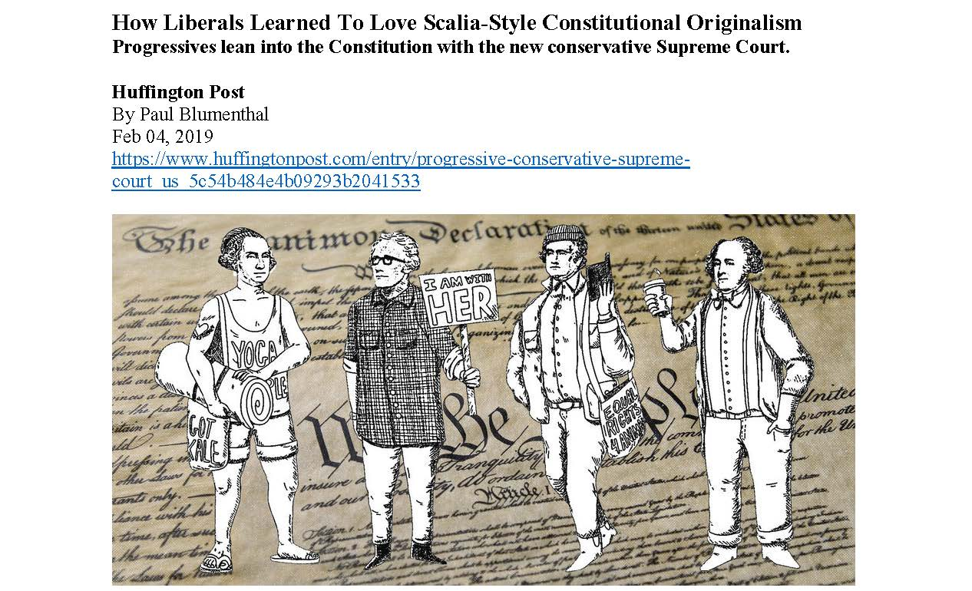

Slide 3
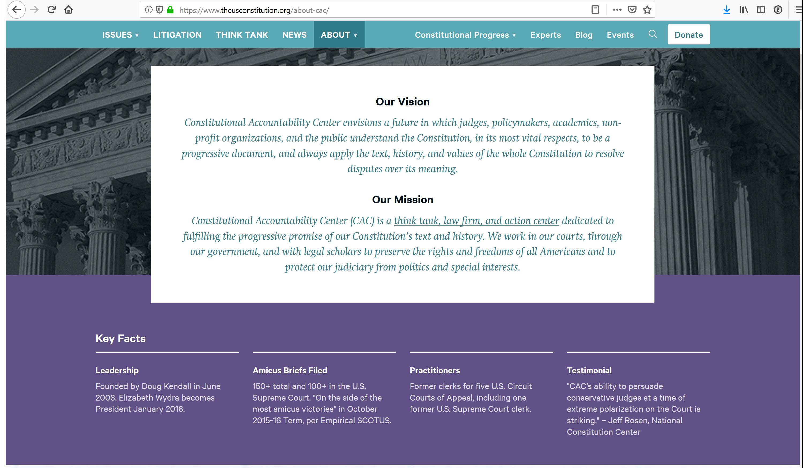

Slide 4
Constitutional Accountability Center
Founded in 2008 by Doug Kendall
Kendall argued that the debate over how judges should interpret the law was over
Textualism had won
It was time to join the fight over the meaning and interpretation of the Constitution

Slide 5
Justice Elena Kagan
“I think we’re all textualists now in a way that just was not remotely true when Justice Scalia joined the bench.”

Slide 6
Brianne Gorod, chief counsel for CAC:
“Our founding belief was that
if progressives spent less time fighting about the method of interpreting the Constitution with conservatives,
we could spend more time discussing what the Constitution actually means”
“And that that’s a fight that progressives can win.”

Slide 7
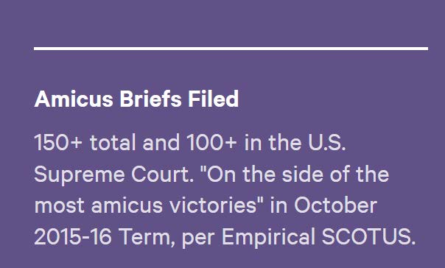
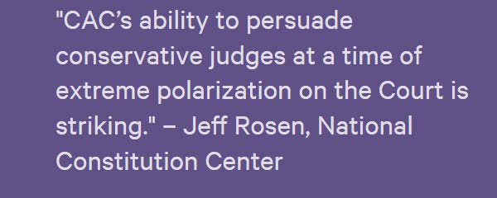
From the CAC Home Page

Slide 8
The Supreme Court Just Handed a Big, Unanimous Victory to Workers.
Wait, What? https://slate.com/news-and-politics/2019/01/gorsuch-arbitration-labor-new-prime-oliveira.html
By Mark Joseph Stern
Jan 15, 2019
“The Supreme Court handed a victory to American workers, ruling unanimously that independent contractors who work in transportation may not be forced into mandatory arbitration.
The decision is a remarkable win for labor rights from a court that typically favors corporate interests over working people.
It will allow hundreds of thousands of contractors to vindicate their rights in court, collectively, rather than in costly and unjust arbitration.
Armed with old dictionaries and common sense, progressive attorneys scored the biggest blow against mandatory arbitration in years.”

Slide 9
NEW PRIME INC., v. OLIVEIRA
139 S.Ct. 532 (2019)(Gorsuch, J.)
The decision marks the triumph of the Gorsuch brief—designed to nab the justice’s vote by fixating on the text of a statute and its meaning at the time of passage.
Gorsuch appears to draw heavily from an amicus brief filed by the Constitutional Accountability Center
The brief dwells on the dictionaries that Gorsuch cites and even dives into the etymology of the word employment, from its Latin roots to its evolution through French and Anglo-Norman usage in the Middle Ages.
The Constitutional Accountability Center provided enough arcane evidence to satisfy Gorsuch that, in 1925, the word employment did not distinguish between employers and contractors.

Slide 10
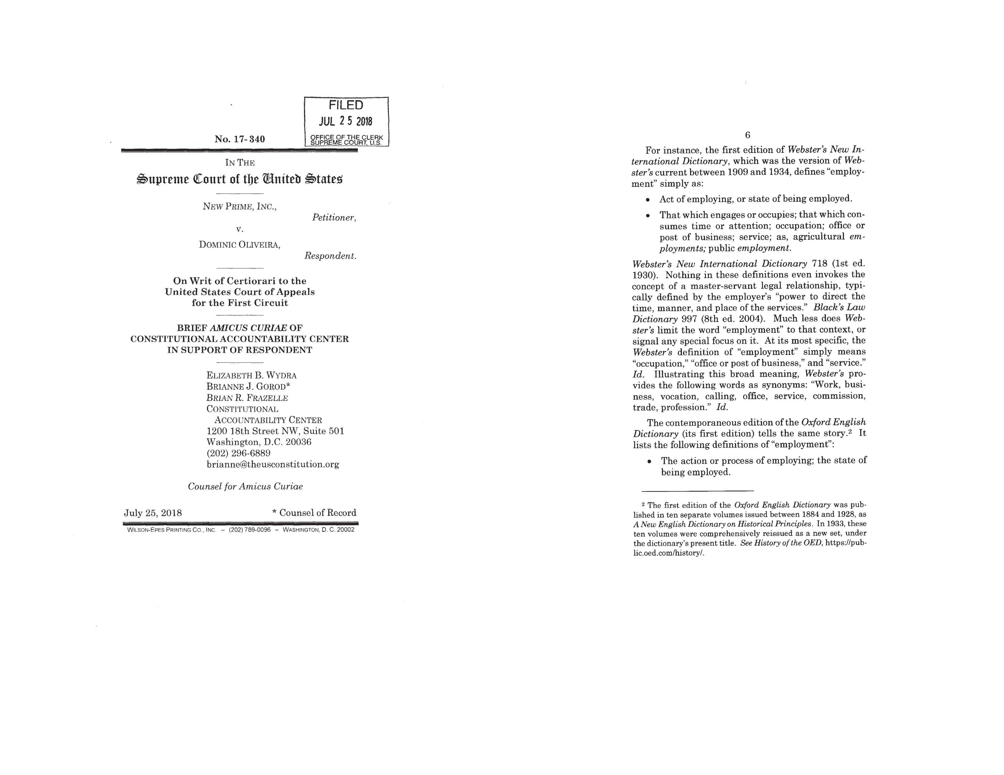

Slide 11
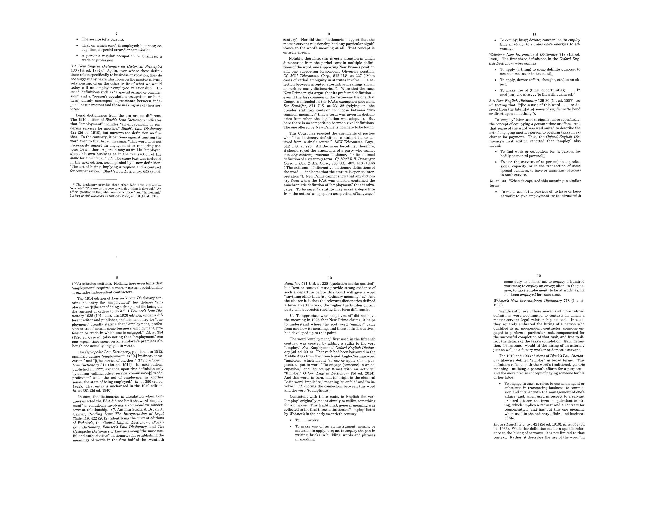

Slide 12
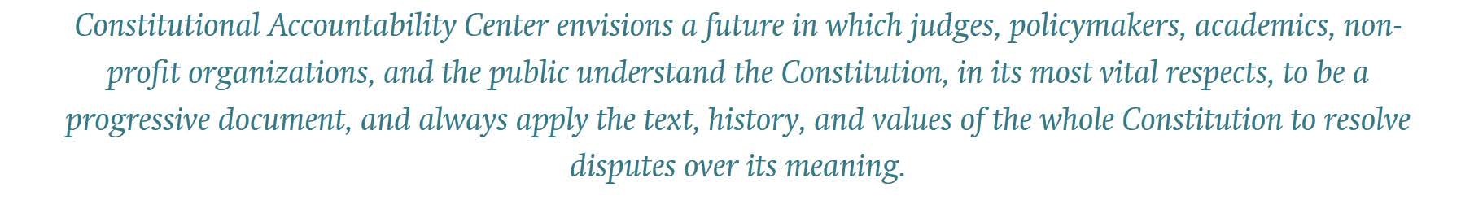

Slide 13
We the People of the United States,
in Order to ….
secure the Blessings of Liberty
to ourselves
and our Posterity,
do ordain and establish this Constitution for the United States of America.

Slide 14
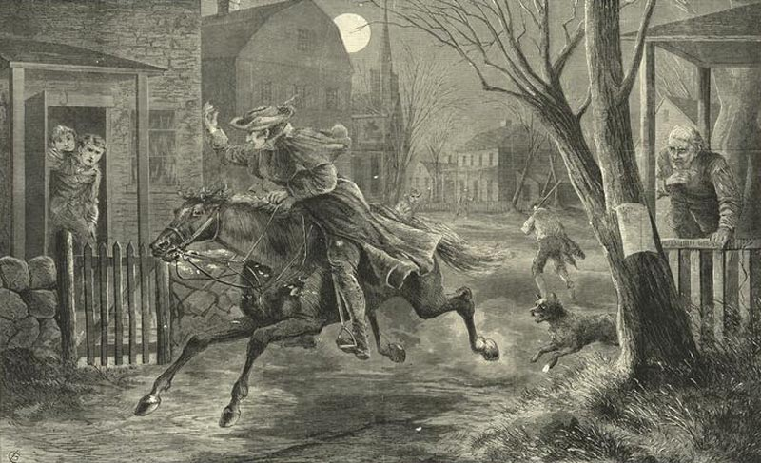
Paul Revere

Slide 15
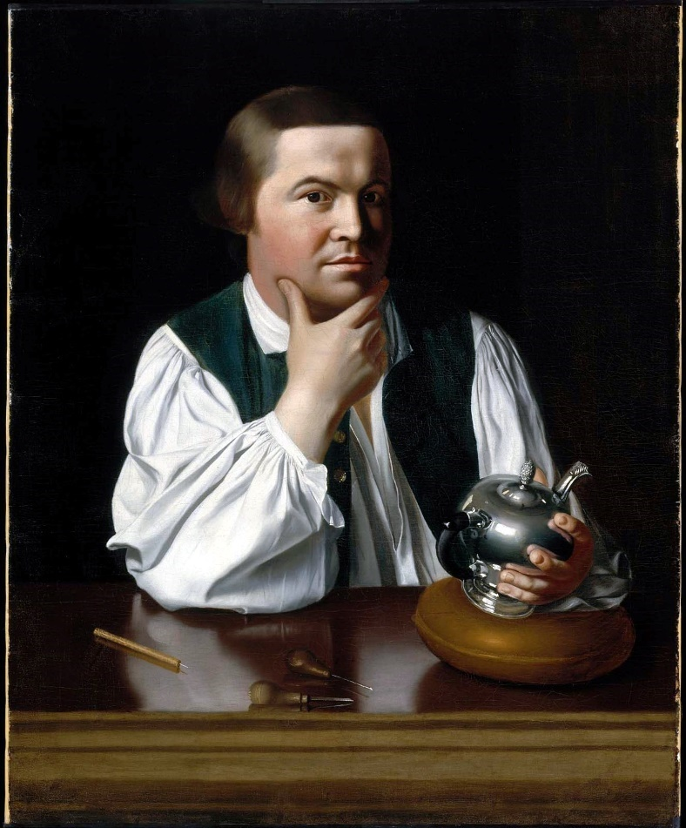
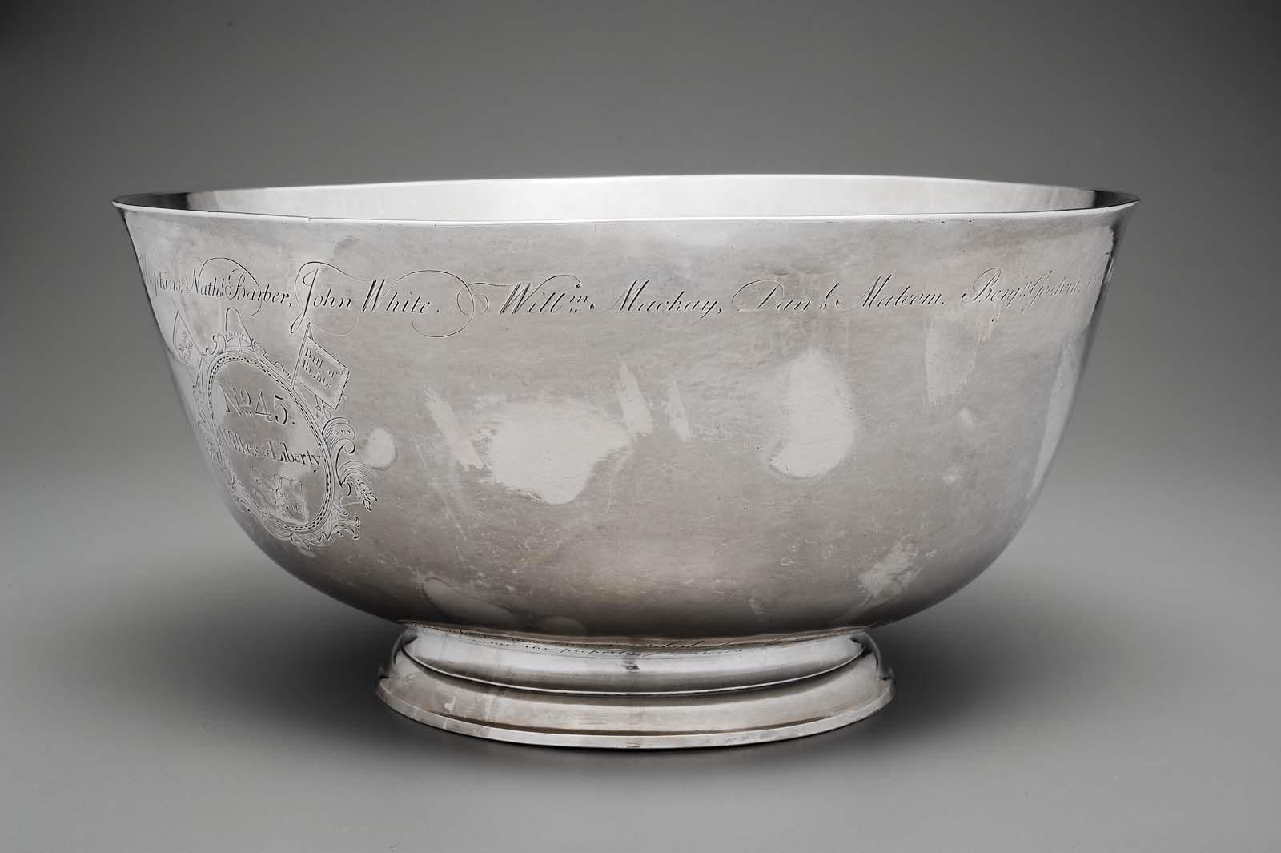
Liberty Bowl (1768)

Slide 16
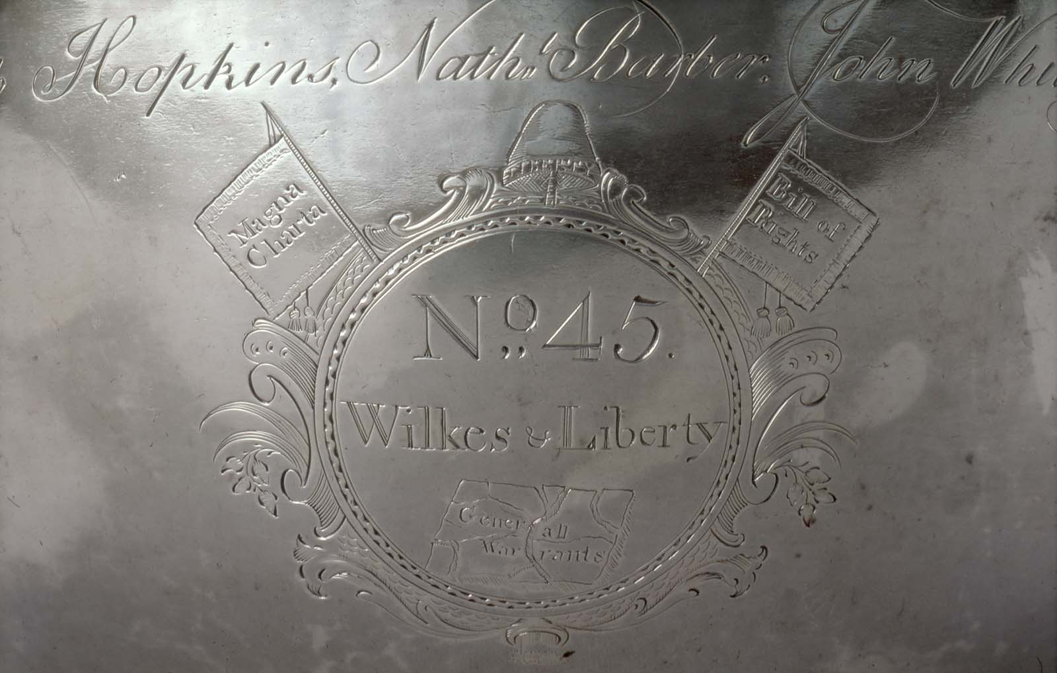

Slide 17
Fourth Amendment
“The right of the people to be secure in their … papers …
against unreasonable searches and seizures
shall not be violated”

Slide 18
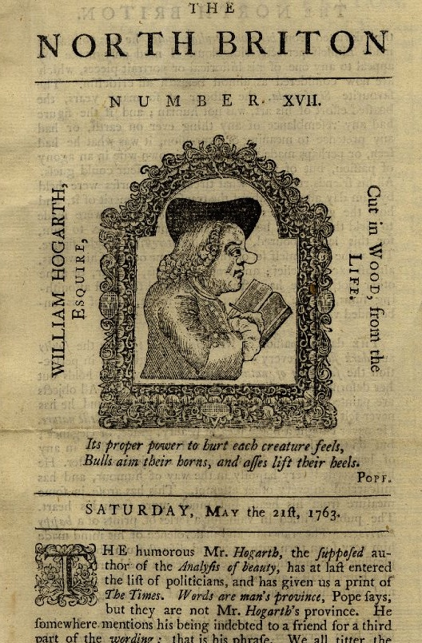
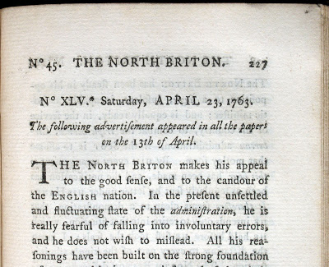
England April 23, 1763

Slide 19
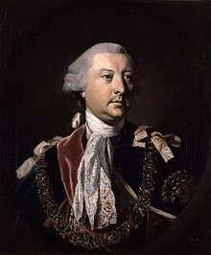
Lord Halifax, Secretary of State: Warrant
make strict and diligent search for the authors, printers and publishers of a seditious and treasonable paper
entitled the North Briton, Number 45

Slide 20
Lord Halifax Warrant
and any of them having found
apprehend and seize
together with their papers

Slide 21
Wilkes’ Attorney
This case extended far beyond Mr. Wilkes personally
It touched the liberty of every subject of this country
Of all offences that of a seizure of papers was the least capable of reparation

Slide 22
Wilkes’ Attorney
And for the promulgation of our most private concerns, affairs of the most secret personal nature, no reparation could be made
The law never admits of a general search warrant
Even in the Inquisition itself, they never delegate an infinite power to search

Slide 23
Fourth Amendment
“no Warrants shall issue,
but upon probable cause, supported by Oath or affirmation,
and particularly describing the place to be searched,
and the persons or things to be seized.”

Slide 24
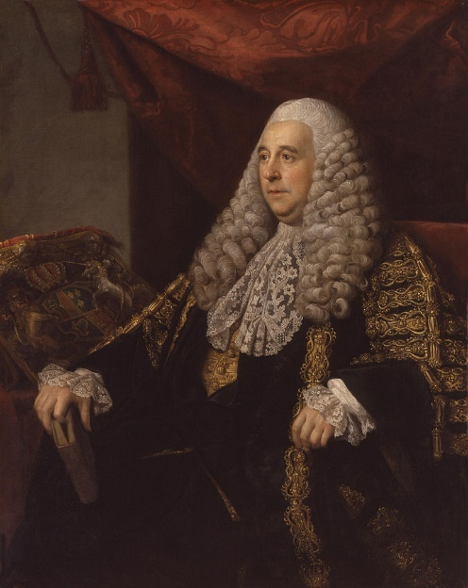
Chief Justice Pratt (later Lord Camden)
was a point of the greatest consequence I have ever met with in my whole practice
“such a power
is totally subversive of liberty”

Slide 25
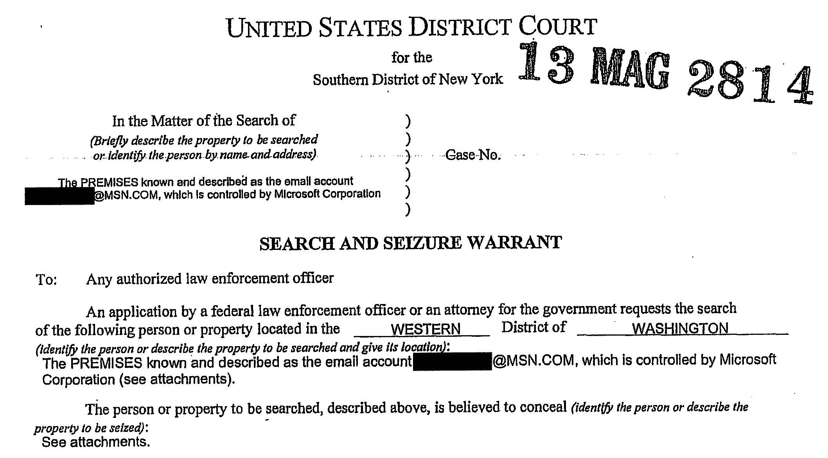

Slide 26
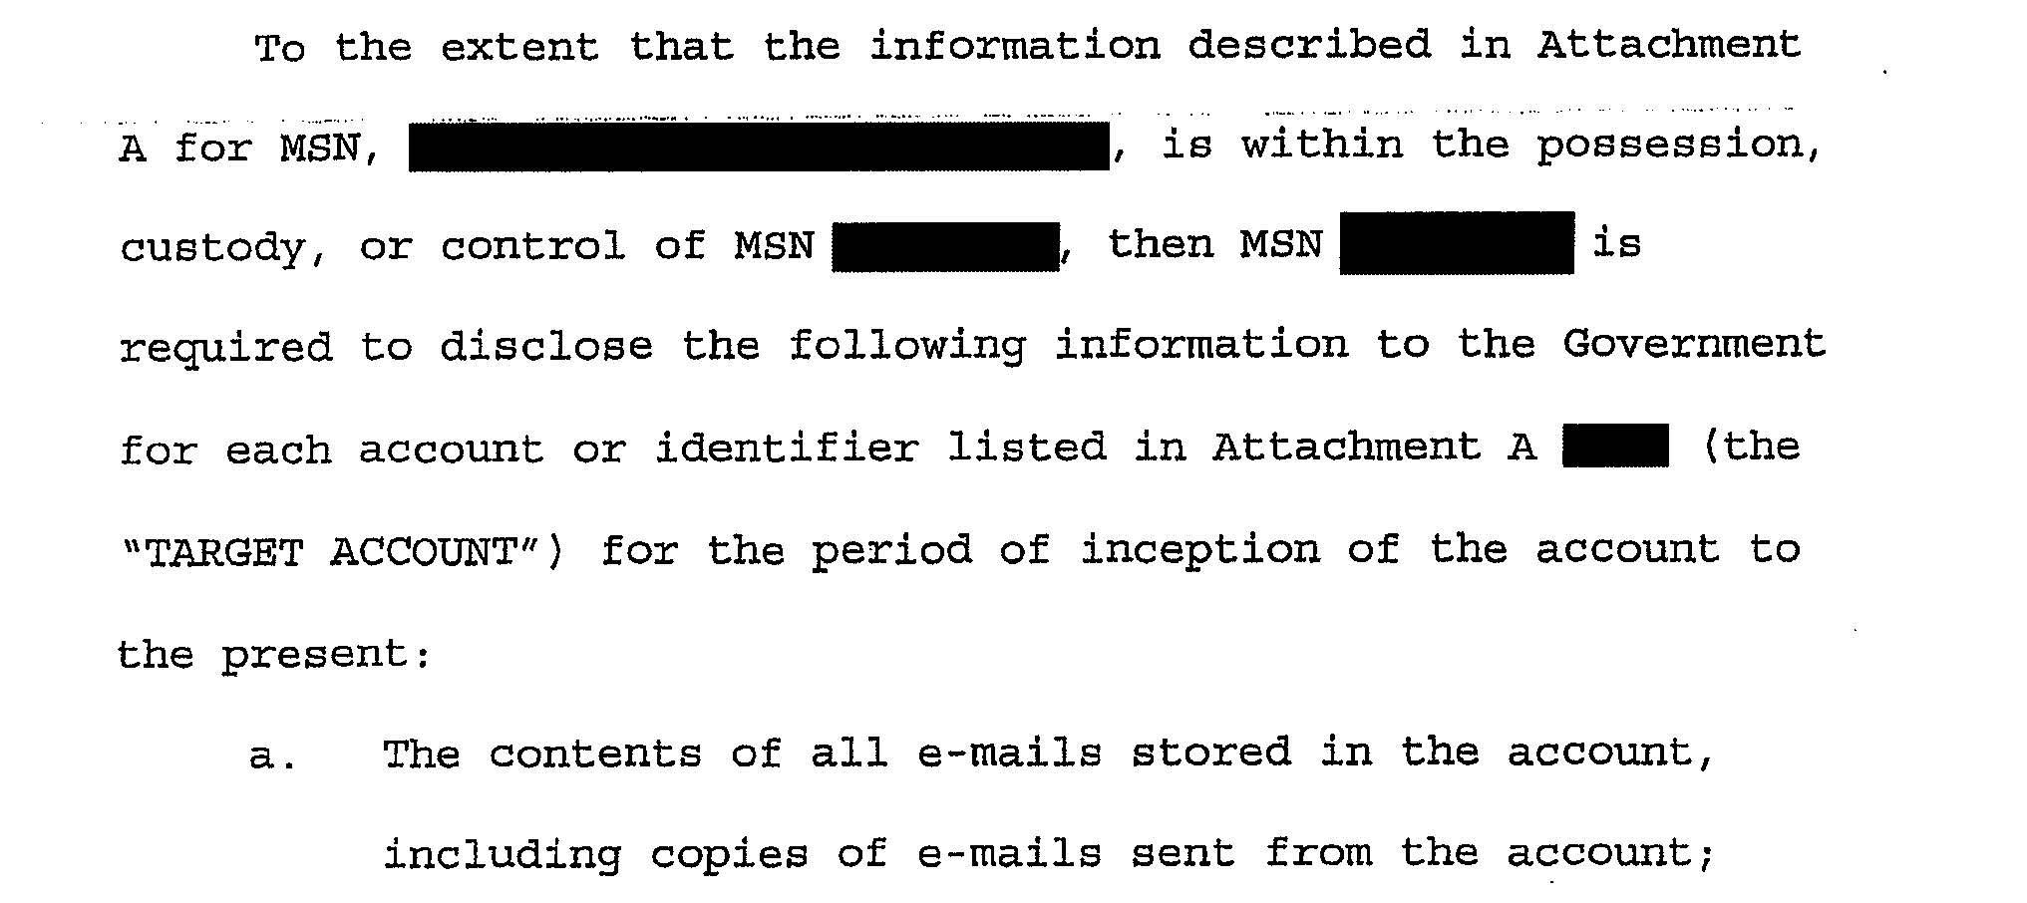

Slide 27
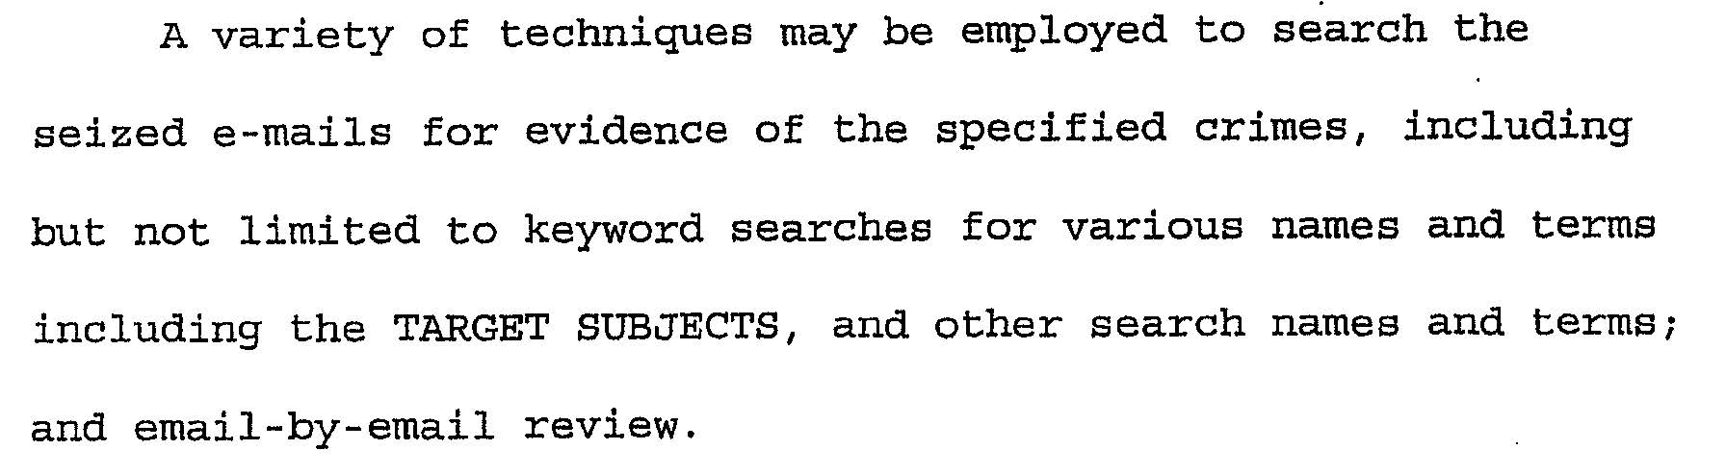

Slide 28
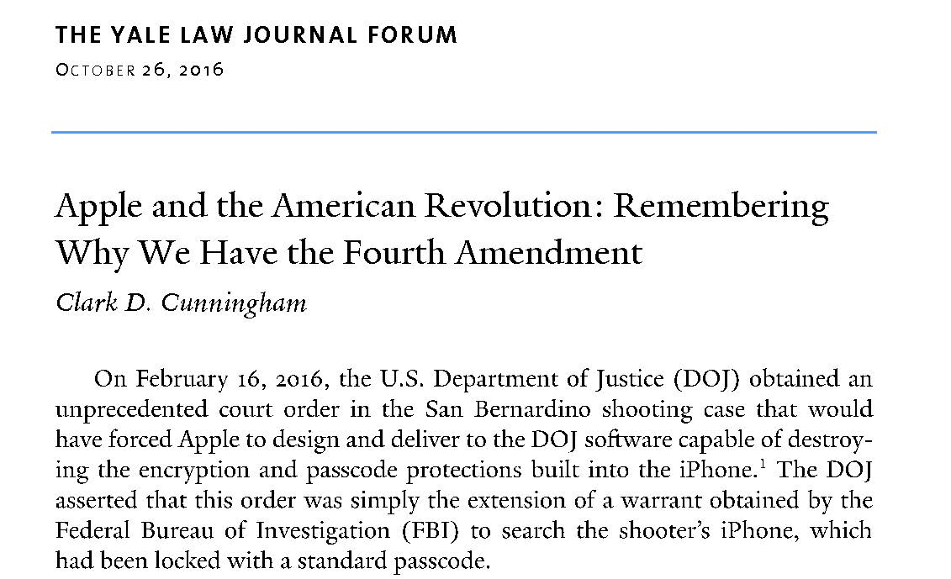
www.yalelawjournal.org/forum/

Slide 29
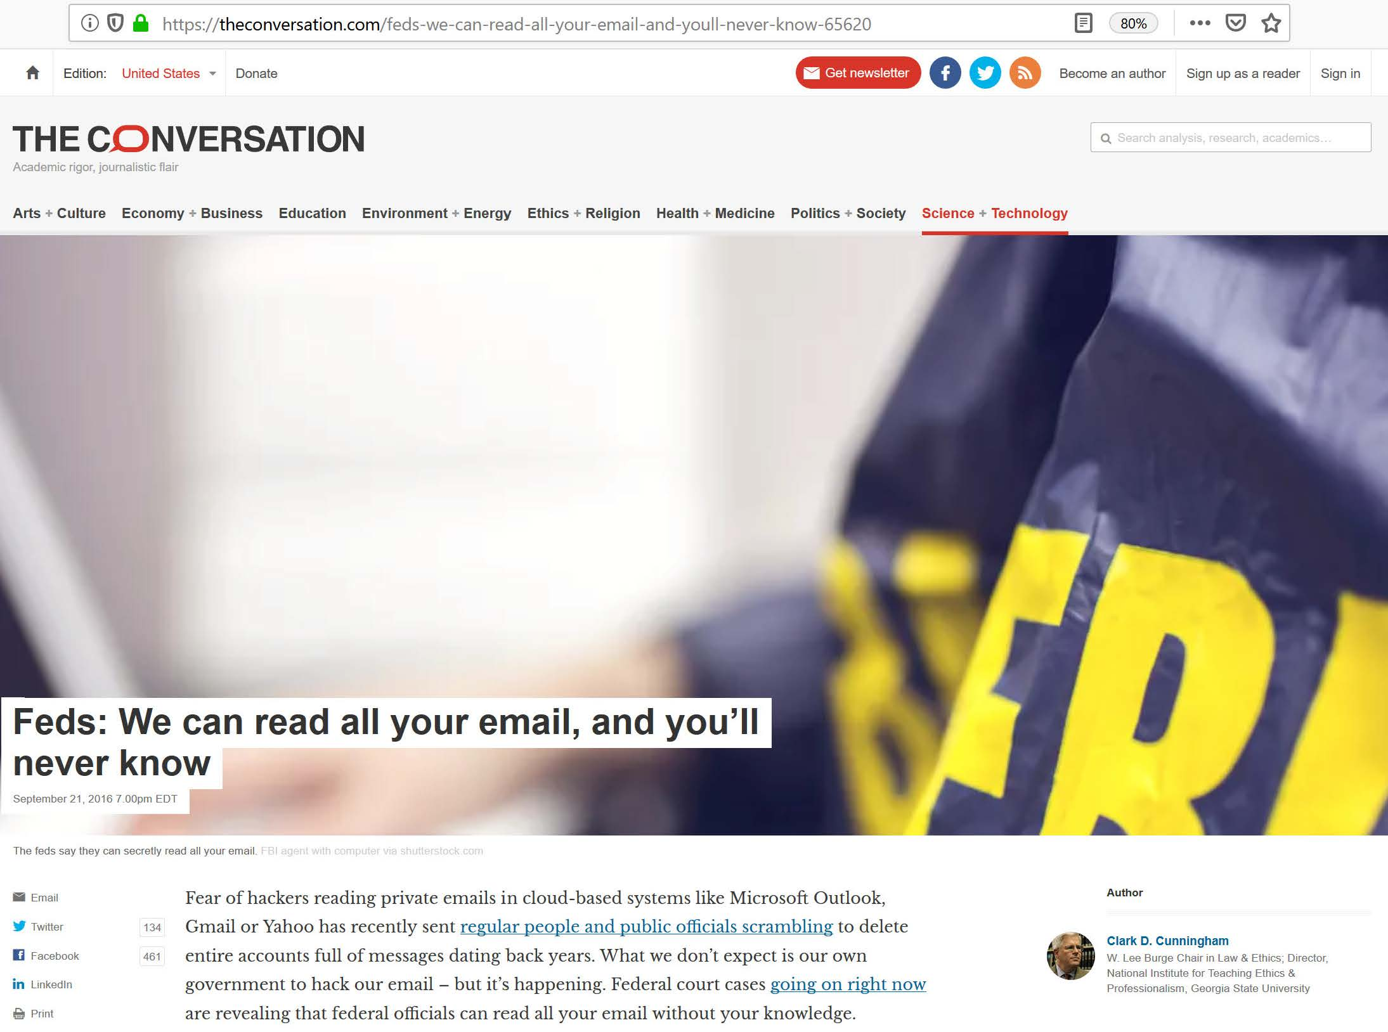

Slide 30
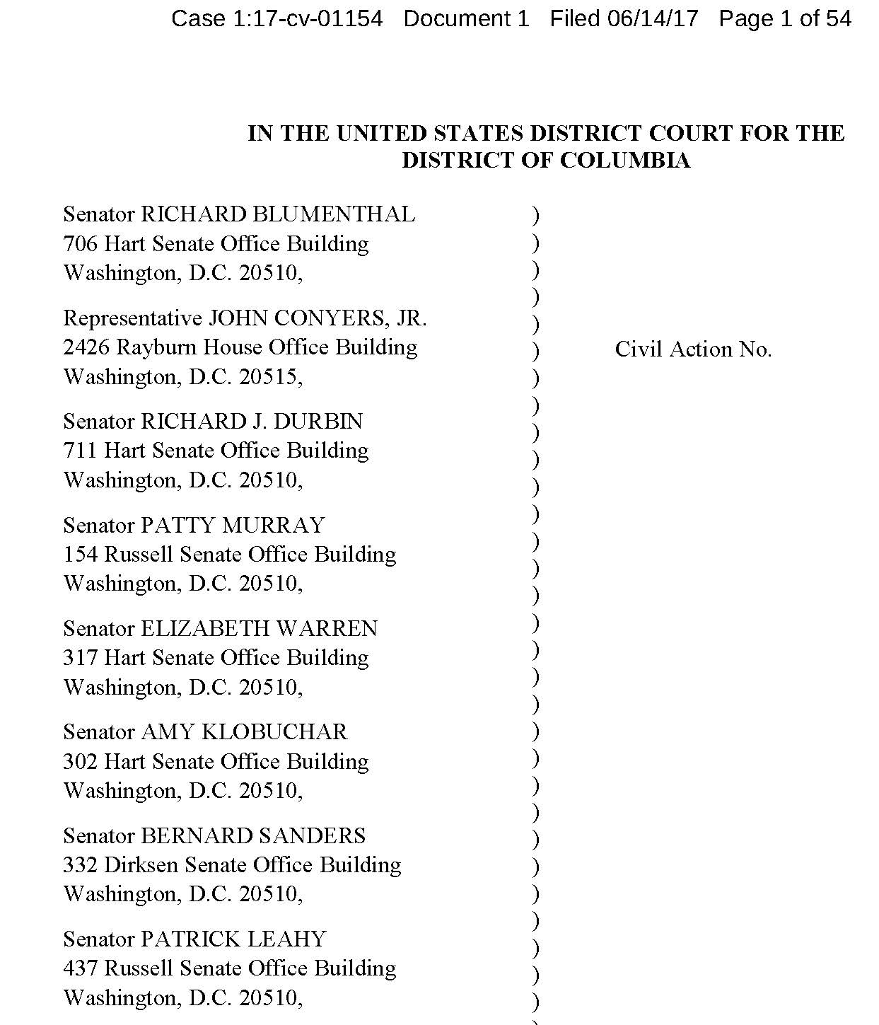
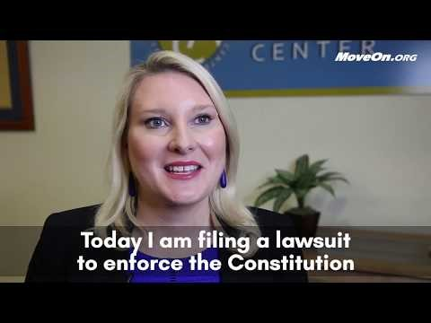
Blumenthal v Trump (D.DC)

Slide 31
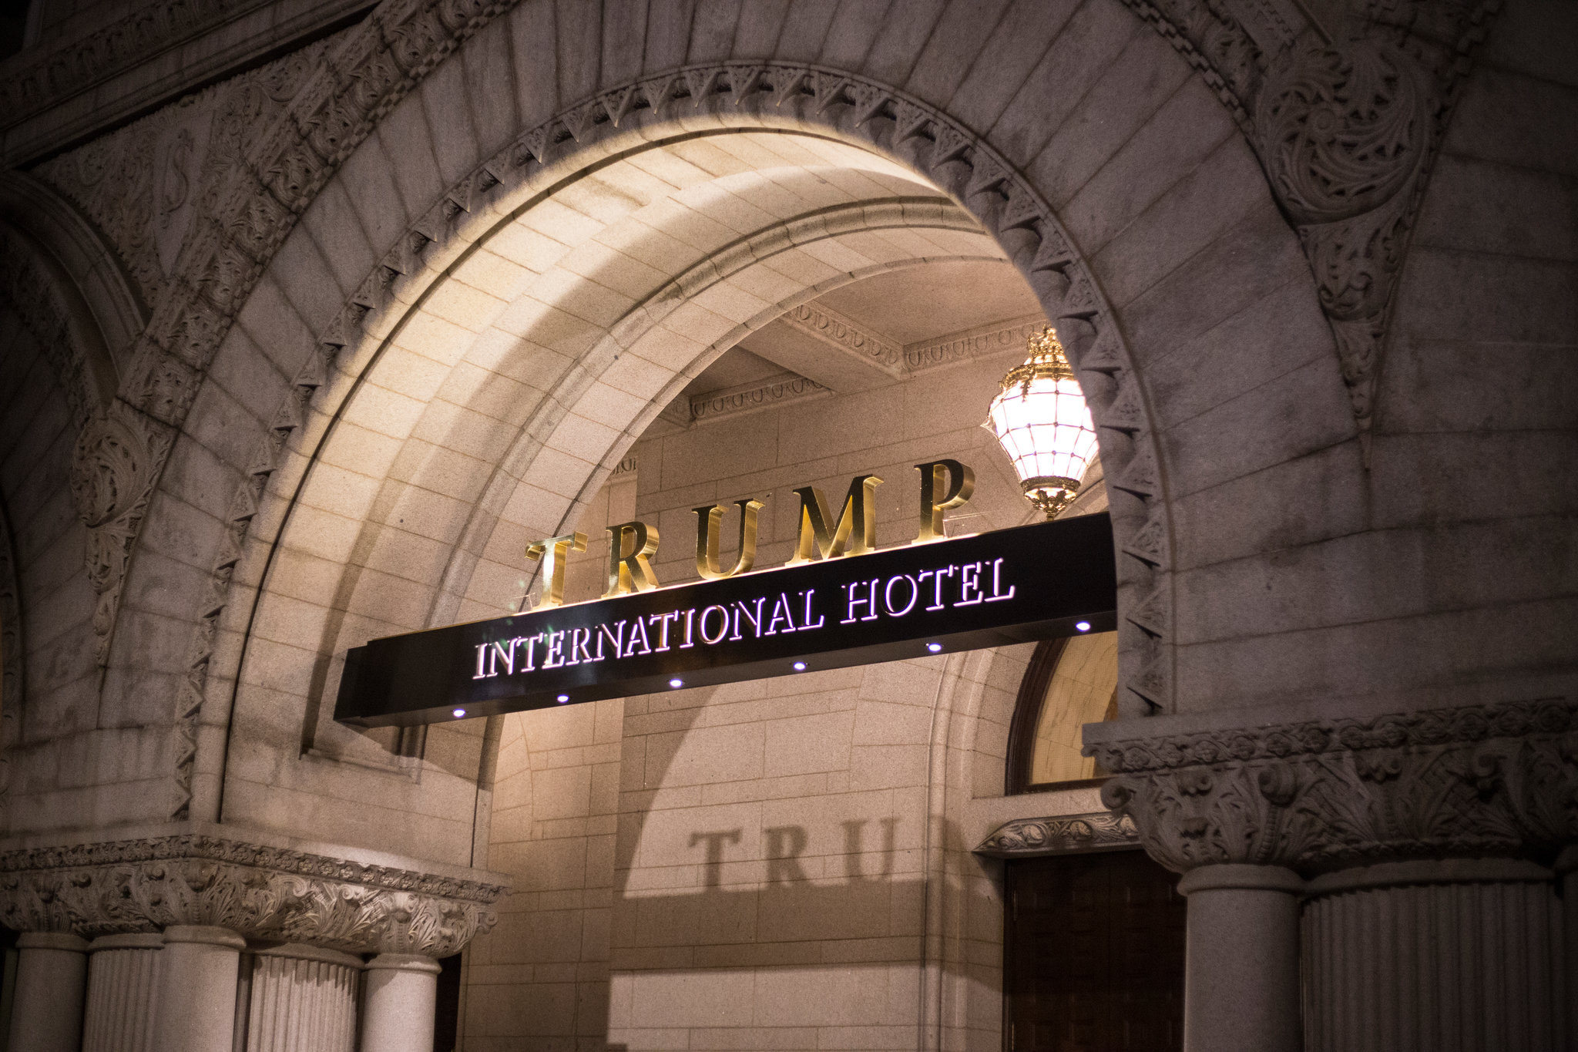

Slide 32
Article I, Section 9
… no Person holding any Office of Profit or Trust … shall,
without the Consent of the Congress,
accept of any present, Emolument, Office, or Title,
of any kind whatever,
from any King, Prince, or foreign State

Slide 33
The DISTRICT OF COLUMBIA
and The State of Maryland, Plaintiffs,
v.
Donald J. TRUMP, individually and in his official capacity as President of the United States, Defendant.
Civil No. PJM 17-1596
United States District Court
D. Maryland

Slide 34
President’s position
when the Constitution was ratified “emolument” had two distinct meanings:
a “narrow” sense limited to “profit arising from an office or employ”
a “broad” sense meaning “benefit, advantage or profit”
emolument in the Constitution only referred to the narrow meaning

Slide 35
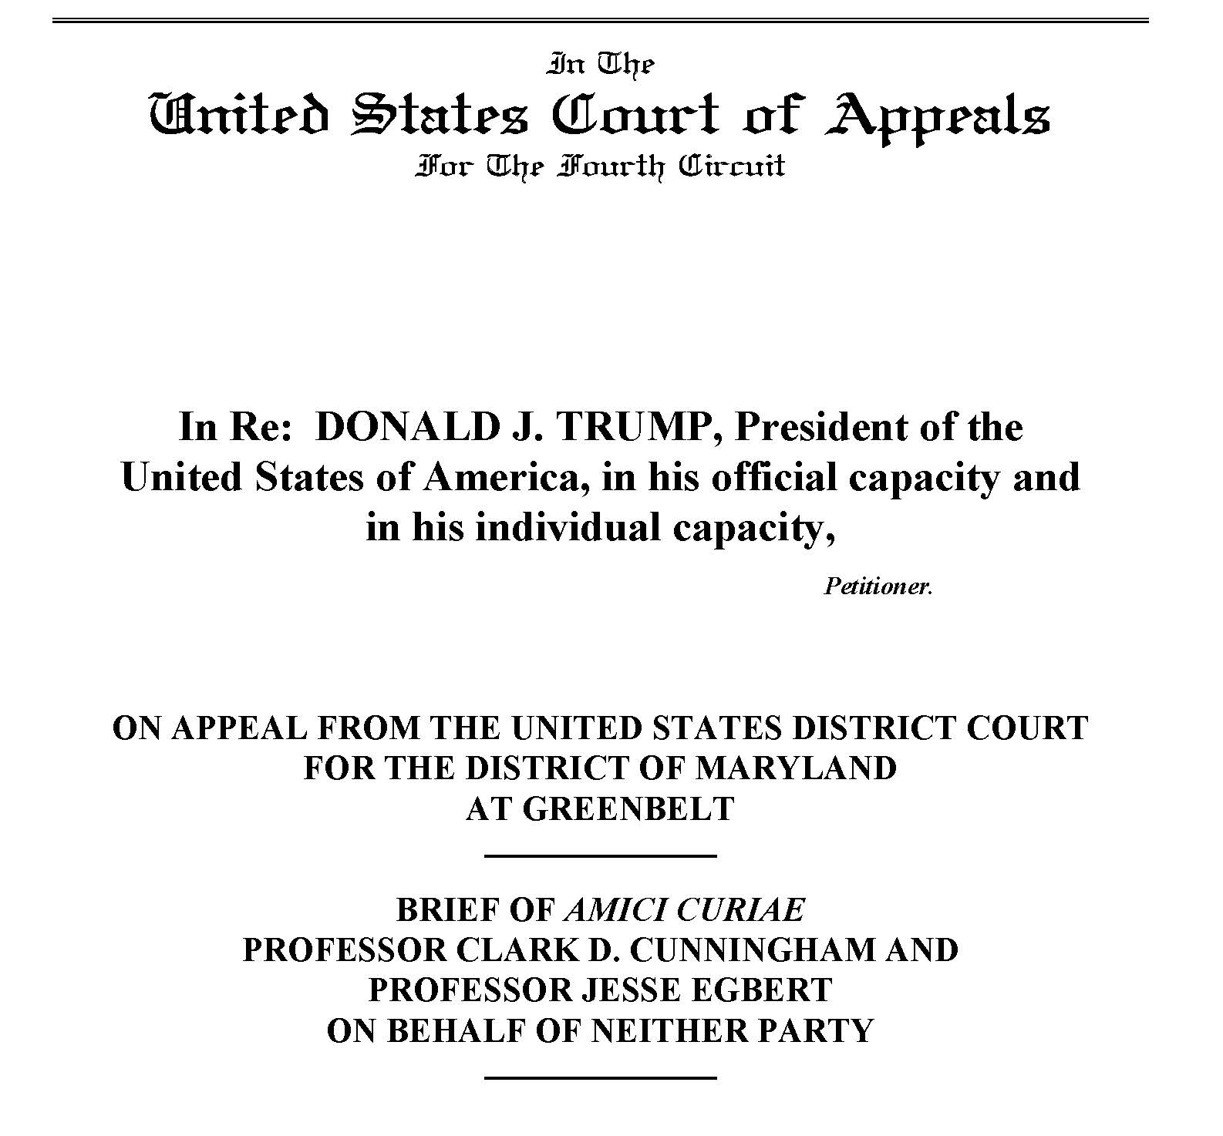

Slide 36
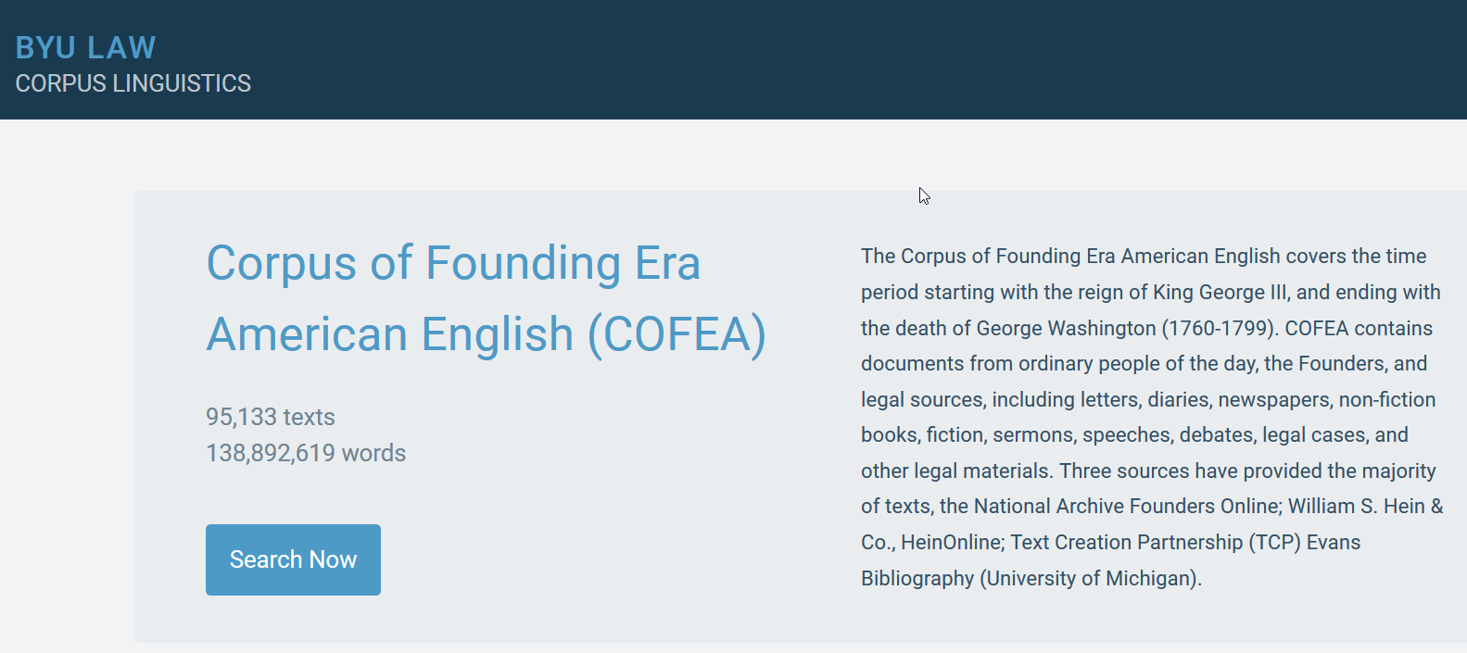

Slide 37
Search results
69 uses of emolument in coordinated noun phrases in which the term appeared at the end of a list, preceded by “other”
Approximately one out of every 40 cases of emolument occurs in this structure
On average, nouns in COFEA appear in this structure in only one out of 1250 cases

Slide 38
Nouns preceding other emolument(s) in coordinated noun phrases will be types of emolument
but will not exhaust meaning of emolument
Cats, dogs, and other animals
*Cats, birds, and other dogs

Slide 39
Examples
having Receiv’d a wound … which has renderd him uncapable of doing duty with his Regiment ever since— and being much Embarrass’d by not having receiv’d any pay, Cloathing or other Emoluments granted to the Officers of your State, Since July 1779 (Leonard Cooper to Virginia Delegates 1781)

Slide 40
Examples
the memorial of William Finnie … praying that the donation of lands and other emoluments appertaining to the rank of a Colonel in the line of the late continental army may be extended to him (Continental Congress 1785)
Rivers and lakes are useful for navigation or for fishing, or for other emoluments arising from their possession (Summary of the Law of Nations 1795)

Slide 41
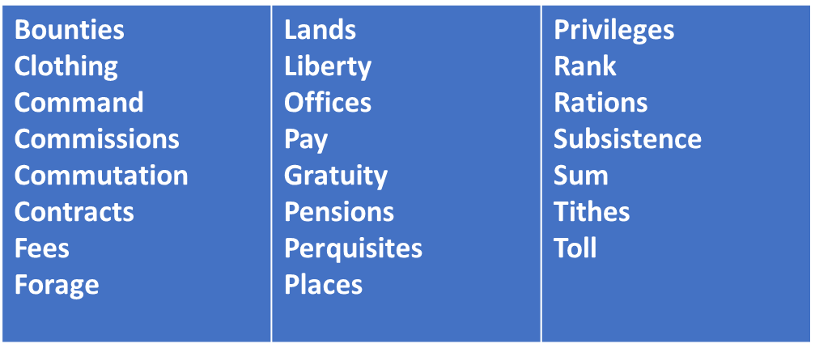
Nouns preceding other emolument(s) in coordinated NPs

Slide 42
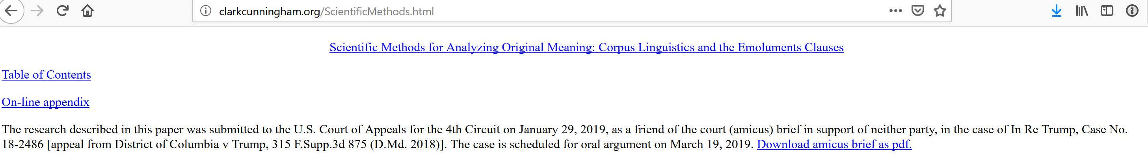
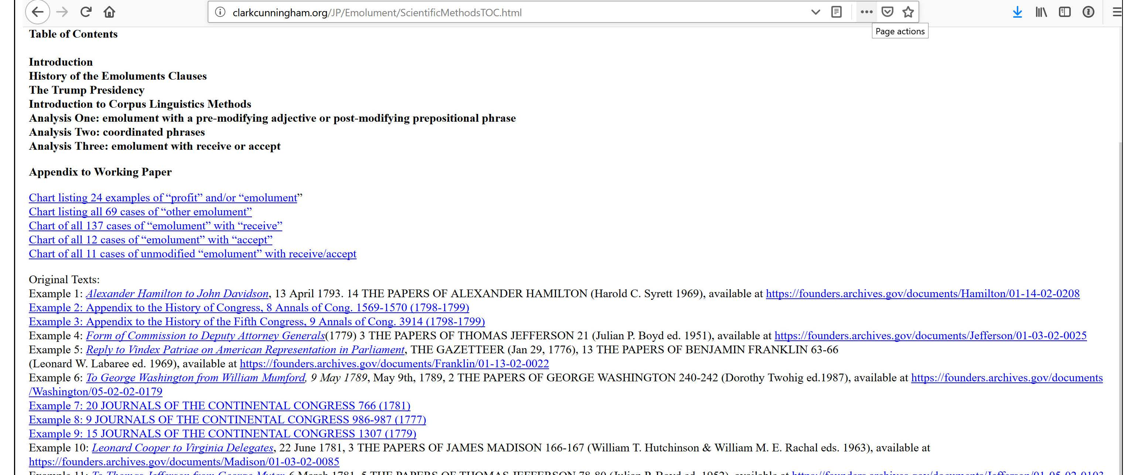

Slide 43
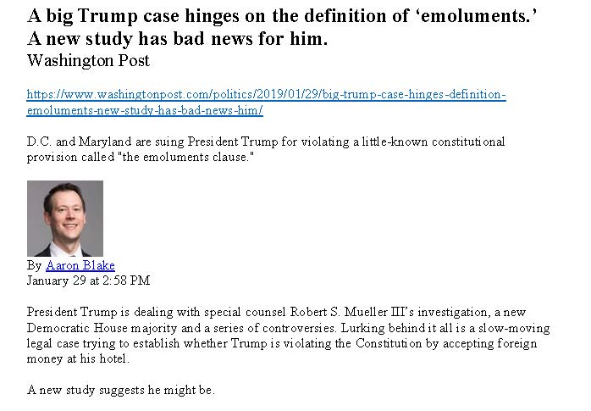

Slide 44
Seminar on Judicial Power
Georgia State University College of Law
Spring Semester 2018
Web Site Address: www.clarkcunningham.org/JP/index.htm

Slide 45
GSU Law Students Present Research: April 11, 2018
Big Data Meets the Constitution in New Originalism Project:
Georgia appellate judges evaluate cutting-edge inquiries into what the Constitution's framers meant from Georgia State University law students.
Meredith Hobbs, Daily Report, May 1, 2018
"This is revolutionary,” said Georgia Appeals Court Chief Judge Stephen Dillard. “It’s like Westlaw for originalism.”
Students Present New Insights on Original Meaning of Constitution to Judges using “Big Data”of Corpus Linguistics
GSU College of Law News, May 21, 2018
“I thought the students were all exceptionally well prepared, the writing was very strong, the research was very strong, and it’s grappling with some of the most difficult questions that courts have to deal with today.”
Justice Nels Peterson, Supreme Court of Georgia

Slide 46
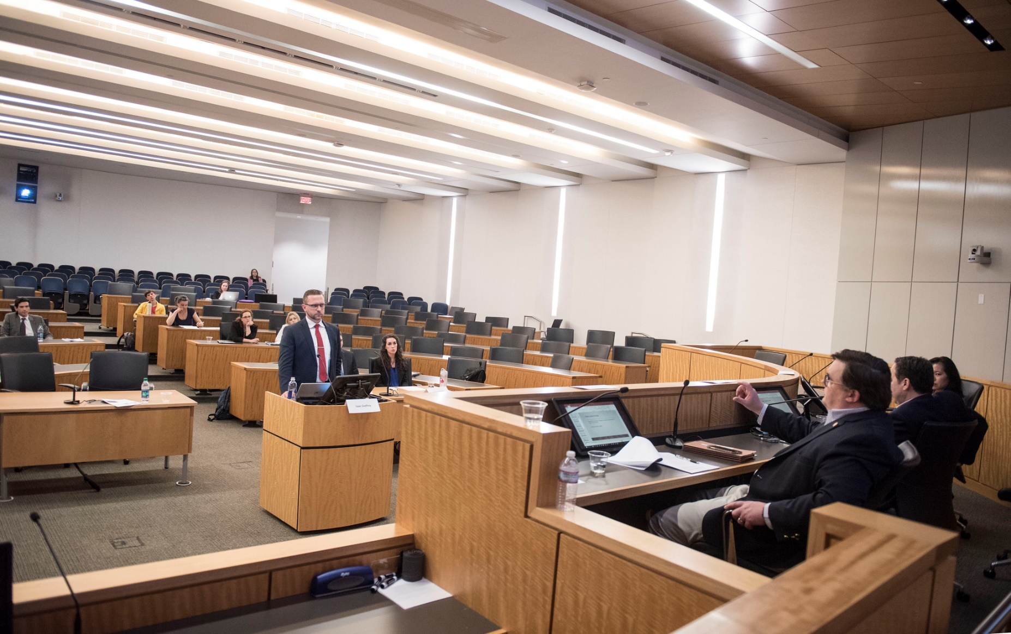
Isaac Godfrey 8th Amendment
“Excessive bail shall not be required …”

Slide 47
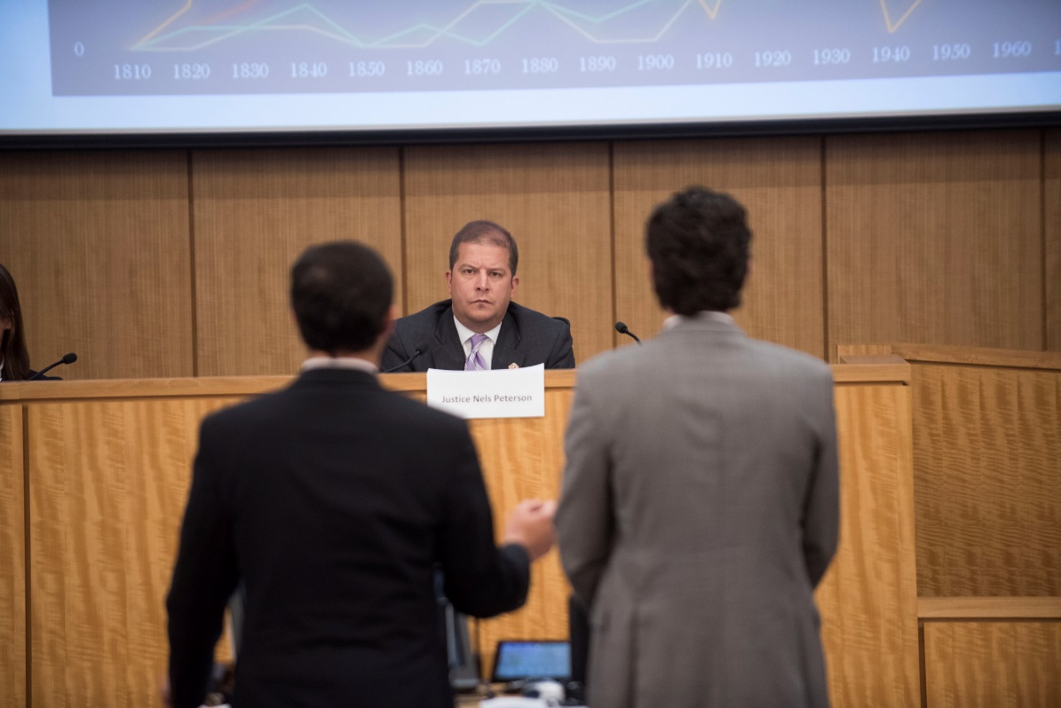
Pearson Cunningham & William Lasker
Congress shall make no law . . . abridging . . . the right of the people . . . to petition the Government for a redress of grievances

Slide 48
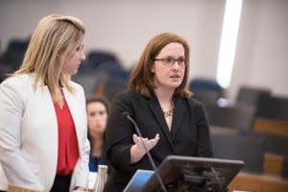
Eleanor Miller &
Heather Obelgoner
The executive power
Article II:
shall be vested in a President
of the United States of America.
Article I:
All legislative powers herein granted
shall be vested in a Congress
of the United States
Article III:
The judicial power of the United States,
shall be vested in one Supreme Court,
and in such inferior courts as the Congress may
from time to time ordain and establish
Notes:
So, like any good textualist, we began with the text of Article II. And what originally caught our attention was this broad grant of singular “executive power” (queue underline), that stood in contrast to the syntax of the other vesting clauses (click for Art I & Art II). Point out limiting language in Art. I & III. Mention this will be a distinction that we will return to later during the linguistic presentation.

Slide 49
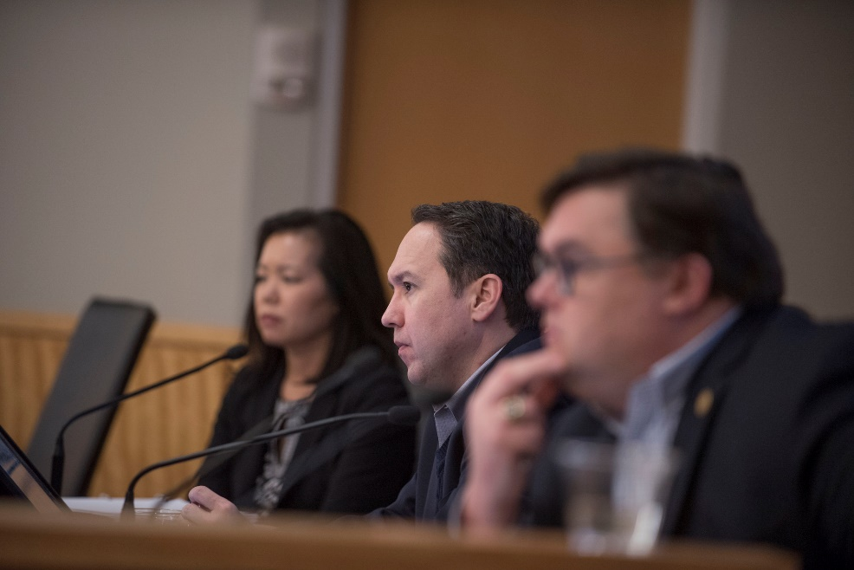
Don’t Be Cruel: A Corpus Analysis of the Cruel and Unusual Punishments Clause
Aaron Smothers and Cecelia Howard
Excessive bail shall not be required, nor excessive fines imposed, nor cruel and unusual punishments inflicted.

Slide 50
Seminar on Judicial Power Spring 2019
Article 3: case or controversy
4th Amendment “papers and effects”
5th Amendment commas v semicolons
7th Amendment: “right of trial by jury shall be preserved”
10th Amendment: “The powers not delegated to the United States by the Constitution, nor prohibited by it to the States, are reserved to the States respectively, or to the people.”

Slide 51
This presentation available at
http://www.clarkcunningham.org/NonpartisanOriginalism.html

