Slide 1
Teaching Lawyers about Using Corpus Linguistics
Clark D. Cunningham
W. Lee Burge Chair in Law & Ethics
Georgia State University College of Law www.ClarkCunningham.org
14th American Association for Corpus Linguistics Conference
Friday, September 21, 2018 2:00 pm
Room SCE 217, Student Center East, Georgia State University, Atlanta
This presentation available at
http://www.clarkcunningham.org/JP/index.htm and
#AACL2018 twitter feed: https://twitter.com/AACL2018
Direct download:
http://www.clarkcunningham.org/JP/AACL-Cunningham-TeachingLawyers-21September2018.pptx

Slide 2
Justice Antonin Scalia
“Find the ordinary meaning of the language in its textual context.
Ask whether there is any clear indication that some meaning other than the ordinary meaning applies.
If not, we apply that ordinary meaning.”
            Chison v Roemer (1991)

Slide 3
Justice Antonin Scalia
“The Constitution was written to be understood by the voters
Its words and phrases were used in their normal and ordinary as distinguished from technical meaning.”
District of Columbia v Heller (2008)(quoting US v Sprague 1931)

Slide 4
Justice Elena Kagan
“I think we’re all textualists now in a way that just was not remotely true when Justice Scalia joined the bench.”
Quoted in Brett M. Kavanaugh, Fixing Statutory Interpretation, 129 Harvard Law Review 2118 (2016)
and
Neil M. Gorsuch, 66 Case Western Reserve Law Review 905 (2016)

Slide 5
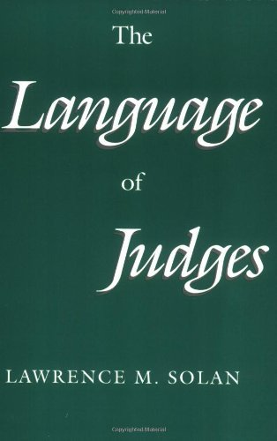
Univ of Chicago Press 1993

Slide 6
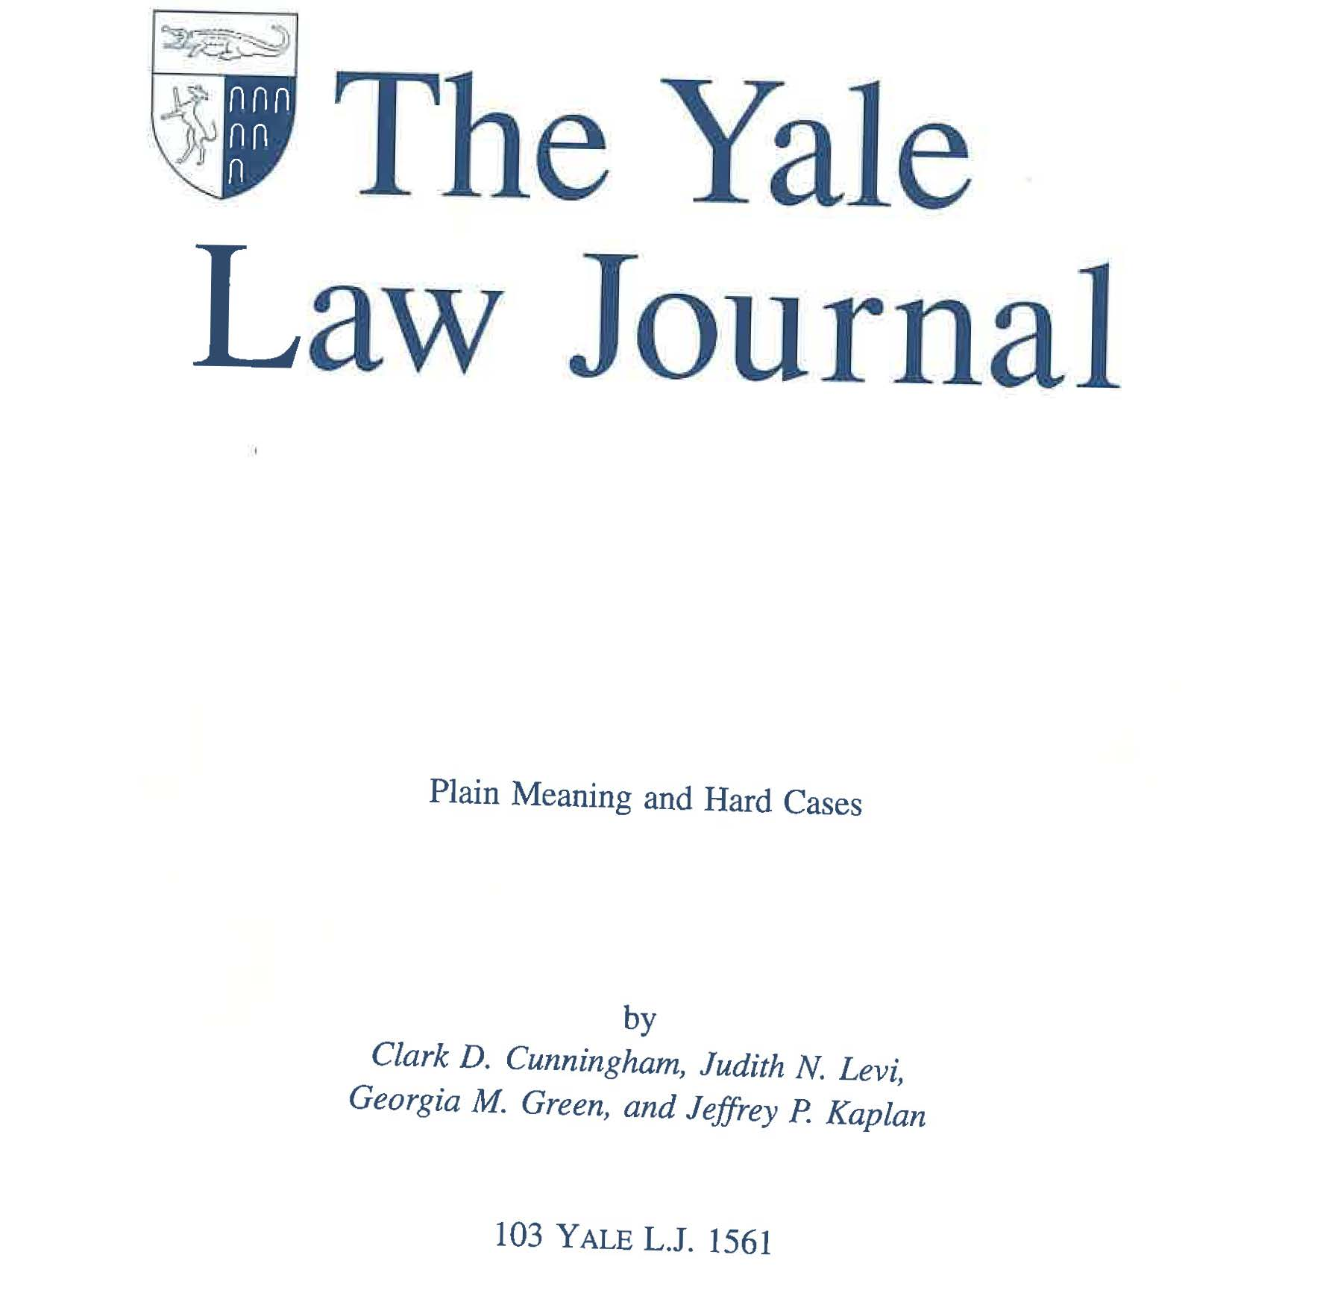
Download: http://www.clarkcunningham.org/Cunningham-Publications.html

Slide 7
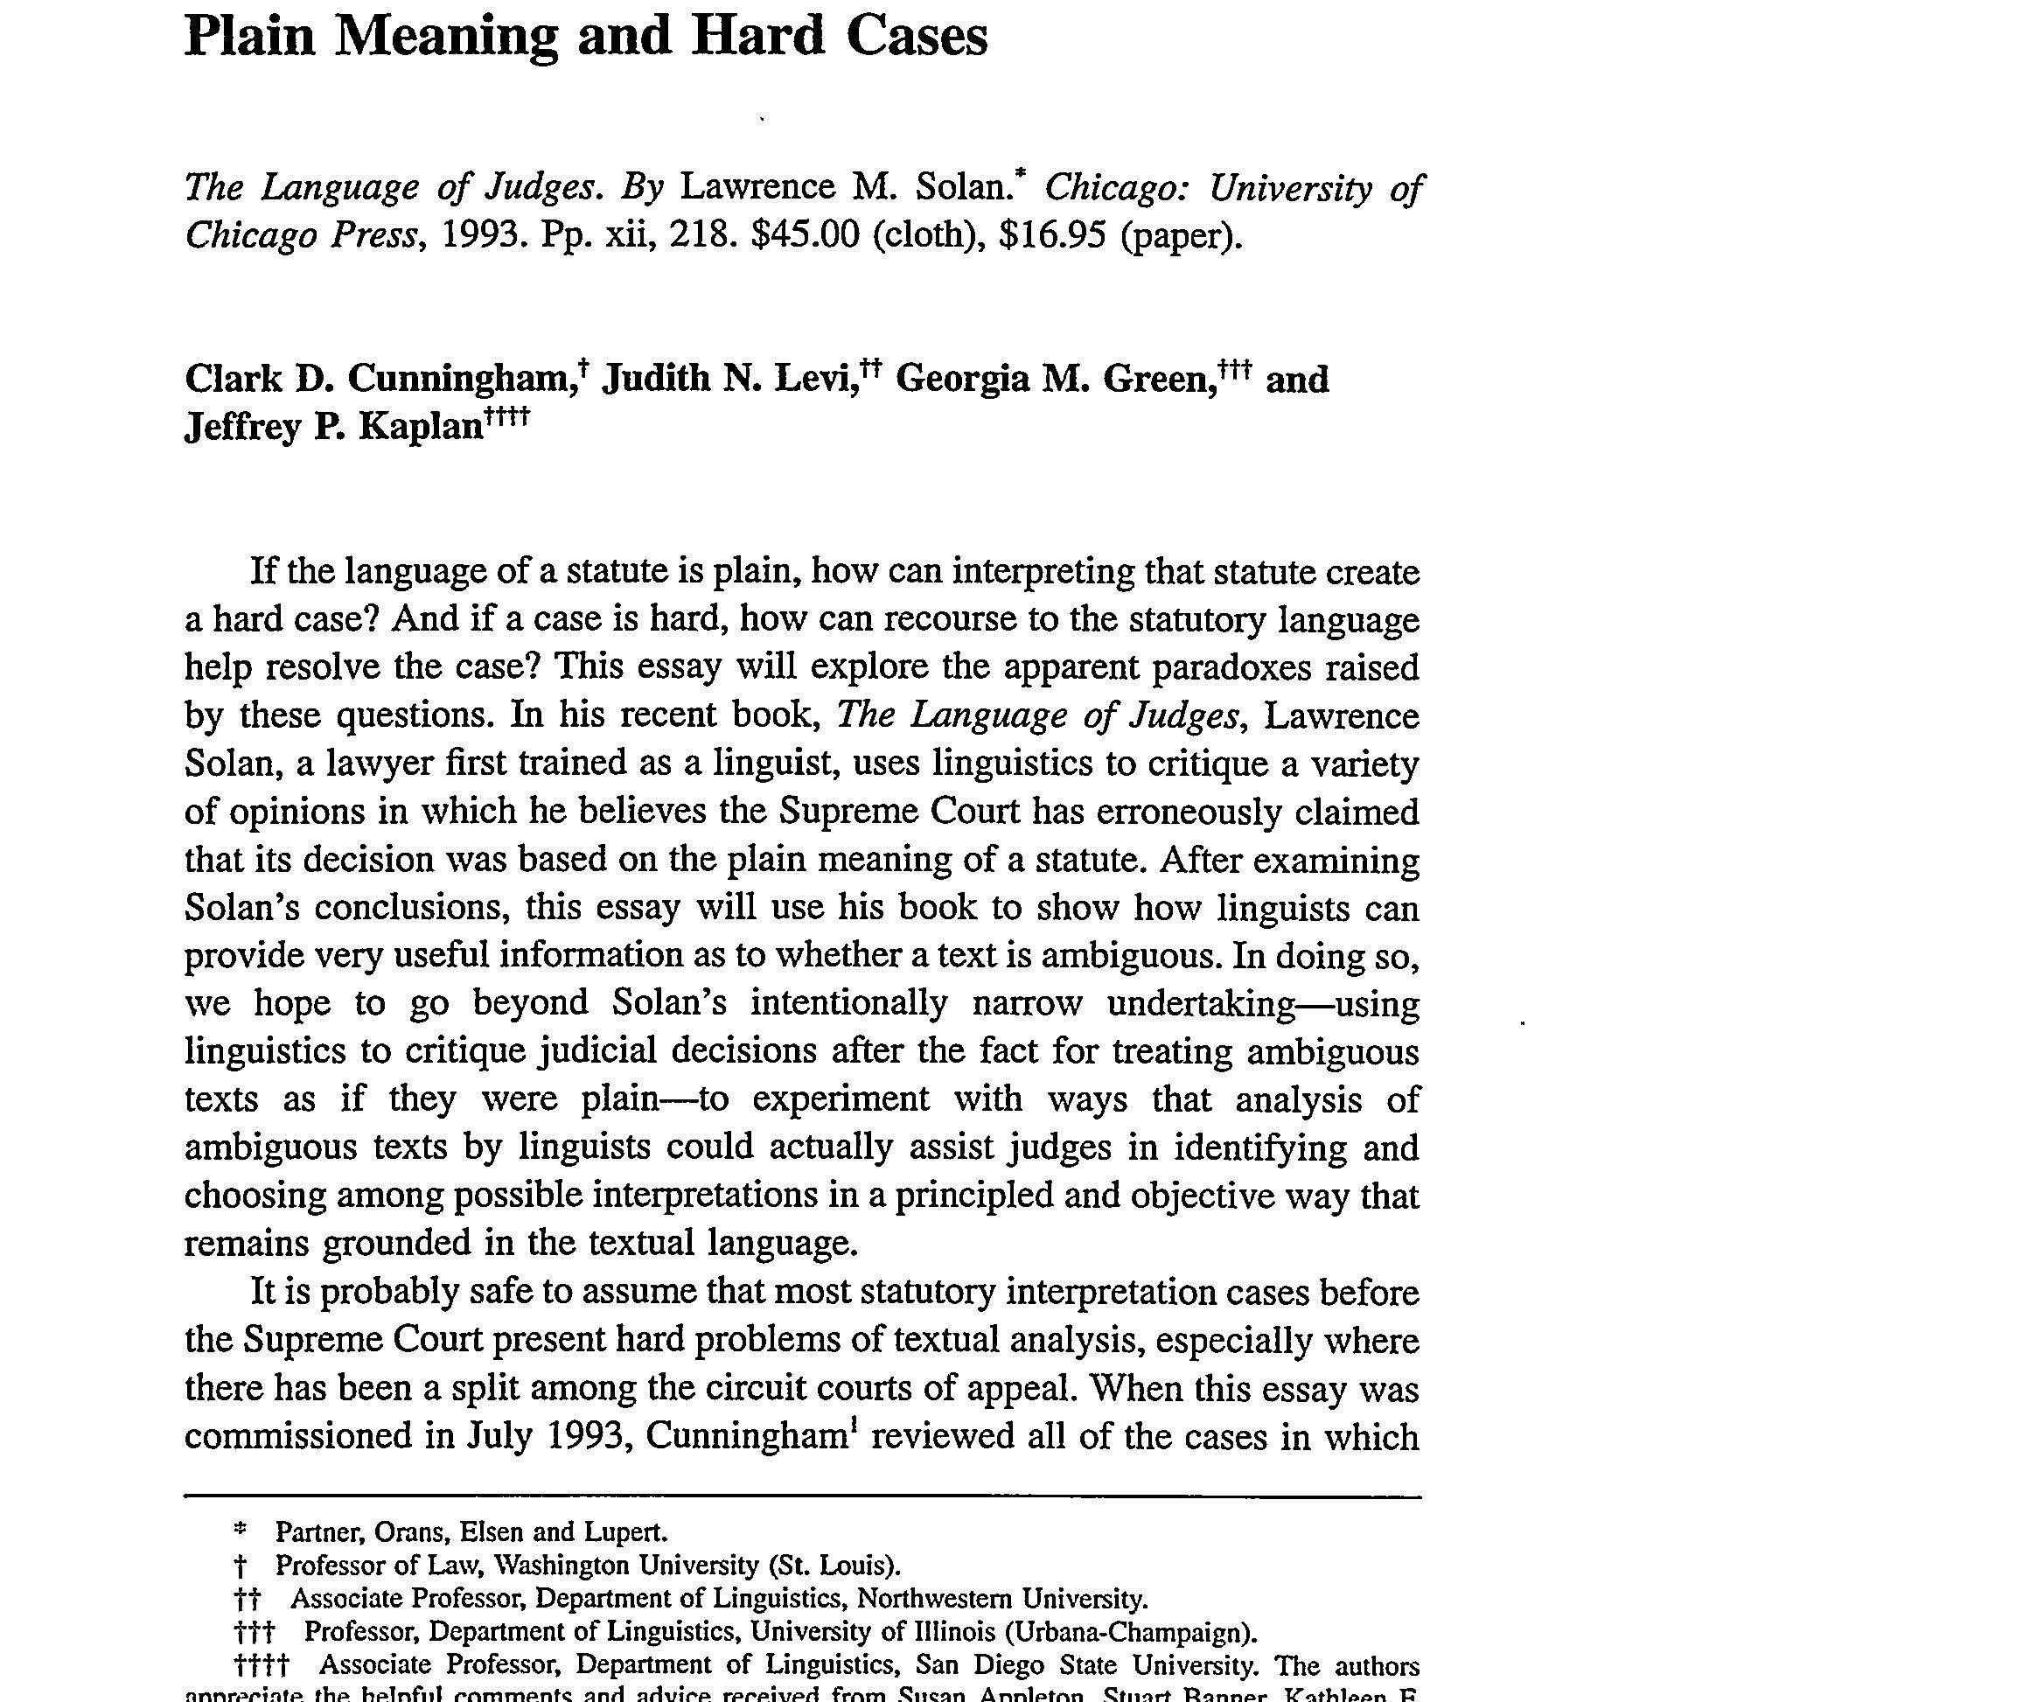

Slide 8
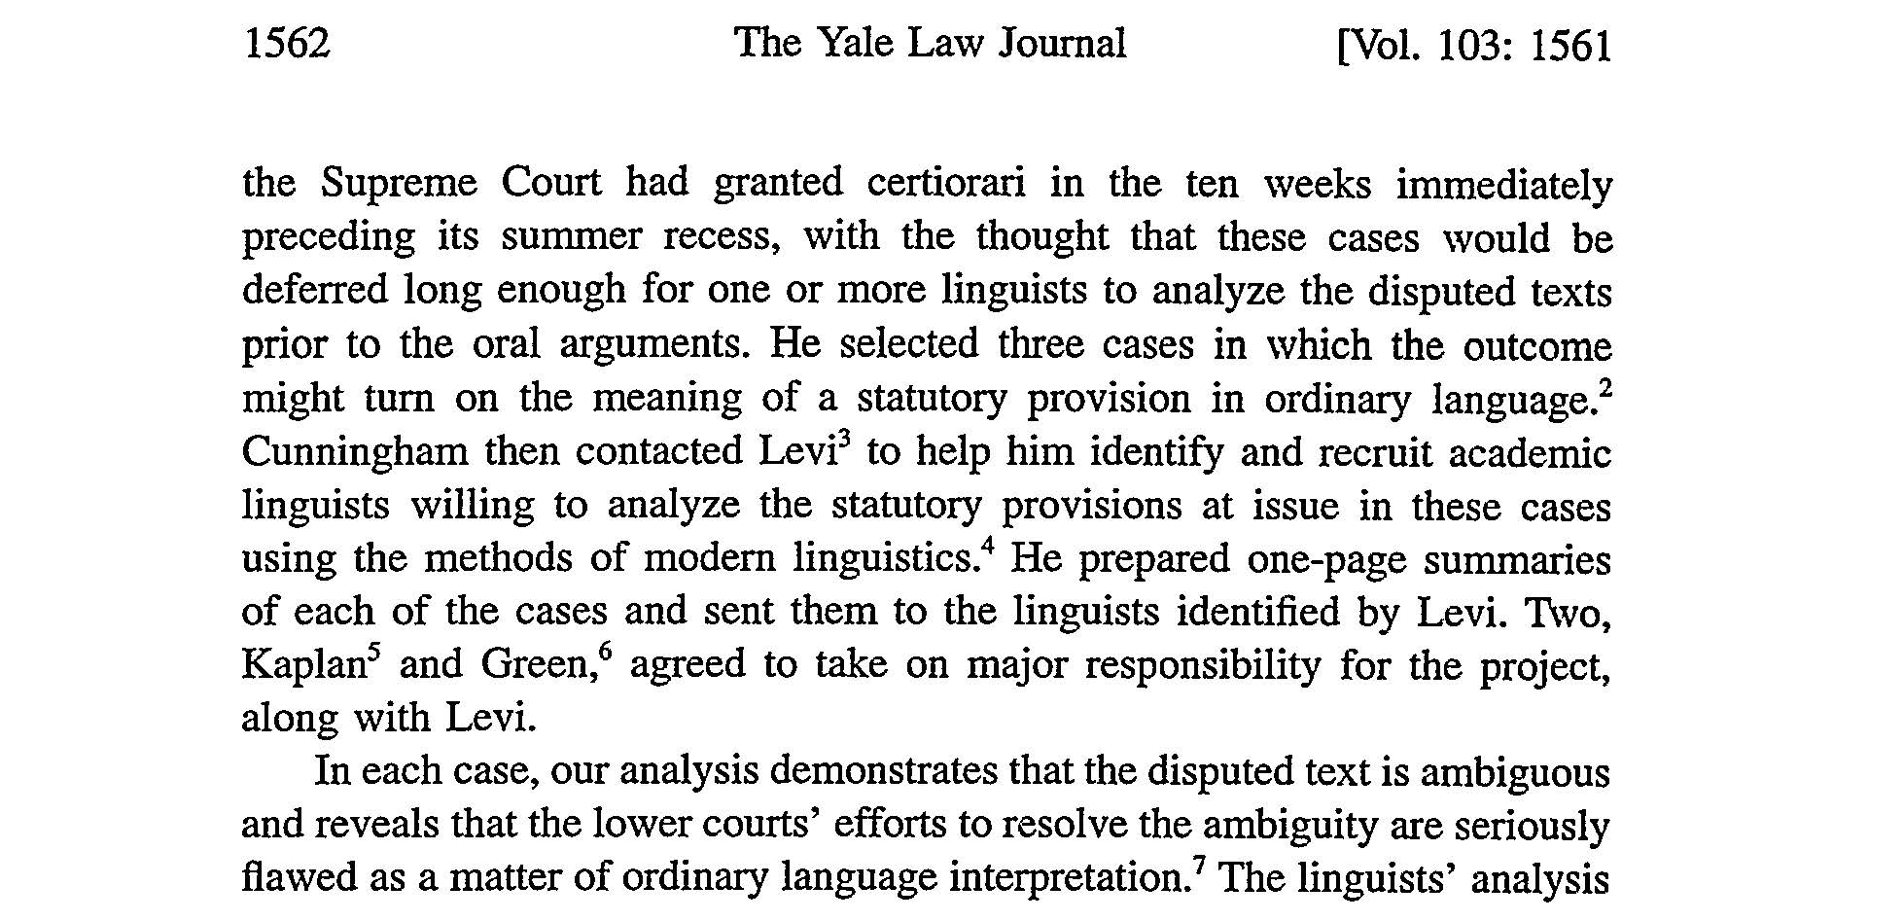

Slide 9
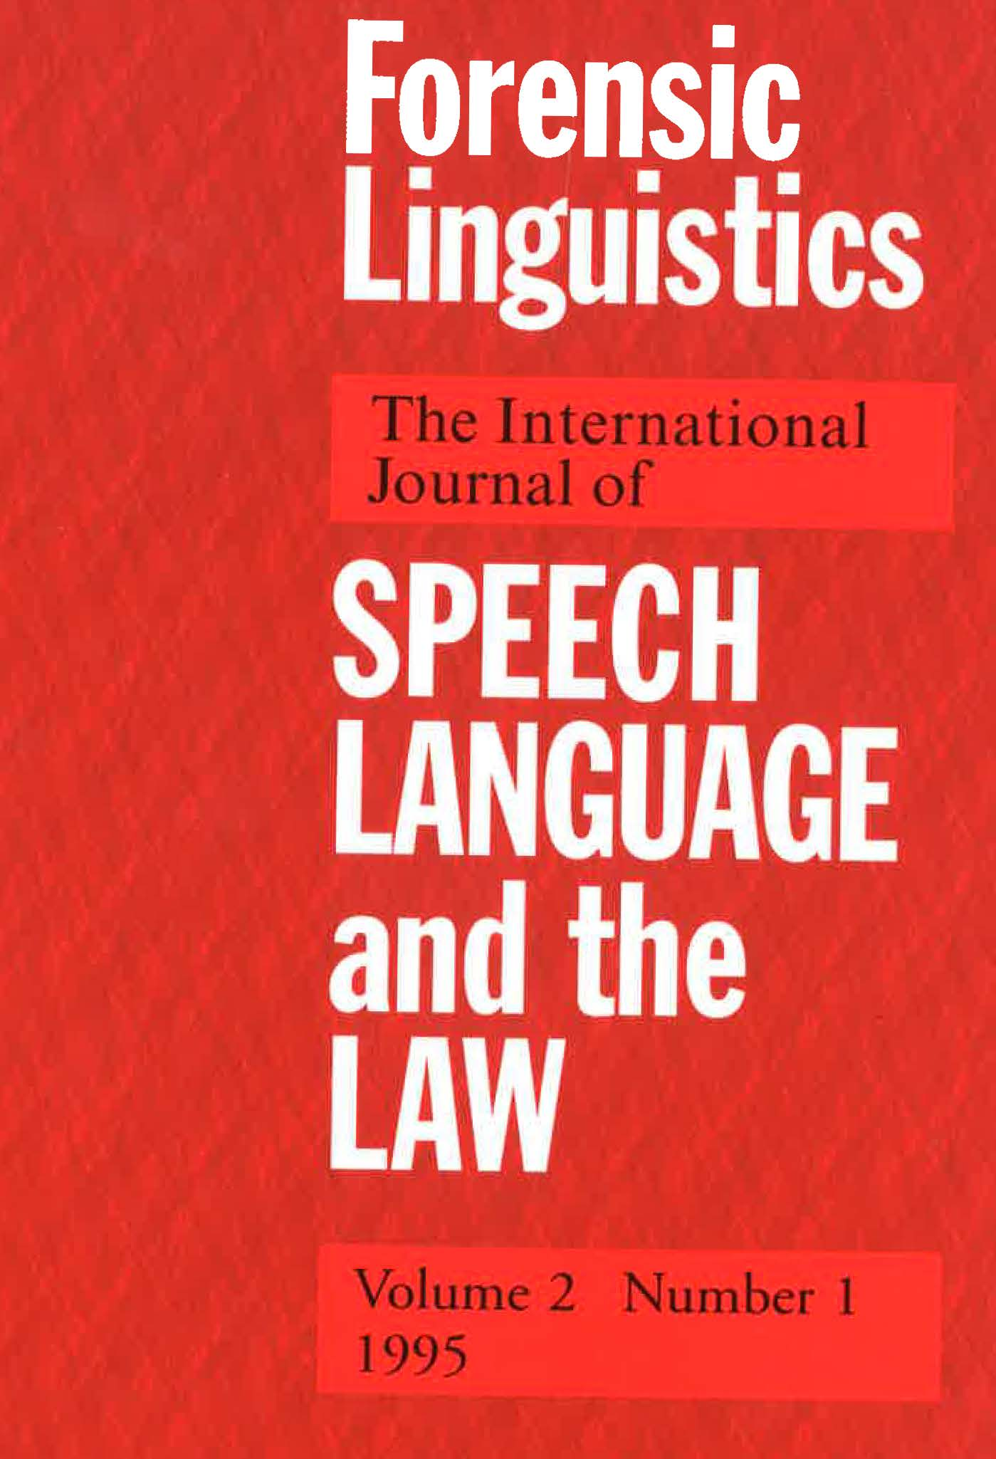
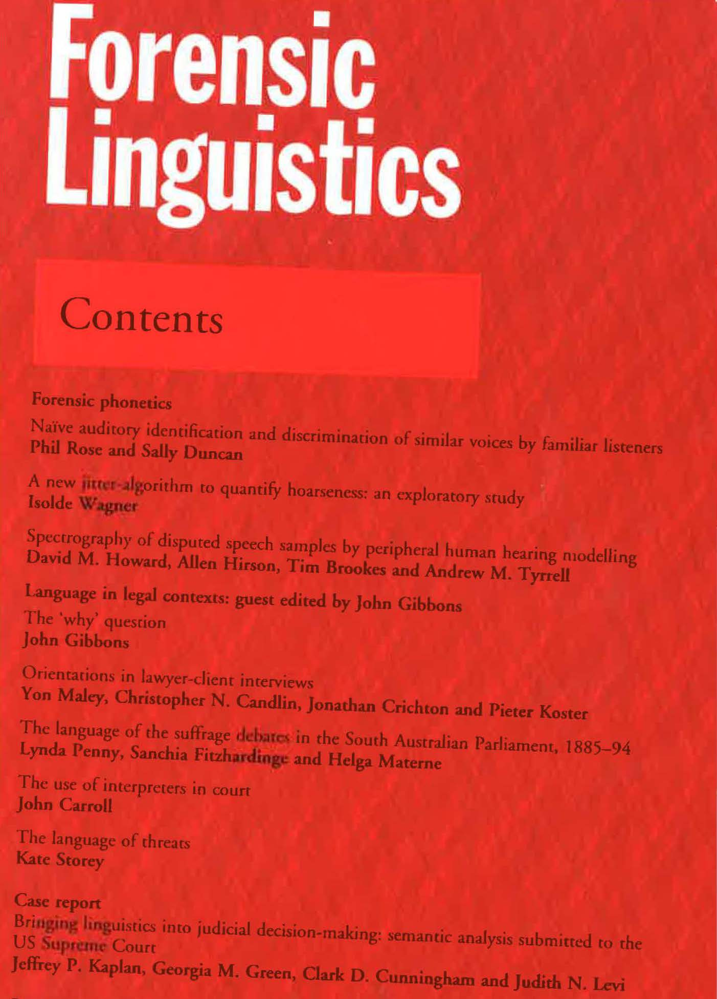
What happened at the Supreme Court

Slide 10
Bringing Linguistics into Judicial Decisionmaking
Download: http://www.clarkcunningham.org/
Cunningham-Publications.html
In its 1993-4 term, the US Supreme Court had the opportunity to see, during deliberations, the results of linguistic research focused directly on three cases before the Court: US v. Granderson, US v. Staples, and NOW v. Scheidler.
The results of this research reached the Court in the form of a review article in the Yale Law journal entitled 'Plain Meaning and Hard Cases' which included a detailed analysis of the contested language in each of the three cases.
In one of the cases, we have reason to believe that the team’s analysis contributed to the Court's opinion;
in another, the concurring opinion seems to have rested directly on the team's analysis;
and in the third case, although the opinion showed no reliance on the team’s research, the decision was nonetheless in line with the general direction of the team's findings.

Slide 11
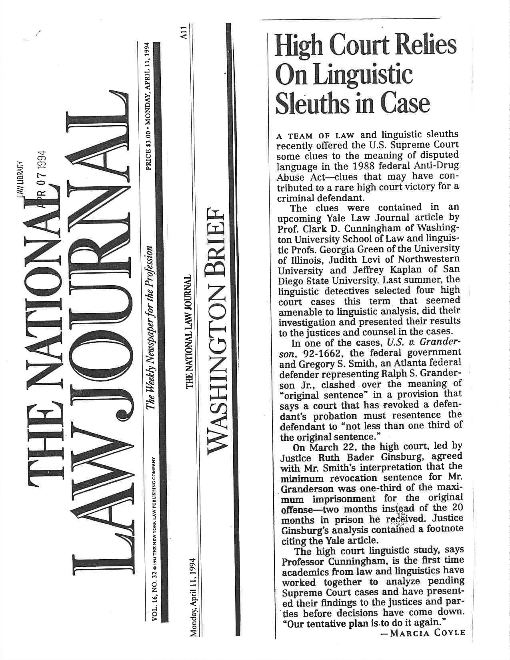

Slide 12
Justice Ruth Bader Ginsburg
Communicating and Commenting on the Court's Work, 83 Georgetown Law Journal 2119, 2127 (1995)
“If law journal citations in Supreme Court opinions are less numerous than they once were, it may be because some in the academy are writing on topics or in a language ordinary judges and lawyers do not comprehend.
But articles accessible and useful to judges remain in vogue.
Last Term, for example, a Yale Law Journal article sensibly discussing "Plain Meaning and Hard Cases" received credit lines in three Supreme Court opinions (two of them mine).
Cited in
Director, Office of Workers' Compensation Programs v. Greenwich Collieries, 114 S.Ct. 2251, 2255 (1994)(O'Connor, J.)
Staples v. United States, 114 S.Ct. 1793, 1806 (1994)(Ginsburg, J., concurring in judgment)
United States v. Granderson, 114 S.Ct. 1259, 1267 n.10 (1994)(Ginsburg, J.)].”

Slide 13
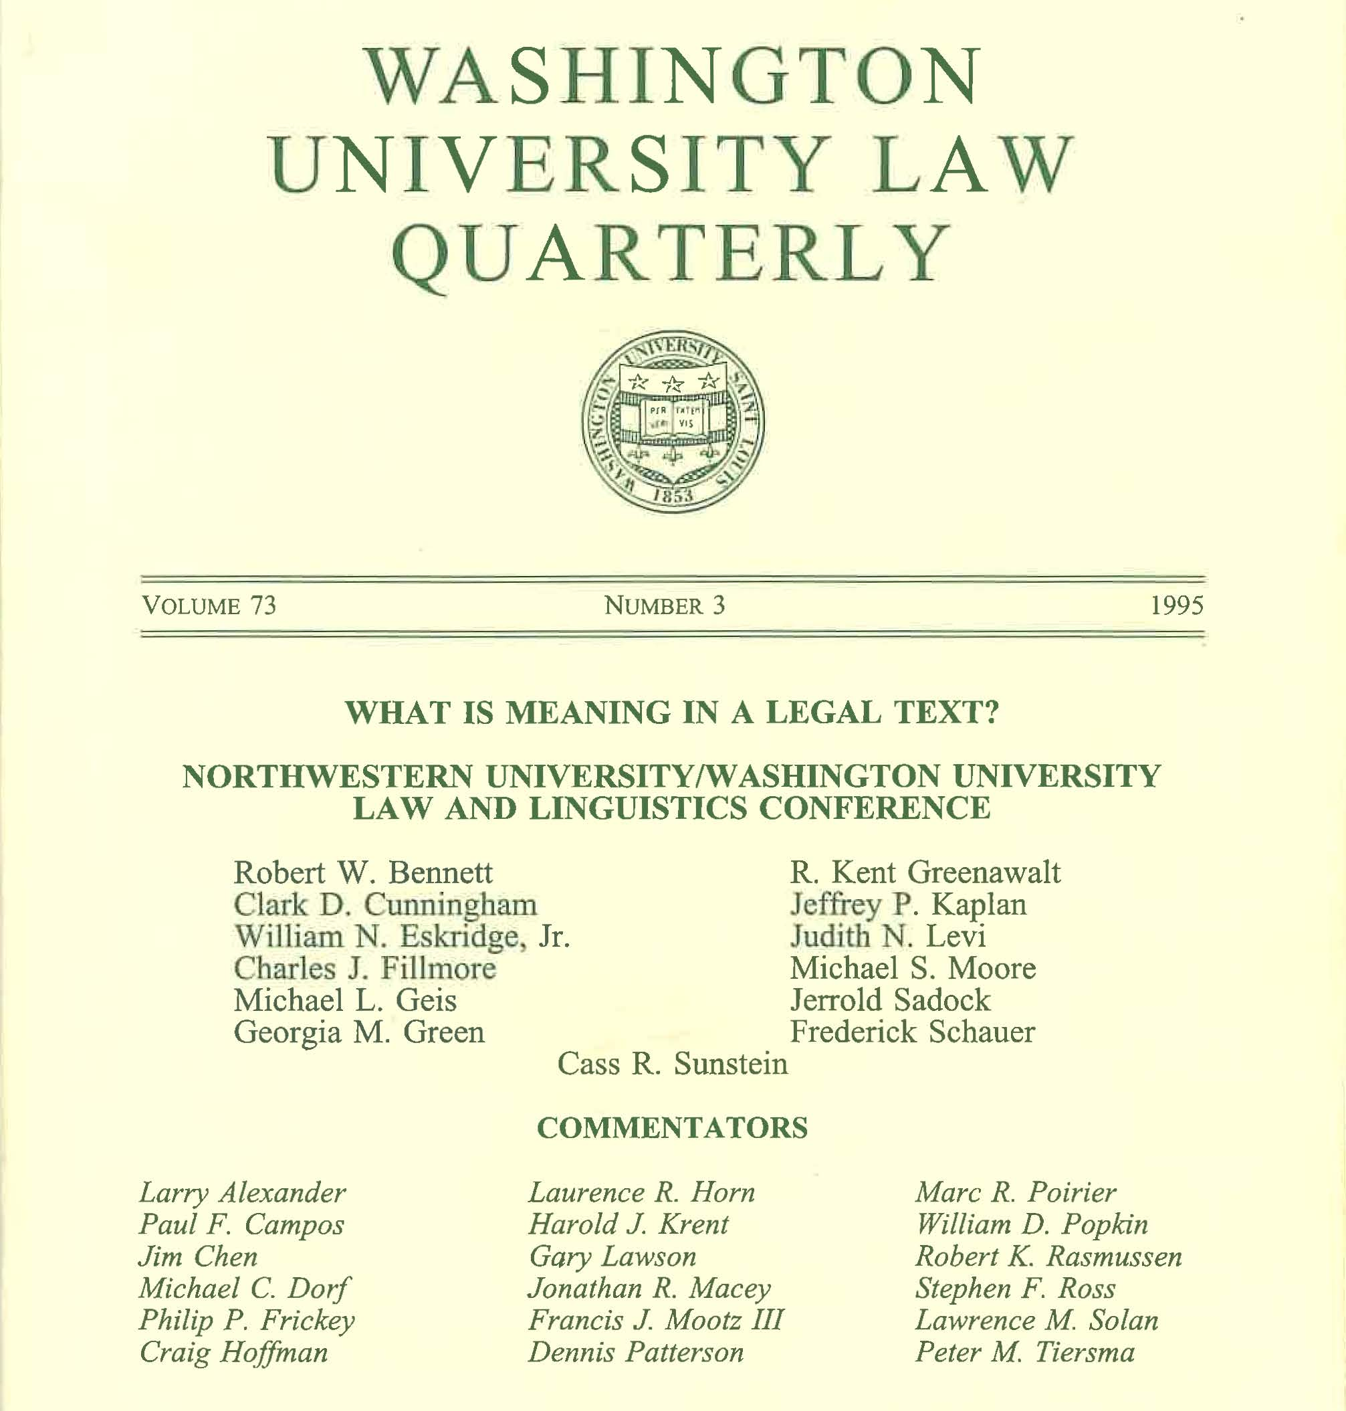

Slide 14
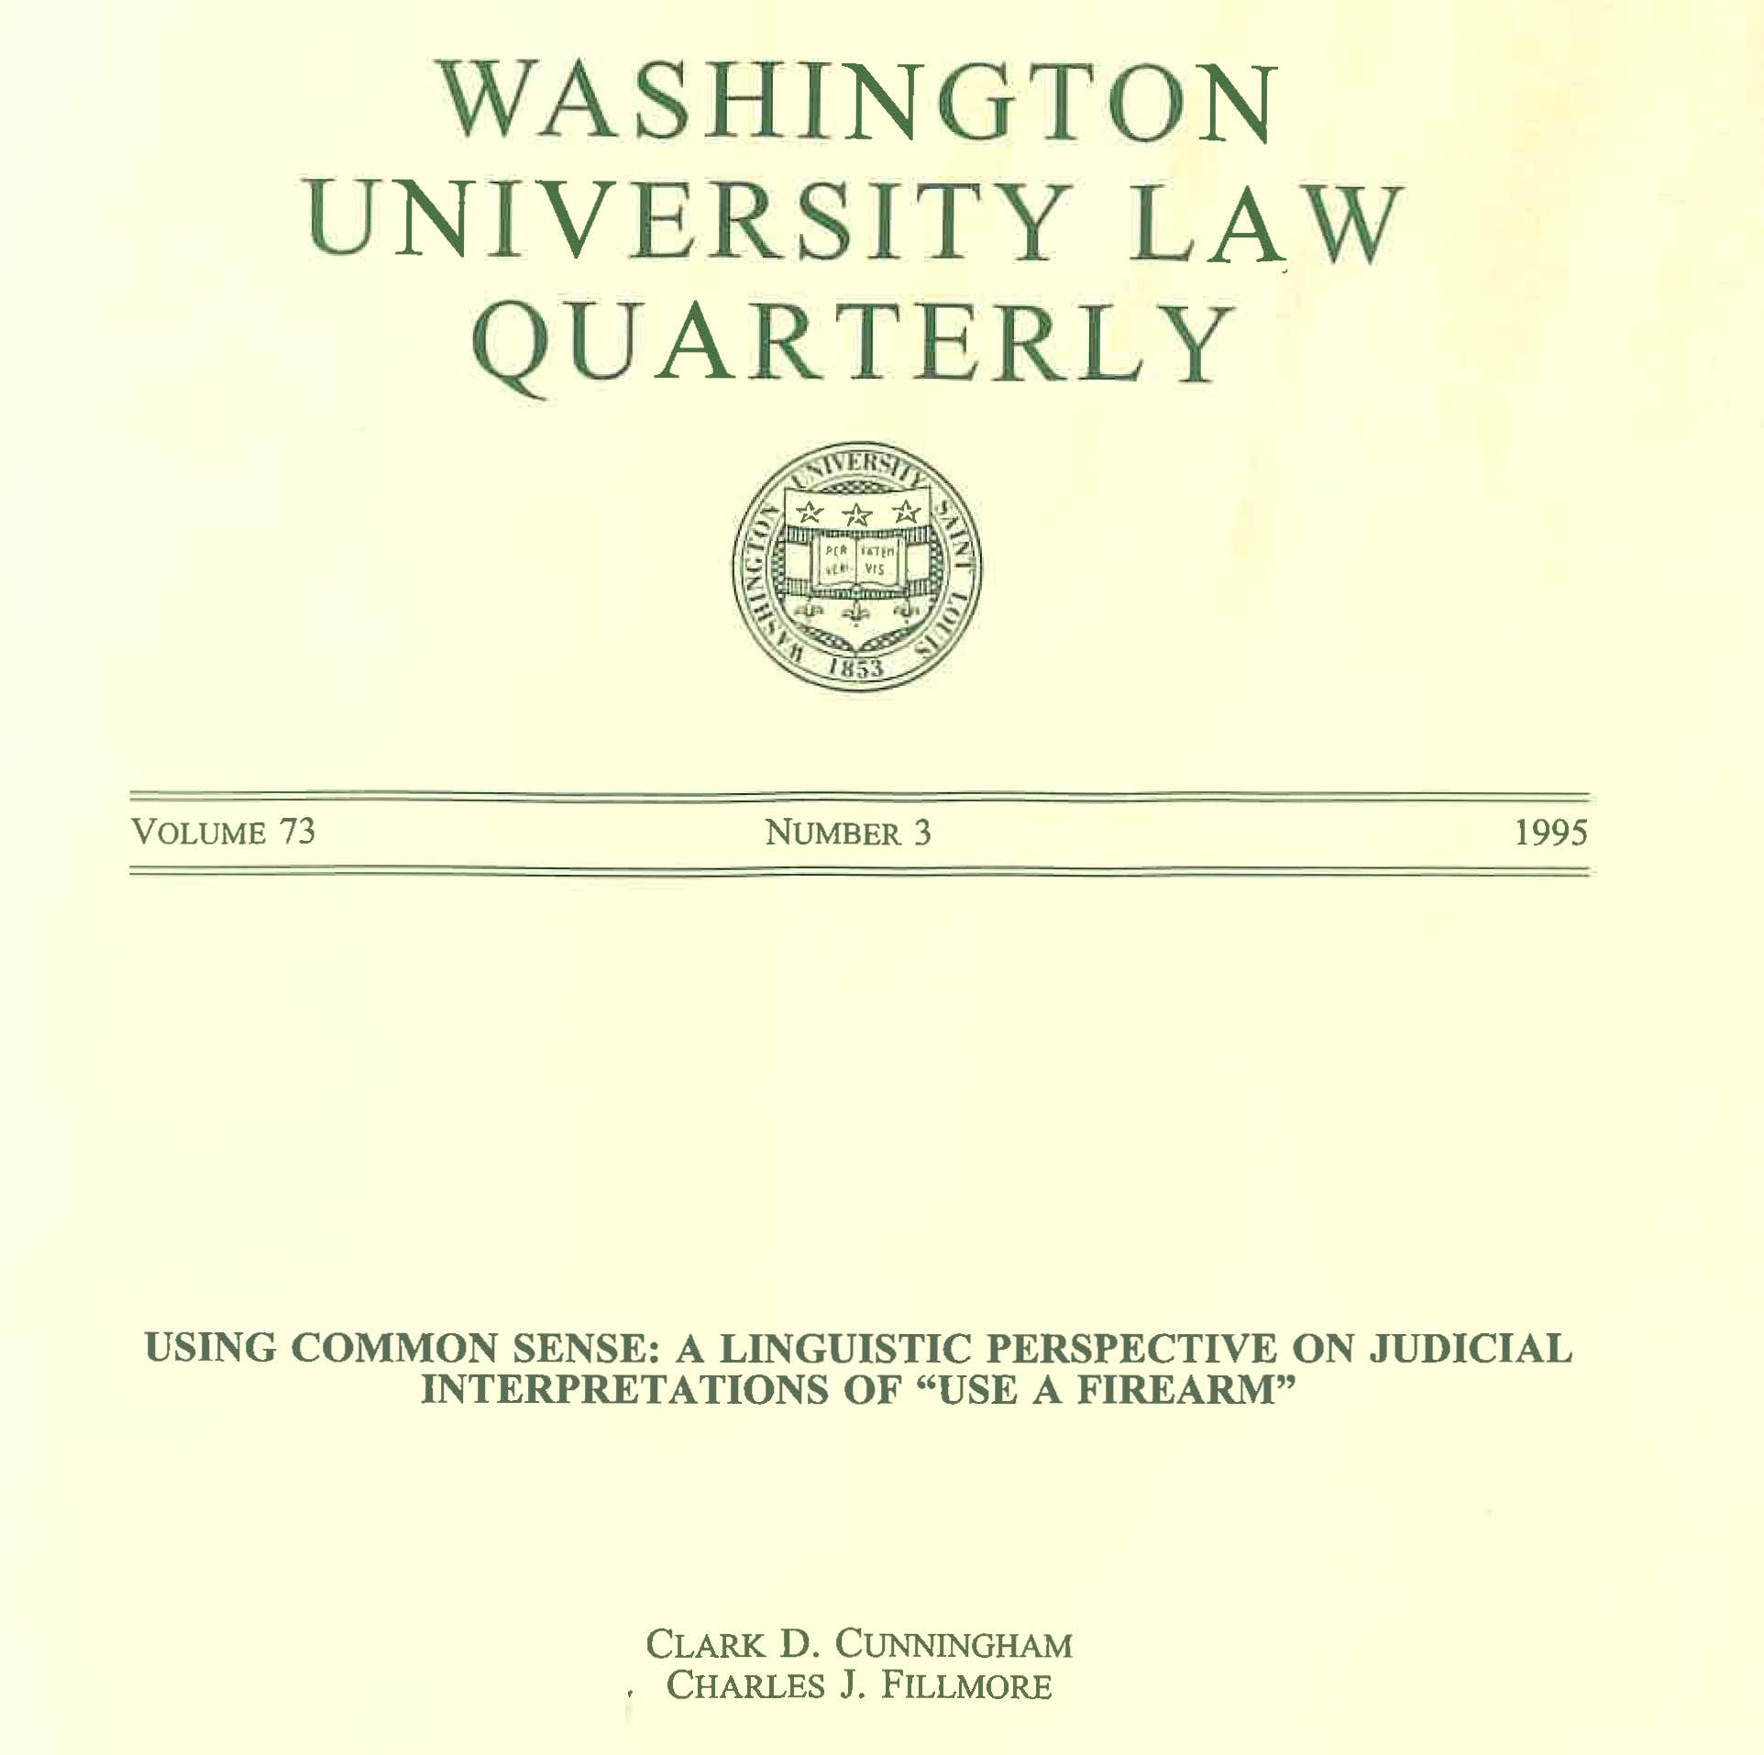

Slide 15
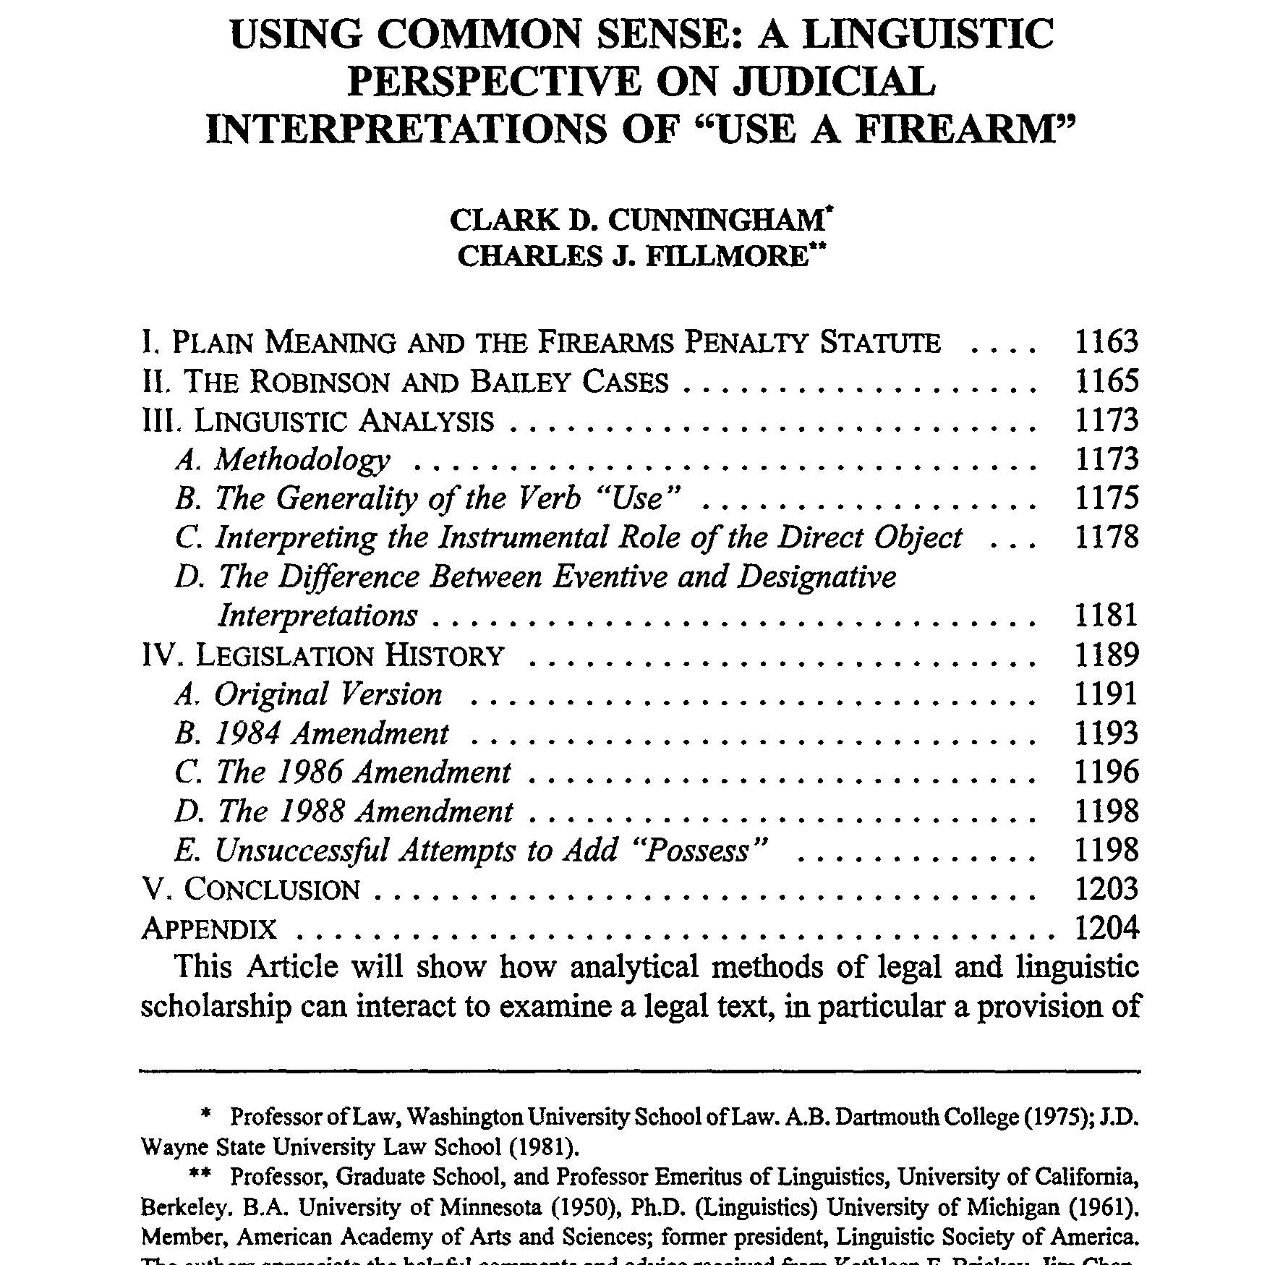

Slide 16
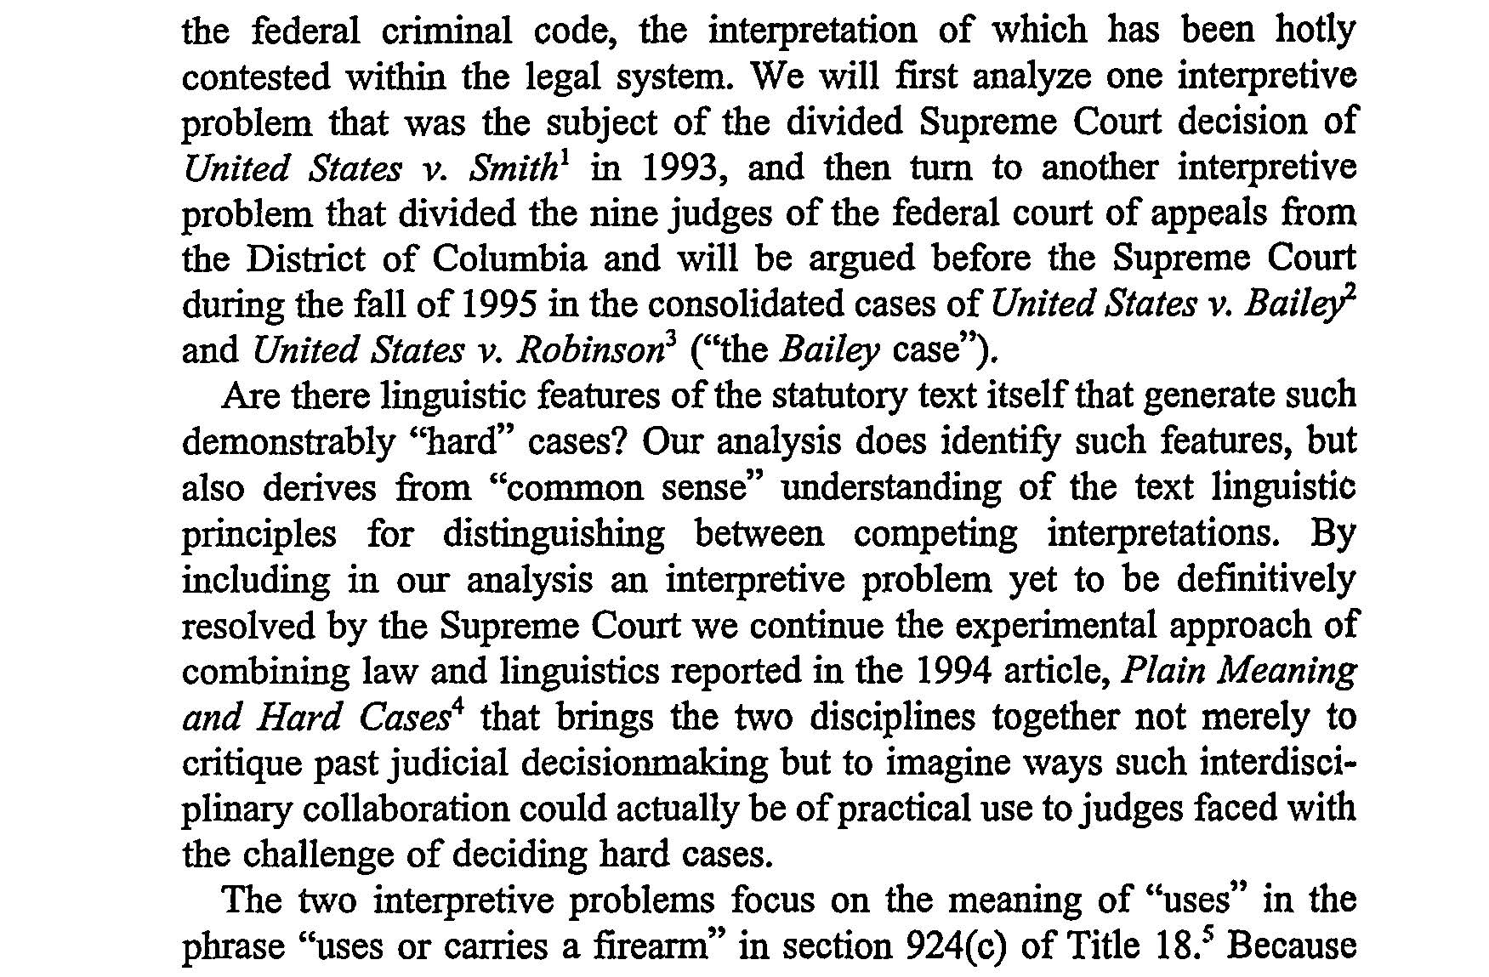

Slide 17
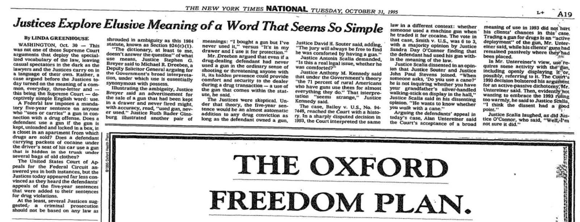
Bailey v US 516 U.S. 137, 116 S. Ct. 501 (1995)

Slide 18
Bailey v US 516 U.S. 137, 116 S. Ct. 501 (1995)
Brief for Bailey:
The error of the government’s reading is confirmed by the linguistic analysis of Section 924(c) in a forthcoming article (which has been lodged with the Clerk). See Clark Cunningham & Charles Fillmore, Using Common Sense: A Linguistic Perspective on Judicial Interpretations of “Use a Firearm,” 73 WASH. U.L.Q. 1159 (1995).
Cunningham and Fillmore analyze the ordinary meaning of the phrase “uses * * * a firearm” by examining instances where that phrase (or its equivalent) occurs in newspaper articles and in Title 18 of the United States Code. See id. at 1162, 1174-1175 & n. 92.
They conclude that the government’s interpretation is “contrary to linguistic ‘common sense.’ ” Id. at 1203.

Slide 19
Bailey v US 516 U.S. 137, 116 S. Ct. 501 (1995)
Brief for Bailey:
“Cunningham and Fillmore distinguish between “eventive” and “designative” meanings.
An eventive meaning is one in which “a reader would understand that a specific event took place in which the gun played an instrumental role.” 73 WASH. U.L.Q. at 1183.
Thus, the statement “John used a gun in self-defense” is eventive because it suggests that “[u]sing the gun was a specific time-bound act.”
By contrast, a “designative” meaning “does not bring to mind a specific event” but rather “designate[s] the firearm to a particular purpose * * * or * * * agent.” Id. at 1182.
As an example of a “designative” usage, Cunningham and Fillmore cite an illustration: a gun kept in a drawer beside one’s bed for fear of an intruder is “used for domestic protection.”
In such a designative usage, “it becomes difficult to identify an activity * * * for which the gun served an instrumental role.” 73 WASH. U.L.Q. at 1181.”

Slide 20
Cunningham & Fillmore, 73 Washington University Law Quarterly 1159,1174-75 (1995)
The first data set we used was the British National Corpus [BNC].
[We reviewed] sentences from the [BNC] that contained the word use and one or more of the words gun, weapon, firearm, rifle, pistol, shotgun.
[We also searched] selected American newspaper articles, a much smaller set used as a control against possible dialect differences.
[Finally we searched] the entire text of Title 18 of the United States Code, which includes most federal criminal law.

Slide 21
Cunningham & Fillmore, 73 Washington University Law Quarterly 1159,1186 (1995)
[Consider] the following examples:
  Take a look at this fine fur coat I bought in England.
  Have you actually used it?
  No, I’m waiting until the first snowfall.
  This is the gun I use for domestic protection.
  Have you actually used it?
  No, thank God, I’ve never had to use it.

Slide 22
Bailey v US 516 U.S. 137, 116 S. Ct. 501 (1995)
Oral argument at the Supreme Court
Justice Ginsburg:
“It was an active use, and you have suggested that one might say the gun that’s hidden in my drawer, I use the gun for protection, but one might equally say about a gun that one has bought and never fired, I bought a gun but I’ve never used it, or I don’t use it. Those are two uses of the word use. … I just gave you two distinct uses. One is, it’s in my drawer, I’ve never fired it, but I say, I use it for protection.”
Justice O’Connor:
“If the distinction is active versus passive, it was an active use to the extent we’re concerned about that. … So there was no ambiguity as among, or as between several active, possible active uses, but there still can be an ambiguity as between active and passive use. … what we have here is a choice between active and passive.”

Slide 23
Bailey v US 516 U.S. 137, 116 S. Ct. 501 (1995)
Opinion by Justice O’Connor for a unanimous Court
“Consider the paradoxical statement: “I use a gun to protect my house, but I’ve never had to use it.” …
“[U]se” must connote more than mere possession of a firearm by a person who commits a drug offense. …
We conclude that the language, context, and history of § 924(c)(1) indicate that the Government must show active employment of the firearm.
We start, as we must, with the language of the statute.
The word “use” in the statute must be given its “ordinary or natural” meaning, a meaning variously defined as “[t]o convert to one’s service,” “to employ,” “to avail oneself of,” and “to carry out a purpose or action by means of.”
These various definitions of “use” imply action and implementation.”

Slide 24
Lawrence Solan, The New Textualists’ New Text, 38 Loyola Law Review 2027, 2049(2005)
Download: http://brooklynworks.brooklaw.edu/faculty
[In Bailey] the strongest argument was a linguistic one. The Court gave the following example: “I use a gun to protect my house but I’ve never had to use it.” The Court surmised that in enacting the statute, the legislature contemplated the second occurrence of “use” in that sentence: active use of some kind.
If the argument sounds more linguistically sophisticated than we should expect for a judge not trained in linguistics – it is.

Slide 25
Lawrence Solan, The New Textualists’ New Text, 38 Loyola Law Review 2027, 2049(2005)
Download: http://brooklynworks.brooklaw.edu/faculty
As the Court was deciding Bailey, Clark Cunningham, a law professor, and Charles Fillmore, a linguist, published an article using the precise example contained in the Court’s opinion.
They made the linguistic argument that the court relied upon.
The opinion did not mention the article, which clearly influenced the Court’s thinking.

Slide 26
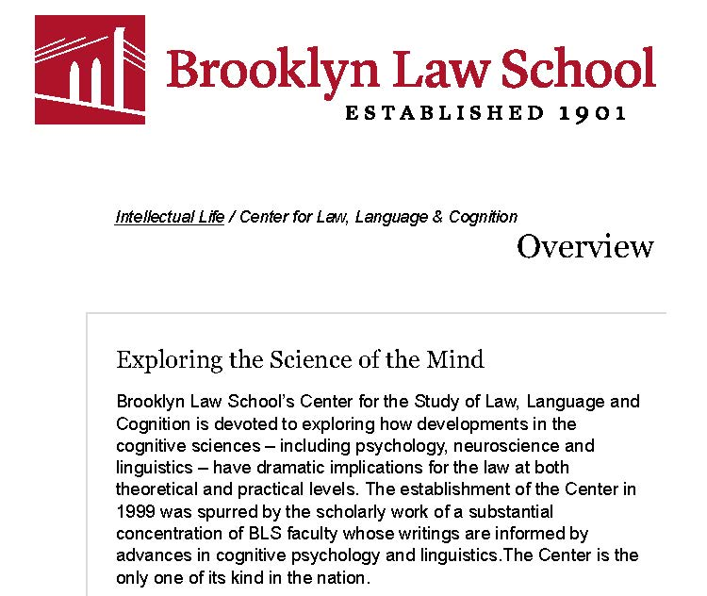
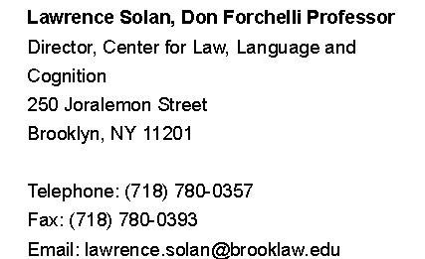
Prof. Lawrence Solan Brooklyn Law School

Slide 27
Solan - Books
Peter Tiersma & Lawrence Solan, SPEAKING OF CRIME: THE LANGUAGE OF CRIMINAL JUSTICE (Cambridge University Press 2005)
Lawrence Solan, THE LANGUAGE OF STATUTES: LAWS AND THEIR INTERPRETATION, (University of Chicago Press 2010)
Lawrence Solan & Peter Tiersma eds., OXFORD HANDBOOK OF LANGUAGE AND LAW (Oxford University Press 2012)
Lawrence Solan, Janet Ainsworth & Roger Shuy, Speaking of Language and Law: Conversations on the Work of Peter Tiersma (Oxford University Press, 2015)

Slide 28
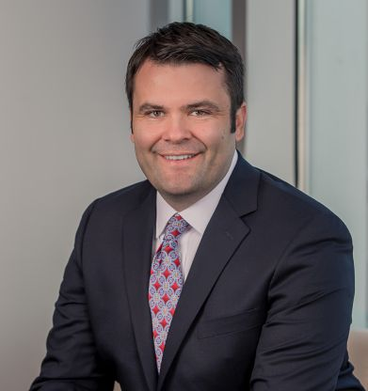
Stephen C. Mouritsen
2007, M.A., Brigham Young University, Linguistics
2010, J.D., magna cum laude, Brigham Young University,
Law School, Lead Articles Editor, BYU Law Review, Award for Outstanding Legal Writing
The Dictionary Is Not a Fortress: Definitional Fallacies and a Corpus-Based Approach to Plain Meaning, 2010 BYU Law Review 1915
2010-2011, Clerk to Justice Thomas Lee, Utah Supreme Court
State v. Rasabout, 356 P.3d 1258 (Utah 2015)
Judging Ordinary Meaning, 127 Yale Law Journal 788 (2018) (with Thomas R. Lee)

Slide 29
Ben Zimmer, The Corpus in the Court: ‘Like Lexis on Steroid’, The Atlantic (March 4, 2011)
James C. Phillips, Daniel M. Ortner, & Thomas R. Lee, Corpus Linguistics & Original Public Meaning: A New Tool To Make Originalism More Empirical, 126 Yale Law Journal Forum 21 (2016)
https://www.yalelawjournal.org/forum/corpus-linguistics-original-public-meaning
Thomas R. Lee & James C. Phillips, Data-Driven Originalism, University of Pennsylvania Law Review (forthcoming 2018)
https://papers.ssrn.com/sol3/papers.cfm?abstract_id=3036206

Slide 30
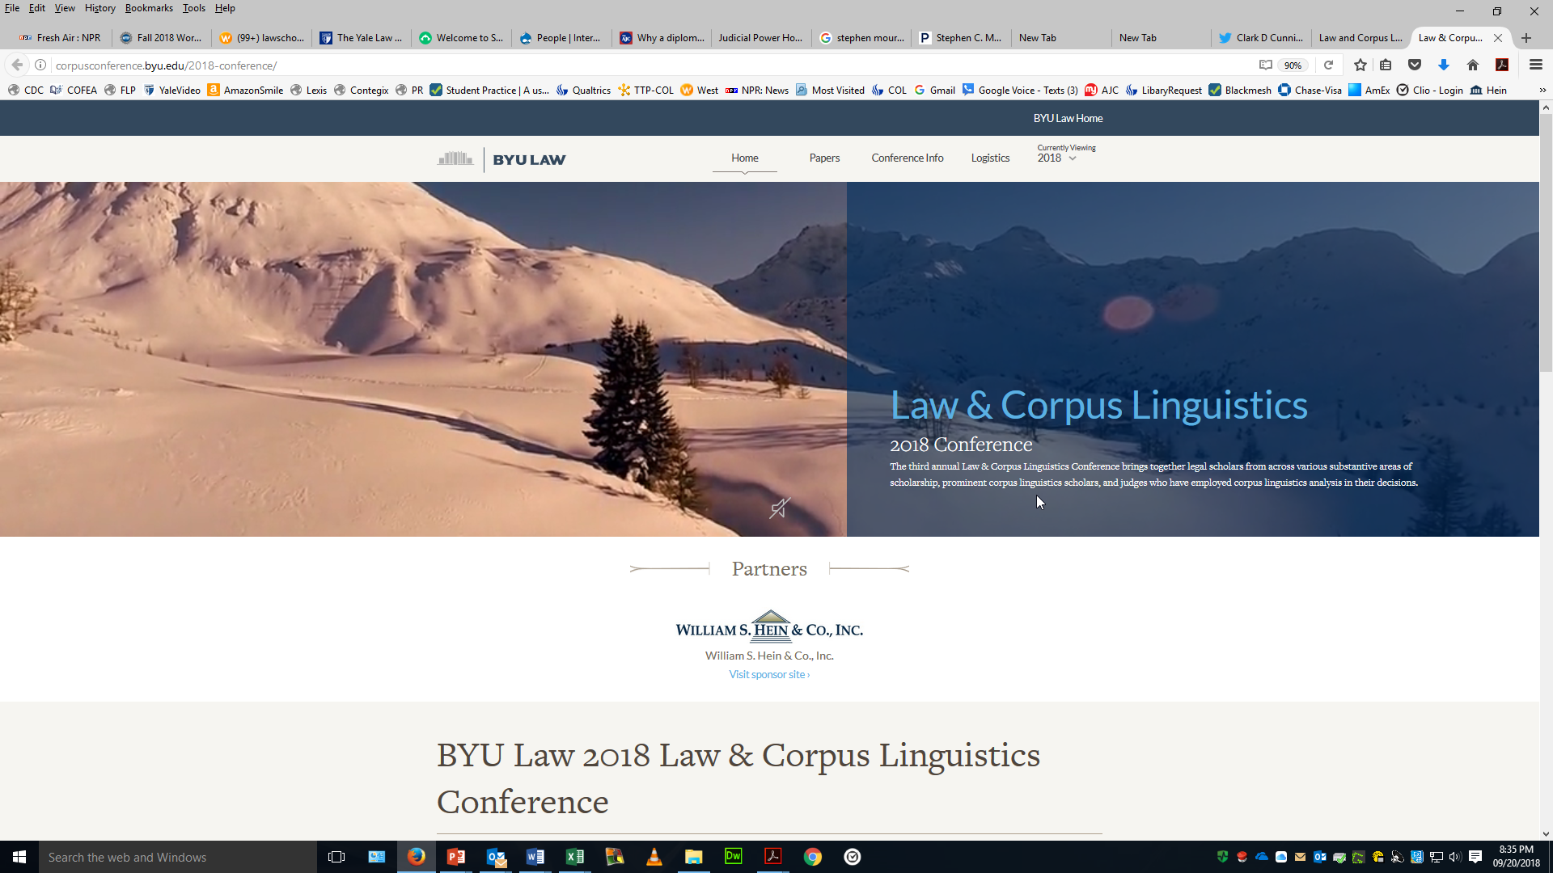

Slide 31
Articles available at https://lcl.byu.edu/scholarship/
Neal Goldfarb, A Lawyer’s Introduction to Meaning in the Framework of Corpus Linguistics, 2017 BYU L. Rev. 1359 (2018)
Jennifer L. Mascott, Who Are “Officers of the United States”?, 70 Stanford L. Rev. 443 (2018).
Stefan Th. Gries and Brian G. Slocum, Ordinary Meaning and Corpus Linguistics, 2017 BYU L. Rev. 1417 (2018).
Carissa Byrne Hessick, Corpus Linguistics and the Criminal Law, 2017 BYU L. Rev. 1503 (2018).
Thomas R. Lee & Stephen C. Mouritsen, Judging Ordinary Meaning, 127 Yale L. J. 788 (2018).
Jennifer L. Mascott, The Dictionary as a Specialized Corpus, 2017 BYU L. Rev. 1557 (2018).
James C. Phillips and Jesse Egbert, Advancing Law and Corpus Linguistics: Importing Principles and Practices from Survey and Content Analysis Methodologies to Improve Corpus Design and Analysis, 2017 BYU L. Rev. 1589 (2018).
Lawrence M. Solan and Tammy Gales, Corpus Linguistics as a Tool in Legal Interpretation, 2017 BYU L. Rev. 1311 (2018).

Slide 32
Works in Progress
James Cleith Phillips & Sara White, The Meaning of the Three Emoluments Clauses in the U.S Constitution: A Corpus Linguistic Analysis of American English, 1760-1799, 59 S. Tex. L. Rev. (forthcoming, issue 2, 2018)
James C. Phillips, Jacob Crump, & Benjamin Lee, Investigating the Original Meaning of “Officers of The United States” With the Corpus of Founding-Era American English (2018) https://papers.ssrn.com/sol3/papers.cfm?abstract_id=3126975

Slide 33
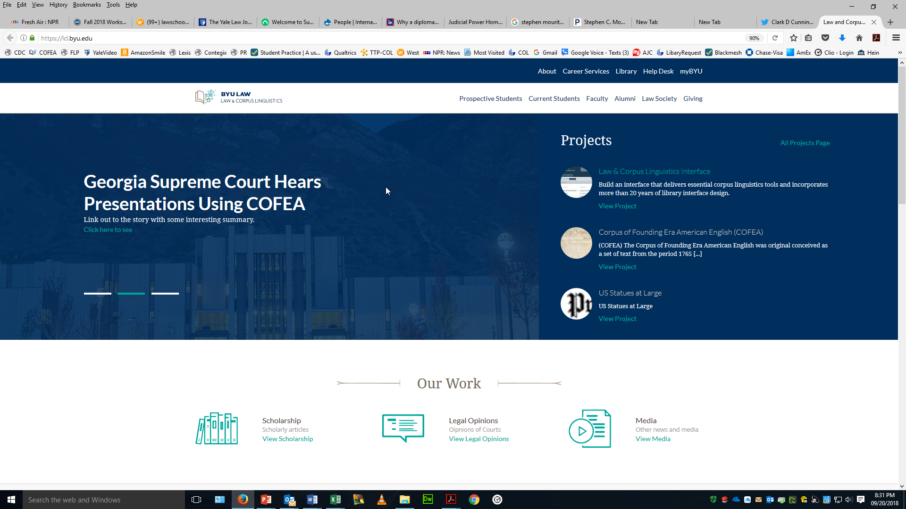

Slide 34
Seminar on Judicial Power
Georgia State University College of Law
Clark D. Cunningham
W. Lee Burge Chair in Law & Ethics
Spring Semester 2018
Web Site Address: www.clarkcunningham.org/JP/index.htm

Slide 35
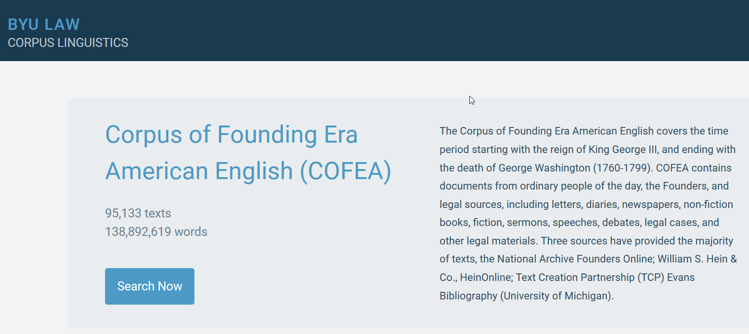

Slide 36
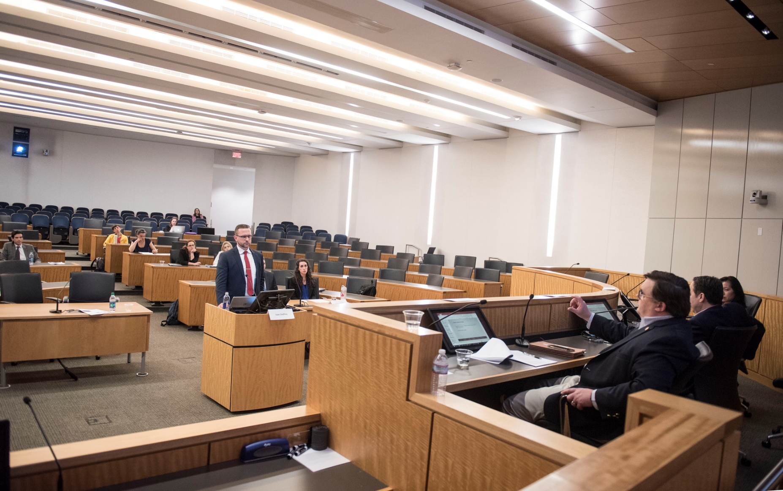
Isaac Godfrey 8th Amendment
“Excessive bail shall not be required …”

Slide 37
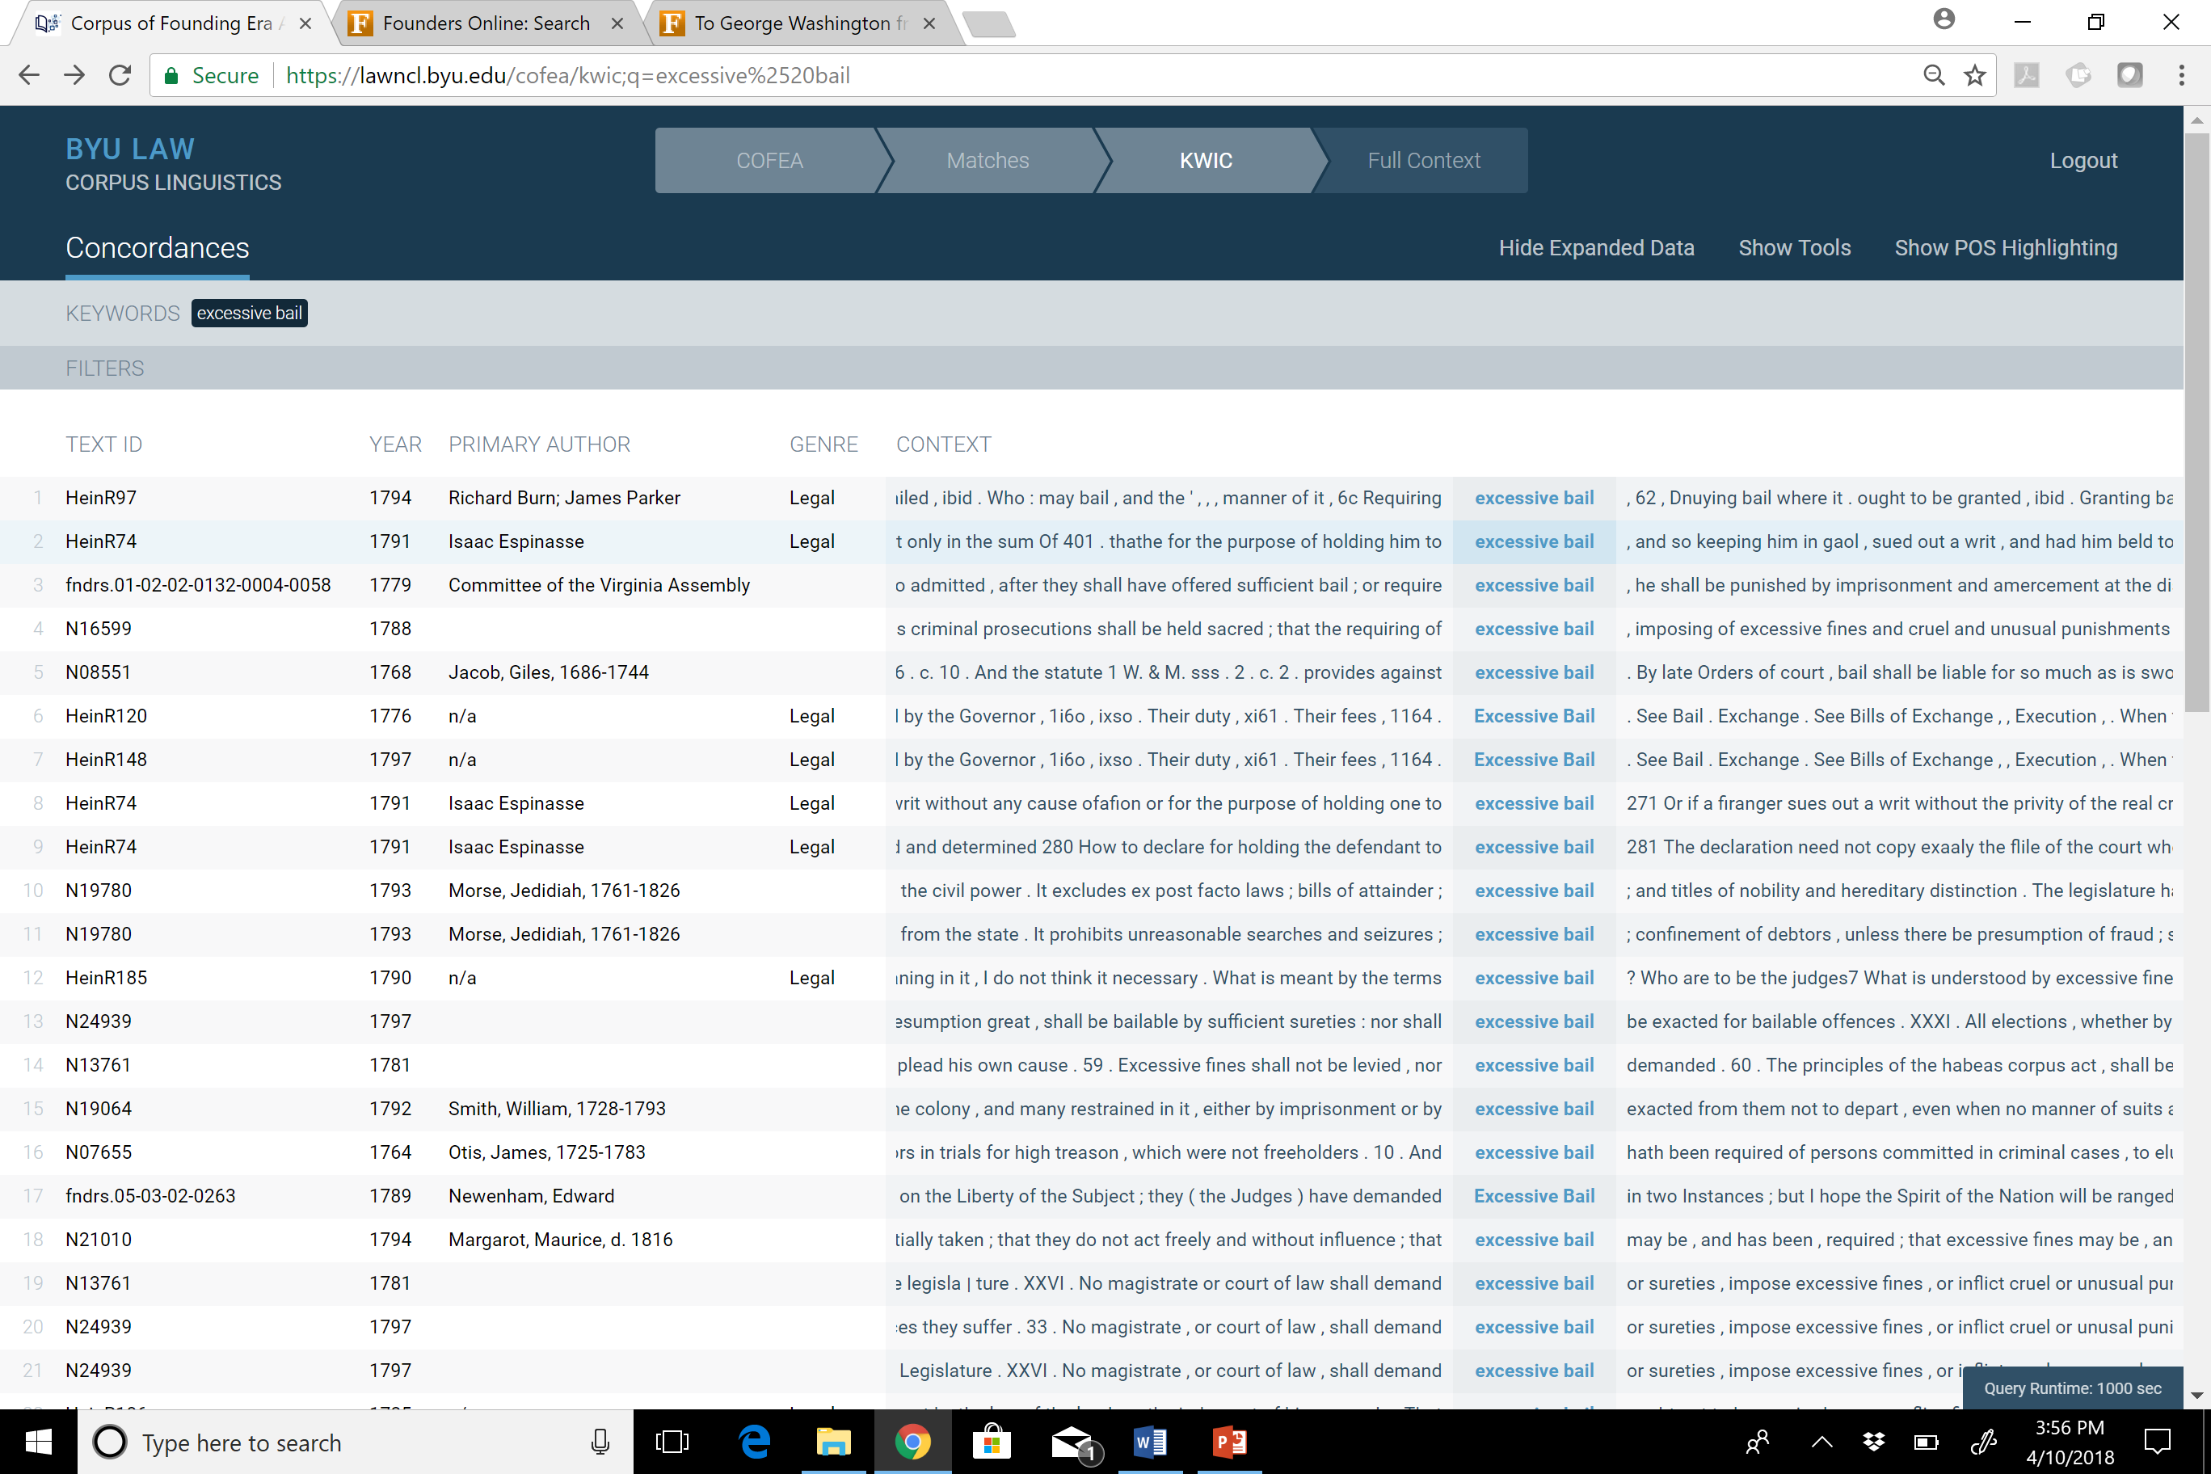

Slide 38
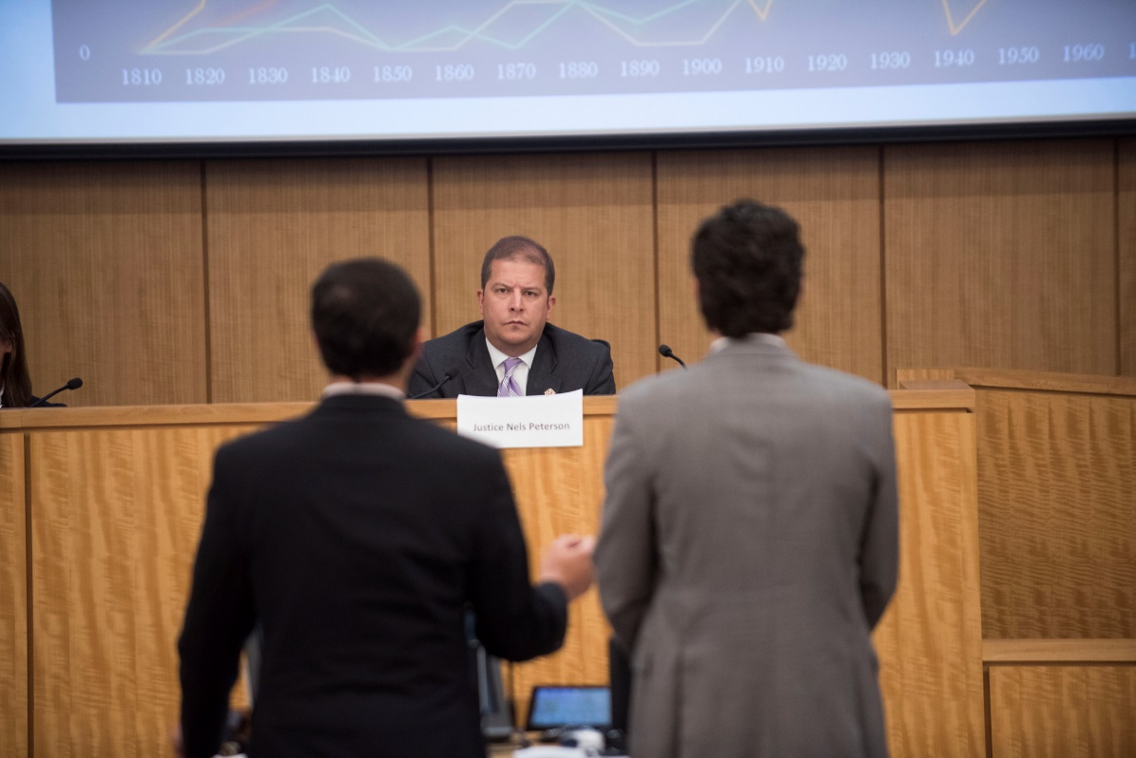
Pearson Cunningham & William Lasker
Congress shall make no law . . . abridging . . . the right of the people . . . to petition the Government for a redress of grievances

Slide 39
Different Senses of Petition – Which to Apply?
Petition = Prayer
Petition = A written request signed by a lot of people asking someone in authority to do something or change something
Petition = lawsuit

Slide 40
Corpus of Historical American English
400 million words of text from the 1810s-2000s

Slide 41
Corpus of Contemporary American English
560+ million words of text (1990-2017)

Slide 42
Corpus of Founders Era English

Slide 43
Corpus of Founding Era English

Slide 44
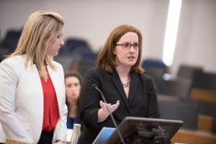
Eleanor Miller &
Heather Obelgoner
The executive power
Article II:
shall be vested in a President
of the United States of America.
Article I:
All legislative powers herein granted
shall be vested in a Congress
of the United States
Article III:
The judicial power of the United States,
shall be vested in one Supreme Court,
and in such inferior courts as the Congress may
from time to time ordain and establish
Notes:
So, like any good textualist, we began with the text of Article II. And what originally caught our attention was this broad grant of singular “executive power” (queue underline), that stood in contrast to the syntax of the other vesting clauses (click for Art I & Art II). Point out limiting language in Art. I & III. Mention this will be a distinction that we will return to later during the linguistic presentation.

Slide 45
Linguistic Drift – COCA Results
Chief
Senior
Top
Marketing
Advertising
Business
Notes:
Explain COFEA vs. COCA. COCA (1990-present); COFEA (1760-1799). Point out drift. “Run the government like a business” first appeared in the 1920s, gaining popularity under Reagan. This connotation was never contemplated at the time of the Founding.

Slide 46
Linguistic Drift – COFEA Results
Supreme
Whole
All
Chief
Federal
Legislative
Notes:
Explain COFEA vs. COCA. COCA (1990-present); COFEA (1760-1799). Point out drift. “Run the government like a business” first appeared in the 1920s, gaining popularity under Reagan. This connotation was never contemplated at the time of the Founding.

Slide 47
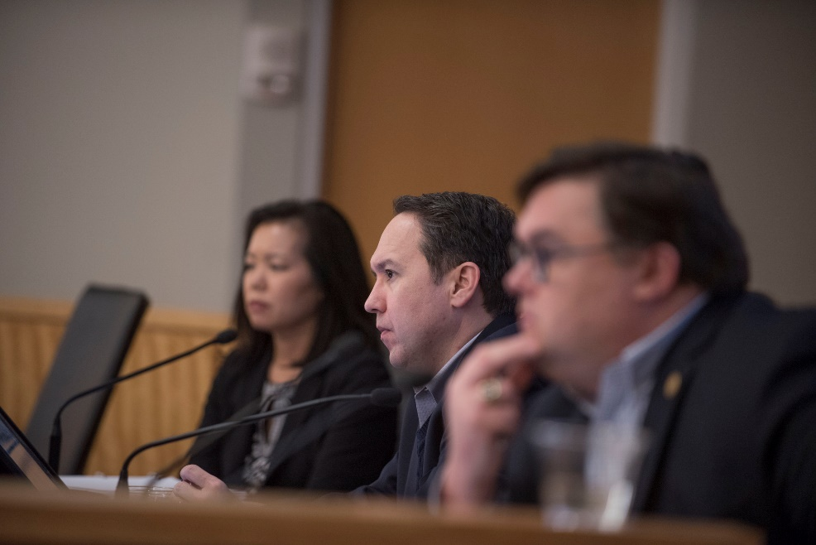
Don’t Be Cruel: A Corpus Analysis of the Cruel and Unusual Punishments Clause
Aaron Smothers and Cecelia Howard
Excessive bail shall not be required, nor excessive fines imposed, nor cruel and unusual punishments inflicted.

Slide 48
Cruel
Cruel and
and Cruel
1. Cruel and unjust;
2. Cruel and ignominious;
3. Cruel and wicked;
4. Cruel and unheard of;
5. Cruel and oppressive;
6. Cruel and contrary;
7. Cruel and unnatural;
8. Cruel and shocking;
9. Cruel and horrid;
10. Cruel and unrelenting or relentless.
1. Unjust and cruel;
2. Bloody and cruel;
3. Sanguinary and cruel;
4. Oppressive and cruel;
5. Dreadful and cruel;
6. Great . . . and cruel;
7. Unkind . . . and cruel;
8. Proud, arrogant, and cruel;
9. Ungenerous, base, defamatory, and cruel;
10. Iniquitous and cruel.

Slide 49
Cruel
Action-Based
Actor-Based
1. Cruel and unjust;
2. Cruel and unheard of;
3. Cruel and contrary;
4. Cruel and unnatural;
5. Cruel and shocking;
6. Cruel and horrid;
7. Bloody and cruel;
8. Sanguinary and cruel;
9. Dreadful and cruel;
10. Great . . . and cruel;
11. Iniquitous and cruel.
1. Cruel and unjust;
2. Cruel and ignominious;
3. Cruel and wicked;
4. Cruel and oppressive;
5. Cruel and unrelenting or relentless.
6. Unkind . . . and cruel;
7. Proud, arrogant, and cruel;
8. Ungenerous, base, defamatory, and cruel.

Slide 50
GSU Law Students Present Research: April 11, 2018
Big Data Meets the Constitution in New Originalism Project:
Georgia appellate judges evaluate cutting-edge inquiries into what the Constitution's framers meant from Georgia State University law students.
Meredith Hobbs, Daily Report, May 1, 2018
"This is revolutionary,” said Georgia Appeals Court Chief Judge Stephen Dillard. “It’s like Westlaw for originalism.”
Students Present New Insights on Original Meaning of Constitution to Judges using “Big Data”of Corpus Linguistics
GSU College of Law News, May 21, 2018
“I thought the students were all exceptionally well prepared, the writing was very strong, the research was very strong, and it’s grappling with some of the most difficult questions that courts have to deal with today.”
Justice Nels Peterson, Supreme Court of Georgia

