Slide 1
Combined Presentation 10:00-10:40 10:40-11:00 Combined Q&A
Changing Attitudes About Client Communication
Clark D. Cunningham
Professional Identity Formation: Better Understanding the Nature of the Attorney-Client Relationships and the Importance and Characteristics of Great Client Service
Jerry Organ

Slide 2
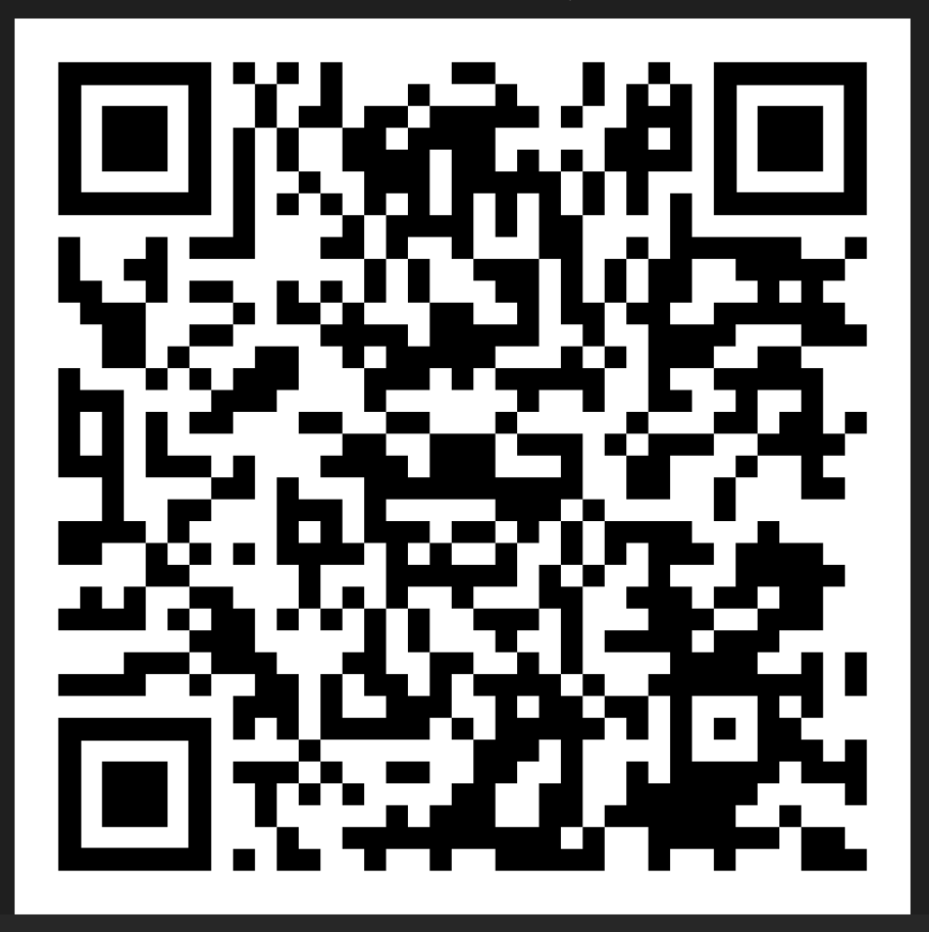
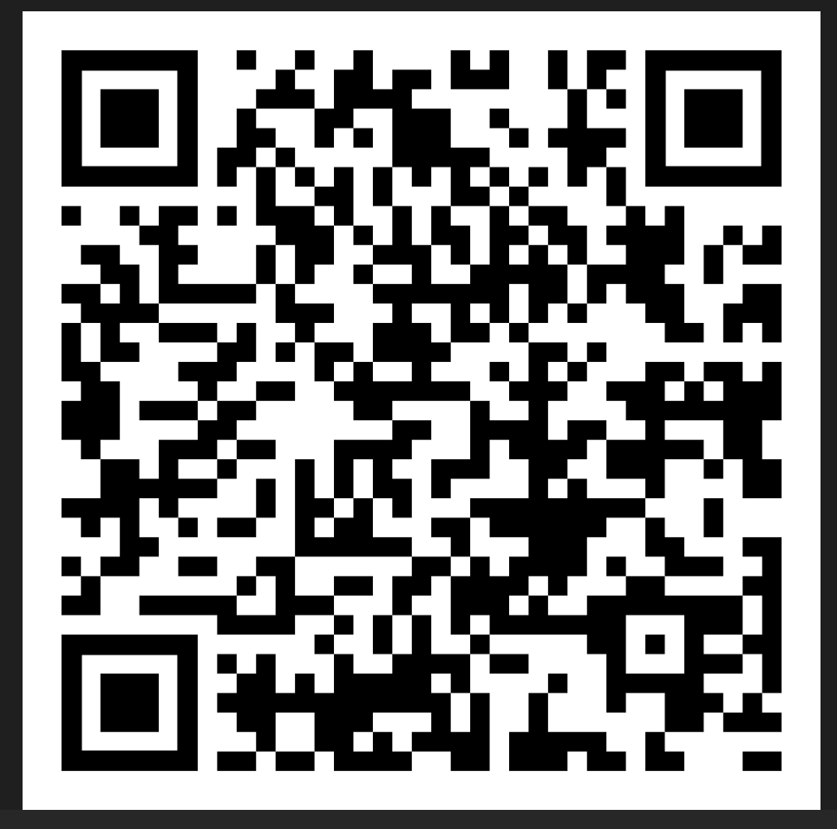
Download this presentation
PPT
PDF

Slide 3
CHANGING ATTITUDES ABOUT CLIENT COMMUNICATION
Clark D. Cunningham
W. Lee Burge Professor of Law & Ethics
Director, National Institute for Teaching Ethics & Professionalism
Georgia State University College of Law
Atlanta, Georgia U.S.A. cdcunningham@gsu.edu www.clarkcunningham.org www.niftep.org

Slide 4
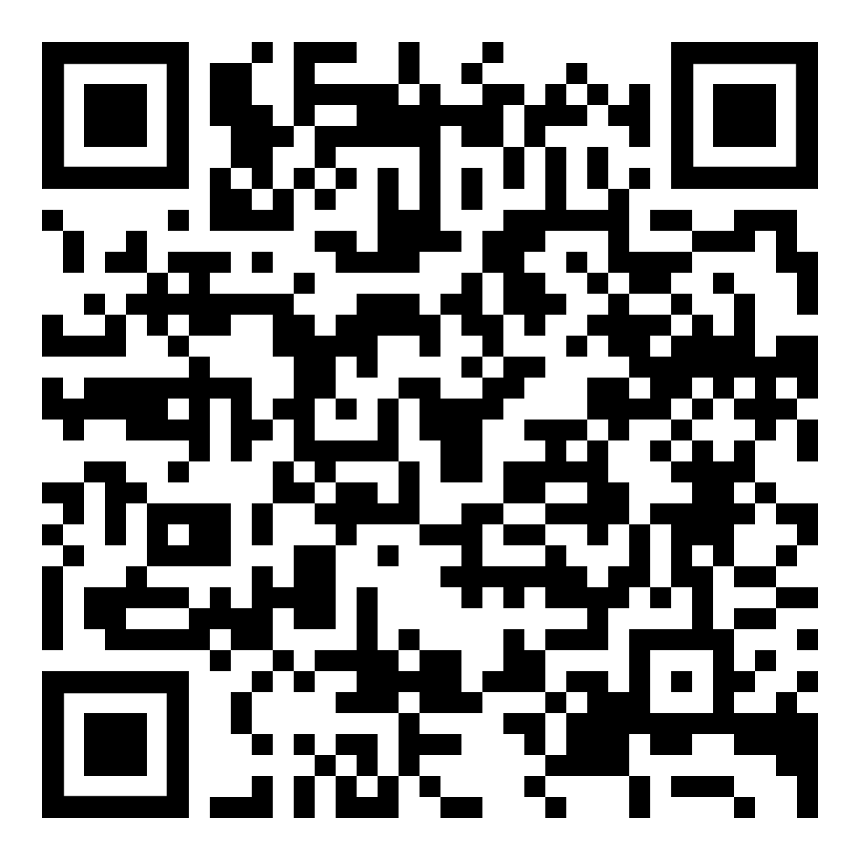
Cunningham, "What Do Clients Want From Their Lawyers?“
2013 Journal of Dispute Resolution 143

Slide 5
What do clients most care about?
CLIENT PERCEPTIONS OF LITIGATION
WHAT COUNTS: PROCESS OR RESULT?
Tom Tyler,Trial Magazine (1988)
Clients care most about the process
  having their problems or disputes settled in a way that they view as fair
second most important is achieving a fair settlement
least important factor is the number of assets they end up winning.

Slide 6
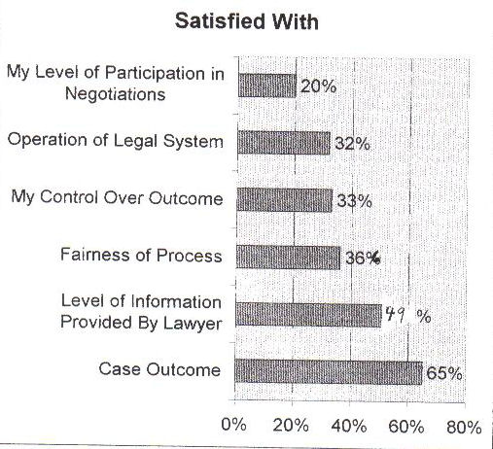
PLAINTIFFS AND THE PROCESS OF LITIGATION:
An Analysis of the Perceptions of Plaintiffs Following their Experience of Litigation
Tania Matruglio (Civil Research Centre Australia 1994)

Slide 7
LawCover Study
Australia’s largest indemnity insurer
  Commissioned a Risk Management Project
  Sample from over 2000 claims
  Extensive & confidential interview with each lawyer
  In most cases also interviewed the lawyer who defended the claim.
Major Causes of Claims
  not dissatisfaction with outcome
  But instead the handling of the client relationship
  Failure to
    listen to the client
    ask appropriate questions
    explain relevant aspects of the matter

Slide 8
Australia: Client Satisfaction with Specialists’ Services
Widespread client satisfaction with the specialists’ legal knowledge and skills
Consistent evidence of client dissatisfaction with the provision of services

Slide 9
Different ideas of competence
Practitioners and clients were selecting divergent indicators of performance
Practitioners concentrated on knowledge and skills to deliver outcomes
Clients expected both competence and positive results
But were disappointed by the process of getting there

Slide 10
Clients complained about
Inaccessibility
Lack of communication
Lack of empathy and understanding
Lack of respect

Slide 11
Additional Training Recommended
client focused rather than transaction focused
client needs are not confined to attaining objective outcomes
listen to clients more attentively
diagnose their various levels of needs
demonstrate empathy

Slide 12
Value of Experience for
Client Communication
Study by Prof. Avrom Sherr (U of London)
143 actual 1st interviews
  24 % trainee solicitors
  76% experienced solicitors
    70% at least 6 years
    23% more than 11 years
High percentages of ineffective interviews
  Experienced solicitors generally no better

Slide 13
Common Problems with All Solicitors
51% failed to get the client’s agreement to advice or plan of action
76% failed to confirm with client the solicitor’s understanding of the facts
85% failed to ask before ending whether there was anything else the client wanted to discuss

Slide 14
Where There Were Differences Between New and Experienced Solicitors
Experienced solicitors
  Used less legalese
  Better at “filling in the gaps”
  Rated their own interview performance higher than did trainee solicitors
But the clients saw no difference in performance between trainees and experienced solicitors

Slide 15

Professional Identity Formation: Better Understanding the Nature of the Attorney- Client Relationship and the Importance and Characteristics of Great Client Service
Jerry Organ
Bakken Professor of Law and Co-Director of the
Holloran Center for Ethical Leadership in the Professions
University of St. Thomas School of Law (Minnesota)
©The Holloran Center for Ethical Leadership in the Professions

Slide 16
Topics We Will Cover
What do we know about employer expectations about client service?
What do we know about law school emphasis on client service?
What is one way to engage students in better understanding the hallmarks of great client service?
What have we learned from these student engagements with clients and attorneys?

Slide 17
2020 Survey of Law Firm Competency Models
~2020 Survey of Law Firm Competency Expectations for Associate Development
Collaborative effort to find out what law firms really focus on when evaluating the development of associates
Developed through the summer and early fall of 2020 and was disseminated to NALP members in early November
50 law firms with written competency models responded
Focused on competencies, on communication of competencies and on use of competency models.
©The Holloran Center for Ethical Leadership in the Professions

Slide 18
2020 Survey of Law Firm Competency Models
~Aside from traditional “law school” competencies – 90% of competency models included:
  Responsibility/Reliability,
  Initiative,
  Attention to Detail,
  Teamwork/Collaboration
  Responsiveness to Clients,
  Understand Client’s Business/Concerns
©The Holloran Center for Ethical Leadership in the Professions

Slide 19
NCBE – NextGen Bar Exam
~ Seven Foundational Skills
  Legal Research
  Legal Writing
  Issue Spotting and Analysis
  Investigation and Evaluation
  Client Counseling and Advising
  Negotiation and Dispute Resolution
  Client Relationship and Management
©The Holloran Center for Ethical Leadership in the Professions

Slide 20
Challenges and Disconnects – LAW FIRMS
~ Little indication that law firms use these competencies in hiring –
~ Over one-third of firms (37.3%) indicated they do not use
competency models in their recruiting and hiring process for attorneys at any level.
~ Respondents at 15.7% of the firms did not know whether competencies were integrated into hiring decisions.
©The Holloran Center for Ethical Leadership in the Professions

Slide 21
Challenges and Disconnects – LAW SCHOOLS
~ These competencies show up very infrequently in law school learning outcomes.
~ Holloran Center Learning Outcomes Database tracks law school learning outcomes.
  ~ https://law.stthomas.edu/about/centers-institutes/holloran-center/learning-outcomes-database/
~ Less than one-quarter of law schools have the following learning outcomes – Counseling (22%), Client Interviewing (18%), Client Centered (18%), Active Listening (17%).
©The Holloran Center for Ethical Leadership in the Professions

Slide 22
CHANGING ATTITUDES ABOUT CLIENT COMMUNICATION
Clark D. Cunningham
W. Lee Burge Professor of Law & Ethics
Director, National Institute for Teaching Ethics & Professionalism
Georgia State University College of Law
Atlanta, Georgia U.S.A. cdcunningham@gsu.edu www.clarkcunningham.org www.niftep.org

Slide 23
2000 Research Study
Law Society of England & Wales
Hillary Sommerlad & David Wall: Legally Aided Clients and Their Solicitors: Qualitative Perspectives on Quality and Legal Aid
Interviewed 44 clients of 21 different solicitors in the north of England.

Slide 24
2000 Research Study
Law Society of England & Wales
50% said that they had previously used a solicitor whom they did not like.
Those 50% were then asked an open-ended question:
  “Why were you disappointed?”

Slide 25
I went to [my current solicitor]...
because of her reputation and expertise
she is a part-time registrar and has a big reputation as a specialist in this area
but SHE JUST DOESN’T LISTEN.
She listens for part of what I have to say, and then interrupts, saying something like
‘OK, I’ve got the picture, what we’ll do is ...’
and she hasn’t really got the picture, she’s only got half the facts.

Slide 26
I think it’s partly because …
she is so busy
and also because she’s simply not used to giving clients a voice.
What’s more she has actually made me frightened of expressing my views.
I am about to change to another solicitor.

Slide 27
Listening
I sent my former solicitor packing because SHE WOULDN’T LISTEN. That is absolutely fundamental; this was my case, only I knew the full circumstances.”
“They must be able to give you time. If solicitors haven’t got enough time, they can’t get enough out of you. You have to have time to be able to tell your story.”

Slide 28
Explaining
“At my first meeting with [my current solicitor] ... I was impressed by his natural ability to talk about technical things with knowledge, but on a level that I could understand.
  we actually talked and he explained in clear language
  Other people just had a job to do, but [he] took time to clearly explain technical things.
  He explained how the system works.”
“She speaks of legal matters in a way that is knowledgeable and she explains it well.”
“She communicates clearly. She puts things in layman’s terms.”

Slide 29
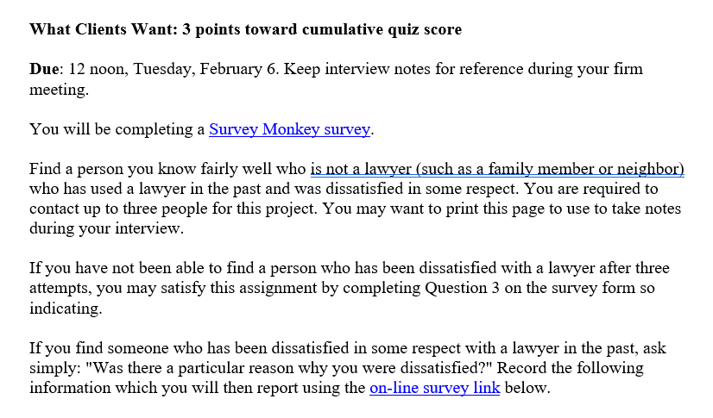

Slide 30
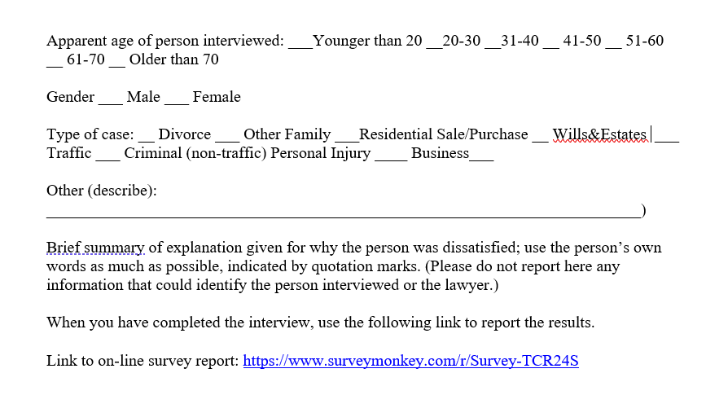

Slide 31
Professional Identity Formation: Better Understanding the Nature of the Attorney- Client Relationship and the Importance and Characteristics of Great Client Service
Jerry Organ
Bakken Professor of Law and Co-Director of the
Holloran Center for Ethical Leadership in the Professions
University of St. Thomas School of Law (Minnesota)
©The Holloran Center for Ethical Leadership in the Professions

Slide 32
Serving Clients Well Course
~ St.Thomas Law emphasizes the importance of client service by requiring a first-year course at the start of the second semester called Serving Clients Well.
~ The course emphasizes relationship skills, including listening skills, cross-cultural competence, and delivering bad news.
~ The course also emphasizes professional development with a focus on growth mindset, time management, self-direction and integrity.
~ The course is one-credit – pass-rail – and is taught in four sections of forty by four full-time faculty.
©The Holloran Center for Ethical Leadership in the Professions

Slide 33
Client Interview Assignment
~ Two important components of the learning experience involve interview projects – one with clients and one with an attorney.
~ Inspired by the work of Clark Cunningham, we started giving students a client interviewing assignment to complete over Winter Break.
~ Each student has to find a satisfied client and a dissatisfied client and have the clients identify whether they were satisfied or unsatisfied.
~ The students work with a confined glossary (over a dozen options) and list up to four reasons why their client was satisfied or dissatisfied.
~ They submit responses in a spreadsheet with all responses then compiled and analyzed.
~ We have been doing this for several years. With roughly 150-160 students we end up with over 700 reasons for satisfied clients and 500-600 for dissatisfied clients.

Slide 34
What do the Students Learn?
~ The following results are averages over the last four years:
~ Satisfied Clients are satisfied because of:
  Competence/Effort (38%) (Competent, Knowledgeable, Attention to Detail, Efficient) and
  Relationship Skills/Communications (34%)(Communicated Clearly, Responsive, Empathetic, Caring/Kind, Listened Well)
  Phrased differently – Competence/Effort and/or Relationship Skills/Communications were mentioned by all satisfied respondents, but only slightly more than half of respondents mentioned Good Results or Fair Price.

Slide 35
What Do the Students Learn?
~ Dissatisfied Clients are dissatisfied because of:
  Relationship Skills/Communications (39%) (Didn’t Communicate Clearly, Didn’t Listen, Didn’t Return Calls, Arrogant, Not Empathetic, Dictated Outcome) and
  Competence/Effort (26%) (Lack of Effort, Incompetence, Lack of Attention to Detail, Missed Deadlines)
  Phrased differently – Relationships Skills/Communications were mentioned by nearly all dissatisfied respondents, but less than half mentioned Inadequate Results or Too Expensive.

Slide 36
Relationship Skills/Communication and Competence/Effort are the “Secret Sauce”
~ Being a successful attorney – that is, having satisfied clients – is pretty easy.
  ~ Care about your client – listen to your client – respond to your client and demonstrate competence and you will have satisfied clients.
~ Being an unsuccessful attorney – having dissatisfied clients – also is pretty easy.
  ~ Don’t care, don’t listen, be arrogant, don’t respond, don’t put forth effort and you will have dissatisfied clients.

Slide 37
Who Are You as a Lawyer?
~ To a large extent, these challenges for some attorneys arise from a problem with professional identity formation.
~ Think about the language used in the slides Clark presented. “Didn’t listen” “What we will do is . . . .
~ If lawyers are socialized to believe that they are the knowledge experts and the analytical wizards, they tend to adopt an arrogant, “I am the decision-maker” attitude.
~ This leaves clients dissatisfied because they feel unheard, not listened to, and not in control of how their matter will be resolved.

Slide 38
A Lawyer is . . . “A Problem-Solver”
~ For most of my career as a Iawyer, and for the first part of my career as a teacher, I would have filled in the phrase “A Lawyer is . . . “ by saying PROBLEM-SOLVER.
~ But what is the problems with this construct?
~ I am the agent – the one solving the problem.
~ I well may be doing so without fully considering my client’s needs/wants/interests/goals.
~ I now say “A Lawyer is . . . Someone Who Helps Clients Solve Problems.”
~ If more lawyers thought this way more clients would be satisfied!!

Slide 39
Attorney Interview Project
~ After we finish with our class sessions, students are put in groups of three and assigned the responsibility to interview an attorney discussing themes raised in the course – including the nature of the attorney-client relationship and how the attorneys resolve conflicts with clients.
~ We do not identify a pool of “preferred” attorneys; students can pick anyone.
~ They then work together to write a memo summarizing the conversation during the interview in relation to the several themes set forth in the assignment.
~ (This is a great teamwork, project management, client communication exercise if you have them think about their partners as “clients”!)
~ With rare exception, the attorneys are “on message” – highlighting the importance of being client-centered and being responsive and focused on the client’s goals and interests.
.

Slide 40
CHANGING ATTITUDES ABOUT CLIENT COMMUNICATION
Clark D. Cunningham
W. Lee Burge Professor of Law & Ethics
Director, National Institute for Teaching Ethics & Professionalism
Georgia State University College of Law
Atlanta, Georgia U.S.A. cdcunningham@gsu.edu www.clarkcunningham.org www.niftep.org

Slide 41
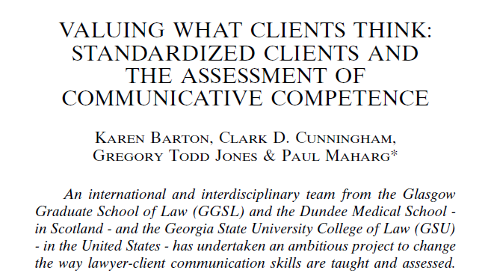
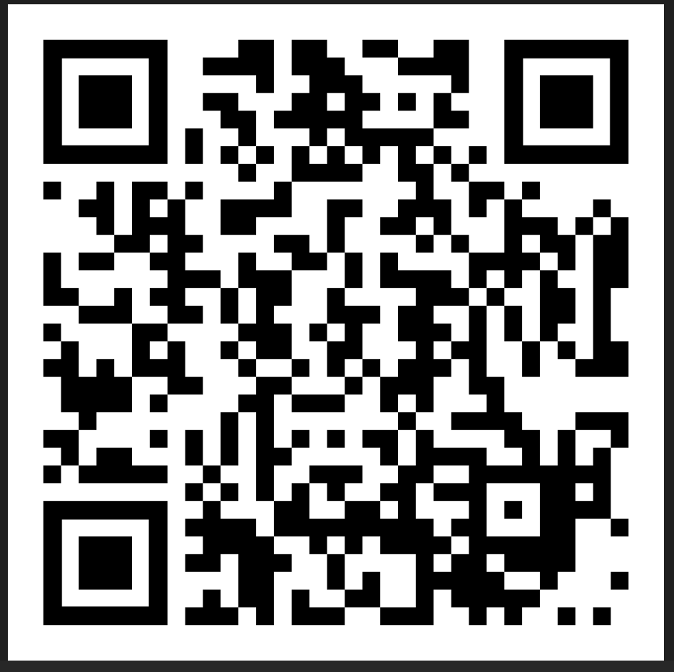
13 Clinical Law Review 1 (2006)

Slide 42

Standardized or Simulated Patients in Medical Education

Slide 43
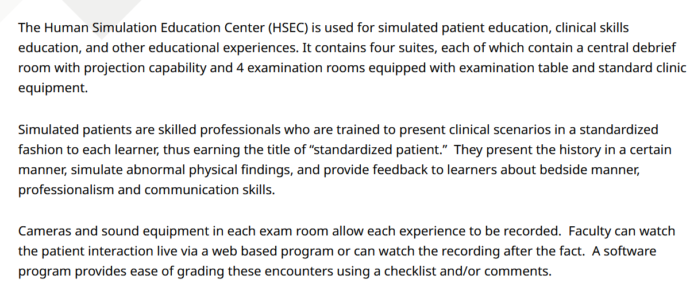

Slide 44
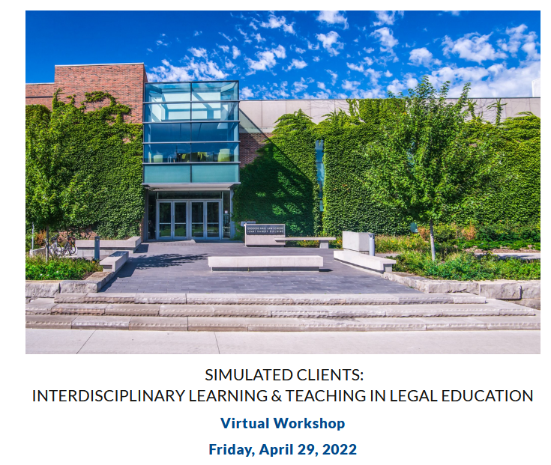
Osgoode Hall Law School
York University, Toronto

Slide 45
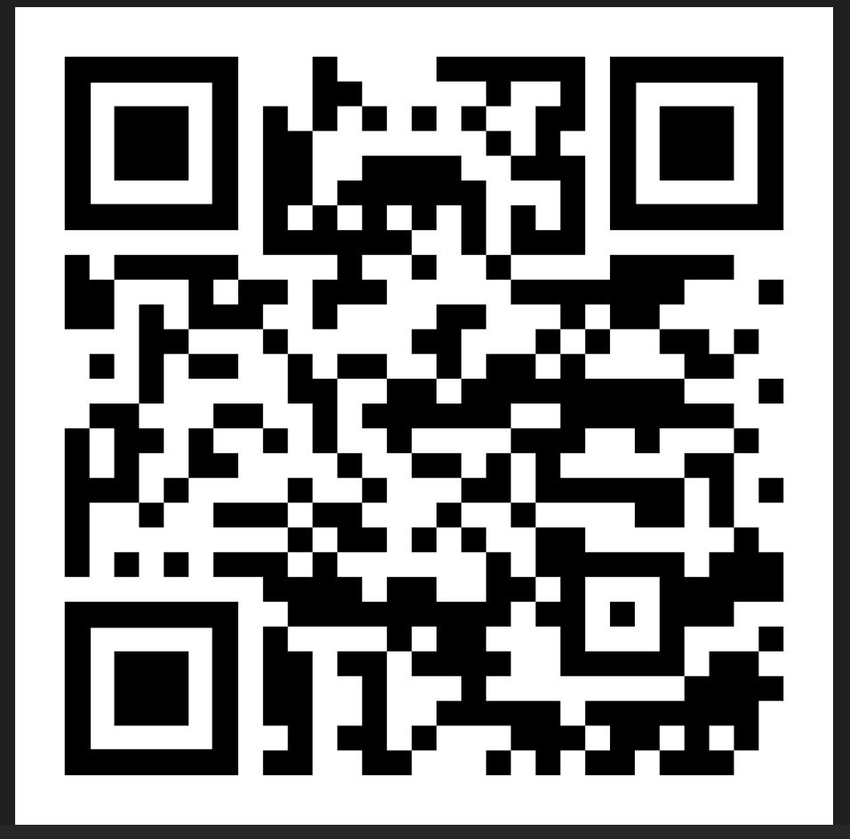
Osgoode Workshop Website

Slide 46
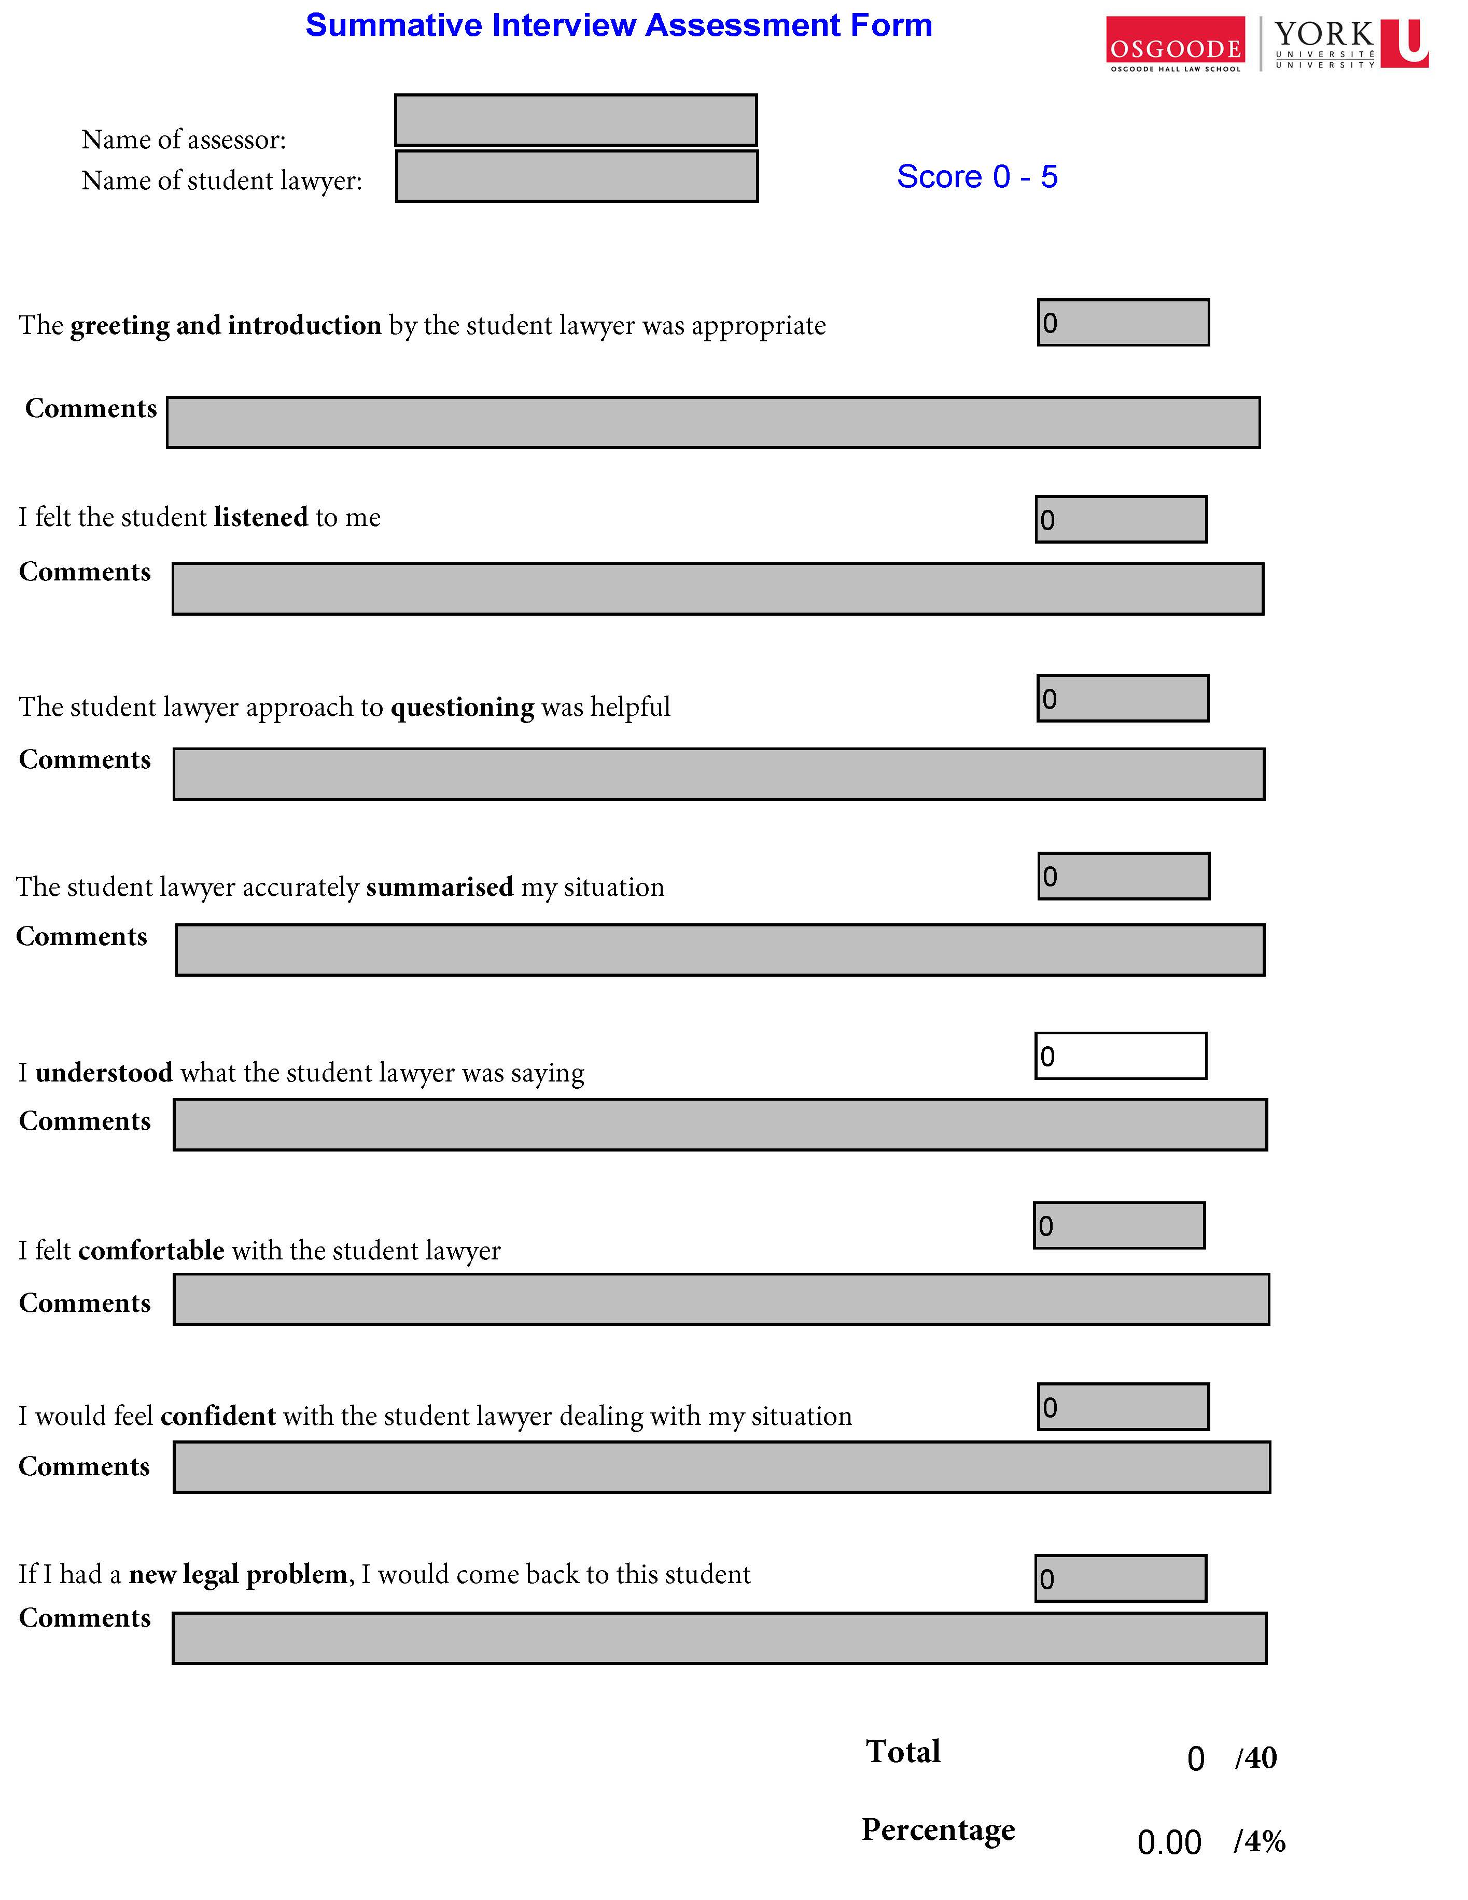

Slide 47
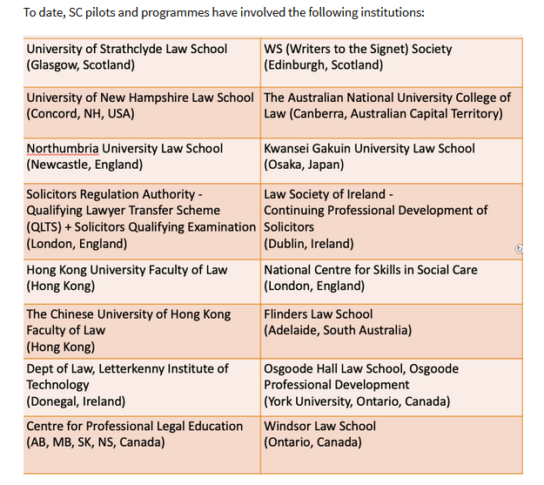
Osgoode Workshop Website

Slide 48
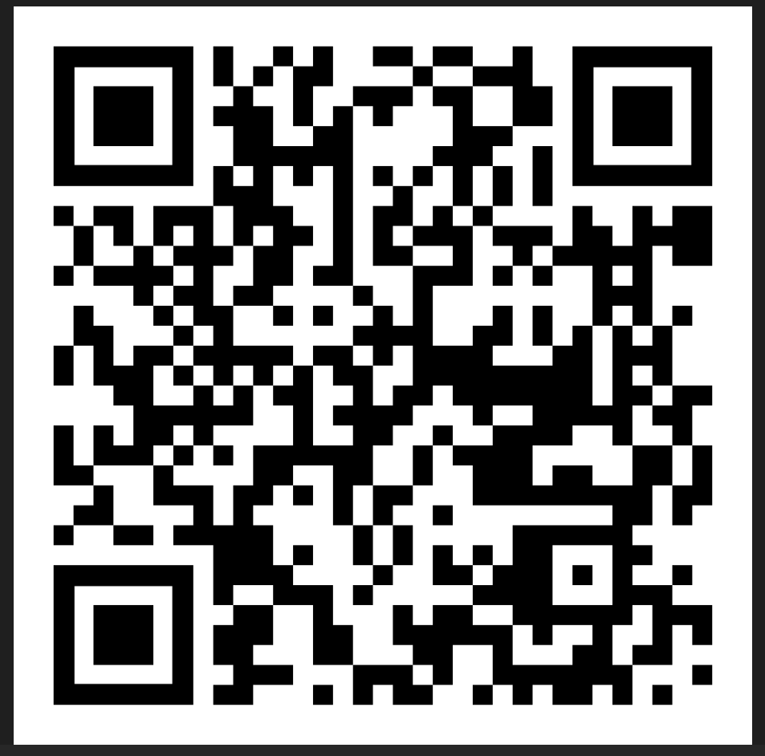
Transitioning Simulated Client Interviews from Face-to-Face to Online
Paul Maharg & Angela Yenssen
13 European Journal of Law and Technology No. 3 (2022)

Slide 49
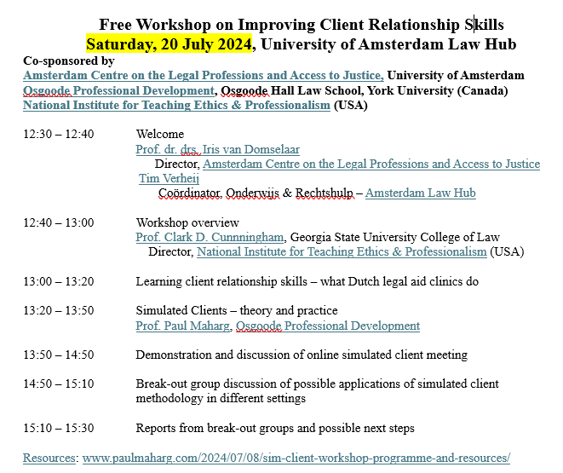

Slide 50
Download this presentation
PPT
PDF

