Slide 1
The Client Relationship and Basics of Legal Ethics in Georgia
Clark D. Cunningham W. Lee Burge Chair in Law & Ethics
Director, National Institute for Teaching Ethics & Professionalism Georgia State University College of Law
www.ClarkCunningham.org

Slide 2
2000 Research Study Law Society of England & Wales
Hillary Sommerlad & David Wall: Legally Aided Clients and Their Solicitors: Qualitative Perspectives on Quality and Legal Aid
Interviewed 44 clients of 21 different solicitors in the north of England.
50% said that they had previously used a solicitor whom they did not like.
The most common complaint was lack of respect, followed by a lack of interest in the client, and then poor communication.

Slide 3
I sent my former solicitor packing
because SHE WOULDN’T LISTEN
“That is absolutely fundamental; this was my case, only I knew the full circumstances.”

Slide 4
I went to [my current solicitor] because of her reputation and expertise
she is a part-time registrar and has a big reputation as a specialist in this area
but SHE JUST DOESN’T LISTEN.

Slide 5
She listens for part of what I have to say, and then interrupts, saying something like
‘OK, I’ve got the picture, what we’ll do is ...’
and she hasn’t really got the picture, she’s only got half the facts.
I think it’s partly because she so busy and also because she’s simply not used to giving clients a voice.

Slide 6
What’s more she has actually made me frightened of expressing my views.
I am about to change to another solicitor.

Slide 7
Explaining
“At my first meeting with [my current solicitor] ... I was impressed by his natural ability to talk about technical things with knowledge, but on a level that I could understand.
we actually talked and he explained in clear language
Other people just had a job to do, but [he] took time to clearly explain technical things.
He explained how the system works.”

Slide 8
“She speaks of legal matters in a way that is knowledgeable and she explains it well.”
“She communicates clearly. She puts things in layman’s terms.”

Slide 9
Legal 500 (Scotland)
“He has the knack of being able to present very complex situations comprehensibly to commercial managers”
“[Their entire legal team is able to] provide a clear explanation to the layperson on sometimes complex legal issues”

Slide 10
Back to England
“They must be able to give you time. If solicitors haven’t got enough time, they can’t get enough out of you. You have to have time to be able to tell your story.”
I like my current solicitor because I “can have a chat with her, I trust her ... ... The other solicitor — I was just a file for him, but for her I’m a real person and that comes across in court.”

Slide 11
“ I wanted the law to be explained. ... The way the solicitor views the client is important. He has to be interested in our views.”
“I never liked him. ... we couldn’t have had a solicitor like him for this; I think he was perfectly competent, but there was no sympathy.”

Slide 12
For many clients, their engagement with the law was not simply about achieving a result.
Their responses indicated that the process itself was important.
Empathy and respect were not luxury items
But fundamental to the service.

Slide 13
What do clients most care about?
CLIENT PERCEPTIONS OF LITIGATION WHAT COUNTS: PROCESS OR RESULT? Tom Tyler,Trial Magazine (1988)
Clients care most about the process
having their problems or disputes settled in a way that they view as fair
second most important is achieving a fair settlement
least important factor is the number of assets they end up winning.

Slide 14
PLAINTIFFS AND THE PROCESS OF LITIGATION: An Analysis of the Perceptions of Plaintiffs Following their Experience of Litigation Tania Matruglio CIVIL JUSTICE RESEARCH CENTRE Australia 1994

Slide 15
Australia: LawCover Study
LawCover: Australia’s largest indemnity insurer for lawyers
Commissioned a Risk Management Project
Sample from over 2000 claims
Extensive & confidential interview with each lawyer
In most cases also interviewed the lawyer who defended the claim.

Slide 16
Major Causes of Claims
not dissatisfaction with outcome
handling of the client relationship
failure to
listen to the client
ask appropriate questions
explain relevant aspects of the matter

Slide 17
Australia: Client Satisfaction with Specialists’ Services
Widespread client satisfaction with the specialists’ legal knowledge and skills
Consistent evidence of client dissatisfaction with the provision of services

Slide 18
Different ideas of competence
Practitioners and clients were selecting divergent indicators of performance
Practitioners concentrated on knowledge and skills to deliver outcomes
Clients expected both competence and positive results
But were disappointed by the process of getting there

Slide 19
Clients complained about
Inaccessibility
Lack of communication
Lack of empathy and understanding
Lack of respect

Slide 20
Value of Experience for Client Communication
Study by Prof. Avrom Sherr (U of London)
143 actual 1st interviews
24 % trainee solicitors
76% experienced solicitors
70% at least 6 years
23% more than 11 years
High percentages of ineffective interviews
Experienced solicitors generally no better

Slide 21
Common Problems with All Solicitors (Sherr Study)
51% failed to get the client’s agreement to advice or plan of action
76% failed to confirm with client the solicitor’s understanding of the facts
85% failed to ask before ending whether there was anything else the client wanted to discuss

Slide 22
Where There Were Differences Between New and Experienced Solicitors
Experienced solicitors
Used less legalese
Better at “filling in the gaps”
Rated their own interview performance higher than did trainee solicitors
But the clients saw no difference in performance between trainees and experienced solicitors

Slide 23
Georgia Rules of Professional Conduct (GRPC): Preamble
Scope
[21] The Comment accompanying each Rule explains and illustrates the meaning and purpose of the Rule.
The Comments are intended as guides to interpretation, but the text of each Rule is authoritative.

Slide 24
Rule 4-403 Formal Advisory Opinions No S Ct Review
If the Supreme Court of Georgia declines to review the Formal Advisory Opinion, it shall be binding only on
the State Bar of Georgia
and the person who requested the opinion,
and not on the Supreme Court of Georgia, which shall treat the opinion as persuasive authority only.

Slide 25
Rule 4-403 Formal Advisory Opinions S Ct Disapproves
If the Supreme Court of Georgia grants review and disapproves the opinion, it shall have absolutely no effect and shall not constitute either persuasive or binding authority.

Slide 26
Rule 4-403 Formal Advisory Opinions S Ct Approves
If the Supreme Court of Georgia approves or modifies the opinion, it shall be binding on all members of the State Bar of Georgia and shall be published in the official Georgia Reports.
The Supreme Court of Georgia shall accord such approved or modified opinion the same precedential authority given to the regularly published judicial opinions of the Court.

Slide 27
Attorney Discipline Flowchart

Slide 28
Consumer Assistance Program (CAP)
CAP Intake Form

Slide 29
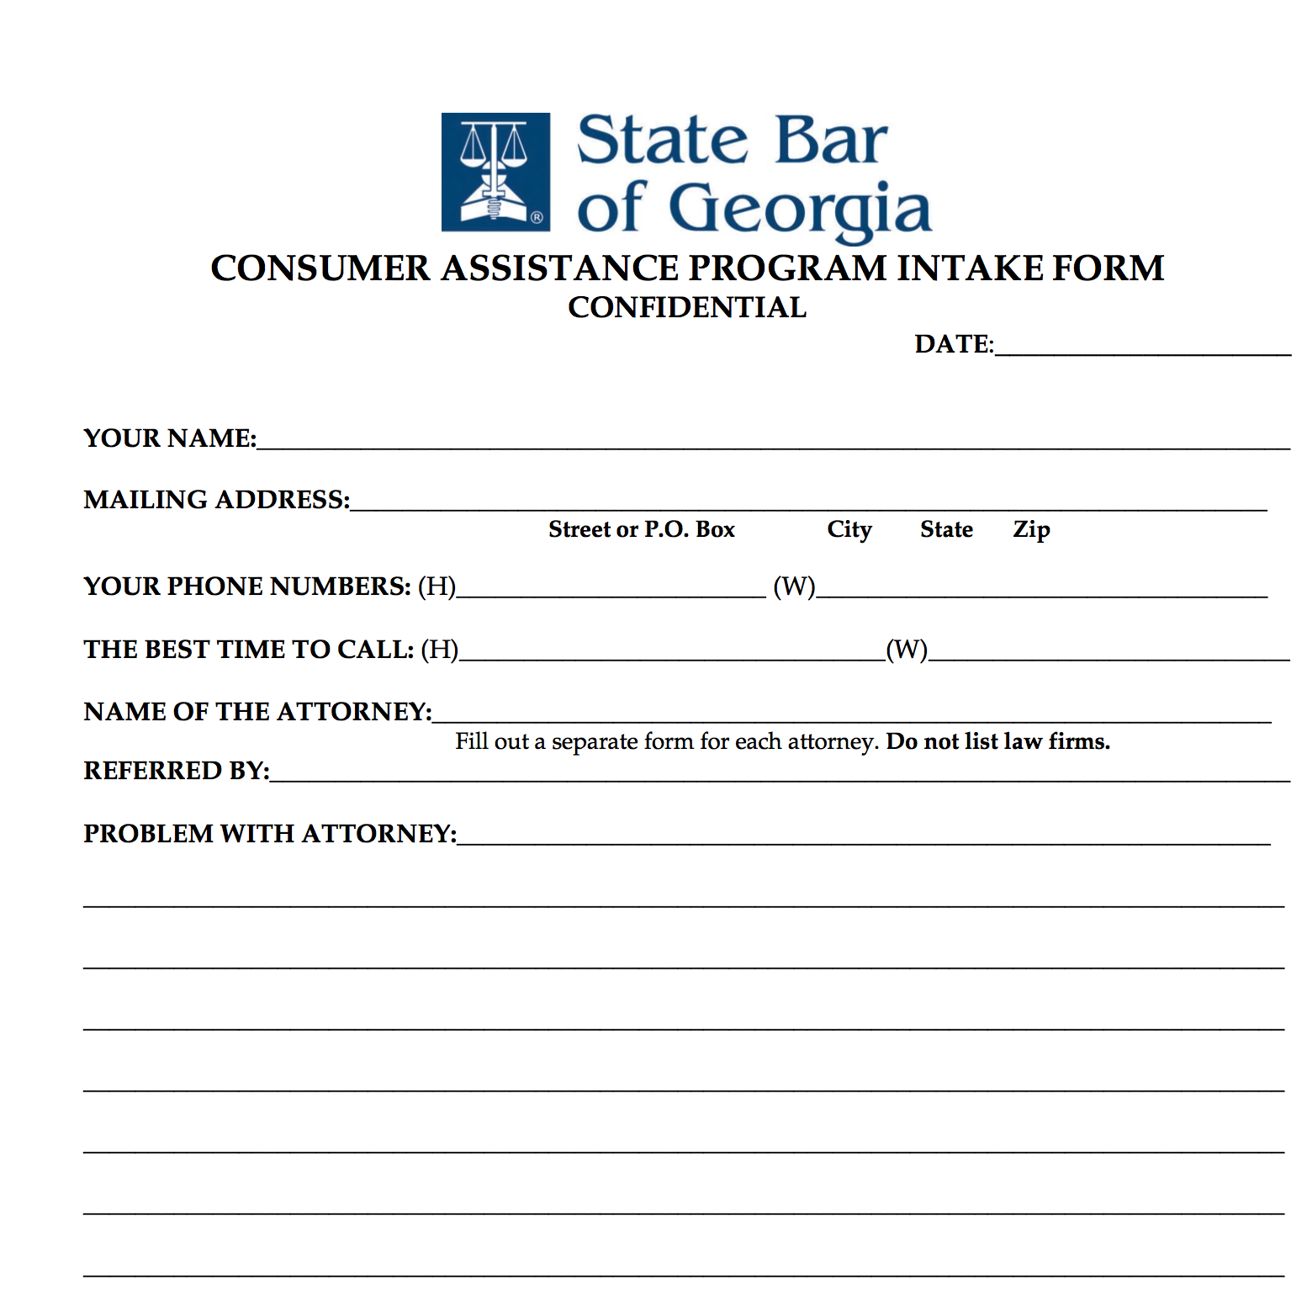

Slide 30
Consumer Assistance Program (CAP)
CAP Intake Form
Resolved by CAP
Refer to General Counsel
Refer to Fee Arbitration

Slide 31
CAP referral Written Grievance or Credible Information to
General Counsel (4-202)
Notice of Investigation
Board Investigation (4-204)
Assigned to Board Member & Staff Investigator
Dismiss
Answer to Notice of Investigation due in 30 days (4-204.3)

Slide 32
Answer to Notice of Investigation due in 30 days (4-204.3)
Dismiss Complaint & Confidential Letter of Instruction (4-204.5)
Confidential Letter of Formal Admonition (4-206)
Confidential Reprimand (4-206)
Notice of Discipline (4-208.1)
Dismiss Complaint
Accept
Rejected (4-208.3)

Slide 33
Rejected
Formal Complaint
Special Master
Review Board
Supreme Court

Slide 34
GRPC 1.1 Competence
A lawyer shall provide competent representation to a client.
Competent representation as used in this Rule means that a lawyer shall not handle a matter which the lawyer knows or should know to be beyond the lawyer’s level of competence
without associating another lawyer who the original lawyer reasonably believes to be competent to handle the matter in question.

Slide 35
GRPC 1.1 Competence
Competence requires
the legal knowledge,
skill,
thoroughness
and preparation
reasonably necessary for the representation.

Slide 36
GRPC 1.2 Scope of Representation
(a) Subject to paragraphs (c) and (d), a lawyer shall abide by a client's decisions concerning the scope and objectives of representation
and, as required by Rule 1.4, shall consult with the client as to the means by which they are to be pursued.
A lawyer may take such action on behalf of the client as is impliedly authorized to carry out the representation.

Slide 37
GRPC 1.2 Scope of Representation
A lawyer shall abide by a client's decision whether to settle a matter.
In a criminal case, the lawyer shall abide by the client's decision,
after consultation with the lawyer,
as to a plea to be entered,
whether to waive jury trial
and whether the client will testify.

Slide 38
GRPC 1.2 Scope of Representation
(c) A lawyer may limit the scope and objectives of the representation
if the limitation is reasonable under the circumstances
and the client gives informed consent.
See Comment [7]

Slide 39
GRPC 1.2 Scope of Representation
Comment [7]
the limitation must be reasonable under the circumstances.
If a client's objective is limited to securing general information about the law the client needs in order to handle a common and typically uncomplicated legal problem, the lawyer and client may agree that the lawyer's services will be limited to a brief telephone consultation.
Such a limitation, however, would not be reasonable if the time allotted was not sufficient to yield advice upon which the client could rely.

Slide 40
GRPC 1.2 Scope of Representation
Comment [7]
Although an agreement for a limited representation does not exempt a lawyer from the duty to provide competent representation,
the limitation is a factor to be considered when determining the legal knowledge, skill, thoroughness and preparation reasonably necessary for the representation.

Slide 41
GRPC 1.2 Scope of Representation
(a) Subject to paragraphs (c) and (d), a lawyer shall abide by a client's decisions concerning the scope and objectives of representation
and, as required by Rule 1.4, shall consult with the client as to the means by which they are to be pursued.

Slide 42
GRPC 1.0 Terminology
(c) ``Consult'' or ``consultation'' denotes communication of information reasonably sufficient to permit the client to appreciate the significance of the matter in question.

Slide 43
GRPC 1.2 Scope of Representation
(c) A lawyer may limit the scope and objectives of the representation
if the limitation is reasonable under the circumstances
and the client gives informed consent.

Slide 44
GRPC 1.0 Terminology
(h) ``Informed consent'' denotes the agreement by a person to a proposed course of conduct
after the lawyer has communicated adequate information and explanation
about the material risks of
and reasonably available alternatives
to the proposed course of conduct.

Slide 45
GRPC 1.4 Communication
(a) A lawyer shall:
(1) promptly inform the client of any decision or circumstance with respect to which the client's informed consent, as defined in Rule 1.0(h), is required by these Rules;
(2) reasonably consult with the client about the means by which the client's objectives are to be accomplished

Slide 46
GRPC 1.4 Communication
(a) A lawyer shall ...
(3) keep the client reasonably informed about the status of the matter;
(4) promptly comply with reasonable requests for information

Slide 47
GRPC 1.4 Communication
(a) A lawyer shall …
(5) consult with the client about any relevant limitation on the lawyer's conduct when the lawyer knows that the client expects assistance not permitted by the Rules of Professional Conduct or other law.
(b) A lawyer shall explain a matter to the extent reasonably necessary to permit the client to make informed decisions regarding the representation.

Slide 48
GRPC 1.4 Communication
(a) A lawyer shall …
(5) consult with the client about any relevant limitation on the lawyer's conduct when the lawyer knows that the client expects assistance not permitted by the Rules of Professional Conduct or other law.

Slide 49
GRPC 1.4 Communication
(b) A lawyer shall explain a matter to the extent reasonably necessary to permit the client to make informed decisions regarding the representation.

Slide 50
GRPC 2.1 Advisor
In representing a client, a lawyer shall exercise independent professional judgment and render candid advice.
A lawyer should not be deterred from giving candid advice by the prospect that the advice will be unpalatable to the client.

Slide 51
GRPC 1.3 Diligence
A lawyer shall act with
reasonable diligence
and promptness
in representing a client.
Reasonable diligence as used in this Rule means that a lawyer shall not without just cause to the detriment of the client in effect wilfully abandon or wilfully disregard a legal matter entrusted to the lawyer.

Slide 52
GRPC 1.5 Fees
a. A lawyer shall not make an agreement for, charge, or collect an unreasonable fee or an unreasonable amount for expenses

Slide 53
GRPC 1.5 Fees
b. The scope of the representation and the basis or rate of the fee and expenses for which the client will be responsible shall be communicated to the client, preferably in writing, before or within a reasonable time after commencing the representation, except when the lawyer will charge a regularly represented client on the same basis or rate.
Any changes in the basis or rate of the fee or expenses shall also be communicated to the client.

Slide 54
Formal Advisory Opinion 01-1
In order to comply with Rule 1.5(b), the attorney must communicate the basis for the fee to the client,
and in order to comply with Rule 7.1(a), the communication must include an explanation of any standard unit billing practice.

Slide 55
Formal Advisory Opinion 01-1
It is the practice of many attorneys to bill on a time-expended basis, and to bill for time expended by rounding to standard units of from 6 to 15 minutes.
While "rounding up" is permissible … repeatedly rounding up from one minute to fifteen minutes is questionable at best and would raise substantial issues as to whether the fee was reasonable
A lawyer could avoid a challenge to rounded up fees as excessive by using a smaller minimum unit (a six minute unit is preferable), and only rounding up if more than half that time was actually expended.

