Slide 1
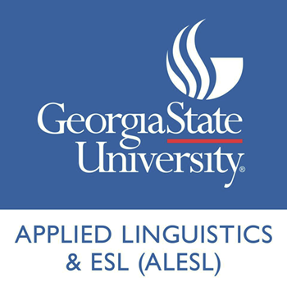
Workshop on
LAW & LINGUISTICS
Eric Friginal
Georgia state university
efriginal@gsu.edu
GSU College of LAW
October 18, 2019

Slide 2
Corpus linguistics
Is a research approach in the study of spoken and written discourse, supporting empirical, frequency-based investigations of naturally occurring language-in-use.
Biber, Reppen, and Friginal (2010)

Slide 3
Corpus linguistics
A research approach for describing language use to answer the question:
How do speakers and writers across various demographics (or registers) actually use the vocabulary and grammar resources available in a language?
What is a CORPUS?
  A large, principled collection of ‘natural’ texts stored on computer
  A corpus should ‘represent’ particular language varieties or registers (e.g., legal written discourse vs. press reports vs. television interviews)
  Design and size are important: texts must be sampled from particular target registers

Slide 4
So what is corpus linguistics?
A research approach – A way of thinking about language
  Shines the spot light on language use: Registers and language for specific purposes
  Allows investigation of language choice: Why does a speaker/writer use a particular word or grammatical form rather than alternatives?
  Allows investigation of meaning in context: Why synonyms are usually not interchangeable
  Allows investigation of language preference: What forms are rare? What is especially common?

Slide 5
Corpus-Based Research in ESP/EOP
Studies in the subfields of English for Specific Purposes (ESP) and English for Occupational Purposes (EOP) have increasingly utilized corpus-based approaches over the past 20 years.
A survey of articles in many recent issues of English for Specific Purposes Journal or the Journal of English for Academic Purposes shows that linguistic descriptions of professional/academic varieties of English are often primarily based on corpora (Biber, Reppen, & Friginal, 2010).

Slide 6
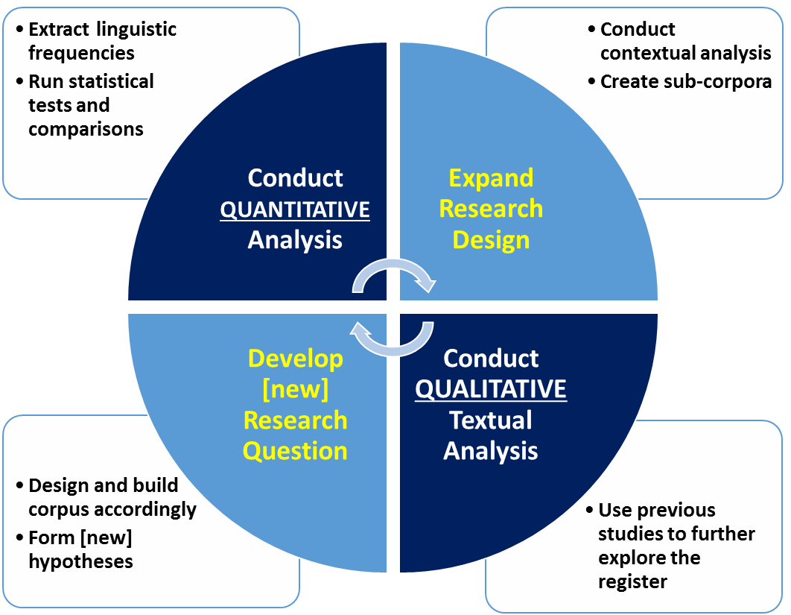
Potential stage cycle for corpus-assisted discourse analysis, adapted from Friginal (2008),
Baker et al. (2008), and Friginal and Hardy (2014)
Include Legal Discourse-Specific Analyses and Datasets
START HERE

Slide 7
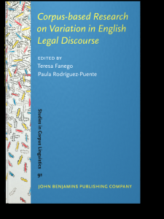
Reflections
Interdisciplinary collaborations are important and very meaningful.
The importance of taking into account diachronic change and shifts in language, especially functions/meanings, and how to interpret speaker/writer intent [RQ: Is there evidence that Americans in the Founding Era could have used the word “emolument” to describe revenue derived from ownership of a hotel?].
Register differences – the 6 different sub-registers of COFEA.
Corpus Linguistics in the U.S., Europe, and globally.

