Slide 1


CL 2021 Online Conference
What counted as a misdemeanor in founding era American English? A corpus approach to uncovering the original public meaning of “misdemeanors” in the impeachment clause
Clark D. Cunningham, College of Law
Ute Römer, Dept of Applied Linguistics and ESL
Georgia State University, Atlanta, Georgia, USA
cdcunningham@gsu.edu
uroemer@gsu.edu

Slide 2
Law – Linguistics Collaboration
In this study we combined corpus linguistic and historical research to explore a contested and important issue regarding interpretation of the U.S. Constitution
We endeavor to model best practices in applying corpus methods to legal interpretation through collaboration of experts in the disciplines of law and linguistics
Our home pages
www.clarkcunningham.org
https://uteroemer.weebly.com/
Download this power point at:
www.clarkcunningham.org/L2-PPT.html

Slide 3
Prior law-linguistics collaborations
Meaning of “emolument” in the US Constitution
  “ no Person … shall, without the Consent of the Congress, accept of any present, Emolument, Office or Title” from a foreign state
Corpus study by Cunningham and Jesse Egbert (Northern Arizona Univ.)
  Filed as friend of the court brief (2019) and cited (2020), In re Trump, US Court of Appeals, 4th Circuit
  Published, Using Empirical Data to Investigate the Original Meaning of “Emolument” in the Constitution, 36 Georgia State Law Review 465 (2020)
Aaron Blake, A big Trump case hinges on the definition of ‘emoluments.’ A new study has bad news for him (Washington Post Jan 29, 2019)

Slide 4
Prior law-linguistics collaborations
Meaning of “cases” in the US Constitution
  “The judicial power shall extend to all cases, in Law and Equity, arising under this Constitution [or] the Laws of the United States”
Corpus study by Cunningham, Römer, Egbert et al.
  Filed as friend of the court brief and cited, Wright v Spaulding, US Court of Appeals, 6th Circuit (2019)
  Published, “Questions Involving National Peace and Harmony” or “Injured Plaintiff Litigation”? The Original Meaning of “Cases” in Article III of the Constitution, 36 Georgia State L. Rev 491 (2020)
These briefs and articles, as well as other resources, are available at:
www.clarkcunningham.org/Law-Linguistics.html

Slide 5
US Constitution Article II, Section 4
“The President, Vice President and all civil Officers of the United States, shall be removed from Office on Impeachment for, and Conviction of,
Treason, Bribery, or other high Crimes and Misdemeanors.”
  Drafted by the Constitutional Convention: 1787
  Ratification by the 13 states completed: 1790

Slide 6
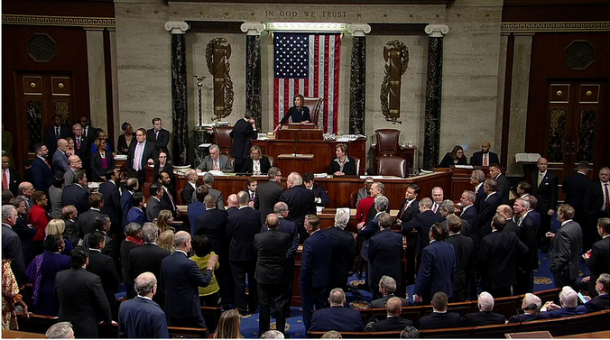
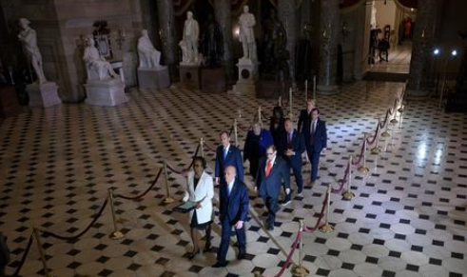
Dec 18, 2019 House of Representatives approves two articles of impeachment against President Donald Trump | Jan 15, 2020 House Managers Deliver Articles of Impeachment to the Senate

Slide 7
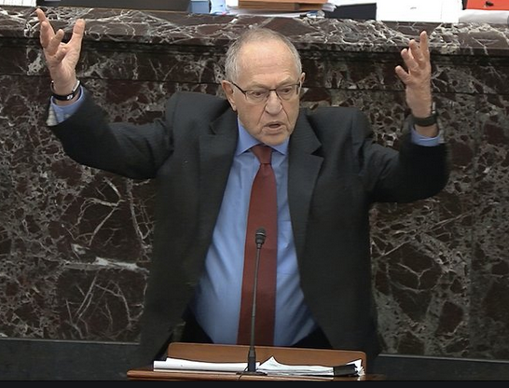
“Misdemeanor just a synonym for crime” interpretation
1st Senate Impeachment Trial –
Donald Trump, January 27, 2020
Emeritus Harvard law prof Alan
Dershowitz, arguing on behalf of Trump:
“[the] terms high crimes and misdemeanors do not encompass the two articles [of impeachment] charging abuse of power and obstruction of Congress”
  Because abuse of power and obstruction are not crimes
“crimes and misdemeanors are mere synonymous terms”, quoting Blackstone’s Commentaries on the Laws of England (1770)

Slide 8
Dershowitz challenged with corpus evidence
Clark D. Cunningham, The One Word Alan Dershowitz Gets Wrong in the Impeachment Clause: There's a reason the Founders didn't just end it at "high crimes" Politico, Jan. 24, 2020
Clark D. Cunningham, The Dershowitz Attack on the Trump Articles of Impeachment is Weakened, Perhaps Fatally, by the Possibility That “Misdemeanors” Could Mean “Misconduct”, Harvard Law Review Blog, Jan. 29, 2020

Slide 9
“Term of art” interpretation of impeachment clause
“high Crimes and Misdemeanors was a term of art [taken] from British parliamentary practice … habitually used to preface description of any conduct for which Parliament thought an official should be impeached.”
  Frank Bowman, High Crimes and Misdemeanors: A History of Impeachment for the Age of Trump (2019)
Similar position:
  Laurence Tribe & Joshua Matz, To End a Presidency: The Power of Impeachment (2019)
  Michael Gerhardt, Impeachment: What Everyone Needs to Know (2018)

Slide 10
“other high Crimes and Misdemeanors”
Research Questions
In founding-era America, was “high crimes and misdemeanors” a “term of art” or idiom such that the entire phrase had a fixed lexicalized meaning and was not understood as the sum of the meaning of its component parts?
Were “crimes” and “misdemeanors” used synonymously in founding era American English?
Does “high” in the impeachment clause modify both “crimes” and “misdemeanors” or only “crimes”?
What is the scope of the modifier “other” in the impeachment clause?

Slide 11
Data and methods
Corpus of 180,000+ texts downloaded from Founders Online (https://founders.archives.gov/)

Slide 12
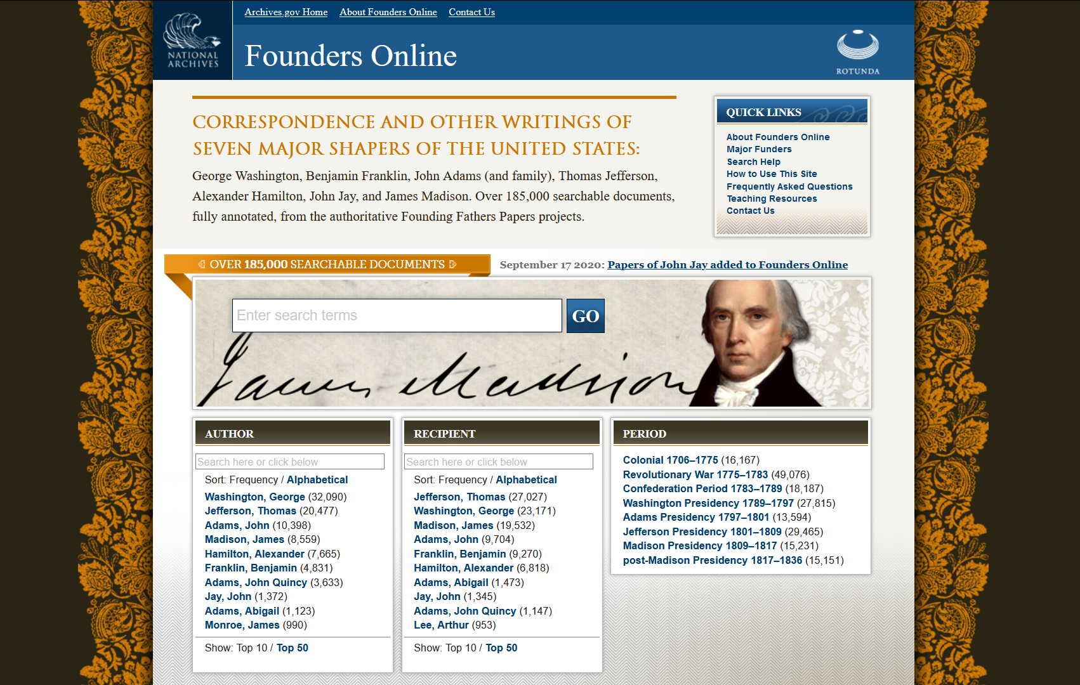

Slide 13
Data and methods
Corpus of 180,000+ texts downloaded from Founders Online (https://founders.archives.gov/)
  Texts written by/to and collected by John Adams (and family), Benjamin Franklin, Alexander Hamilton, Thomas Jefferson, James Madison, and George Washington
  Texts cover time periods from Colonial (1706-1775) to post-Madison presidency (1817-1836)
  Corpus size: over 67 million words
Use of AntConc (Anthony, 2020) to explore the distributional and contextual patterns of “misdemeanors” and related lexical items (concordance, collocation, cluster, and text dispersion analysis)

Slide 14
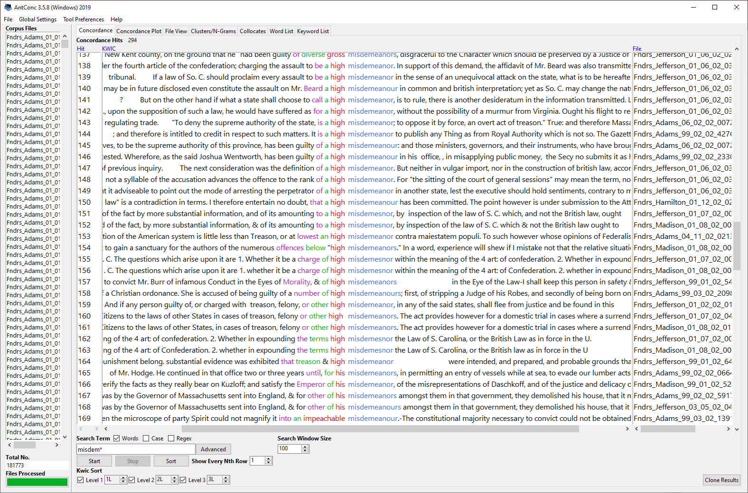
Search for misdem* to capture sg/pl forms and spelling variants:
misdemeanor(s) misdemesnor(s) misdemeanour(s) misdemianor(s) misdemeanure(s)
Result: 294 instances across 203 texts
Concordance sorting (1L/2L/3L and 1R/2R/3R) to highlight co-occurrence patterns
Manual inspection of saved concordances

Slide 15
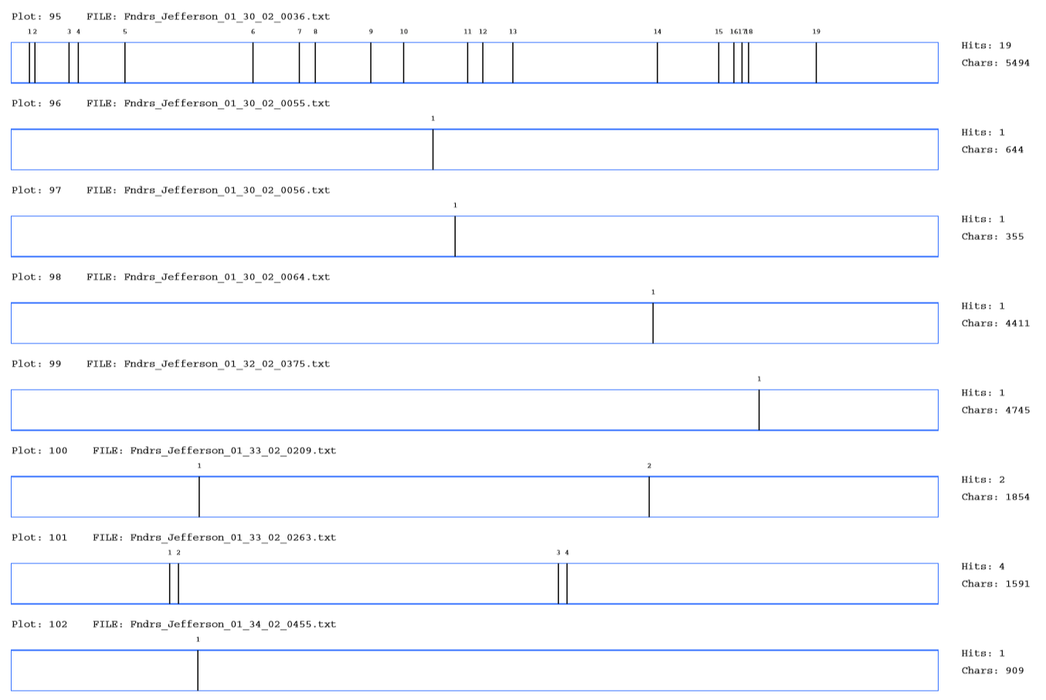
Distribution of misdem* across text files
1-4 instances per text, except for 3 files:
Madison_04_02_02_0182.txt (8 instances); Jefferson_01_06_02_0377.txt (8 instances); Jefferson_01_30_02_0036.txt (19 instances)

Slide 16
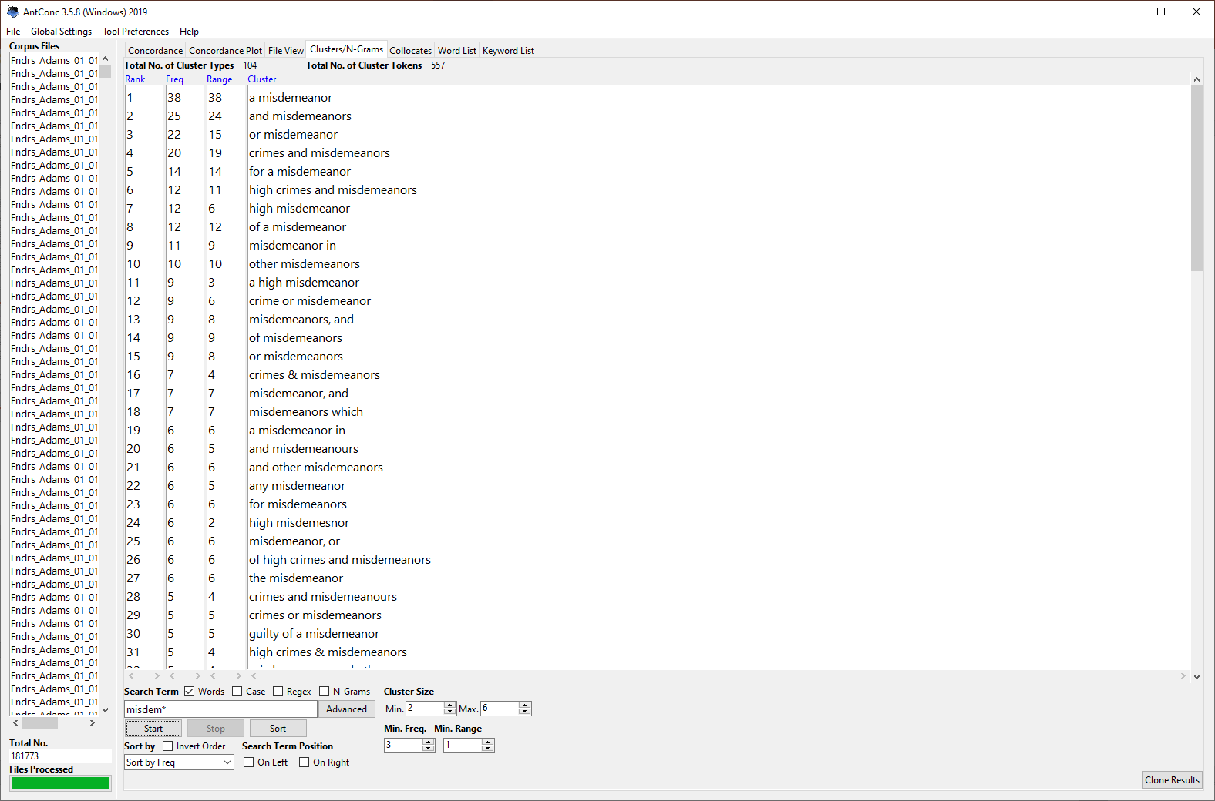
Cluster search to extract repeated phrases containing misdem*
Span: 2 to 6 words
Min. freq.: 3

Slide 17
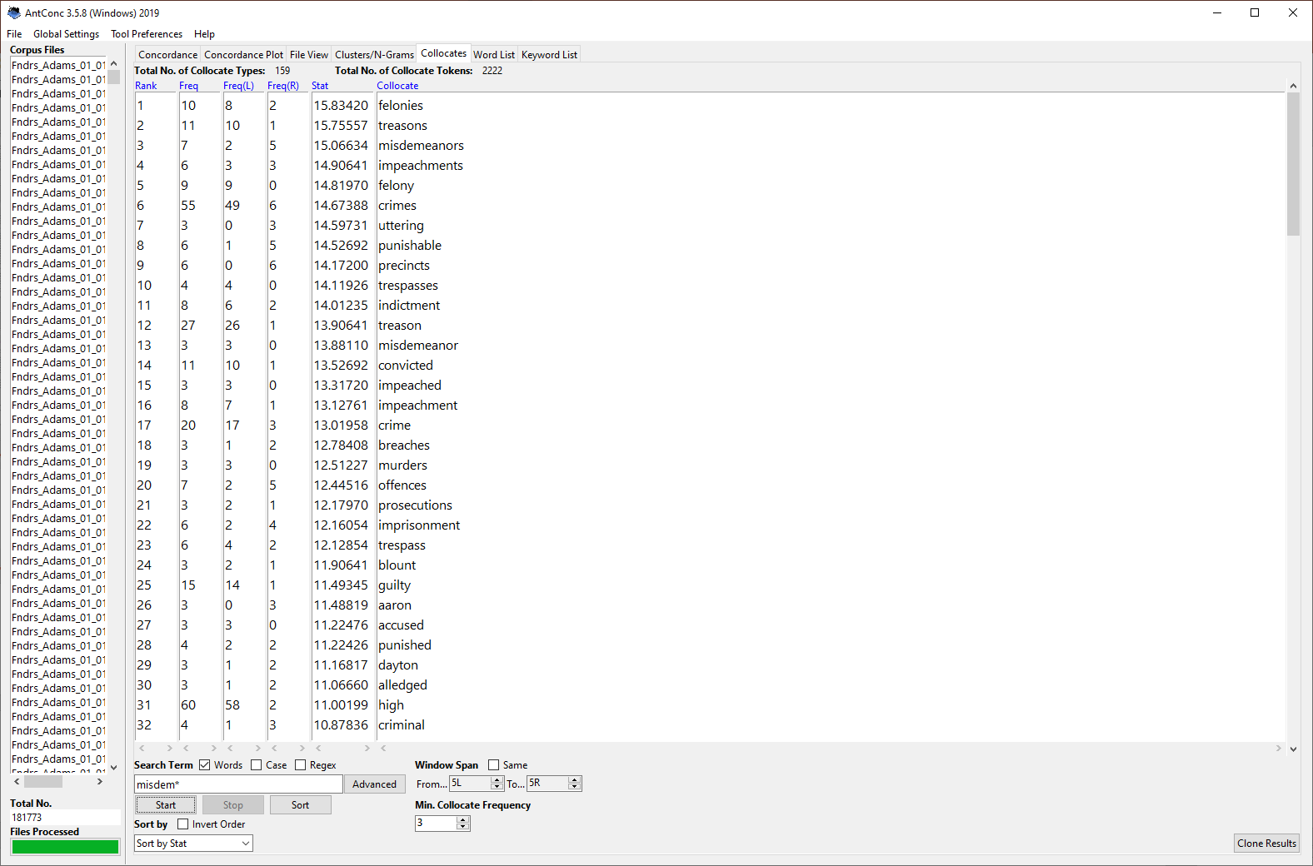
Collocates search for misdem*
Span: 5L to 5R
Min. freq.: 3
Sorted by association strength measure (Mutual Information)

Slide 18
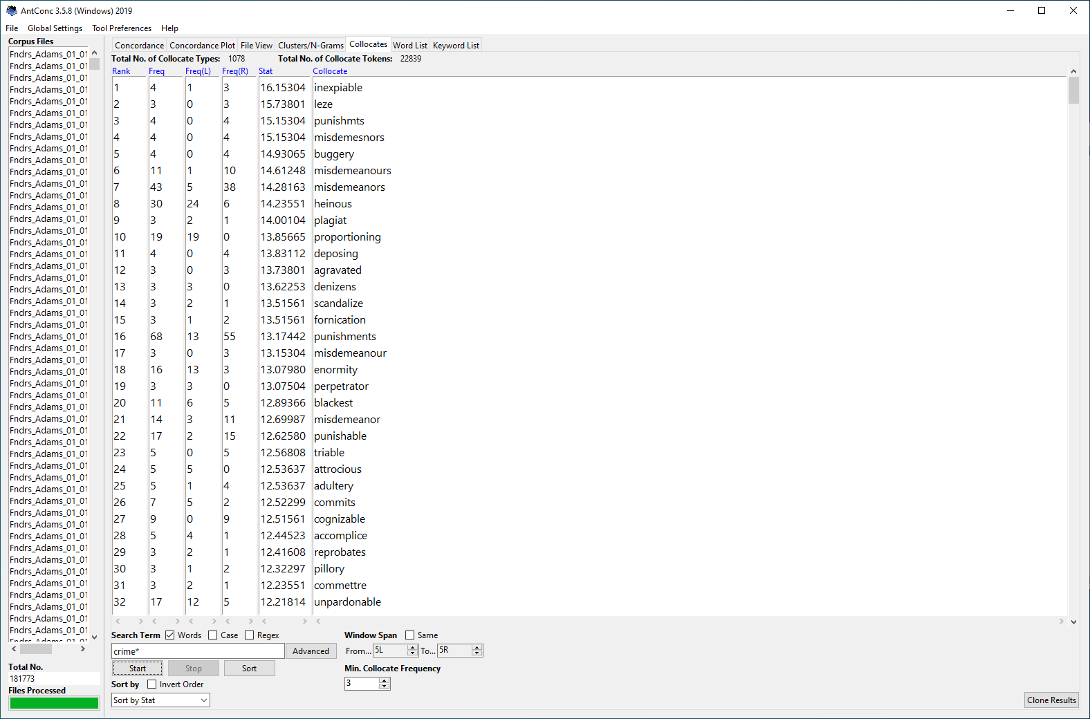
Collocates search for crime*
Span: 5L to 5R
Min. freq.: 3
Sorted by association strength measure (Mutual Information)

Slide 19
Question 1: “term of art” / idiom?
“misdemeanor(s)” occurs in a range of repeatedly used patterns
18 instances of “high crimes and misdemeanors” (plus 8x “high crimes & misdemeanors”)
Other frequent phrases: “crime or misdemeanor” (14x), “crimes or misdemeanors” (10x), “a high misdemeanor” (16x), “high misdemeanors” (11x), “other misdemeanors” (12x), “misdemeanors, and other (pleas|crimes)” (6x), “treasons, felonies, misdemeanors” (5x)
“high crimes and misdemeanors” does not appear to be a fixed phrase before/during the Founding Era (constituency and positional variation)

Slide 20
Question 2: “misdemeanors” and “crimes” synonyms?
A comparison of the collocates most strongly associated with “crime*” and “misdem*” indicates distinctive usage profiles of the two nouns
“crime*” and “misdem*” are unlikely to have been used synonymously before/during the Founding Era
Collocates with high MI scores for “crime(s)” but absent from the collocates list for “misdemeanor(s)” point towards severe legal offences (e.g., manslaughter, murder, bribery, forgery, adultery) and punishments they resulted in (hanging)

Slide 21
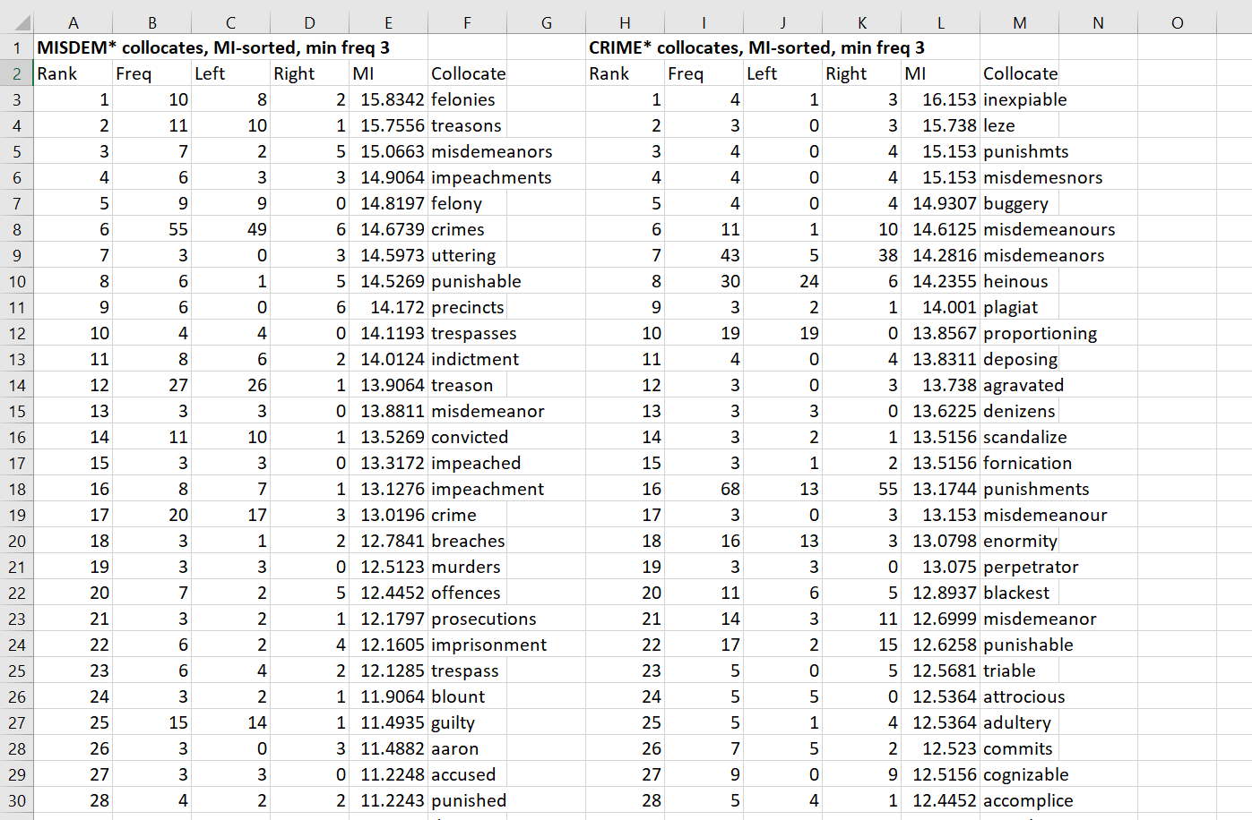
Collocates strongly associated with “misdem*” but not with “crime*”: trespass(es), precincts, pleas, blount
Collocates strongly associated with “crime*” but not with “misdem*”: heinous, inexpiable, buggery, punishment(s), fornication, adultery, enormity, enormous, black(est), at(t)rocious, unpardonable, manslaughter, follies, theft, stealing, robbery, sin(s), vice(s), bribery, murder, forgery, horrid, horror, piracy/ies, abominable, scandalous, hang, pernicious, sentence(d)

Slide 22
Question 3: Does “high” modify “misdemeanors”?
In “high N and N” constructions, does “high” tend to modify both or only the first noun in the sequence?
Concordance results for “high * and” (1,738 instances) indicate that, when “and” is preceded and followed by a noun, “high” tends to modify both nouns: e.g.,
  “high consideration and respect”
  “high regard and esteem”
  “high esteem and respect”

Slide 23
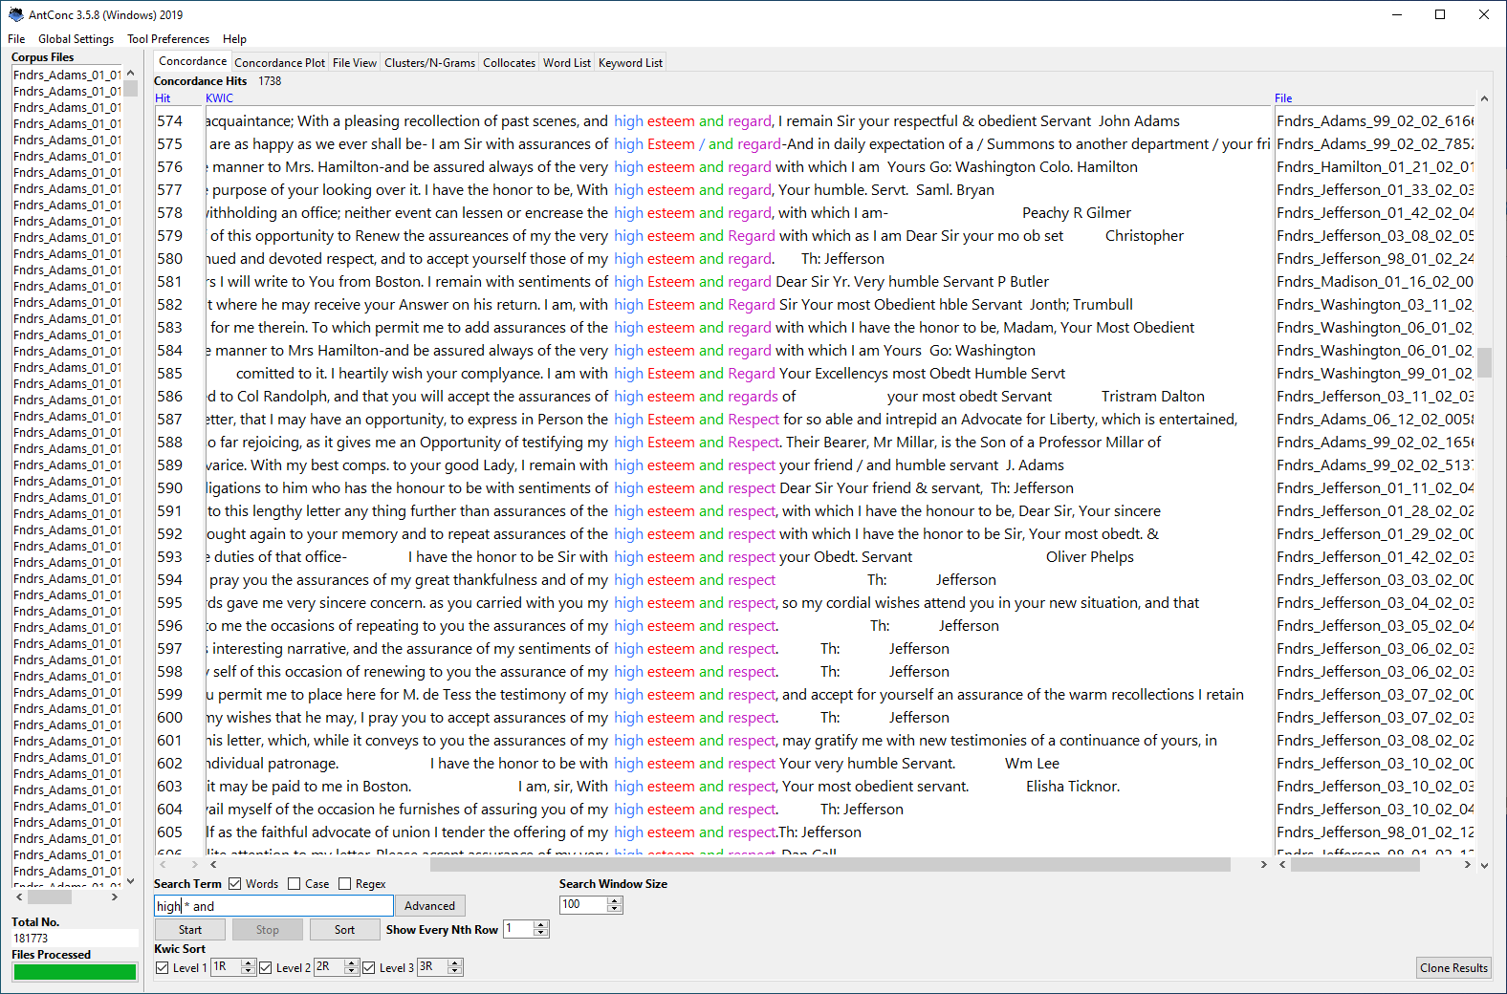

Slide 24
Question 4: Does “other” modify “misdemeanors”?
In “other N and N” constructions, does “other” tend to modify both or only the first noun in the sequence?
Concordance results for “other * and” (4,857 instances) indicate that, when “and” is preceded and followed by a noun, “other” tends to modify both nouns: e.g.,
  “other officers and soldiers”
  “other days and times”
  “other matters and things”

Slide 25
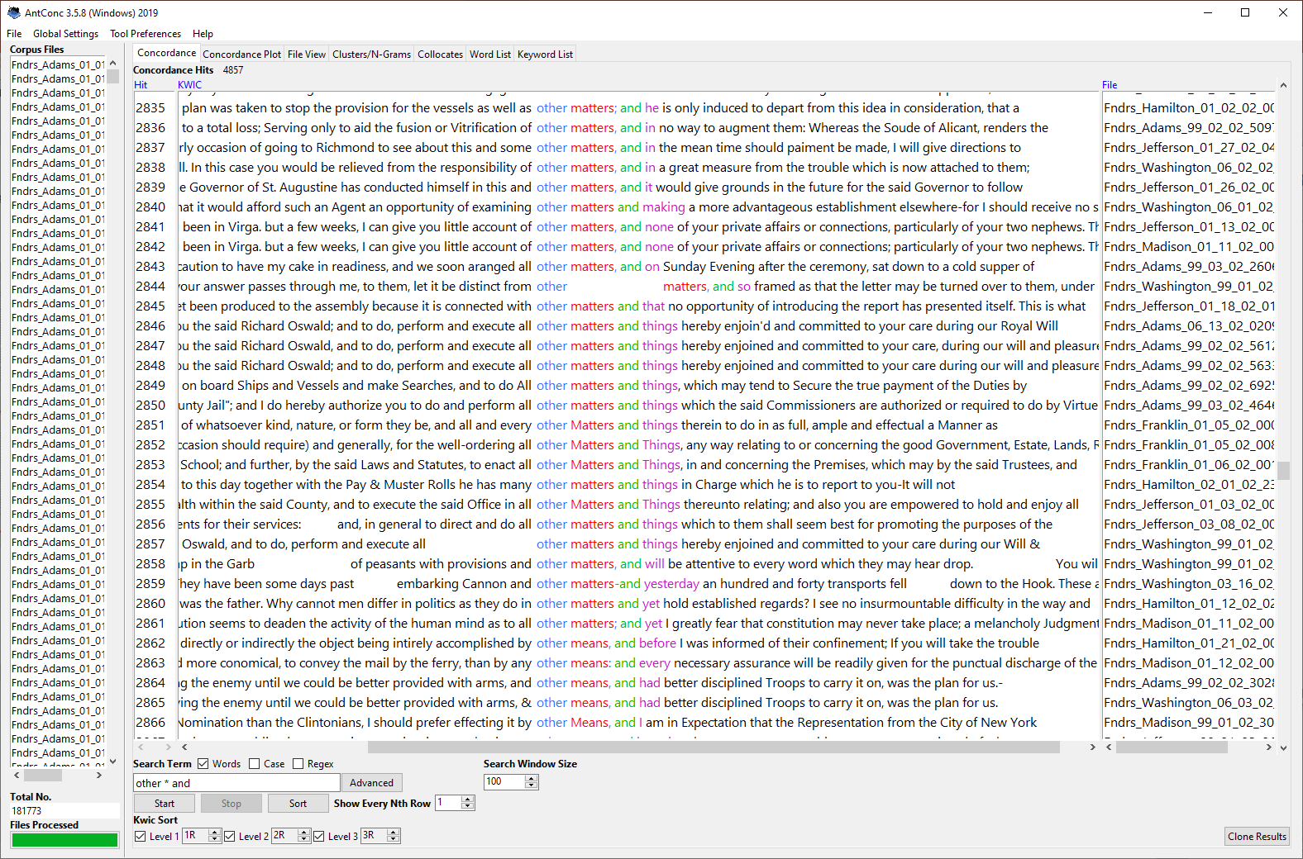

Slide 26
Ongoing research
If the Constitutional phrase “other high crimes and misdemeanors” was understood as “other high crimes” and “other high misdemeanors” …
Research Question: what meaning does “high misdemeanors” add to the impeachment clause, i.e. how is the meaning different than if the clause ended at “other high crimes”?
We are examining every occurrence of “high misdemeanor(s)” in Founders Online and Corpus of Founding Era American English (COFEA) in reference to its full context

Slide 27
CL 2021 Online Conference
Thanks for watching!
We look forward to your comments, questions and suggestions
Clark D. Cunningham, College of Law
Ute Römer, Dept of Applied Linguistics and ESL
Georgia State University, Atlanta, Georgia, USA
cdcunningham@gsu.edu
www.clarkcunningham.org
uroemer@gsu.edu
https://uteroemer.weebly.com/

Slide 28
Extra slides

Slide 29
Where preliminary results are leading us
“high misdemeanor” appears to be a regular phrase although instances in the corpus are limited
“high misdemeanor” appears in the corpus in contexts not derived from the constitutional text “high crimes and misdemeanors”
“high misdemeanors” most frequently appears in contexts describing misconduct that affects government functioning or threatens the authority or security of the state
“high misdemeanor” is used to describe misconduct that justifies removal from office
Some interesting examples …

Slide 30
John Adams 13 March 1775
“To deny the supreme authority of the state, is a high misdemeanor; to oppose it by force, an overt act of treason.”[quoting another source]
“True and therefore [one] who denies the king represented by his governor, his majesty’s council, by charter, and house of representatives, to be the supreme authority of this province, has been guilty of a high misdemeanour”

Slide 31
Constitutional Convention 20 August 1787
“Mr. King moved to insert before the word ‘power’ the word ‘sole’, giving the U[nited] States the exclusive right to declare the punishment of Treason.”
“Mr. King this amendment … excludes any treason ag[ain]st particular States. These may however punish offences as high misdemesnors.”

Slide 32
Alexander Hamilton, Sec of Treasury 3 Sep 1792
Regarding resistance to whiskey tax in western Pennsylvania
“incidents, in the Western parts of this state, announce so determined and persevering a spirit of opposition to the laws, as in my opinion to render a vigorous exertion of the powers of government indispensable.”
“avowed object is to “obstruct the operation of the law.” This is attempted to be qualified by a pretence of doing it by “every legal measure.”
“But “legal measures to obstruct the operation of a law” is a contradiction in terms.”
“I therefore entertain no doubt, that a high misdemeanour has been committed.”

Slide 33
To President John Adams 8 Feb 1798
The Secretary of the Treasury respectfully reports
Wherefore, as the said Joshua Wentworth [Supervisor of Revenue, District of New Hampshire]
has been guilty of a high misdemeanour in his office in misapplying public money
the Secy submits it as his opinion that the said Joshua Wentworth
ought to be immediately removed from office.

Slide 34
Thomas Boylston Adams 1 Feb 1812
Son of John Adams, referring to a letter sent from St. Petersburg, Russia, writing in a humorous way
“[T]he Minister and his family … have a Daughter added to their number”
“She [the daughter] is accused of a number of high misdemeanors”
[S]econdly, of being born on the same day of the year, which is the Prince Regent’s birthday”

