Slide 1
What do clients want from their lawyers?
Professor Clark D. Cunningham
W. Lee Burge Chair in Law & Ethics
Director, National Institute for Teaching Ethics & Professionalism
Georgia State University College of Law
Atlanta, Georgia U.S.A. cdcunningham@gsu.edu www.clarkcunningham.org www.niftep.org

Slide 2
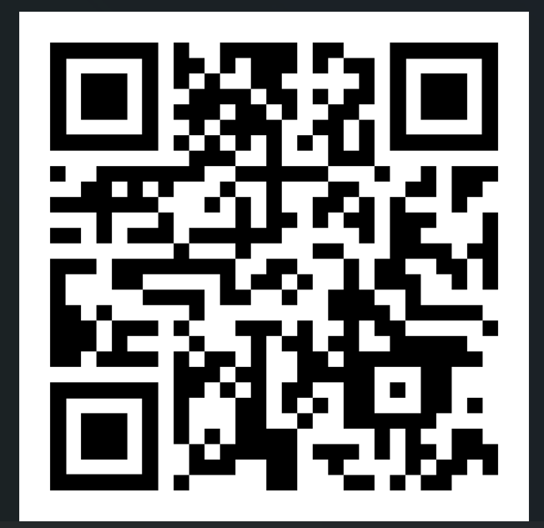
www.clarkcunningham.org

Slide 3


GSU: AT A GLANCE
#1 public university in U.S. for undergraduate teaching*
#5 public university in US for learning communities*
Most innovative public universities in the U.S. – in top 5 for last 11 years*
One of the fastest growing research institutions in the country
One of the most diverse universities in the country
*US News & World Report
“No other university has accomplished what Georgia State has the last decade” ~ Bill Gates
“A hotbed of growth and innovation” ~ Washington Post
One of the largest universities in Georgia with an enrollment of more than 53,000

Slide 4


ATLANTA
World’s Busiest Airport
Center for Global Health
National Center for Civil and Human Rights
$9.5 Billion Film Industry
Fortune 500 Companies – 3rd in the U.S.
28 “Am Law 100” Firms
Seven Professional Sports Teams

Slide 5

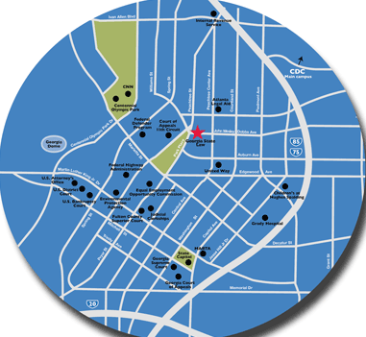
COLLEGE OF LAW: AT 85 PARK PLACE NE

Slide 6


GSU LAW: AT A GLANCE
Established: 1982
Student Body: 700
Flexibility: Full-Time and Part-Time programs
Rankings among U.S. Law Schools
Health Law #2 * Quality of Teaching #14*
Practical Training #14* *Princeton Review
Part-Time #21* Best Value Law School #14*
Clinical Training #36* *National Jurist
*US News & World Report
Bar Performance
#1 Pass Rate in Georgia-First-Time Takers (Feb 2026)
93% Bar Passage Rate (Class of 2023)
Notes:
destiny

Slide 7
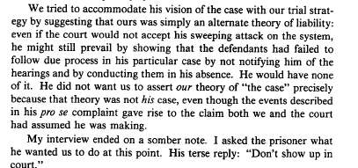
Cunningham,
"A Tale of Two Clients: Thinking About Law as Language," 87 Michigan Law Review 2459 (1989)

Slide 8

Cunningham,
"A Tale of Two Clients: Thinking About Law as Language," 87 Michigan Law Review 2459 (1989)

Slide 9
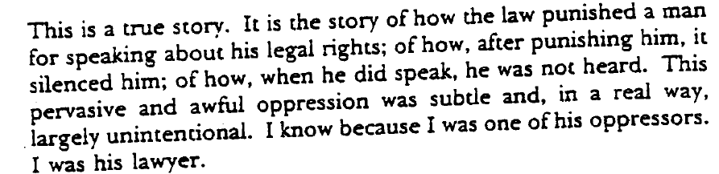
Cunningham,
The Lawyer as Translator, Representation as Text: Towards an Ethnography of Legal Discourse
77 Cornell Law Review 1298 (1992)

Slide 10
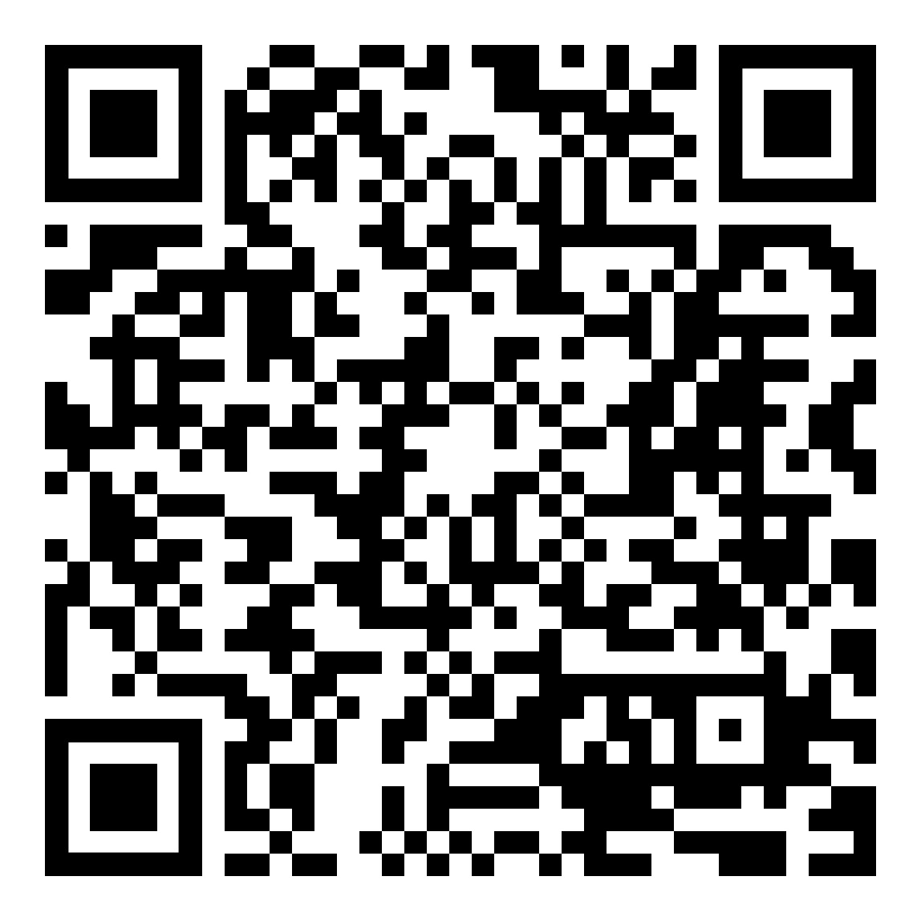
Cunningham,
The Lawyer as Translator, Representation as Text: Towards an Ethnography of Legal Discourse
77 Cornell Law Review 1298 (1992)

Slide 11

Clark D. Cunningham & Bonnie S. McElhinny
Taking It to the Streets:
Putting Discourse Analysis to the Service of a Public Defender's Office
2 Clinical Law Review 285 (1995)

Slide 12
Evaluating Effective Lawyer-Client Communication: an International Project Moving From Research to Reform
Worldwide Advocacy Conference, Inns of Court School of Law, London, England (July 1998) (plenary address)
The Conference on The Delivery of Legal Services to Low-Income Persons: Professional and Ethical Issues sponsored by the American Bar Association, Open Society Institute, and The Legal Services Corporation (Fordham Law School, New York City December 1998)
Annual Meeting of the International Client Counseling Competition Board (March 1999)
Midwest Clinical Teachers Association (October 1999)
Inaugural Conference of the Global Alliance for Justice Education (December 1999)
New York University Law School (September 2000).

Slide 13

Cunningham, "What Do Clients Want From Their Lawyers?", 2013 Journal of Dispute Resolution 143

Slide 14
What do clients most care about?
CLIENT PERCEPTIONS OF LITIGATION
WHAT COUNTS: PROCESS OR RESULT?
Tom Tyler,Trial Magazine (1988)
Clients care most about the process
  having their problems or disputes settled in a way that they view as fair
second most important is achieving a fair settlement
least important factor is the number of assets they end up winning.

Slide 15
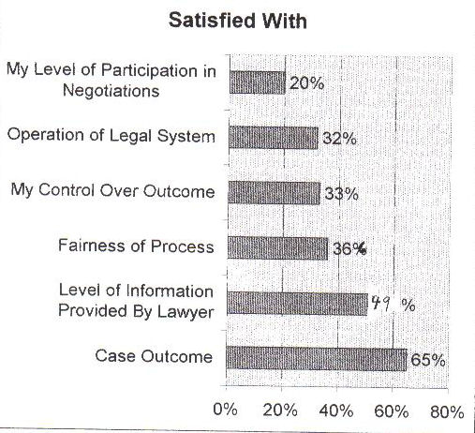
PLAINTIFFS AND THE PROCESS OF LITIGATION:
An Analysis of the Perceptions of Plaintiffs Following their Experience of Litigation
Tania Matruglio (Civil Research Centre Australia 1994)

Slide 16
LawCover Study
Australia’s largest legal malpractice insurance provider
  Commissioned a Risk Management Project
  Sample from over 2000 claims
  Extensive & confidential interview with each lawyer
  In most cases also interviewed the lawyer who defended the claim.
Major Causes of Claims
  not dissatisfaction with outcome
  But instead the handling of the client relationship
  Failure to
    listen to the client
    ask appropriate questions
    explain relevant aspects of the matter

Slide 17
Australia: Client Satisfaction with lawyers who were certified specialists
Widespread client satisfaction with the specialists’ legal knowledge and skills
Consistent evidence of client dissatisfaction with HOW services were provided

Slide 18
Different ideas of good service
Lawyers: good service is delivering good outcomes using knowledge and skills
Clients expected lawyers to have knowledge and skills
But were disappointed by the PROCESS of getting to outcomes

Slide 19
Clients complained that
Lawyers were not accessible
Lack of communication
Lack of empathy and understanding
Lack of respect

Slide 20
Additional Training Recommended
client focused rather than transaction focused
client needs are not confined to attaining outcomes
listen to clients better
understand their needs
demonstrate empathy

Slide 21
Value of Experience for
Client Communication
Study at University of London
143 actual 1st interviews
  24 % beginning lawyers
  76% experienced lawyers
    70% at least 6 years
    23% more than 11 years
High percentages of ineffective interviews
  Experienced lawyers generally NO better

Slide 22
Common Problems with
Both New and Experienced Lawyers
51% failed to get the client’s agreement to advice or plan of action
76% failed to confirm with client the lawyer’s understanding of the facts
85% failed to ask before ending whether there was anything else the client wanted to discuss

Slide 23
Where There Was a Difference Between New and Experienced Lawyers
Experienced lawyers
  Rated their own interview performance higher than did new lawyers
But the clients saw no difference in performance between new and experienced lawyers

Slide 24
2000 Research Study
Law Society of England & Wales
Study of client satisfaction when government pays lawyers to represent people (“legal aid”)
Interviewed 44 legal aid clients of 21 different lawyers in the north of England.

Slide 25
2000 Research Study
Law Society of England & Wales
50% said that they had previously used a solicitor whom they did not like.
Those 50% were then asked an open-ended question:
  “Why were you disappointed?”

Slide 26
I went to [my current lawyer]...
because of her reputation and expertise
she is a part-time judge and has a big reputation as a specialist
but SHE JUST DOESN’T LISTEN.
She listens for part of what I have to say, and then interrupts, saying something like
‘OK, I’ve got the picture, what we’ll do is ...’
and she hasn’t really got the picture, she’s only got half the facts.

Slide 27
I think it’s partly because …
she is so busy
and also because she’s simply not used to giving clients a voice.
What’s more she has actually made me frightened of expressing my views.
I am about to change to another lawyer

Slide 28
The Importance of Listening
I sent my former lawyer packing because SHE WOULDN’T LISTEN. That is absolutely fundamental; this was my case, only I knew the full circumstances.”
“They must be able to give you time. If lawyers haven’t got enough time, they can’t get enough out of you. You have to have time to be able to tell your story.”

Slide 29
The Importance of Explaining
“At my first meeting with [my current lawyer] ... I was impressed by his natural ability to talk about technical things with knowledge, but on a level that I could understand.
  we actually talked and he explained in clear language
  Other people just had a job to do, but [he] took time to clearly explain technical things.
  He explained how the system works.”
“She speaks of legal matters in a way that is knowledgeable and she explains it well.”
“She communicates clearly. She puts things in layman’s terms.”

Slide 30
How to address this problem?
How do law schools TEACH client relationship skills?
How do law schools TEST client relationship skills?
Are basic client relationship skills REQUIRED to become a lawyer?
Are law firms training and testing their lawyers on client relationship skills?

Slide 31

Standardized Patients in Medical Education

Slide 32
Standardized Patients
Used at all levels of medical education
And sometimes as part of the examination to be licensed as a doctor
Developed over the past 50 years
Used in many countries, including here at UAG

Slide 33

Standardized Patients
Simulated clinical
examination
Standardized patient presents as the same person with the same medical problems to each examiner
Standardized patient ALSO evaluates the examiner as to basic communication skills

Slide 34
Standardized Patients
In 2004 a team from the United States and Scotland was formed to test
Whether this method could be adapted to legal education

Slide 35
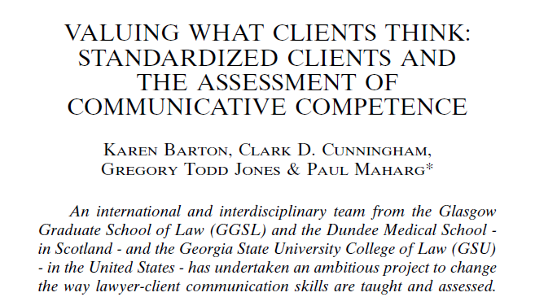

13 Clinical Law Review 1 (2006)

Slide 36


Slide 37


Slide 38


Slide 39

1st Simulated Client Project
Glasgow Graduate School of Law 2004-2006
Post-university 9-month training program required to become a lawyer in Scotland

Slide 40
2nd Simulated Client Project
Bar Association in Edinburgh 2006-2010
Specialty certification for junior lawyers

Slide 41
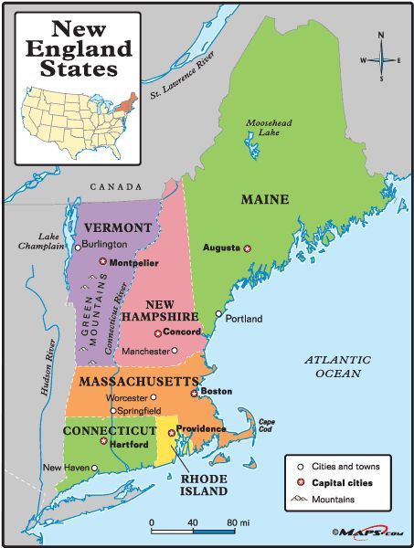
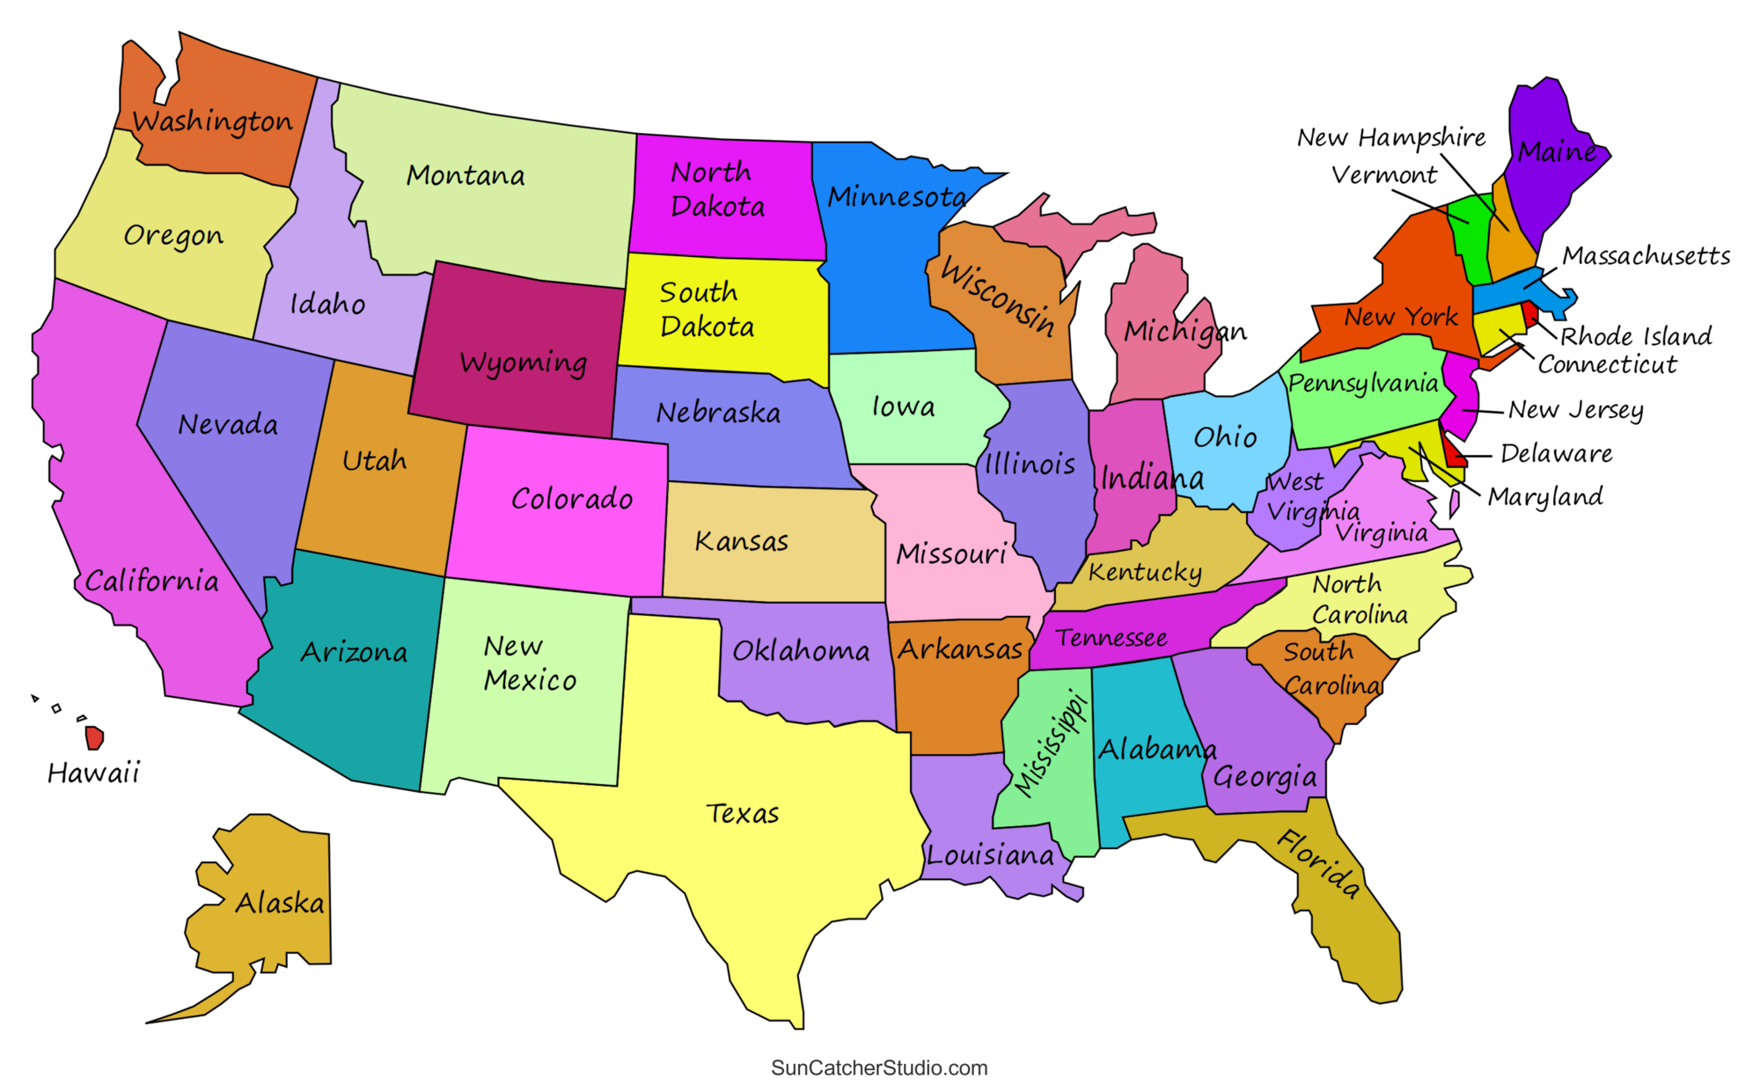
3rd Simulated Client Project
State of New Hampshire 2006-2025
Part of testing to be licensed as a lawyer

Slide 42






Other places using simulated clients

Slide 43
Innovations in current project
Expand to civil law jurisdictions
  Latin America
  Continental Europe
Expand from English to other languages
  Beginning with Spanish
Expand to online format

Slide 44

Transitioning Simulated Client Interviews from Face-to-Face to Online
Paul Maharg & Angela Yenssen
13 European Journal of Law and Technology No. 3 (2022)

Slide 45
