Slide 1
Are most search warrants for electronically stored information unconstitutional general warrants?
Association of American Law Schools 2024 Meeting
Criminal Procedure Section
Friday, January 5, 2024
Clark D. Cunningham, Georgia State Law, Moderator
Leonard Bailey, U.S. Department of Justice
Laura Donohue, Georgetown Law
Orin Kerr, Berkeley Law
Tracey Maclin, Levin College of Law, University of Florida
Paul Ohm, Georgetown Law

Slide 3
Format of today’s session
General warrants: overview
Roundtable discussion among panelists
  Can post questions or comments to moderator from your phone
Open Q&A

Slide 4
Orin Kerr
DOJ Computer Crime and Intellectual Property Section 1998-2001
One of the authors of SEARCHING AND SEIZING COMPUTERS AND OBTAINING ELECTRONIC EVIDENCE IN CRIMINAL INVESTIGATIONS (DOJ 2002)
“Current law allows computer searches for any evidence to look disturbingly like searches for all evidence. Everything can be seized. Everything can be searched. Nearly everything can come into plain view and be subject to use in unrelated cases. The result seems perilously like the regime of general warrants that the Fourth Amendment was enacted to stop.”
  Executing Warrants for Digital Evidence: The Case for Use Restrictions on Nonresponsive Data, 48 TEX. TECH L. REV. 1, 11 (2015)

Slide 5
Paul Ohm
DOJ Computer Crime and Intellectual Property Section
“[There is a] manifest lack of probable cause and particularity in almost every computer case. … Computer search warrants are the closest things to general warrants we have confronted in the history of the Republic.”
  Massive Hard Drives, General Warrants, and the Power of Magistrate Judges, 97 VA. L. REV. IN BRIEF 1, 4, 11 (2011)

Slide 6
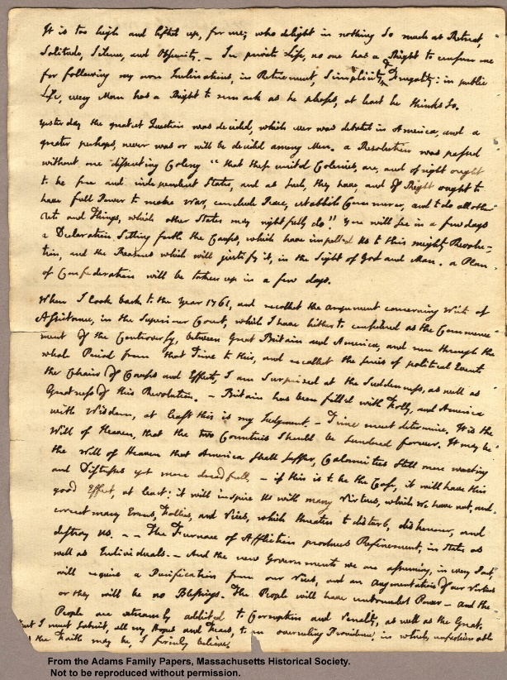
John Adams to Abigail Adams: July 3, 1776
Yesterday the greatest Question was decided, which ever was debated in America, and a greater perhaps, never was or will be decided among Men
A Resolution that these united Colonies, are, and of right ought to be free and independent States
You will see in a few days a Declaration setting forth the Causes, which have impell'd Us to this mighty Revolution

Slide 7
July 3, 1776
When I look back to the Year 1761
and recollect the Argument concerning Writs of Assistance, in the Superiour Court
which I have hitherto considered as the Commencement of the Controversy between Great Britain and America
I am surprized at the Suddenness as well as Greatness of this Revolution.

Slide 8
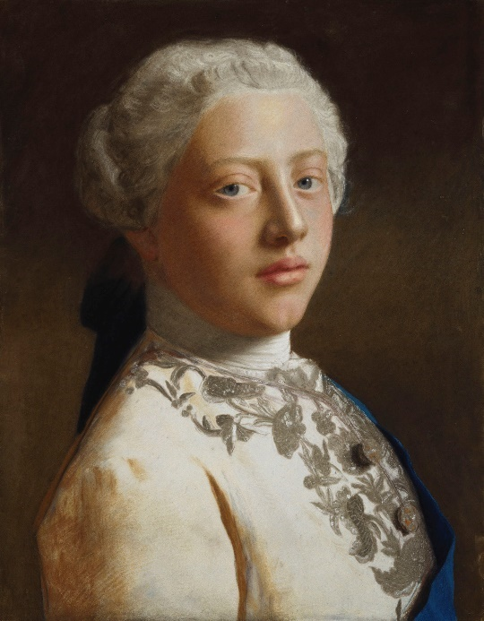
Writ of Assistance
Province of Massachusetts Bay
George the third by the Grace of God of Great Britain King
To all Our Officers and Subjects
We strictly Injoin and Command you that you permit
Charles Paxton, Surveyor and Searcher
To enter into all places
Where goods, for which customs have not been paid,
Are suspected to be concealed
And to add, assist and help in the execution of [the search]

Slide 9
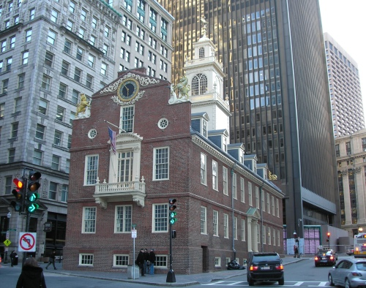
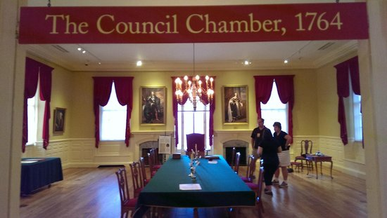
Feb 24, 1761

Slide 10
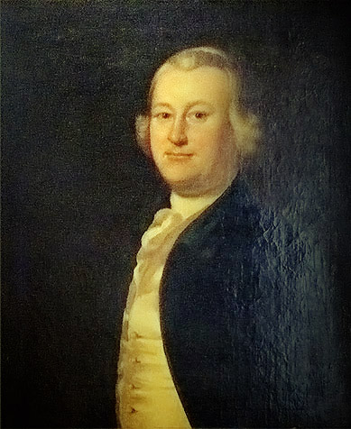
James Otis
The writ of assistance is
“the worst instrument of arbitrary power
the most destructive of English liberty”

Slide 11
Otis Fourth Amendment
“special warrants only are legal”
“upon oath by the person who asks
that he suspects such goods to be concealed in THOSE VERY PLACES HE DESIRES TO SEARCH.”
“no Warrants shall issue
but upon probable cause supported by Oath or affirmation, and
particularly describing the place to be searched and
the persons or things to be seized.”

Slide 12
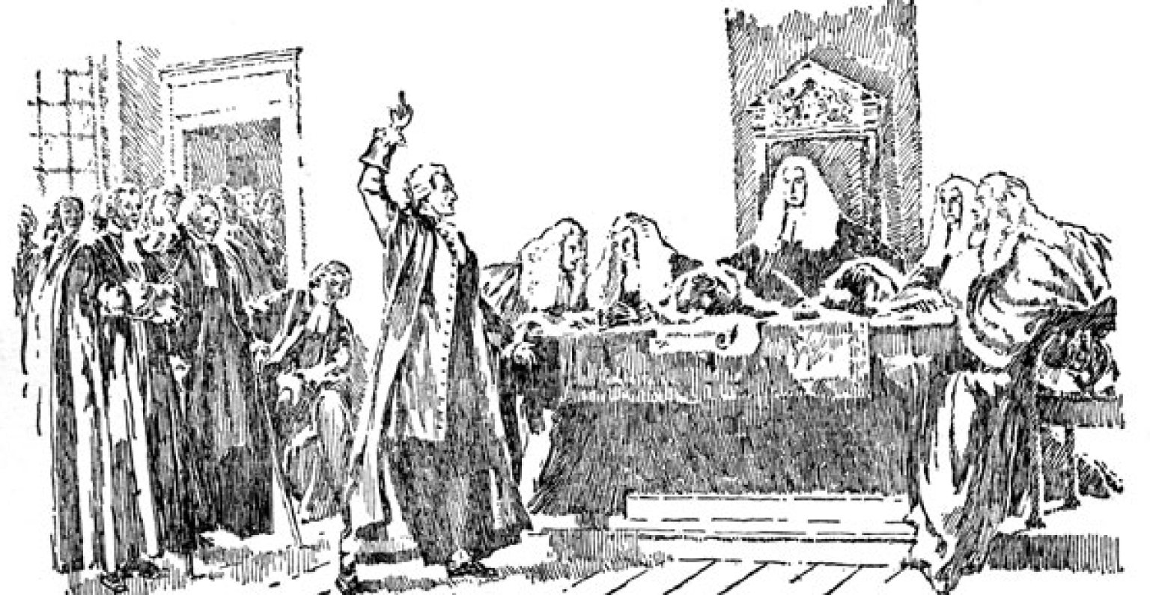
John Adams
“Otis was a flame of Fire!”
“Every man of an immense crowded Audience appeared to me to go away, as I did, ready to take up Arms against Writts of Assistants [sic].
Then and there was the first scene of the first Act of Opposition to the arbitrary Claims of Great Britain.”

Slide 13
Fourth Amendment
“The right of the people to be secure in their … papers …
against unreasonable searches and seizures
shall not be violated”

Slide 14
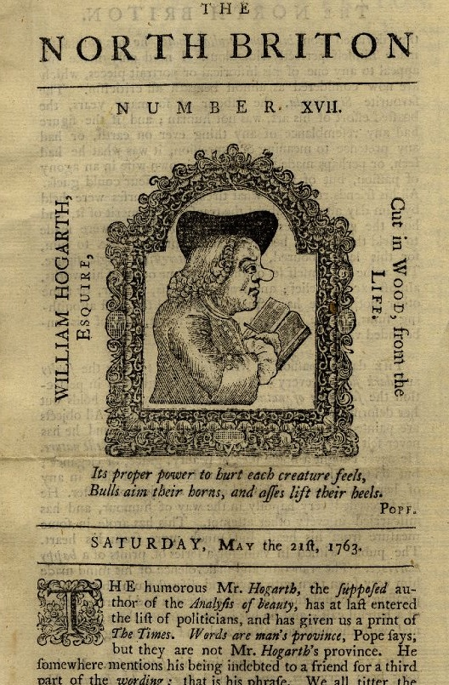
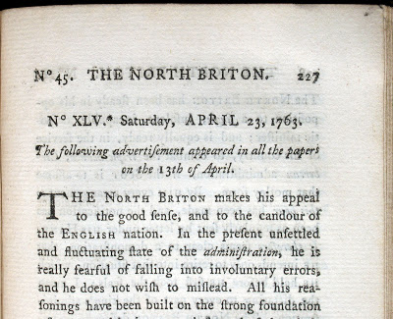
England April 23, 1763

Slide 15
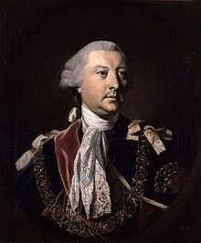
Lord Halifax, Secretary of State: Warrant
make strict and diligent search for the authors, printers and publishers of a seditious and treasonable paper
entitled the North Briton, Number 45

Slide 16
Lord Halifax Warrant
and any of them having found
apprehend and seize
together with their papers

Slide 17
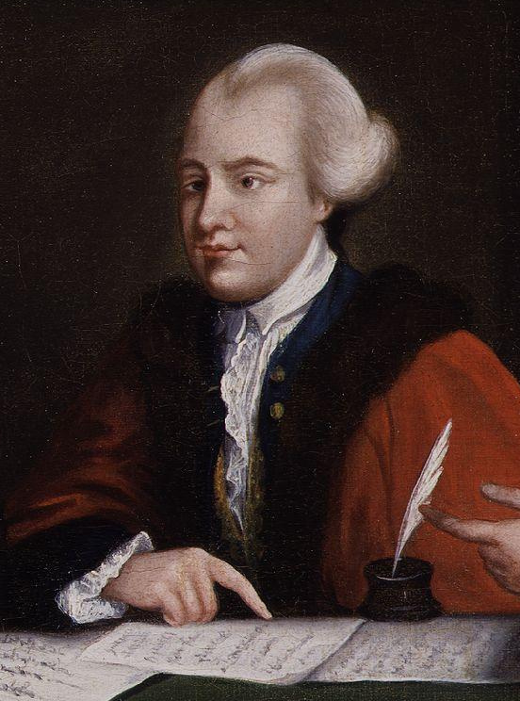
John Wilkes Testimony at trial
“Whether a table with a locked drawer should be removed entire or be opened”
“Mr. Mann was sent to Lord Halifax for directions, and brought word that the drawers must be opened.”

Slide 18
John Wilkes Testimony at trial
“Blackmore fetched a smith to open the table.”
“They took all the papers in those drawers and pocket book of Mr. Wilkes’s
And put them all in a sack together”

Slide 19
Wilkes’ Attorney
This case extended far beyond Mr. Wilkes personally
It touched the liberty of every subject of this country
Of all offences that of a seizure of papers was the least capable of reparation

Slide 20
Wilkes’ Attorney
And for the promulgation of our most private concerns, affairs of the most secret personal nature, no reparation could be made
The law never admits of a general search warrant
Even in the Inquisition itself, they never delegate an infinite power to search

Slide 21
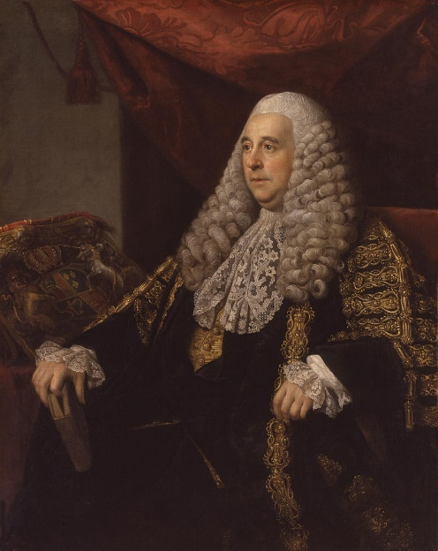
Chief Justice Pratt (later Lord Camden)
was a point of the greatest consequence I have ever met with in my whole practice
“such a power
is totally subversive of liberty”

Slide 22
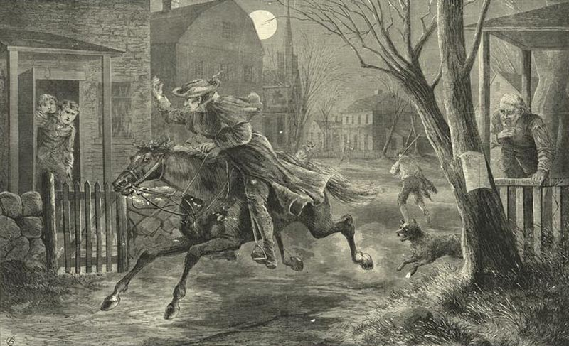
Paul Revere

Slide 23
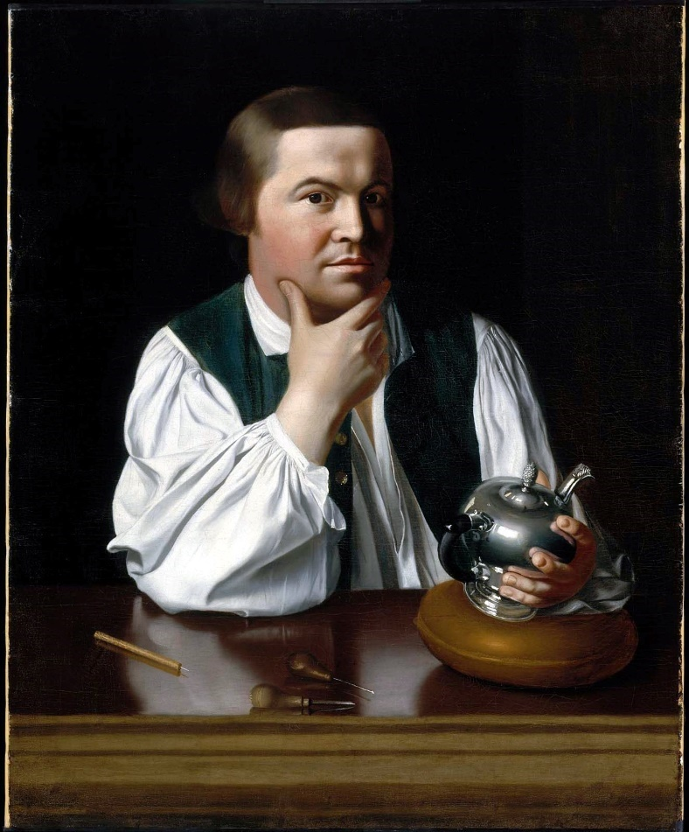
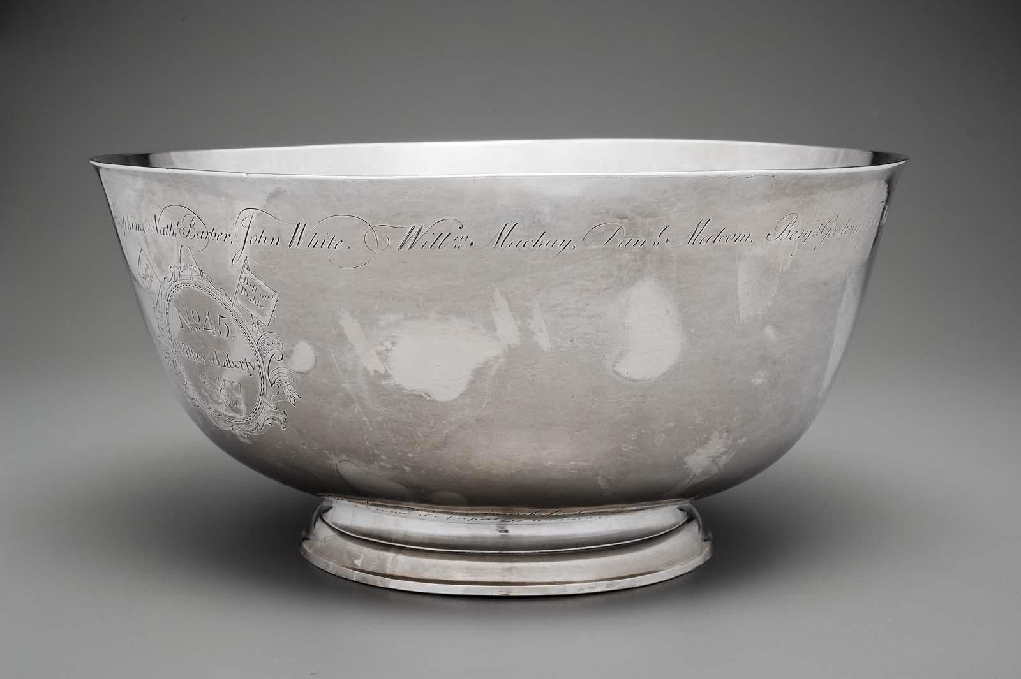
Liberty Bowl (1768)

Slide 24
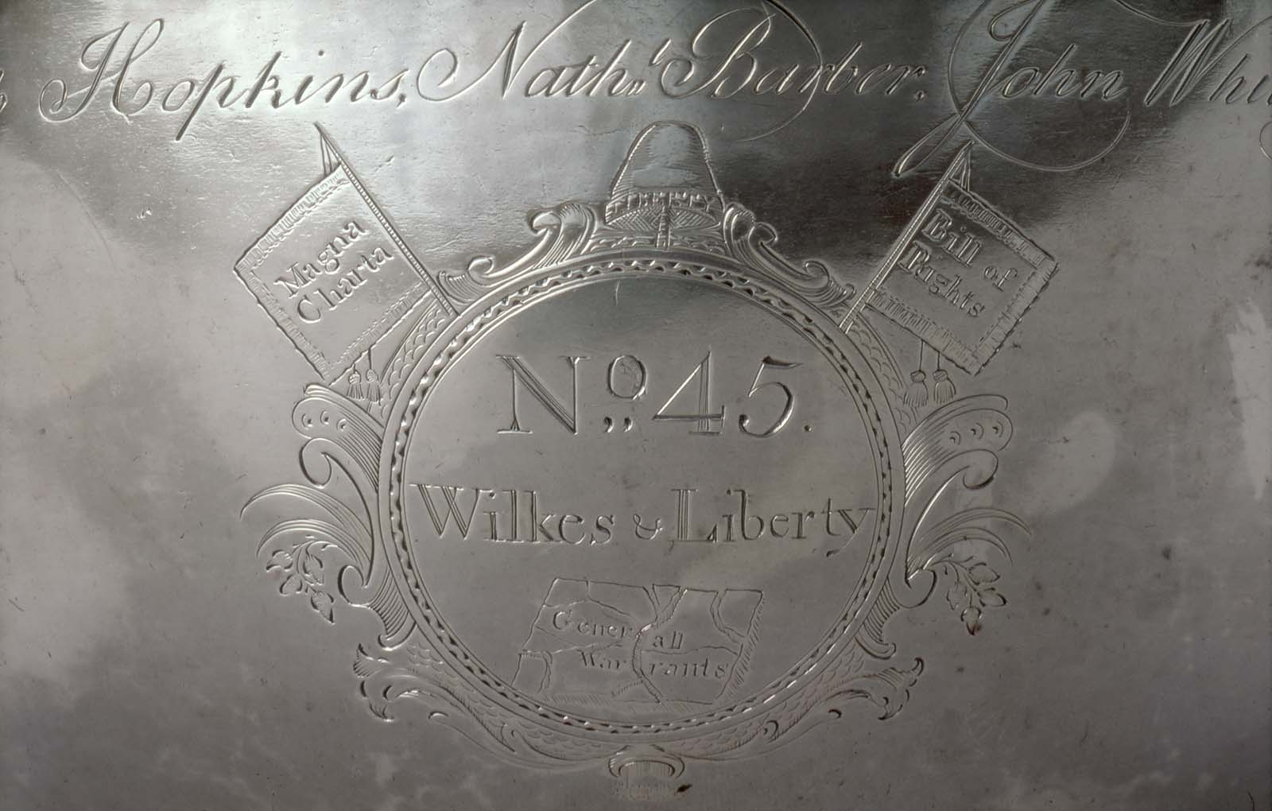

Slide 25
For more on this history:
Clark D. Cunningham, Apple and the American Revolution: Remembering Why We Have the Fourth Amendment, 126 Yale Law Journal Forum 218 (2016)
www.yalelawjournal.org/forum/apple-and-the-american-revolution-remembering-why-we-have-the-fourth-amendment-1
Laura K. Donohue, The Original Fourth Amendment, 83 U. Chi. L. Rev. 1181-1328 (2016)
Tracey Maclin, The Complexity of the Fourth Amendment: A Historical Review, 77 B.U. L. Rev. 925 (1997)
Tracey Maclin, James Otis (1725-1783), Yale Biographical Dictionary Of American Law (Roger K. Newman ed. 2009)
And see other references in bibliography at end of this ppt

Slide 26
General Warrant?
As written?
As executed?

Slide 27
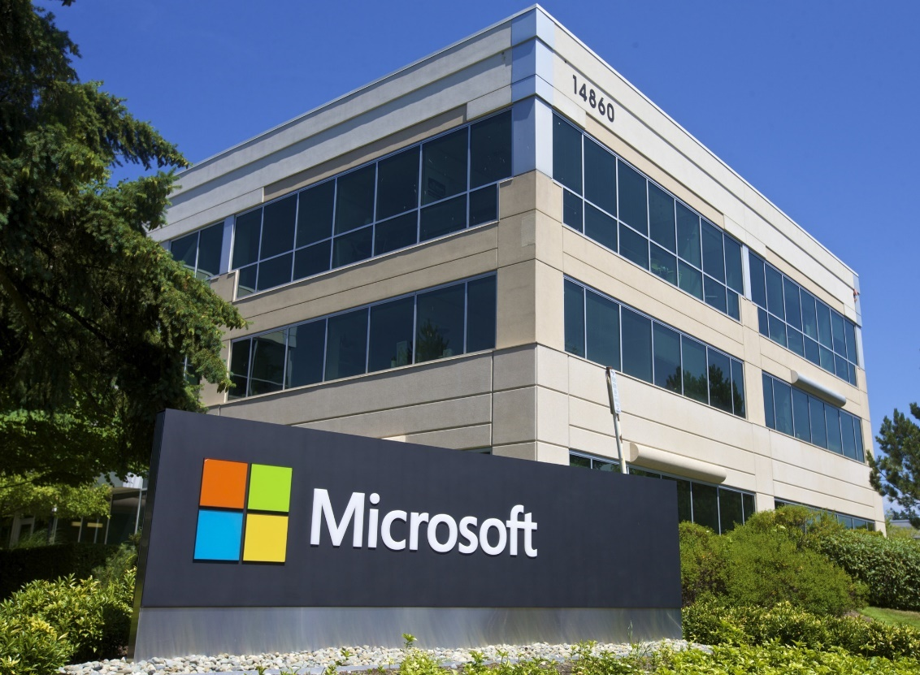
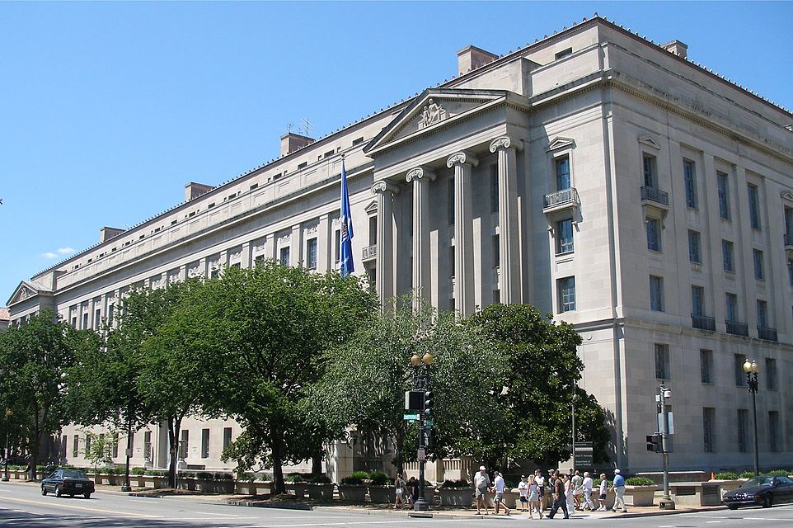
As Written
Microsoft v US Dept of Justice (S.D.N.Y) http://www.clarkcunningham.org/Apple/Cases/Microsoft2dCir.html

Slide 28
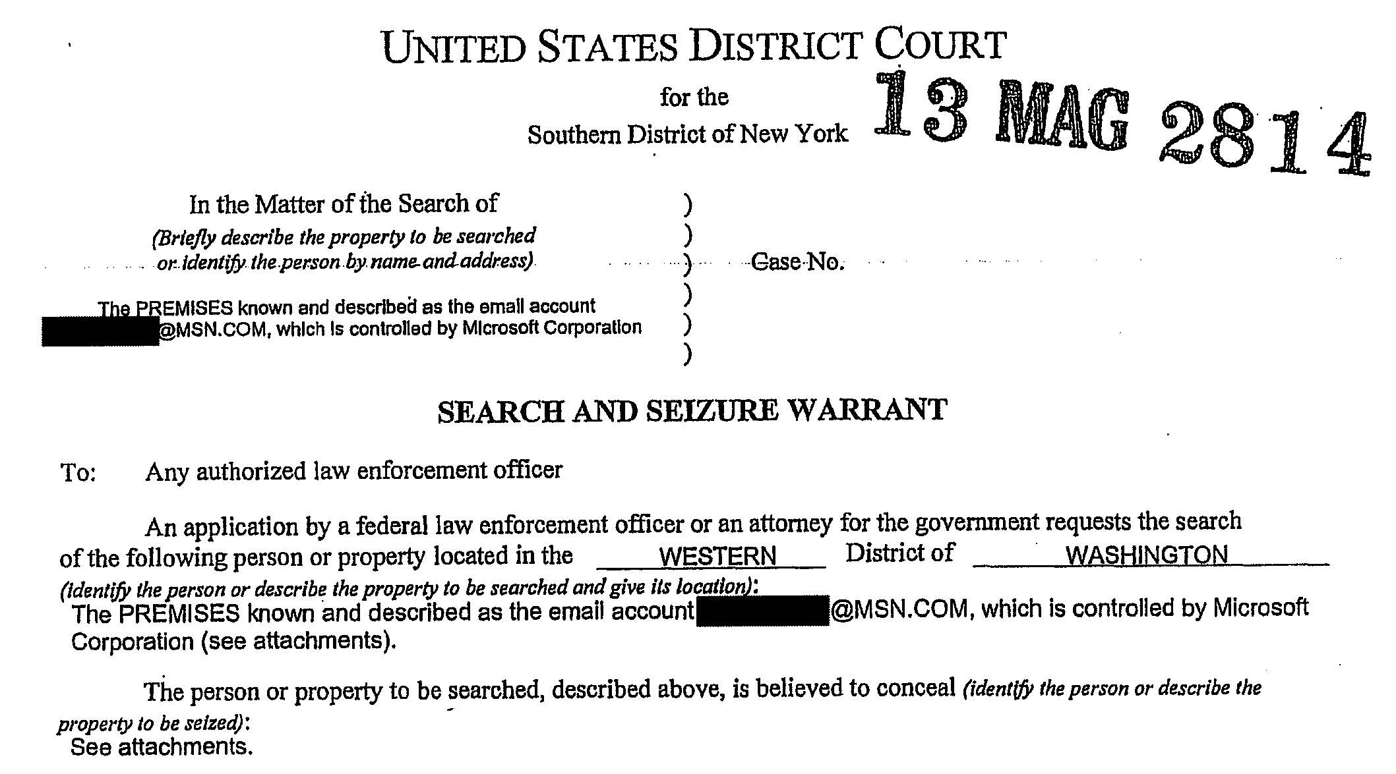

Slide 29
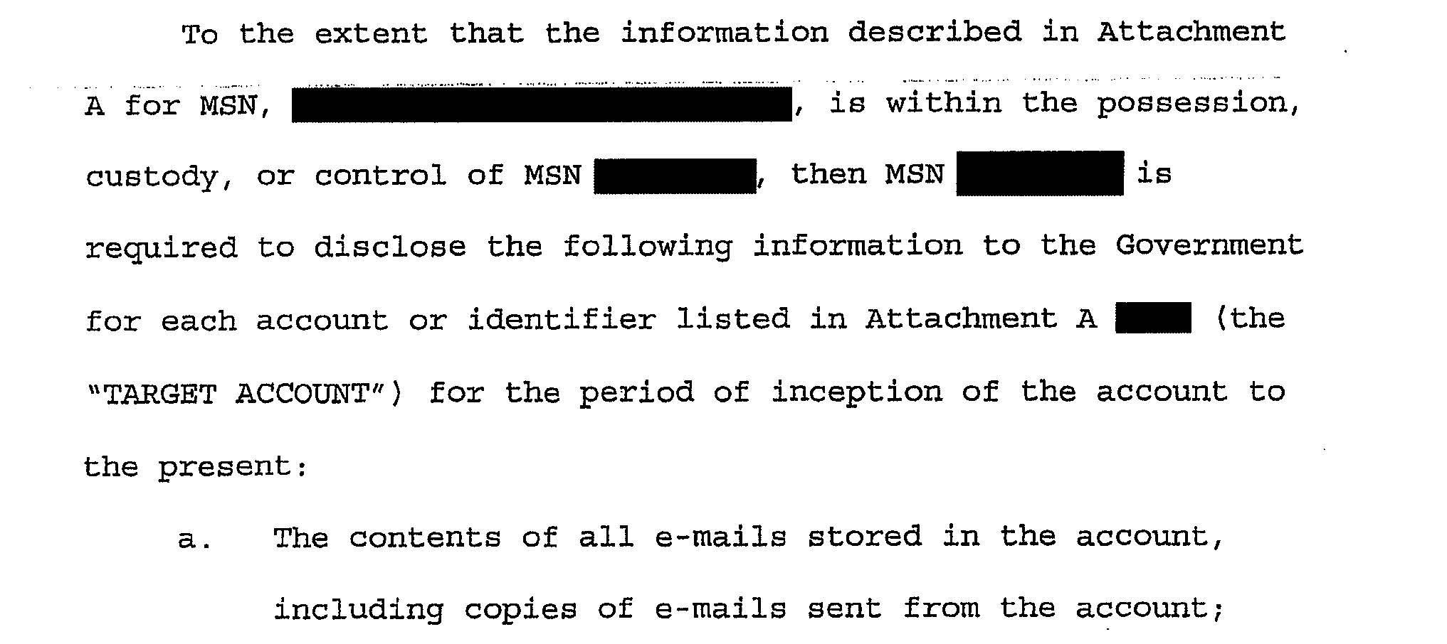

Slide 30
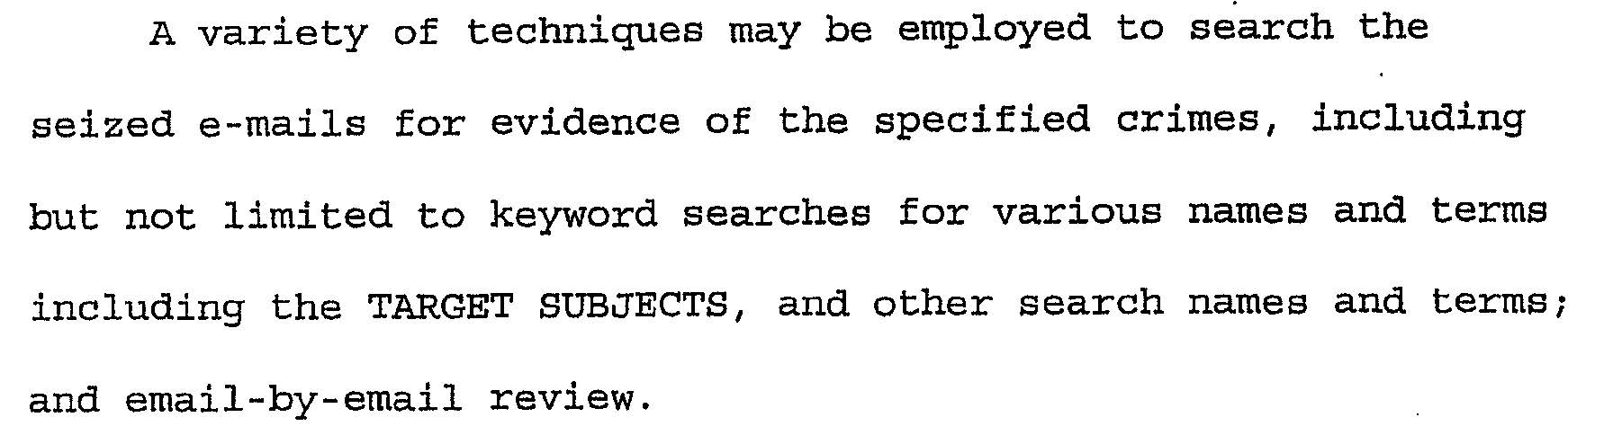

Slide 31

As executed
U.S v. Ravelo (D. N.J.) http://clarkcunningham.org/Apple/Cases/USvRavelo.html
Paul Barrett, Inside a $5.7 Billion Antitrust Trainwreck, Bloomberg Businessweek, Nov. 11, 2015
  “story has a can’t-make-this-stuff-up quality”
Keilo Ravelo: Grew up in Dominican Republic
Columbia Law ‘91
Sidley Austin – then Partner, Roger & Wells
Then Hunton & Williams, then Wilkie Farr & Gallagher
Negotiated $5.7B antitrust settlement for Master Card

Slide 32
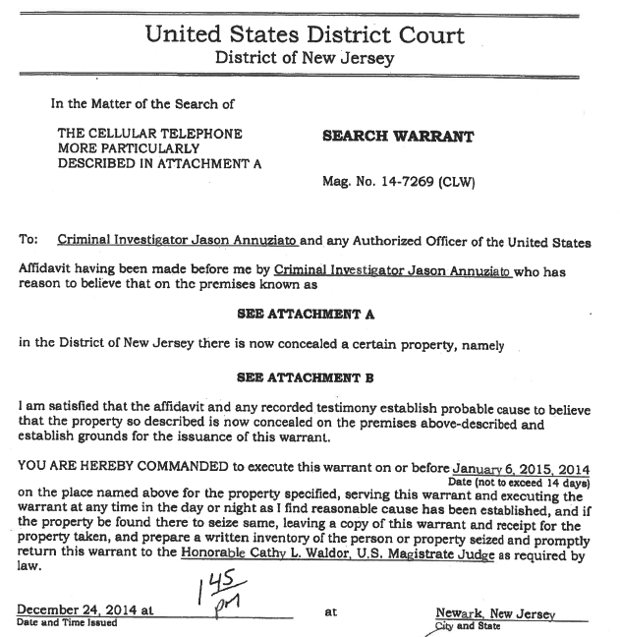

Slide 33
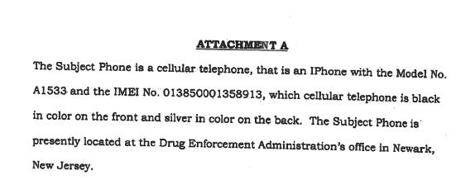

Slide 34
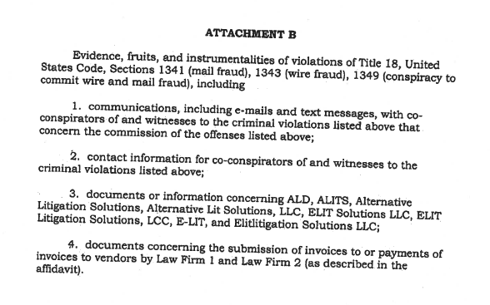

Slide 35
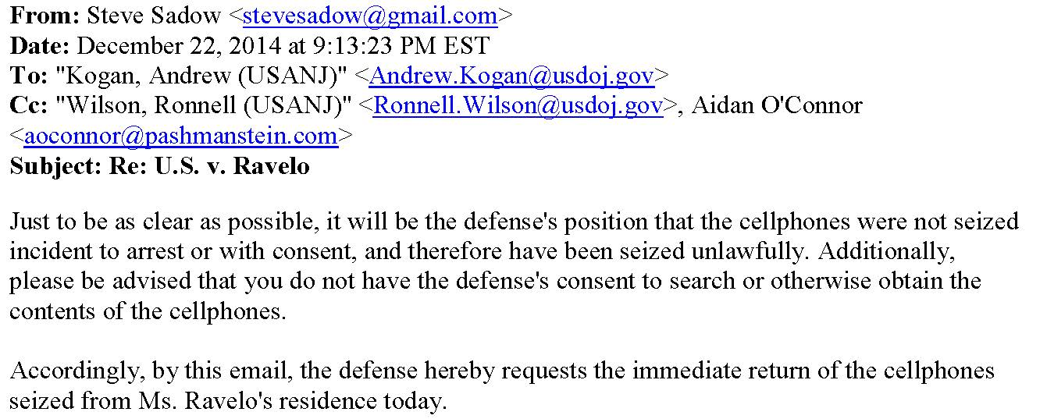

Slide 36
May 23, 2016 Dear Judge McNulty,
“The Government is in the process of determining whether it intends to introduce any of the contents of the Phone in its case-in-chief at trial.
Once it is determined what, if any, evidence on the Phone is privileged, the trial team will receive the contents of the Phone minus the privileged items.
The trial team will then conduct its review and determine if it intends to use any of the contents of the Phone in its case-in-chief at trial.”

Slide 37
May 23, 2016 Dear Judge McNulty,
If the trial team determines that it will indeed use any of the contents of the Phone in its case-in-chief at trial,
it will provide the [Search Warrant] Affidavit to defense counsel
and will address any motion to suppress at that time.
Respectfully submitted,
Paul J. Fishman, United States Attorney
  By: Andrew Kogan, Assistant U.S. Attorney

Slide 38
May 23, 2016 Dear Judge McNulty,
If the trial team determines that it will indeed use any of the contents of the Phone in its case-in-chief at trial,
it will provide the [Search Warrant] Affidavit to defense counsel
and will address any motion to suppress at that time.
Respectfully submitted,
Paul J. Fishman, United States Attorney
  By: Andrew Kogan, Assistant U.S. Attorney

Slide 39
Back to the Future
Ravelo case (2016)
Wilkes case (1763)
[T]he Government is in the process of determining whether it intends to introduce any of the contents of the Phone in its case-in-chief at trial. . . .
Once it is determined what, if any, evidence on the Phone is privileged, the trial team will receive the contents of the Phone minus the privileged items.
The trial team will then conduct its review and determine if it intends to use any of the contents of the Phone in its case-in-chief at trial.
If the trial team determines that it will indeed use any of the contents of the Phone in its case-in-chief at trial, it will provide the [Search Warrant] Affidavit to defense counsel and will address any motion to suppress at that time.
  Paul J. Fishman, United States Attorney
May 7, 1763 Mr. Wilkes
In answer to your letter of yesterday, we acquaint you, that your papers were seized in consequence of the heavy charge brought against you, for being the author of an infamous and seditious libel,
for which his Majesty has ordered you to be prosecuted
Such of your papers as do not lead to a proof of your guilt, shall be restored to you.
Such as are necessary for that purpose, it was our duty to turn over to those, whose office it is to collect the evidence, and manage the prosecution against you.
  Dunk Halifax [Secretary of State]

Slide 40
July 12, 2016 Dear Judge McNulty,
“Assuming arguendo that the Court granted Keila Ravelo’s motion to suppress the contents of her cellular telephone (“the Phone”) and a motion to return the Phone, the government would still be able to retain a copy of the Phone to be used lawfully, among other reasons, for impeachment purposes, at a sentencing hearing, filing an appeal, and/or in opposition to any habeas petition.
if the court were to grant Ms. Ravelo’s motion to suppress evidence obtained from the Phone, Ms. Ravelo would likely file a subsequent motion under Fed. R. Crim. P. 41(g) for the return of the Phone.
Were the Court to grant the defendant’s Rule 41 motion, the government would likely retain copies of the contents of the Phone.“
Paul J. Fishman, United States Attorney
  By: Andrew Kogan, Assistant U.S. Attorney

Slide 41
Are most search warrants for electronically stored information unconstitutional general warrants?

Slide 42
Orin Kerr
DOJ Computer Crime and Intellectual Property Section 1998-2001
One of the authors of SEARCHING AND SEIZING COMPUTERS AND OBTAINING ELECTRONIC EVIDENCE IN CRIMINAL INVESTIGATIONS (DOJ 2002)
“Current law allows computer searches for any evidence to look disturbingly like searches for all evidence. Everything can be seized. Everything can be searched. Nearly everything can come into plain view and be subject to use in unrelated cases. The result seems perilously like the regime of general warrants that the Fourth Amendment was enacted to stop.”
  Executing Warrants for Digital Evidence: The Case for Use Restrictions on Nonresponsive Data, 48 TEX. TECH L. REV. 1, 11 (2015)

Slide 43
Paul Ohm
DOJ Computer Crime and Intellectual Property Section 2001-2005
“[There is a] manifest lack of probable cause and particularity in almost every computer case. … Computer search warrants are the closest things to general warrants we have confronted in the history of the Republic.”
  Massive Hard Drives, General Warrants, and the Power of Magistrate Judges, 97 VA. L. REV. IN BRIEF 1, 4, 11 (2011)

Slide 44
Some sample warrants www.clarkcunningham.org/Apple-web/AALS-2024-Resources/Warrants.html
2009-FEDERAL
Searching and seizing computers and obtaining electronic evidence in criminal investigations 241-250 (3RD ed. DOJ), Appendix F
Sample Premises Computer Search Warrant Affidavit
2010 – Vermont
In re Appeal of Application for Search Warrant, 2012 Vt. 102, 71 A.3d 1158 (2012)
Search warrant for computer with conditions
2013-FEDERAL
Microsoft Corporation v United States, Joint Appendix (2nd Cir.)
Search warrant to Microsoft for msn.com email accounts

Slide 45
Some sample warrants www.clarkcunningham.org/Apple-web/AALS-2024-Resources/Warrants.html
2014-FEDERAL (D.N.J.)
Ravelo search warrant for iPhone
2016-FEDERAL (D.Mass.)
Crawford search warrant for iPhone with order requiring Apple to bypass lock screen
Warrant application
Warrant application excerpts
Warrant
2018-GEORGIA
Nelson v. State, 863 S.E.2d 61 (Ga, 2021)
Nelson search warrant for iPhone

Slide 46
Some selected cases
United States v. Comprehensive Drug Testing Inc., 621 F.3d 1162, 1180 (9th Cir. 2010) (en banc) (Kozinski, C.J., concurring).
In re Appeal of Application for Search Warrant, 2012 Vt. 102, 71 A.3d 1158 (2012), cert. denied, 130 S.Ct. 2391 (2013) (conditions added to search warrant for personal computer requiring that search be performed by third parties or trained computer personnel separate from the investigators and operating behind a firewall protected a legitimate privacy interest and were not an abuse of discretion)
In the Matter of the Search of premises known as: Three Hotmail Email accounts, 2016 WL 1239916 (D. Kansas 2016) (David J. Waxse, U.S. Magistrate Judge) (Memorandum and Order Denying Application for Search Warrant) (thorough review of both caselaw and scholarship in this area, urges use of court-appointed special masters, potentially assisted by independent vendors, to review aggregate data and then turn over only responsive items to the government pursuant to a warrant that meets constitutional standards for particularity, citing approval of such an approach for searching computer data by the Vermont Supreme Court, 71 A3d 1158 (2012).)
In the Matter of the Search of Information Associated with [redacted]@mac.com That is Stored at Premises Controlled by Apple, Inc., 13 F.Supp.3d 145 (D.D.C., April 7, 2014) (John M. Facciola, U.S. Magistrate Judge), vacated sub nom, 13 F.Supp.3d 157 (D.D.C., August 8, 2014)
More cases at www.clarkcunningham.org/Apple/Index.html

Slide 47
Short bibliography
William Clark, Note, Protecting the Privacies of Digital Life: Riley v California, the Fourth Amendment's Particularity Requrement and Search Protocols for Cell Phone Search Warrants, 56 Boston College L. Rev. 1981, 1997-2007 (2015).
Patrick J. Cotter, Magistrates' Revolt: Unexpected Resistance to Federal Government Efforts to Get "General Warrants" for Electronic Information, The National Law Review, May 15, 2014
Clark D. Cunningham, Apple and the American Revolution: Remembering Why We Have the Fourth Amendment, 126 Yale L.J. F. 216 (2016), available at
www.yalelawjournal.org/forum/apple-and-the-american-revolution-remembering-why-we-have-the-fourth-amendment-1
Reid Day, Comment, Let the Magistrates Revolt: A Review of Search Warrant Applications for Electronic Information Possessed by Online Services, 64 U. Kan. L. Rev. 491 (2015)
Laura K. Donohue, The Fourth Amendment in a Digital World, 71 N.Y.U. Ann. Surv. Am. L. 533-685 (2017) https://scholarship.law.georgetown.edu/facpub/1791
Laura K. Donohue, The Original Fourth Amendment, 83 U. Chi. L. Rev. 1181-1328 (2016)
Adam M. Gershowitz, The Post-Riley Search Warrant: Search Protocols and Particularity in Cell Phone Searches, 69 Vanderbilt L.Rev. 585, 617-21 (2016)

Slide 48
Short bibliography
Orin S. Kerr, Executing Warrants for Digital Evidence: The Case for Use Restrictions on Nonresponsive Data, 48 Texas Tech Law Review 1 (2015).
Orin S. Kerr, Fourth Amendment Seizures of Computer Data, 119 Yale L.J. 700 (2010).
Orin S. Kerr, Ex Ante Regulation of Computer Search and Seizure, 96 Va. L. Rev 1241 (2010)
Tracey Maclin, James Otis, (1725-1783) in THE YALE BIOGRAPHICAL DICTIONARY OF AMERICAN LAW (Roger K. Newman ed. 2009)
Tracey Maclin, The Complexity of the Fourth Amendment: A Historical Review, 77 B.U. L. Rev. 925 (1997).
Tracey Maclin, When the Cure For The Fourth Amendment is Worse Than the Disease, 68 Southern California Law Review 1 (1994).
Ann E. Marimow & Craig Timberg, Low-level federal judges balking at law enforcement requests for electronic evidence, Washington Post, Apr. 24, 2014

Slide 49
Short bibliography
Paul Ohm, Massive Hard Drives, General Warrants, and the Power of Magistrate Judges, 97 Virginia Law Review Online 1 (2011).
Paul Ohm, The Life of Riley (v. California), 48 Tex. Tech L. Rev. 133 (2015).
Stephen Wm. Smith, Gagged, Sealed & Delivered: Reforming ECPA’s Secret Docket, 6 Harv. L. & Pol’y Rev. 313, 313 (2012)
More resources listed at www.clarkcunningham.org/Apple/Index.html

Slide 50
Possible remedies/reforms?

Slide 51
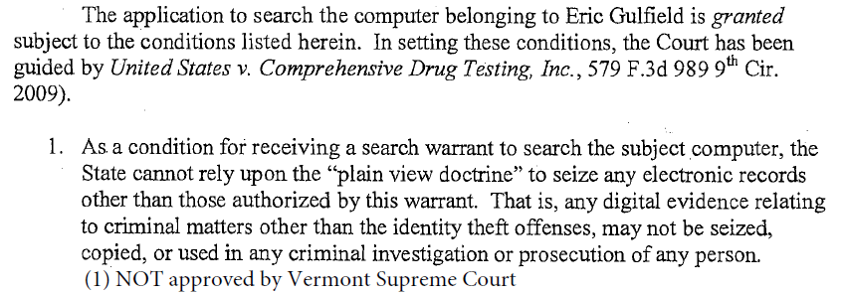
In re Appeal of Application for Search Warrant, 2012 Vt. 102, 71 A.3d 1158 (2012)

Slide 52
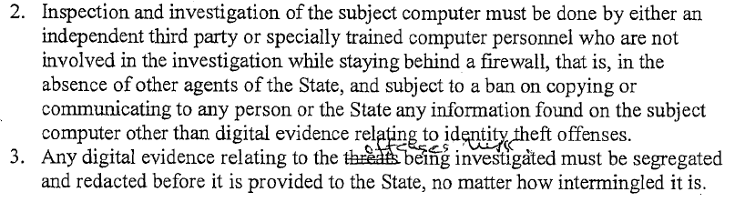
Vermont Warrant

Slide 53
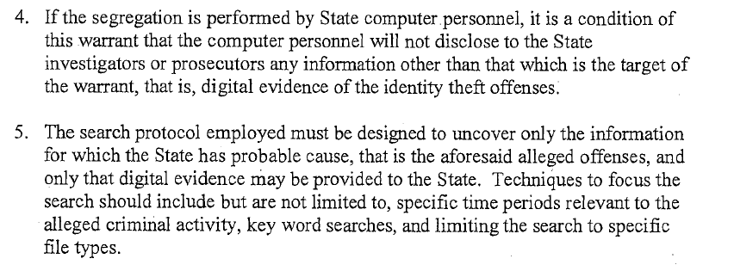
Vermont Warrant

Slide 54
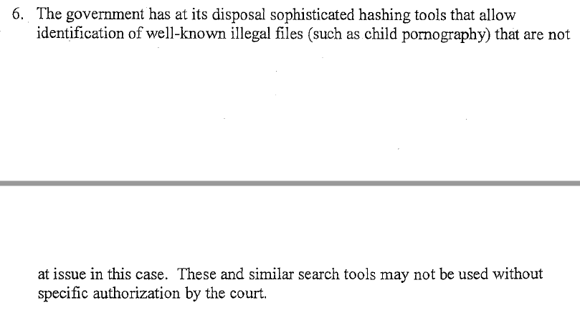
Vermont Warrant

Slide 55
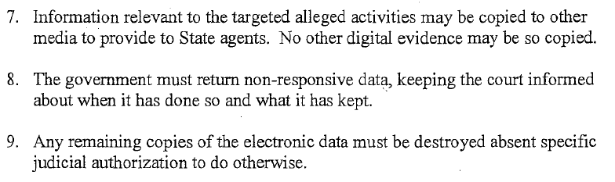
Vermont Warrant

Slide 56
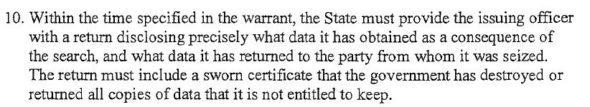
Vermont Warrant

Slide 57
Import from wiretap statute
Wiretap statute
Applied to ESI
18 USC § 2511(1), (4)
18 USC § 2516(1)(a)-(t)
18 USC § 2518(3)(c)
18 USC § 2516(1),(2)
Felony to obtain, disclose, or use ESI except as authorized by this statute
Limited to specified serious crimes
Limited to circumstances where other investigatory procedures have already been tried or are unavailable
Must be authorized by a DOJ official at least at the level of Deputy Assistant Attorney General or,
for state warrants, the Attorney General of the relevant jurisdiction,
or the principal prosecuting attorney of any political subdivision thereof, if such attorney is authorized by a statute of that State to apply for an ESI warrant

Slide 58
Apple and the American Revolution, 126 Yale Law Journal Forum at 203
If a warrant authorizes seizure of a device containing ESI or the copying of ESI from such a device or any other storage media (such as a remote server)
the device or copied ESI shall be held under court supervision
until the owner of the ESI has been provided notice and an opportunity for a hearing to contest the terms of the warrant and/or the procedures to be used to search the device or copied ESI for one or more items of information described with particularity in the warrant
Exigent circumstances exception

