Slide 1
Protecting Data: What Happened to the Fourth Amendment?
Professor Clark D. Cunningham W. Lee Burge Chair in Law & Ethics
Georgia State University College of Law
Presentation available at: www.clarkcunningham.org/Apple/
Tower to Trenches Program
Georgia State College of Law
April 28, 2017

Slide 2
EXCLUSIVE: Anthony Weiner carried on a months-long online sexual relationship with a troubled 15-year-old girl
September 21, 2016
When confronted with the claims, Weiner did not deny exchanging 'flirtatious' messages with the teen.
He gave a statement to DailyMail.com in which he says, in part: 'I have repeatedly demonstrated terrible judgement about the people I have communicated with online and the things I have sent. I am filled with regret and heartbroken for those I have hurt.'
http://www.dailymail.co.uk/news/article-3790824/Anthony-Weiner-carried-months-long-online-sexual-relationship-troubled-15-year-old-girl-telling-hard-asking-dress-school-girl-outfits-pressing-engage-rape-fantasies.html

Slide 3
Early October: FBI seizes laptop from Weiner His estranged wife is top Clinton Aide Huma Abedin She has email backed up on the laptop

Slide 4
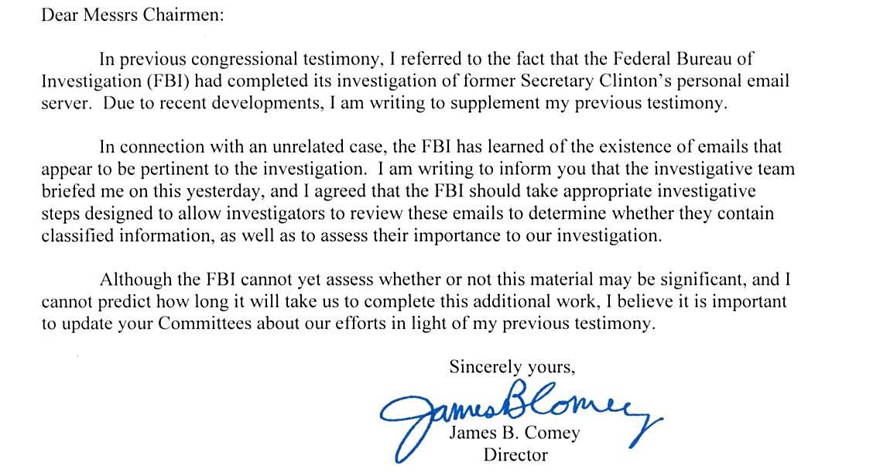

Slide 5
Andresen v. Maryland 427 U.S. 463 (1976)
The 4th Amendment:
Prohibits “general, exploratory rummaging in a person’s belongings and
“prevents the seizure of one thing under a warrant describing another.”

Slide 6
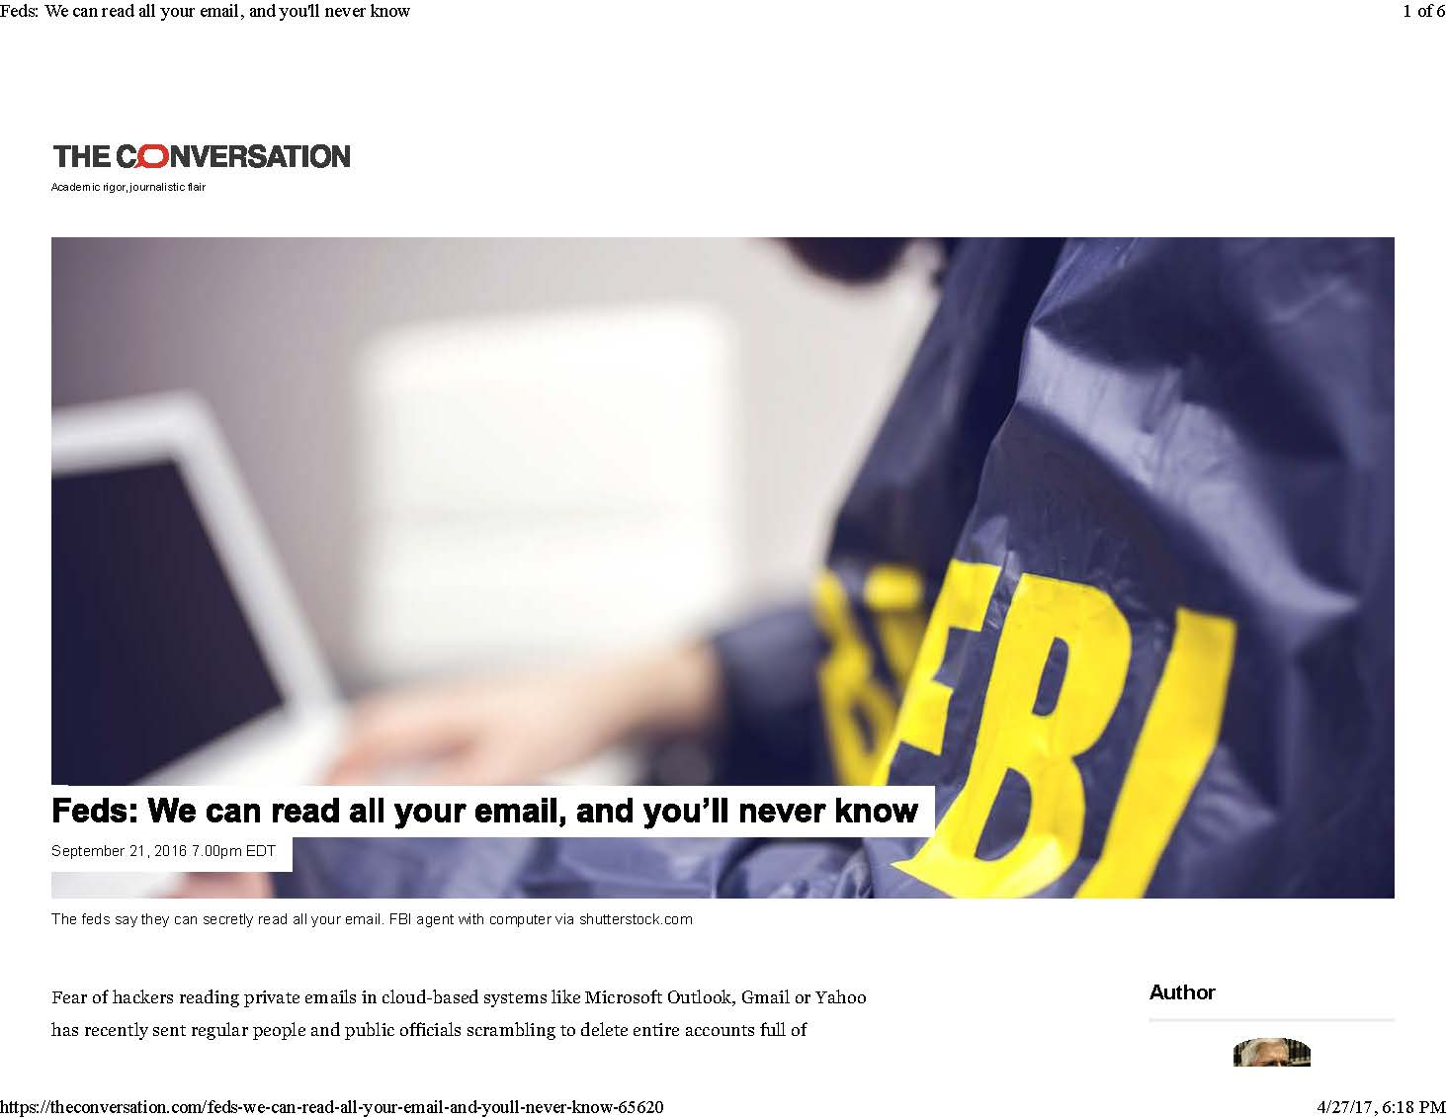

Slide 7
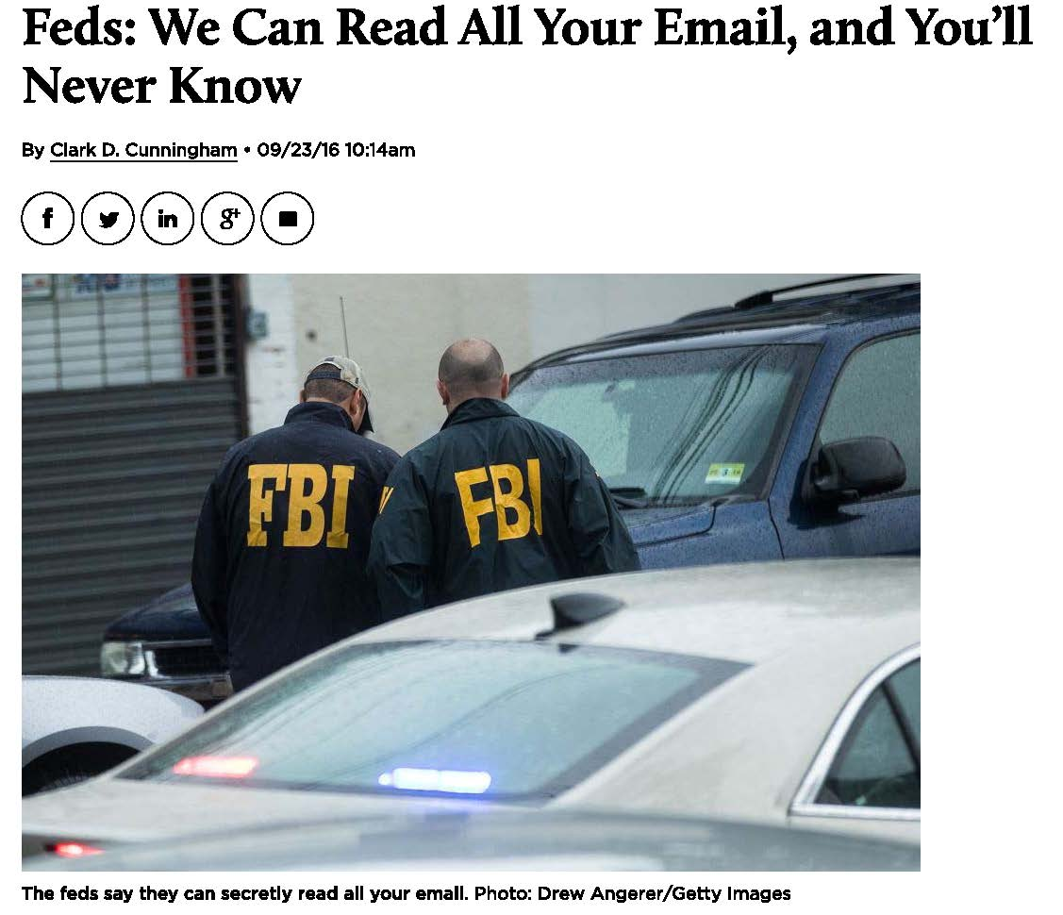

Slide 8
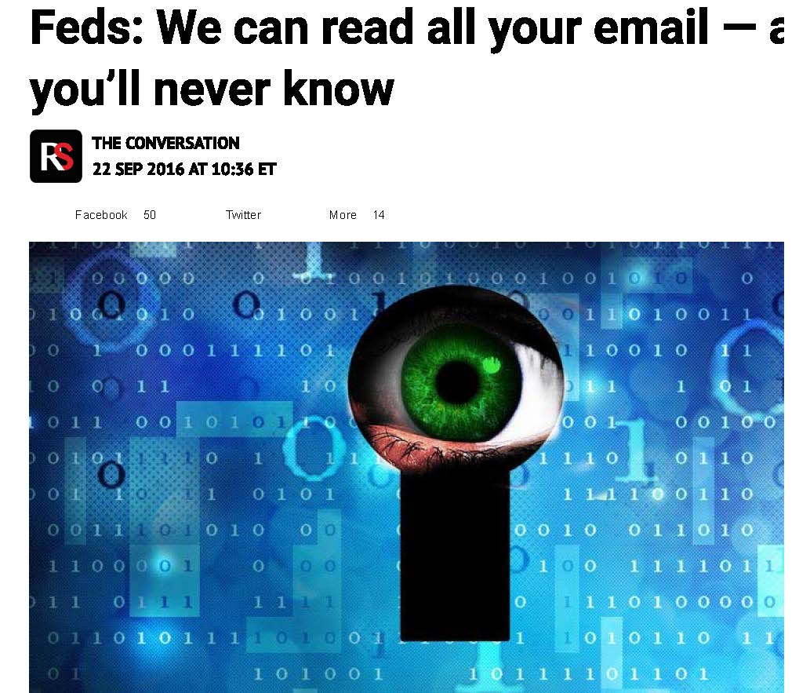

Slide 9
John Adams, 2nd President of the US

Slide 10
Abigail Adams

Slide 11
July 3, 1776
Yesterday the greatest Question was decided, which ever was debated in America, and a greater perhaps, never was or will be decided among Men
A Resolution that these united Colonies, are, and of right ought to be free and independent States
You will see in a few days a Declaration setting forth the Causes, which have impell'd Us to this mighty Revolution

Slide 12
July 3, 1776
When I look back to the Year 1761
and recollect the Argument concerning Writs of Assistance, in the Superiour Court
which I have hitherto considered as the Commencement of the Controversy between Great Britain and America
I am surprized at the Suddenness as well as Greatness of this Revolution.

Slide 13
Writ of Assistance
Province of Massachusetts Bay
George the third by the Grace of God of Great Britain King
To all Our Officers and Subjects
We strictly Injoin and Command you that you permit
Charles Paxton, Surveyor and Searcher
To enter into all places
Where goods, for which customs have not been paid,
Are suspected to be concealed
And to add, assist and help in the execution of [the search]

Slide 14
Feb 24, 1761

Slide 15
James Otis
The writ of assistance is
“the worst instrument of arbitrary power
the most destructive of English liberty”

Slide 16
Otis Fourth Amendment
“This Writ is against the fundamental Principles of Law”
“The Privilege of the House”
“is one of the most essential branches of English liberty”
“The right of the people to be secure in their … houses …
against unreasonable searches and seizures
shall not be violated”

Slide 17
Otis Fourth Amendment
“special warrants only are legal”
“upon oath by the person who asks that he suspects such goods to be concealed in THOSE VERY PLACES HE DESIRES TO SEARCH.”
“no Warrants shall issue
but upon probable cause supported by Oath or affirmation, and
particularly describing the place to be searched and
the persons or things to be seized.”

Slide 18
John Adams
“Otis was a flame of Fire!”
“Every man of an immense crowded Audience appeared to me to go away, as I did, ready to take up Arms against Writts of Assistants [sic].
Then and there was the first scene of the first Act of Opposition to the arbitrary Claims of Great Britain.”

Slide 19
Fourth Amendment
“The right of the people to be secure in their … papers …
against unreasonable searches and seizures
shall not be violated”

Slide 20
Paul Revere

Slide 21
Sons of Liberty Bowl (1768)

Slide 22
1768: Gov. Bernard dissolves Mass legislature for refusing (92-17) to retract letter opposing the Townshend Act

Slide 23
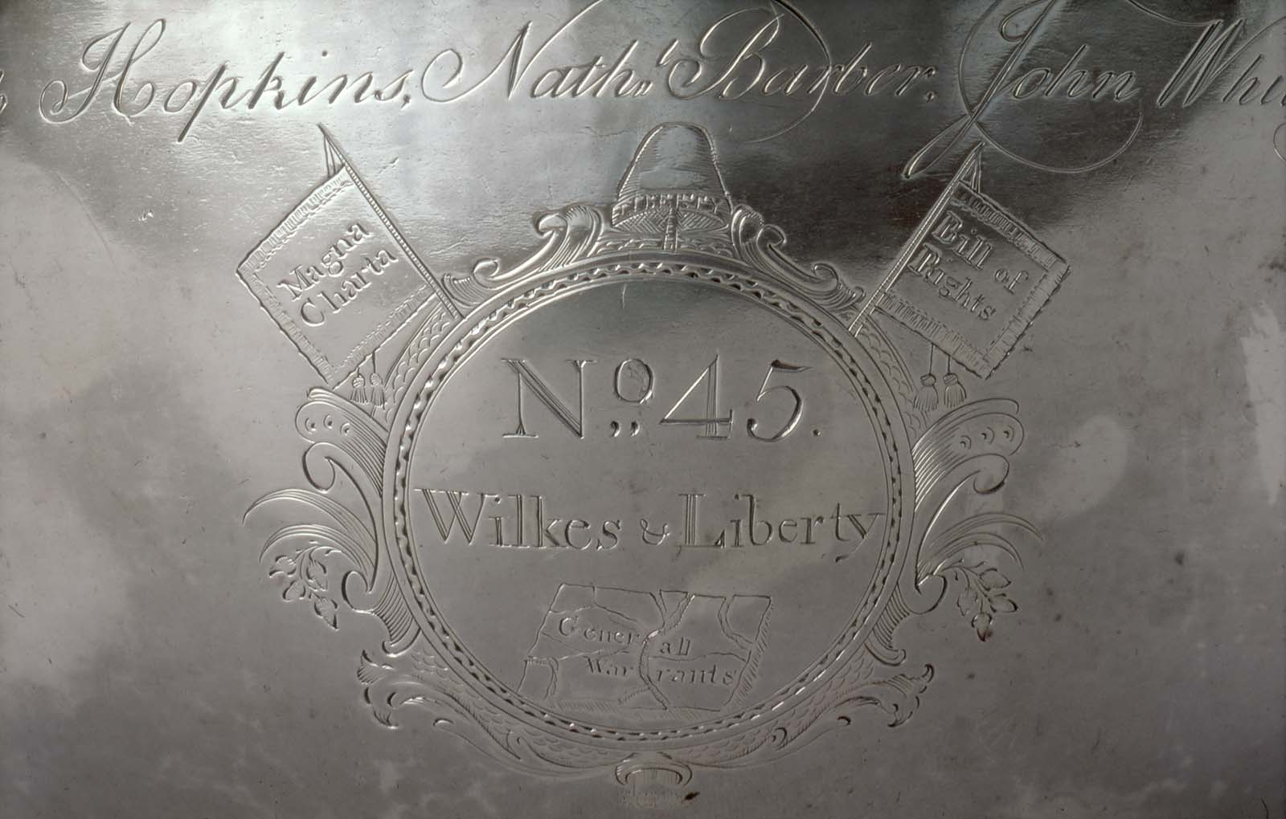

Slide 24
England April 23, 1763

Slide 25
Lord Halifax, Secretary of State: Warrant
make strict and diligent search for the authors, printers and publishers of a seditious and treasonable paper
entitled the North Briton, Number 45

Slide 26
Lord Halifax Warrant
and any of them having found
apprehend and seize
together with their papers

Slide 27
John Wilkes Testimony at trial
“Whether a table with a locked drawer should be removed entire or be opened”
“Mr. Mann was sent to Lord Halifax for directions, and brought word that the drawers must be opened.”

Slide 28
John Wilkes Testimony at trial
“Blackmore fetched a smith to open the table.”
“They took all the papers in those drawers and pocket book of Mr. Wilkes’s
And put them all in a sack together”

Slide 29
Wilkes’ Attorney
This case extended far beyond Mr. Wilkes personally
It touched the liberty of every subject of this country
Of all offences that of a seizure of papers was the least capable of reparation

Slide 30
Wilkes’ Attorney
And for the promulgation of our most private concerns, affairs of the most secret personal nature, no reparation could be made
The law never admits of a general search warrant
Even in the Inquisition itself, they never delegate an infinite power to search

Slide 31
Chief Justice Pratt (later Lord Camden)
was a point of the greatest consequence I have ever met with in my whole practice
“such a power
is totally subversive of liberty”

Slide 32
Microsoft v US Dept of Justice (W.D. Wash.)

Slide 33
US v Miller 425 US 435 (1976)
“Third Party Doctrine”
the documents subpoenaed here are not respondent's “private papers”
respondent can assert neither ownership nor possession.
Instead, these are the business records of the banks

Slide 34
US v Warshak 631 F.3d 266 (6th Cir. 2010)
defendant enjoyed reasonable expectation of privacy in his e-mails vis-a-vis his Internet service provider (ISP)
government agents violated his Fourth Amendment rights by compelling ISP to turn over email
without first obtaining warrant based on probable cause

Slide 35
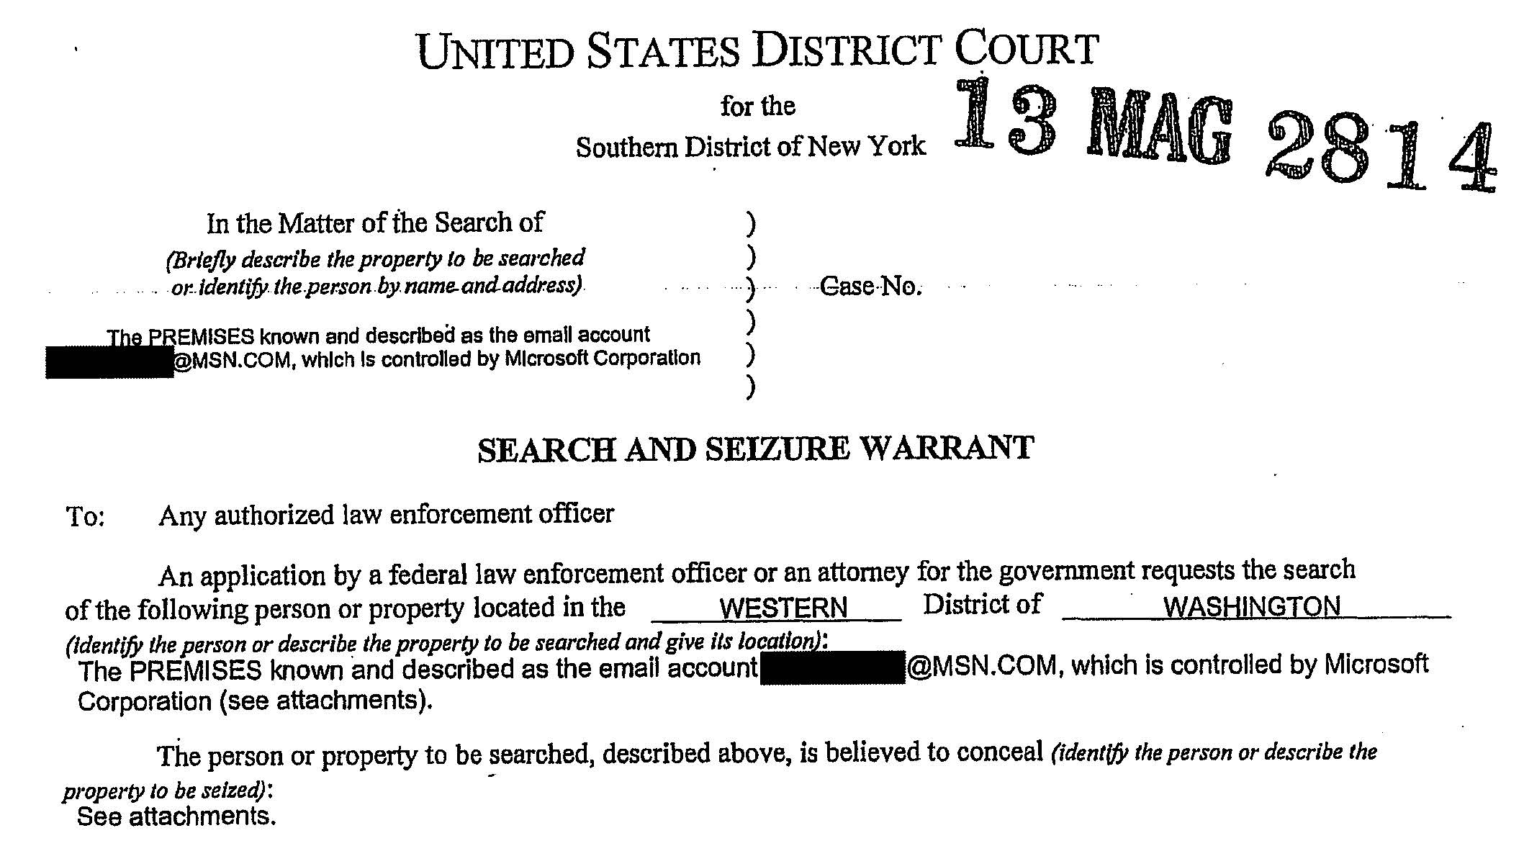

Slide 36
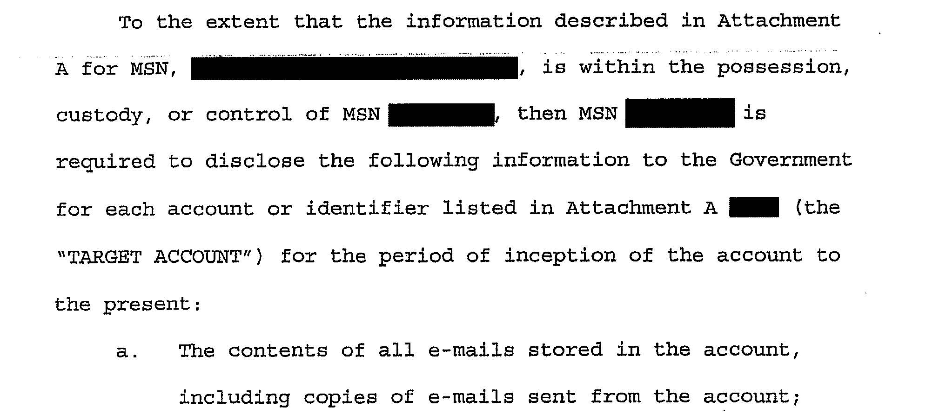

Slide 38
US v Ravelo (D.N.J.) Judge Kevin McNulty

Slide 39
Keila Ravelo http://clarkcunningham.org/Apple/Cases/USvRavelo.html
Paul Barrett, Inside a $5.7 Billion Antitrust Trainwreck, Bloomberg Businessweek, Nov. 11, 2015
“story has a can’t-make-this-stuff-up quality”
Grew up in Dominican Republic
Columbia Law ‘91
Sidley Austin
Partner Roger & Wells
Hunton & Williams
Wilkie Farr & Gallagher
Negotiated $5.7B antitrust settlement for Master Card

Slide 40
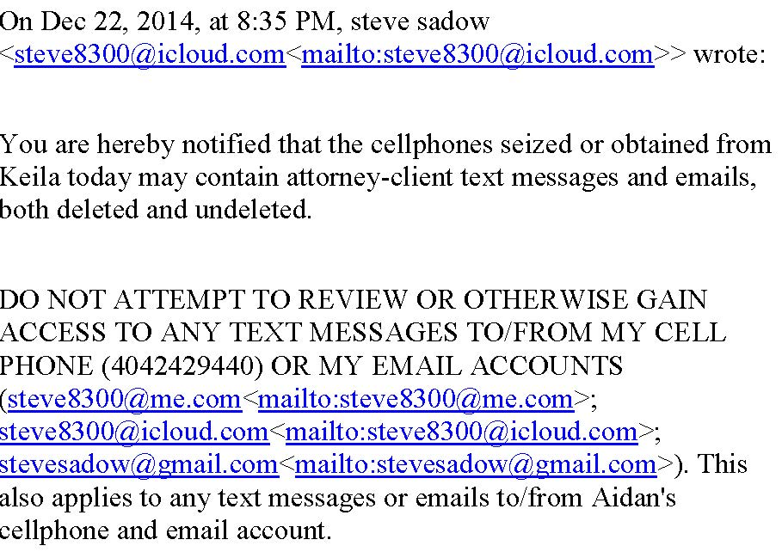

Slide 41
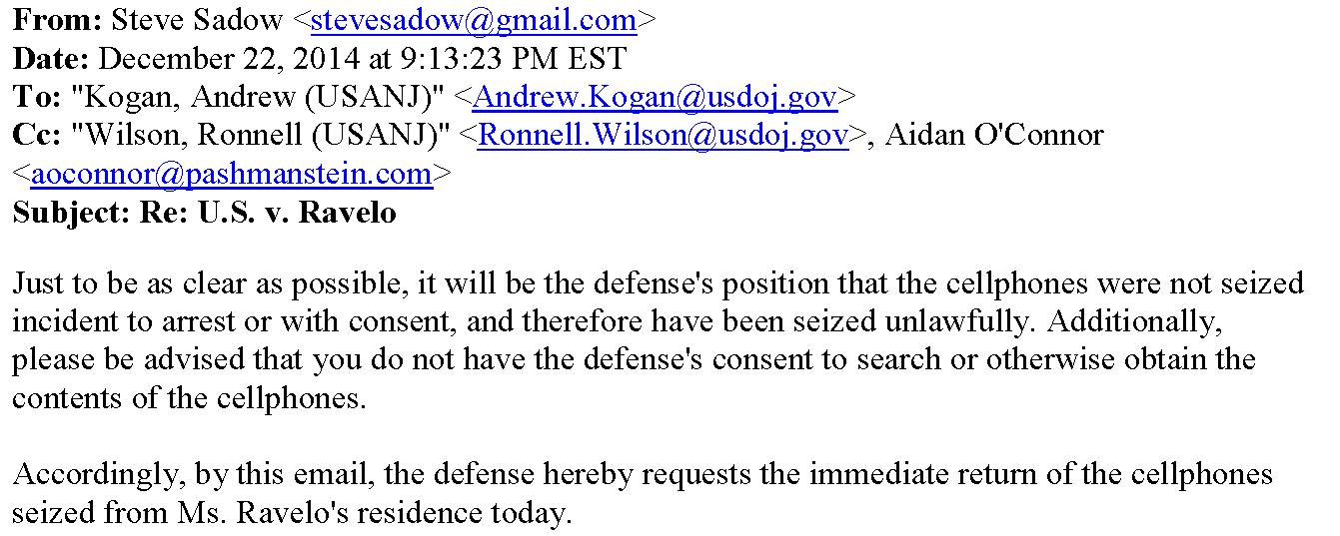

Slide 42
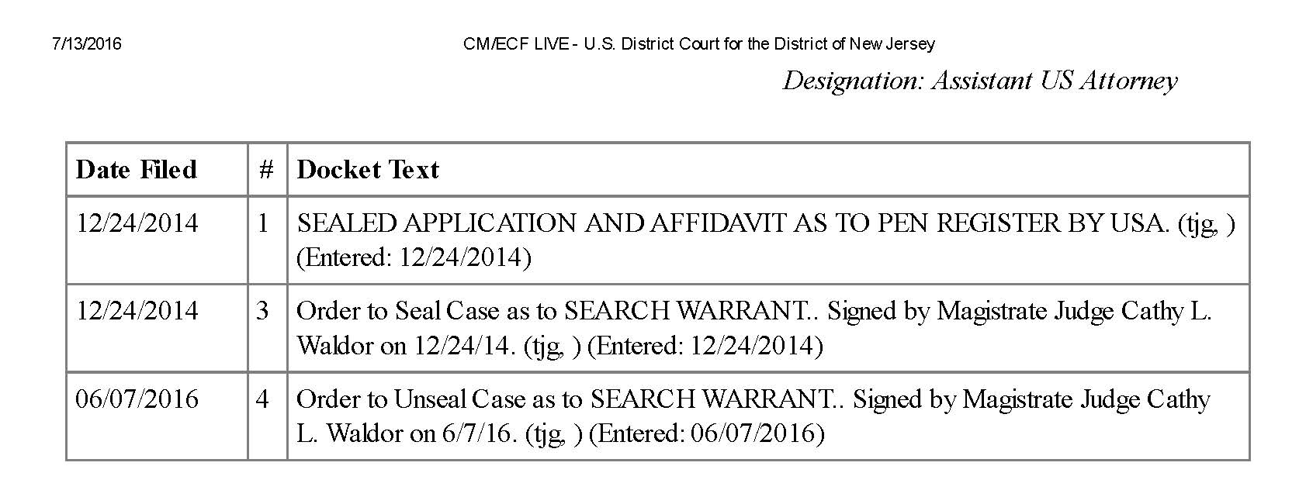

Slide 43
May 23, 2016 Dear Judge McNulty,
“The Government is in the process of determining whether it intends to introduce any of the contents of the Phone in its case-in-chief at trial.
Once it is determined what, if any, evidence on the Phone is privileged, the trial team will receive the contents of the Phone minus the privileged items.
The trial team will then conduct its review and determine if it intends to use any of the contents of the Phone in its case-in-chief at trial.”

Slide 44
May 23, 2016 Dear Judge McNulty,
If the trial team determines that it will indeed use any of the contents of the Phone in its case-in-chief at trial,
it will provide the [Search Warrant] Affidavit to defense counsel
and will address any motion to suppress at that time.
Respectfully submitted,
Paul J. Fishman, United States Attorney
By: Andrew Kogan, Assistant U.S. Attorney

Slide 45
May 23, 2016 Dear Judge McNulty,
If the trial team determines that it will indeed use any of the contents of the Phone in its case-in-chief at trial,
it will provide the [Search Warrant] Affidavit to defense counsel
and will address any motion to suppress at that time.
Respectfully submitted,
Paul J. Fishman, United States Attorney
By: Andrew Kogan, Assistant U.S. Attorney

Slide 46
Back to the Future
May 7, 1763 Mr. Wilkes
In answer to your letter of yesterday, we acquaint you, that your papers were seized in consequence of the heavy charge brought against you, for being the author of an infamous and seditious libel,
for which his Majesty has ordered you to be prosecuted
Such of your papers as do not lead to a proof of your guilt, shall be restored to you.
Such as are necessary for that purpose, it was our duty to turn over to those, whose office it is to collect the evidence, and manage the prosecution against you.
Dunk Halifax
[T]he Government is in the process of determining whether it intends to introduce any of the contents of the Phone in its case-in-chief at trial. . . .
Once it is determined what, if any, evidence on the Phone is privileged, the trial team will receive the contents of the Phone minus the privileged items.
The trial team will then conduct its review and determine if it intends to use any of the contents of the Phone in its case-in-chief at trial.
If the trial team determines that it will indeed use any of the contents of the Phone in its case-in-chief at trial, it will provide the [Search Warrant] Affidavit to defense counsel and will address any motion to suppress at that time.

Slide 47
July 12, 2016 Dear Judge McNulty,
“Assuming arguendo that the Court granted Keila Ravelo’s motion to suppress the contents of her cellular telephone (“the Phone”) and a motion to return the Phone, the government would still be able to retain a copy of the Phone to be used lawfully, among other reasons, for impeachment purposes, at a sentencing hearing, filing an appeal, and/or in opposition to any habeas petition.
if the court were to grant Ms. Ravelo’s motion to suppress evidence obtained from the Phone, Ms. Ravelo would likely file a subsequent motion under Fed. R. Crim. P. 41(g) for the return of the Phone.
Were the Court to grant the defendant’s Rule 41 motion, the government would likely retain copies of the contents of the Phone.“
Paul J. Fishman, United States Attorney
By: Andrew Kogan, Assistant U.S. Attorney

Slide 49
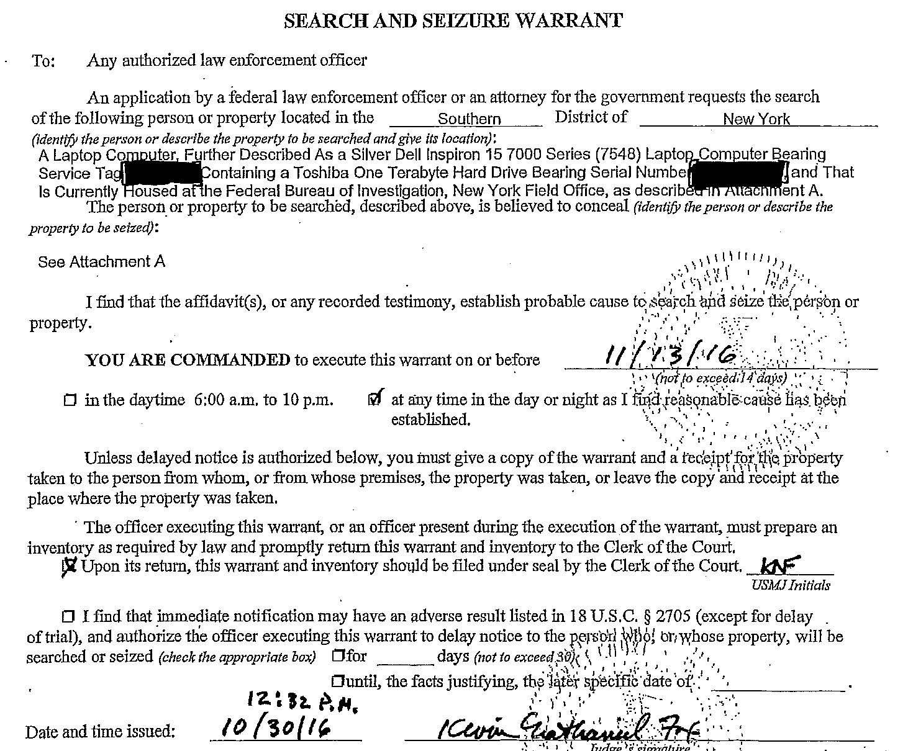

Slide 50
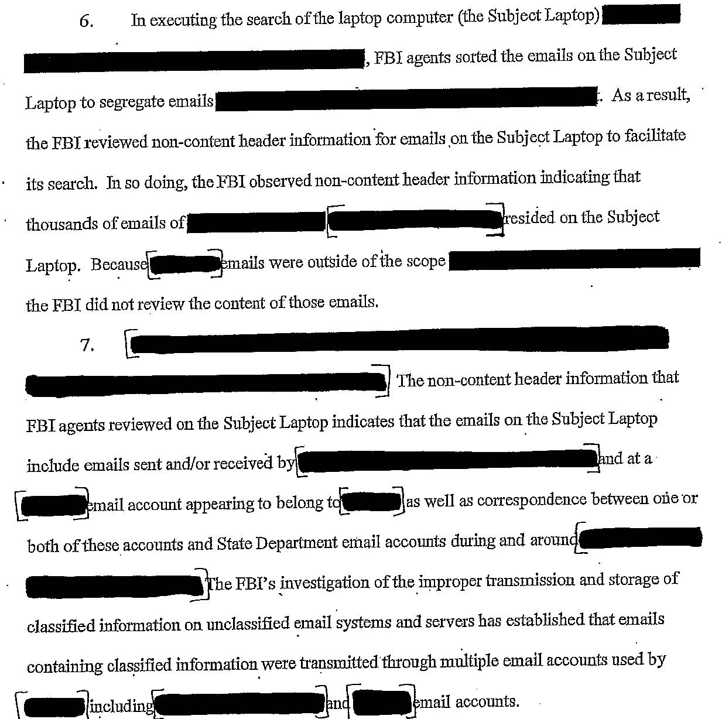

Slide 51
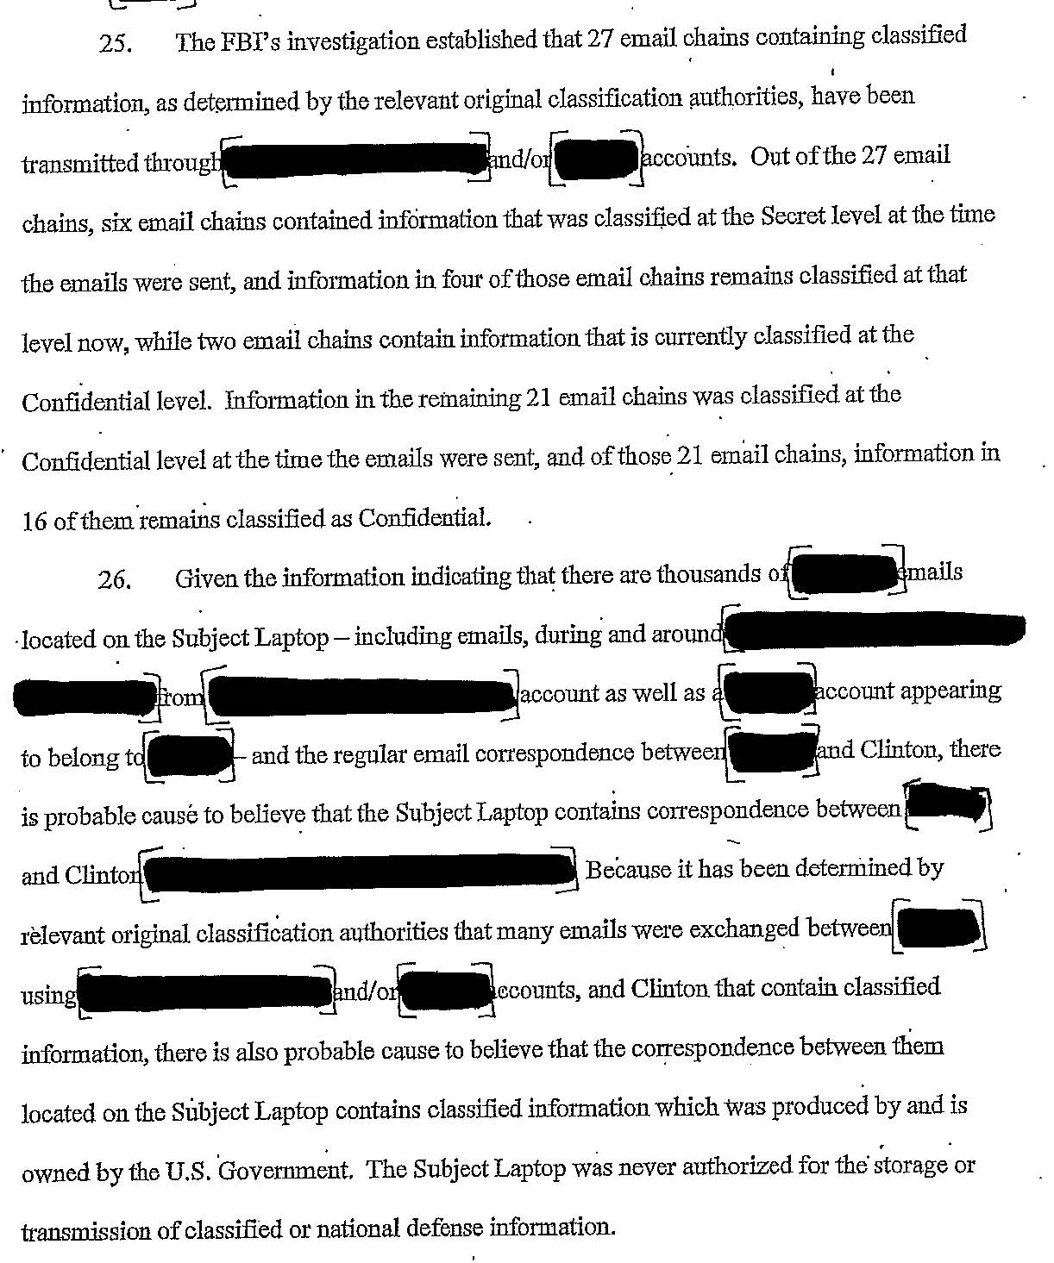

Slide 52
John Wilkes Testimony at trial
“Blackmore fetched a smith to open the table.”
“They took all the papers in those drawers and pocket book of Mr. Wilkes’s
And put them all in a sack together”

Slide 53
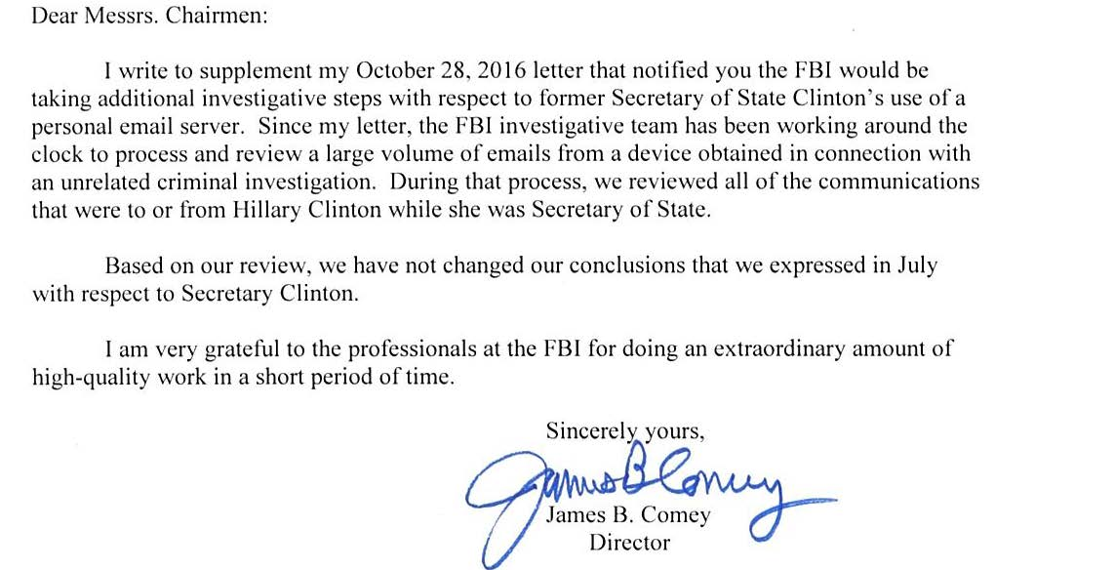

Slide 54
